Slide 1
Course overview
IT skills: none
IT concepts: the scope of the course
This work is licensed under a Creative Commons Attribution-Noncommercial-Share Alike 3.0 License.
Notes:
In this presentation, I’m going to give you an overview of our course.
Each of our presentations will begin with a slide like this one, letting you know which skills and concepts are covered.
This one doesn’t cover any skills, and the only concept it covers is the scope or outline of the course.

Slide 2
Class outline
Internet concepts
  Applications
  Implications
  Technology
Internet skills
  Application development
  Content creation
  User skills
Notes:
This is the course outline, which you’ll also see at the start of every presentation.
I’ll use it to show where the presentation falls within the class.
Lets go over the outline topics now.

Slide 3
Skills and concepts
We will cover the skills and concepts needed for success as a student and after graduation as a professional and a citizen.
Notes:
Here in a nutshell, you can see what our course covers – the skills and concepts you need for success as a student and after graduation as a professional and a citizen.
The skills and concepts that are relevant have changed as we moved from early room=sized computers to personal computers and now the Internet.
We’ll be covering IT literacy for the Internet era.

Slide 4
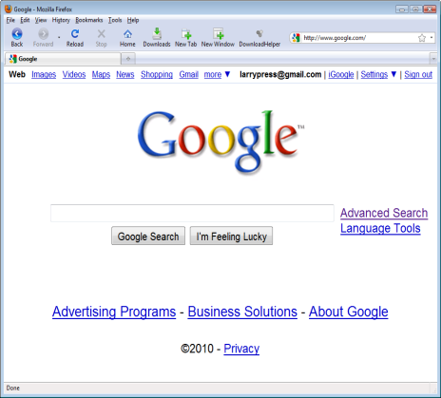
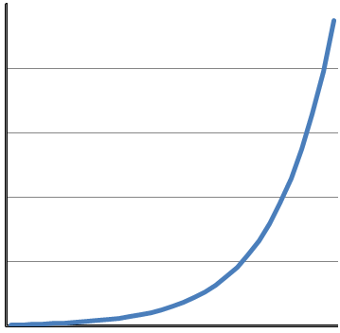

Internet concepts
Applications
Technology
Implications
Notes:
Let’s start with a look at Internet era IT concepts, then we’ll move on to skills.
I’ve organized the concepts into three groups – those having to do with IT applications, implications and technology.
Applications are the things people do with computers and the Internet – the things they use them for.
Implications are the ways information technology changes our individual lives, our organizations and society.
Just think of the ways you use computers and the Internet. How do they affect your life, organizations like your school and workplace and society as a whole?
We’ll also present technology concepts. As the graph on the right show, all forms of information technology -- storage, communication and memory and processing – are improving rapidly.
This rapid technology change will lead us to think about future applications and implications as well as those we see today.

Slide 5

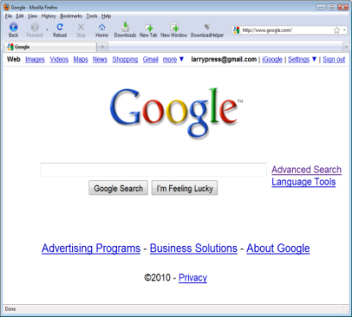
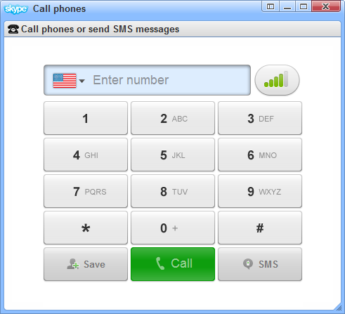
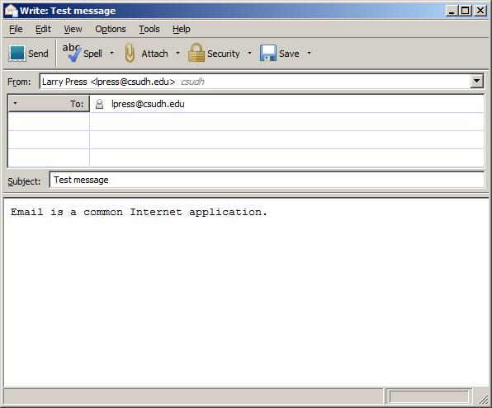
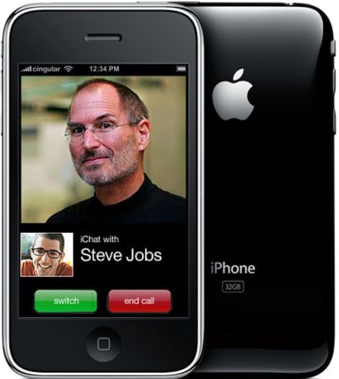

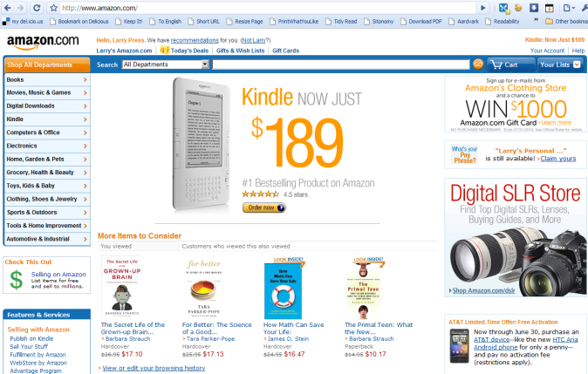
Applications
Video
Web search
Phone calls
email
Chat
Music
Shopping
Notes:
This slide shows some common applications, and I bet you’ve done most of them. Have you made an Internet phone call or listened to music or watched a video? I am sure you’ve sent and received email and searched the Web, and I bet you’ve shopped online and engaged in text or perhaps video chat.
Each application requires a program, and, if it’s a networked application, a computer connected to the Internet.
As we will see, the program may be installed on your computer or downloaded when you start to use it.
These programs are also often referred to as “application programs” or just “apps.”
Note that the computer you use these days may be portable – a phone or tablet – rather than a traditional laptop or desktop computer.

Slide 6

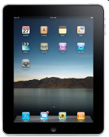
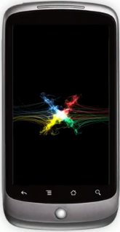

Network applications
Internet
Desktop or stand alone
Network based
Notes:
All of the application examples in the previous slide involved the Internet.
There are, of course, many computer applications that don’t involve the Internet – for example, using Microsoft Word to write a document or Excel to make a spreadsheet.
In our class, the focus will be on network-based applications in which the computer is connected to the Internet.
Remember, this is IT literacy for the Internet era.

Slide 7
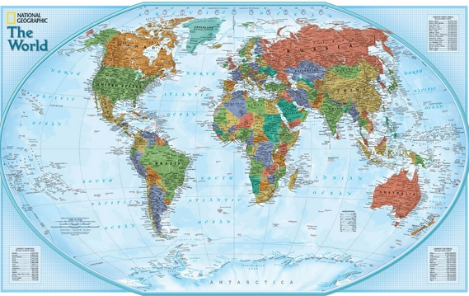
Implications for …
President
VP Marketing
VP Production
VP Finance
Society
Individuals
Organizations
Notes:
We’ll look at IT implications as well as applications.
We’ll ask how IT affects individuals, organizations and society as a whole.
Here we see a man working from home – making obvious changes in his life.
How does the Internet affect your life – or to put it another way, how would your life change if the Internet disappeared tomorrow?
Organizations have also been changed by the Internet – it enables different management styles, decentralization, rapid innovation, easier collaboration between companies, and so forth.
The Internet has also changed society. For example, its facilitated the move toward globalization, improved national economies, and affected politics, schools and health care.
To give just one example, President Obama made very good use of the Internet while campaigning.
As Kennedy was the first television President, Obama may be thought of as the first Internet president – both while campaigning and while in office.

Slide 8
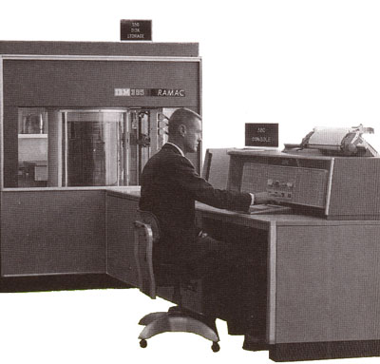
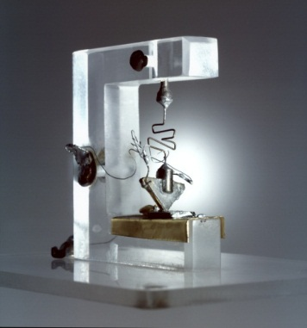
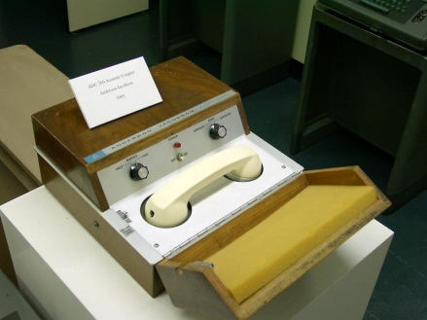
Technology
Storage
Memory &
processing
Communication
Notes:
Technology is our third concept area.
We’ll cover storage, communication, memory and processing technology.
We’ve seen fantastic improvement in all three.
You can see how far we’ve come by looking back.
Here we see the first commercial disk storage, which IBM offered in 1956. The stack of two-foot diameter disks behind the man in the photo held only 5 million characters. Today, you can hold billions of characters on a flash drive in the palm of your hand.
The transistor was unveiled in 1948.
The transistor is the basis of electronic information processing and memory today, and the first one, shown here, was about as big as the palm of your hand.
We now get over two billion transistors on a chip the size of a postage stamp.
You may have heard of “Moore’s Law,” which says the number of transistors that can be placed on a commercially economical chip will double every 18 months or so.
Communication speed and reliability have also exploded. The 1970s terminal shown here communicated at 10 characters per second over a voice telephone line. Today, home connections to the Internet can easily be a million times faster.
There’s been mind boggling progress in each of these technology areas, and the amazing thing is that they continue to improve at an accelerating rate. In other words, you haven’t seen anything yet.

Slide 9
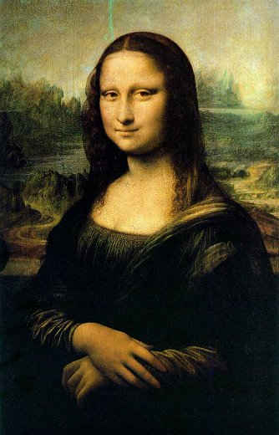
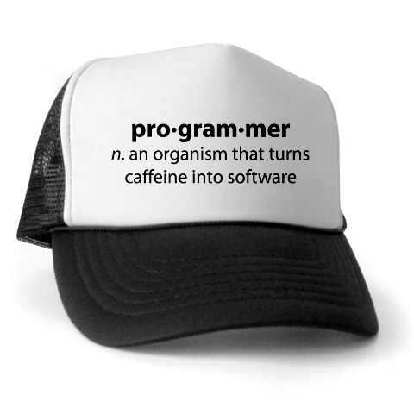

Skills
Content creation
Application development
User skills
Notes:
That covers the concept areas for our class, now lets turn to skills.
I’ve divided the skills portion of the class into three areas, creating and editing content, developing new applications, and using applications.
The technical progress we just mentioned has led to software that greatly simplifies all three.

Slide 10
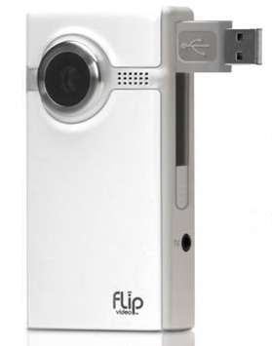

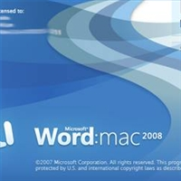
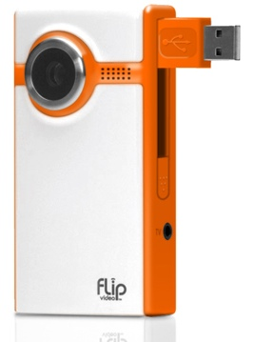

Content creation data types
Text
Image
Video
Audio
Notes:
This slide shows four data types, and we need to be able to work to some extent with each of them.
You are already familiar with the mechanics of word processing, but Internet writing is somewhat unique, so we’ll focus on writing style and technique rather, not the mechanics of using the software.
Today’s student also needs to be able to capture and edit image, video and audio data, so we’ll spend some time on those skills as well.

Slide 11


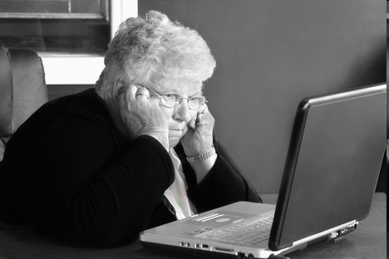
Application development
Personal computer
Batch processing and time sharing
Internet platform
Notes:
In the early days of computing – when we used batch processing and time sharing on giant sized computers -- only skilled professionals could develop new applications. You really had to be kind of a nerd.
The advent of the personal computer and spreadsheet made developing applications much easier.
Business people and others began building spreadsheets, databases, reporting systems, slide presentations and more without the help of a professional programmer.
Today, Internet era tools have lowered the bar even further.
Those spreadsheets, databases and presentations are even easier to build and share online and you can create applications using tools like blogs and wikis in just a few minutes.

Slide 12
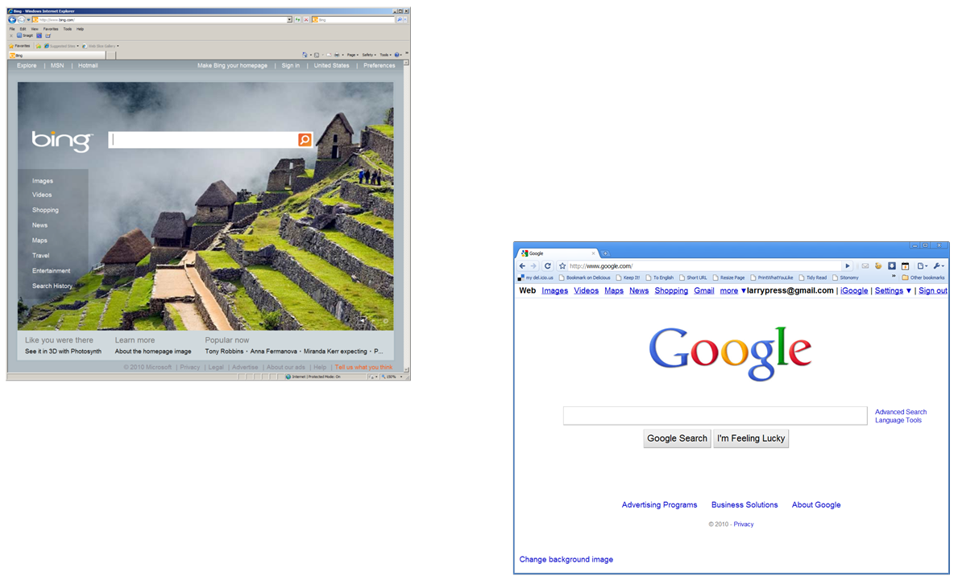
User skills
Notes:
We’ll also spend some time, though not as much, polishing skills with some programs and services you may already use, like Web browsers and search engines.

Slide 13
Summary
Internet concepts
  Applications
  Implications
  Technology
Internet skills
  Application development
  Content creation
  User skills
Notes:
Well, that summarizes the skills and concepts we’ll be covering in this class, and here you see it pulled together in the class outline. Internet concepts will be divided into applications, implications and technology and we’ll work on application development and content creation.
As I mentioned earlier, I’ll include this slide at the start of every presentation, so you can see where it fits into the overall class outline.

Slide 14
Resources
A blog where I worked out thoughts on IT literacy: http://computerliteracy3.blogspot.com
The history of IT literacy: http://computerliteracy3.blogspot.com/search/label/history
Nielsen survey on the ways we use the Internet: http://blog.nielsen.com/nielsenwire/online_mobile/what-americans-do-online-social-media-and-games-dominate-activity/
Obama’s use of the Internet during the campaign: http://www.nytimes.com/2008/06/08/weekinreview/08cohen.html?_r=1
Roosevelt, Eisenhower, Kennedy and Obama’s use of new media: http://cis471.blogspot.com/2008/08/internet-and-presidential-election.html
Moore’s Law: http://en.wikipedia.org/wiki/Moore's_law
Moore’s Law article: http://download.intel.com/museum/Moores_Law/Articles-Press_Releases/Gordon_Moore_1965_Article.pdf

Slide 15
Self-study questions
Which Internet-based applications have you used this week?
Has the Internet changed your life? Or, to put it a different way, how would your life change if the Internet had not been invented?
How has the Internet changed politics in your country?
We will cover three types of technology. Without looking back, do you recall them?
What do all of the technologies have in common?
We will cover content creation skills for four types of data – do you recall them?
We will cover the implications of the Internet at three levels – do you recall them?
Without looking back, can you reproduce our class outline? Can you explain each item in the outline to a friend? (Try writing a short summary of one of the topics in the outline).
What is the difference between a stand-alone and a network applications?

Slide 16
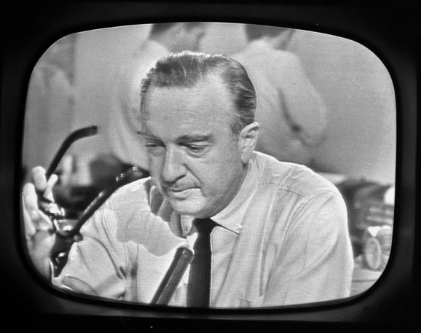

Self-study questions
Are the critical thinking skills needed during the era of broadcast media still needed in the Internet era? Are they more or less important? Explain your answer.
Notes:
Who needs more critical thinking skills -- students in the era of Walter Cronkite, News Papers, and books or students in the Internet era?

