Slide 1
Discussion

Slide 2
Week 1

Slide 3
Who am I?
Who are you?
What does the class cover?
How does it work?

Slide 4

Notes:
Poker is a zero sum game.
This class is not.
School is not.
Life is not.

Slide 5
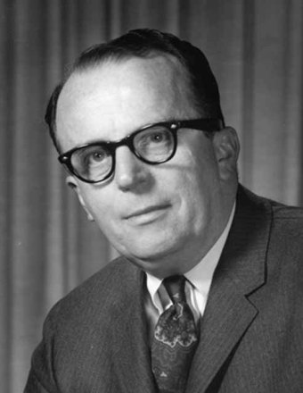

In a few years, men will be able to communicate more effectively through a machine than face to face.
What will on-line interactive communities be like? ... They will be communities not of common location, but of common interest.
Licklider and Taylor, The Computer as a Communication Device, 1968

Slide 6
Quiz 1
1-2: The course will present the information technology ___ and ___ one needs for success as a student and after graduation as a professional and a citizen.
3-6: We said we would consider content creation using four types of data, what were they?

Slide 7
Week 2

Slide 8
First list server message
Subject: Student Assistants Needed - Help Desk
Date: Fri, 27 Jan 2012 10:18:18 -0800
From: Muneca X. Williams <mxwilliams@csudh.edu>
To: DH Email <dhemail@csudh.edu>
Help DeskStudent Assistants Needed!!!!! We need bright, friendly customer service oriented students to assist the Help Desk. Duties to include answering phone, logging Help Desk tickets as well as assisting walk in customers. Shifts are available between the hours of 8 am and 6pm. We currently are in need of someone specifically for a 10am-2pm shift, Monday - Friday. Pay will be determined by skill and experience. If you are */_a current CSUDH student_/* and are interested please turn in your applications to IT Dept in WH 380.Please respond to this email to request an application.
Notes:
Our first email was regarding a job opportunity on campus.
You should use the list in any way you see fit.

Slide 9
Email from a student
From: xxx@toromail.csudh.edu
To: Larry Press <lpress@csudh.edu>
Date: Mon, 30 Jan 2012 17:55:02 -0800
Subject: Question 2 on Assignment
I still do not know how to subscribe to the server list, and I can not add to the roster database either.
Notes:
It was sent pretty late -- don’t put off homework to the last minute because you might get stuck.
Several people did both these assignments during the time I gave in class.
This person should have tried the assignment and gotten help during class if it was not going well.
The instructions for subscribing to the list server were spelled out in the assignment.
It is imperative that you get in the habit of reading carefully from screens.
We have a strong tendency to skim material on the screen and that will not do!

Slide 10
Sending commands to the server
To: lyris@lists.csudh.edu
login xxx
review cis275s2012 full
Notes:
The administrator can send commands to the server.
Here I am requesting a list of the subscribers.

Slide 11
Week 3

Slide 12
Study habits (survey)
Read half of week 1 presentations 12
Printed half of week 1 presentations 5
Read half of week 2 presentations 4
Printed half of week 2 presentations 0
Read the syllabus 13

Slide 13
Study habits (listserv)
January 24: 12 (in class)
January 25: 1
January 29: 1
January 30: 2
January 31: 2
First one done:
Email Address: jdaniels39@toromail.csudh.edu
Name: Julie Daniels
Type: normal
Subscription type: mail
Date joined: January 24, 2012
Member ID: 116129

Slide 14
Study habit survey question: Have you looked back at this weekly discussion presentation? (yes/no)

Slide 15
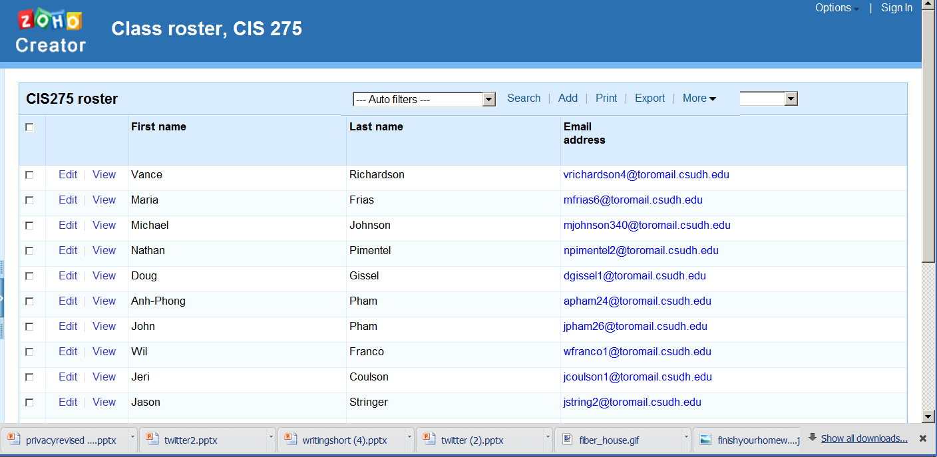
Did you play around with the class roster?
Notes:
Play around with new applications and services.
Learn the way little kids learn to play new games.
This is an easy to use platform for developing database applications in a few minutes.
You do not have to be a geek.
It is a tool for you to use in school and after.

Slide 16



Application development
Personal computer
Batch processing and time sharing
Internet platform
Notes:
In the early days of computing – when we used batch processing and time sharing on giant sized computers -- only skilled professionals could develop new applications. You really had to be kind of a nerd.
The advent of the personal computer and spreadsheet made developing applications much easier.
Business people and others began building spreadsheets, databases, reporting systems, slide presentations and more without the help of a professional programmer.
Today, Internet era tools have lowered the bar even further.
Those spreadsheets, databases and presentations are even easier to build and share online and you can create applications using tools like blogs and wikis in just a few minutes.

Slide 17
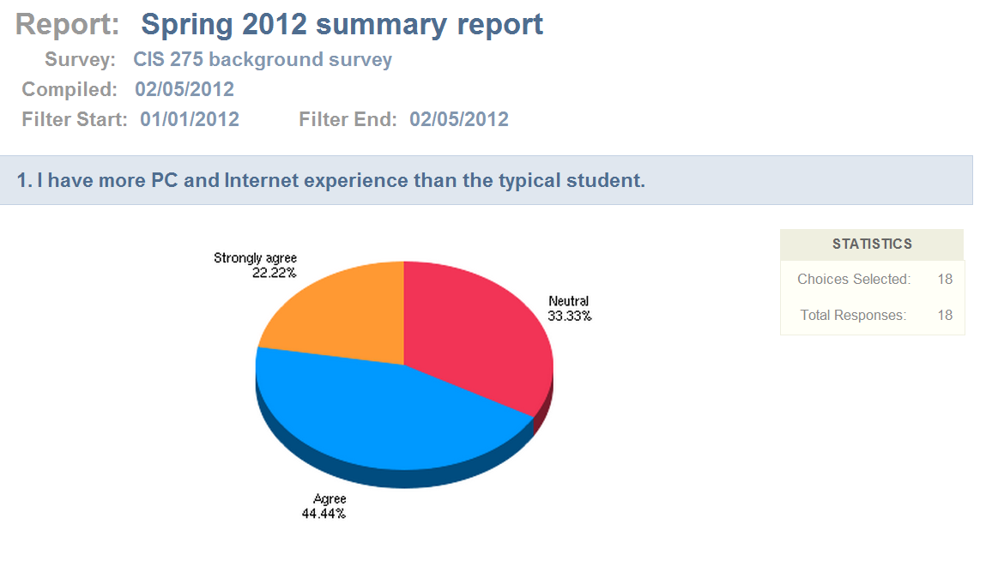
Look for people to help you.
Summary results
Full results

Slide 18
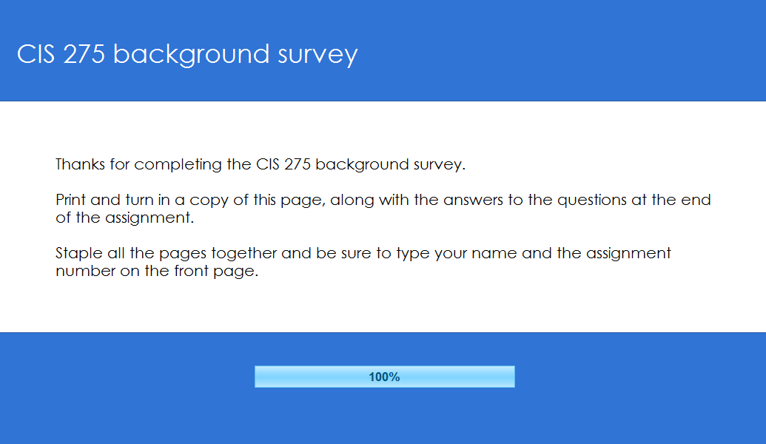
Zen of Internet reading
“When you finish and submit the survey, you will see a thank-you screen with further instructions. Print that out to turn in along with the answers to the following questions: …”
Notes:
This “thank you” page that was displayed at the end of the survey reminded you to answer the questions.
Still, only 3 of you read it carefully enough to notice.
The instructions were displayed twice, but the majority of the students didn’t follow them.
What would Jason Fried say?

Slide 19
Assignment feedback
General:
Missing assignment numbers
Missing staples when multiple page assignments
Type your name or print it big letters (why not type it)?
Handwritten answers
Assignment 1:
Confusion over memory vs storage and ROM vs RAM
Skipped answers to questions
Food for thought: what program were you executing while you completed the survey?
Assignment 3:
Skipped answer to question

Slide 20
Quizzes
Collectively, you know all the answers.
Use the quiz blog or other means of collaborating.
Do not be satisfied with memorizing answers – it is not worth the time and effort it takes.

Slide 21
Week 4

Slide 22
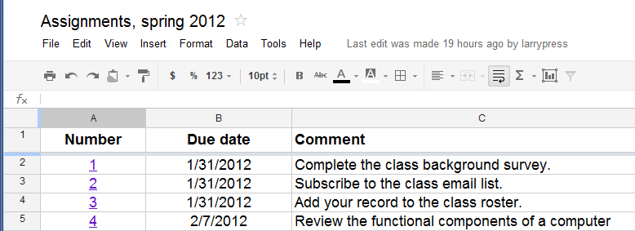
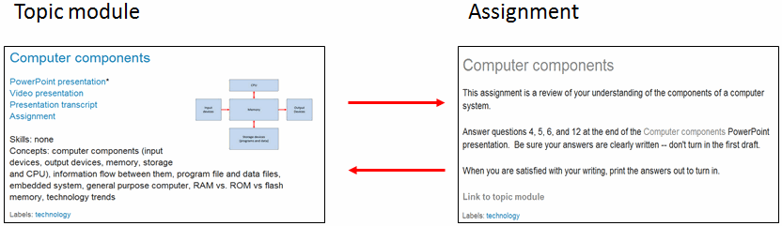
A couple of people accidently did too many assignments -- how did that happen?
Notes:
How does something like the assignment mechanism slip through the cracks?
Is it another example of rushed reading when online?

Slide 23
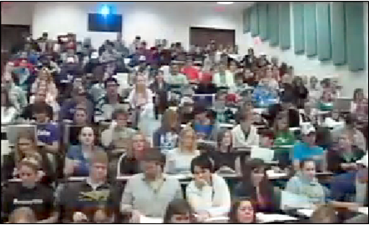
Asking questions is hard
what program were you executing while you completed the survey?
What is the difference between memory and storage?
Notes:
Asking good questions is hard.
These questions generated a half hour of discussion last week.
Many of you were confused on the difference between memory and storage, but no one asked.

Slide 24
Assignment feedback
Several people did not turn in their Google Docs home page with their post description – read carefully.
Confusion on program execution – go over example.
Is the movie industry long tail? Explain.
iPad I/O devices
Cost trends for memory, CPU and storage – answer was not in the presentation – what can you do?
Groups!
Presentation/transcript confusion – use presentations

