Slide 1
Discussion

Slide 2
Week 1 and 2

Slide 3
Study habit feedback survey
1. In week 1-2, I asked you to study a presentation on list servers. Which of the following did you do?
Skim slides on the screen
Read the slide annotation on the screen?
Study the presentation on the screen?
Print the presentation?
Study the printed presentation?

Slide 4
Study habit feedback survey
For week 3, I asked you to study three annotated PowerPoint presentations in advance of class:
  Computer components
  Michael Wesch on the classroom, discussion and learning
  Yahoo Groups
How many did you skim over on the screen?
How many did you read the annotations on the screen?
How many did you study on the screen?
How many did you print out?
How many did you study in printed form?

Slide 5
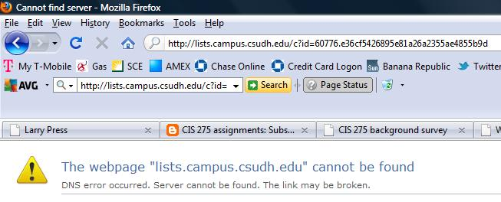
Problem subscribing to the class email list
Notes:
The campus email list server was down last week, causing this error.
It turned out that the operators had made two different errors, so several calls and tests were needed to fix the problem.
Does Yahoo Groups ever go down?

Slide 6
Your list subscriptions are logged
On 9/12/2011 5:49 AM, Lyris ListManager wrote:
Re: your 'review' command
review cis275f2011 full
--------
Email Address: lpress@csudh.edu
Name: Larry Press
Type: normal
Subscription type: mail
Date joined: October 26, 2010
…
Notes:
Your subscription requests are logged without informing you.
Is that a violation of your privacy?
Does it bother you?
What are other examples of loss of privacy on the Internet?
Do you get something in return for your loss of privacy?

Slide 7



Client and server
Client
Server
Notes:
We have been referring to the computer that maintains the address list and broadcasts emails as a “server.”
The computer we use to send commands to the server is called a “client.”
In this case, the server is running a list management program -- list management is the service it offers to clients.
The client and server can communicate with each other because they are both connected to the Internet.
The Internet is usually represented by a cloud in diagrams, and it is often referred to as “the cloud.”
In this case, the client is running an email program and the server is running a list management program.

Slide 8
Computer components
CPU
Input
devices
Memory
Output
Devices
Storage devices
(programs and data)
Notes:
Well, that concludes our presentation on computer components.
We’ve seen the functions of each type of component and the direction of information flow between them.
We saw that many special purpose devices have computers embedded inside them.
Embedded computers often get input from sensors, and their programs are stored in non-volatile memory.

Slide 9
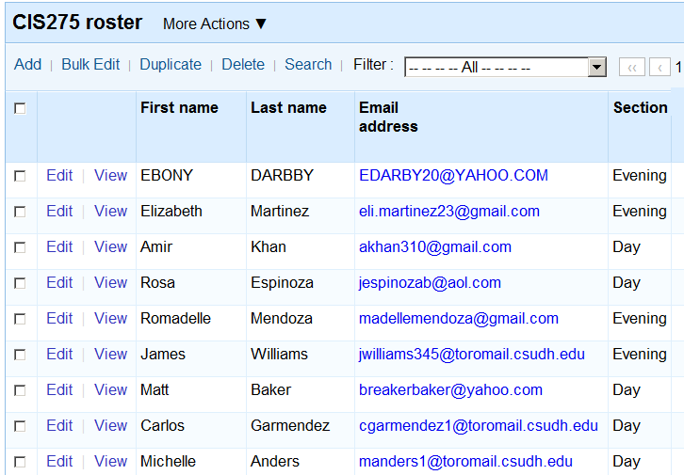
Play around with new tools
Notes:
Play around with new applications and services.
Learn the way little kids learn to play new games.
This is an easy to use platform for developing database applications in a few minutes.
You do not have to be a geek.
It is a tool for you to use in school and after.

Slide 10



Application development
Personal computer
Batch processing and time sharing
Internet platform
Notes:
In the early days of computing – when we used batch processing and time sharing on giant sized computers -- only skilled professionals could develop new applications. You really had to be kind of a nerd.
The advent of the personal computer and spreadsheet made developing applications much easier.
Business people and others began building spreadsheets, databases, reporting systems, slide presentations and more without the help of a professional programmer.
Today, Internet era tools have lowered the bar even further.
Those spreadsheets, databases and presentations are even easier to build and share online and you can create applications using tools like blogs and wikis in just a few minutes.

Slide 11

Notes:
I saw a Cuban dance lesson in which the entire class waited till every kid could do the step.
The kids could count on their classmates for help.
That may not work in all situations, but keep it in mind.

Slide 12
Week 3

Slide 13
Study habit feedback survey
1. In week 1-2, I asked you to study a presentation on list servers. Which of the following did you do?
Skim slides on the screen - 25
Read the slide annotation on the screen? - 13
Study the presentation on the screen? - 12
Print the presentation? - 7
Study the printed presentation? – 4
Nothing at all - 4

Slide 14
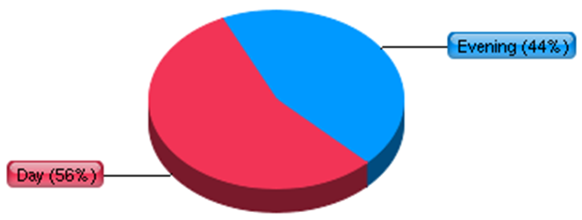
Background survey

Slide 15
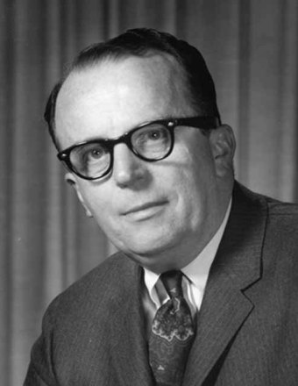

Communication and community
“In a few years, men will be able to communicate more effectively through a machine than face to face.”
“What will on-line interactive communities be like? ... They will be communities not of common location, but of common interest.”
Licklider and Taylor, 1968
Notes:
Email list management is a common Internet application or service.
We’ve described list servers, now let’s step back and talk about network applications.
The Subscribers to a list form a community of common interest.
They may be collaborators on a project at work, students in a class, or people with a common hobby, etc.
This sort of communication was foreseen by JCR Licklider and Robert Taylor in the 1960s.
Licklider was instrumental in the invention and development of the personal computer, the portable computer and the Internet.
He is an unsung hero.

Slide 16
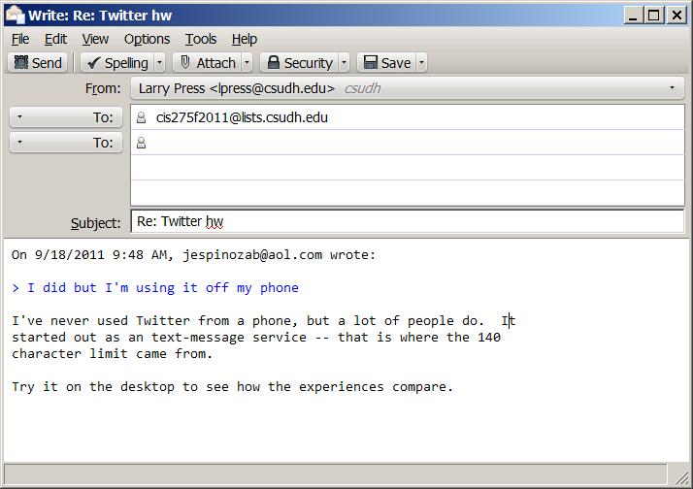
Mobile Internet – you know more than me
Notes:
We all have different experiences so we all can and should learn from each other.
How does this class have to change for the mobile Internet era?

Slide 17
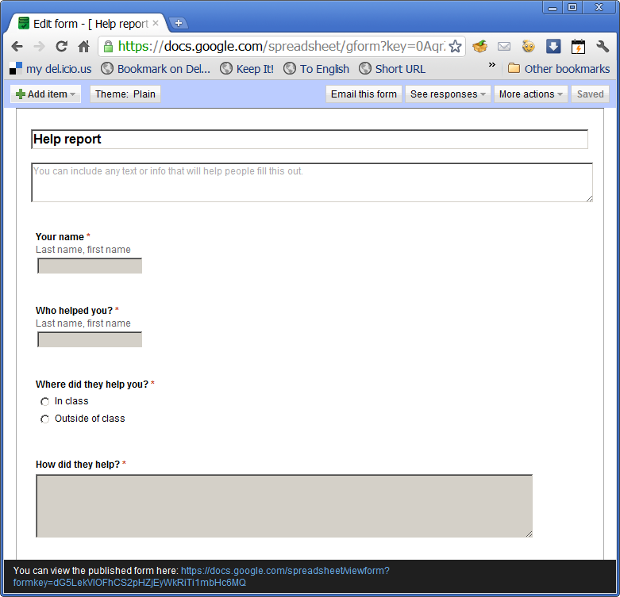
Form view:
http://bit.ly/oHK4eJ
Spreadsheet view:
http://bit.ly/nWABTw
Notes:
I asked you to come up with a shared database application.
Here is mine one we can use in our class.
How, if at all, should this figure in our grading?
Note that this is a simple survey implemented using Google Docs forms.
Google Docs forms and Survey Gizmo do the same sort of thing, but Survey Gizmo has many more features.

Slide 18
Which question would Michael Wesch like best?
What is the relationship between Yahoo Groups and Twitter?
Will this be on the midterm exam?
Notes:
Michael Wesch says we need to learn to ask good questions.
Which of these would he like and which would he dislike?

Slide 19
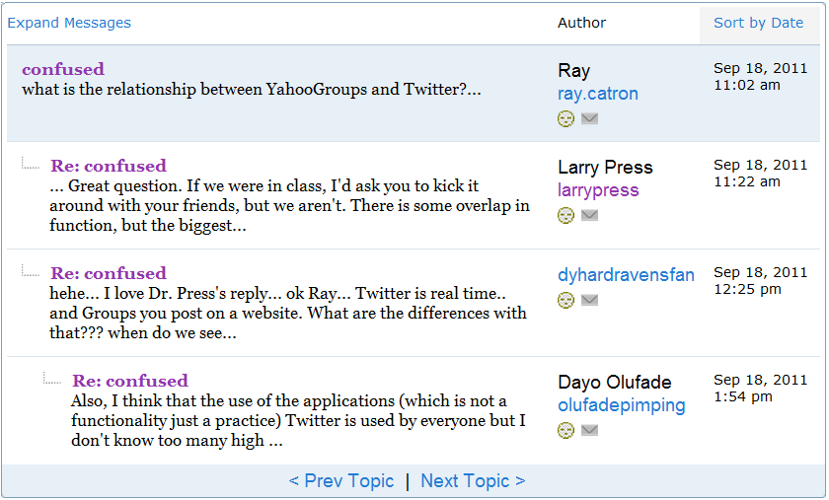
Good answers – just from me
http://groups.yahoo.com/group/cis275f2011/message/24

Slide 20
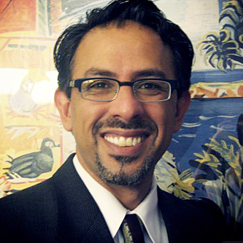
What will be the role of the CSU?
CS221 at Stanford: 200 students in class, over 60,000 online
Notes:
Mahyar Amouzegar is dean of engineering at Cal Poly Pomona.

Slide 21
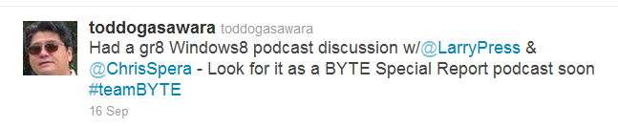
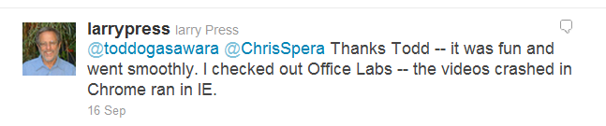
Twitter conversation
Missing context: http://bit.ly/p3KQn6
Notes:
The problem with Twitter conversations using the @ prefix is that everyone following me sees my answer, but does not know what it refers to.
You can also use the Twitter “messages,” email works better for private conversation.

Slide 22
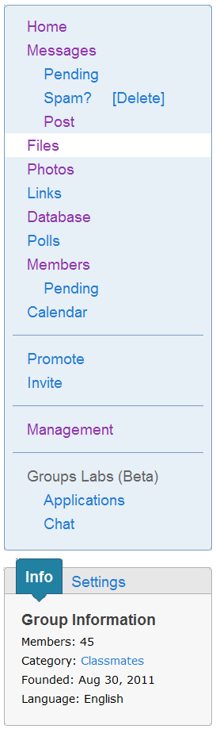
http://groups.yahoo.com/group/cis275f2011/
Notes:
Which is best – our email list or our Yahoo group?
Which has the most features?
Which is simplest?

Slide 23
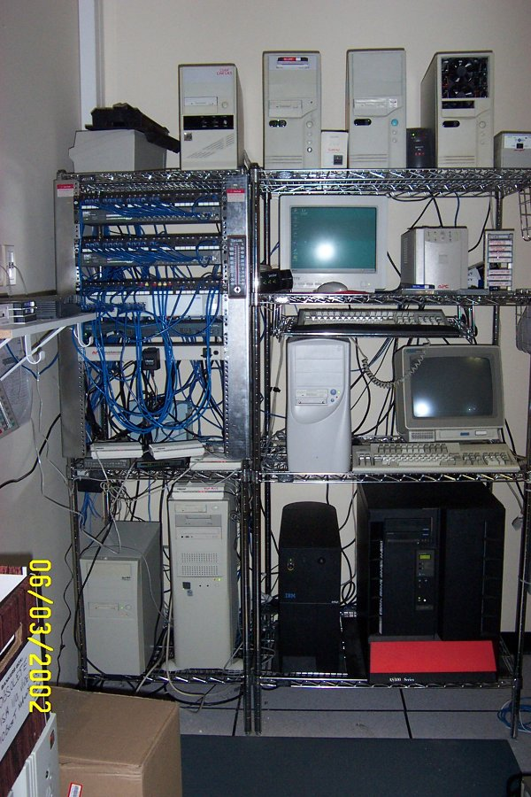
Run the service in-house or use a net service?
Notes:
We saw two ways to get a class email list running – operate it on campus using the list server program or use Yahoo Groups, a network service.
What are the pros and cons for the two approaches?
How much does Yahoo charge for their service?
How can they offer it for free?

Slide 24

Books must be read as deliberately and reservedly as they were written
Thoreau, Walden, 1854
The best way to go fast is to go slow
Chinese proverb
Go slow now, go fast later
German proverb
READ
Notes:
To write well on the Internet, you have to read well – carefully and attentively.

Slide 25
Week 4

Slide 26
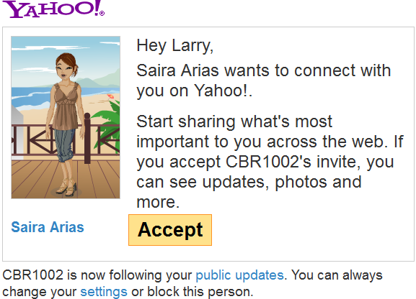
Did you know about this social/profile service?
Notes:
This service is called Yahoo Pulse.
If I agree, Saria will be able to see any changes I make to my Yahoo profile.
She will also be able to see my Twitter feed and Facebook posts if I give Yahoo permission to forward them.
I opened my Yahoo account before social networking took off.
They did not offer sharing at that time.
I did not know about Yahoo Pulse – another example of students knowing things the professor doesn’t.

Slide 27



Wire-line connection technologies
Copper, twisted pair (electronic)
Copper, coaxial cable (electronic)
Fiber (optical)
Communication link characteristics
Notes:
Wire-line links either use copper wire or optical fiber.
Fiber speeds are generally higher than copper speeds.
Fiber often replaces fiber when higher speeds are required.
For example, many developed nations are deploying fiber to homes and buildings, replacing copper wires.
If you have a DSL connection to the Internet, it uses your twisted-pair telephone wires.
If you have a cable connection, it comes over coaxial cable.

Slide 28
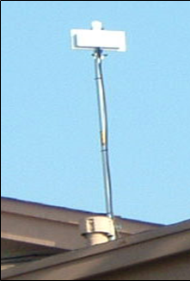
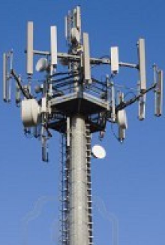
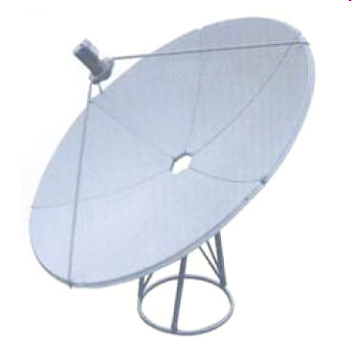
Wireless connection technologies
Terrestrial radio
Satellite radio
Communication link characteristics
Notes:
Wireless links are either terrestrial or via satellite.
The terrestrial antenna on the left links one of our dorm buildings to the campus LAN.
The call phone antennae on the right are also used for Internet connections.
Both are terrestrial – on the Earth.
Satellite links are slow and expensive because the signal has to travel up to a satellite and back to earth and the equipment is expensive.
Satellite links are generally used in rural areas or other places where there is no other alternative.

Slide 29
Asst: Join our Yahoo Group
At CSUDH, IT sets up email lists, so I need their permission to do it. Anyone can set up a Yahoo group without permission. Which is best – pros and cons?
CSUDH runs their own server for mail lists. Yahoo runs the Yahoo Groups server. Is it better to run things in house or to use an outside service like Yahoo – pros and cons?

Slide 30

Asst: First Twitter experience
The purpose of this assignment is to introduce Twitter, and to give you additional practice writing a short document.
Look through my past posts, and pick one that sounds interesting. Follow the link or links to learn more.
Write a short description of my tweet and state where it fits in our class outline.
Notes:
I let this go this time, but will not in the future.
MTV and Web surfing have trained you to skim, but you need to start reading carefully and thoughtfully.

Slide 31
Asst: Review functional components of a computer
There is still some confusion over the difference between storage and memory. Storage holds all your programs and data, memory only the ones you are currently working with.
There have been many different memory technologies.
There have been many different storage technologies.
Some storage characteristics – capacity, cost, data transfer rate, power consumption, reliability, removable (yes/no), physical size.
Name the input, output and storage devices on the computer inside a camera.

Slide 32
Asst:
Prepare a well-written answer to Wesch’s questions
Did you pay attention to the tips I gave for writing short documents?
(http://cis275topics.blogspot.com/2010/09/writing-short-documents.html)
Notes:
This assignment was about collaborative writing and writing short documents as well as Michael Wesh.

Slide 33
Honesty and disagreement
I do not recognize myself in what he says - I thought that he is a quack in honesty.
-----
I recognize myself as if Michael Wesch collaborated with me and got the information before his presentation.
When I viewed the video and watched what Michael Wesch was speaking about it made me feel like he was talking about me.
Notes:
There is a bias toward agreeing with someone the professor recommends.
Some of you answered as if the assignment were to say how cool was and summarize what he said.
Many, but not all, thought Wesh characterized them well.

Slide 34
Did you like Michael Wesch?
I think that listening to that talk was a waste of time because I really do not like hypocrisy.
-----
Wesch is a person that I believe would be a great teacher.
Notes:
One person did not like him.
There is room for disagreement.

Slide 35
You can’t like all of your classes
Michael Wesch made me feel somewhat guilty and made me realize that many of us students just go to class just to get a grade.
Notes:
Don’t feel guilty about your identifying with Wesch’s unmotivated students – you cannot love all your classes and subjects.
It is rational to put less effort into some so that you can focus on those you really like.
The best thing that could happen to you in school is that you might find a topic you love and want to pursue.

Slide 36
Why I don’t participate
I do not want to sound stupid.
My confidence plays a key role in my nonparticipation.
Some of the factors that prevent me from participating in class discussions are being uninterested, tired, and unprepared.
it's really fear of being wrong.
Notes:
Don’t be shy about speaking or taking risks in school – this is a safe place to make mistakes.

Slide 37
Technology is used in face-to-face classes
As a student who has not successfully taken an online course I can say that online learning is for some students and not all.
Notes:
What technology do we use in our class?

Slide 38
What will stick five years later?
I may not be able to recall facts but I have gained enough skill in my education to resourcefully analyze and evaluate research.
Notes:
Many of our concepts will still be valid, but not all.
Many of the skills will be obsolete.
You need to learn the big picture, and build confidence that you can pick up new things.

Slide 39
Most heartfelt comment
When I hear a lecture, my mind wanders and I get lost trying to find my way back. I combat the mind-wandering by taking notes. I feel like I'm on the outside looking in; I'm not part of the experience.
What are strategies for avoiding this?
Notes:
What are strategies for avoiding this?
Take notes.
Answer questions – in your head if not aloud.
Prepare in advance.
Try to do homework in advance.
Ask a question as soon as you hear something you do not understand.

Slide 40
Other tools I have used that we could use
Skype
GoTo meeting
Chat
Notes:
These are all synchronous tools.
That is a new concept that you should acquire.

Slide 41
Quantification is another underlying cause
I would also have to tell Wesch that I think all of this has come out of the need for institutions of education to quantify and rate how “successfully” the teachers have taught and the students have learned; this causes teachers to be focused on “learning objectives” rather than learning itself, then this mentality transfers to the students.
Notes:
Adding to what Wesch said.
Showed careful reading of what he had said and extended it.
Good example of careful reading and writing – go back and read it.

Slide 42
Why do teachers ask questions in class?
(Can you google the answer to this question)?
Notes:
Not to test.
To engage students – to get them thinking about something.

Slide 43
The role of memory-based questions
What are the user controls for a car?
Notes:
This serves as a checklist in a way.
You will not be a very good driver if you do not know and understand the function of each.
Knowing about all but one will not do the trick – there is no partial credit for this question.

Slide 44
Why might I ask these questions?
What are the three types of wireless communication in use on the Internet today?
What are the functional components of a computer?
What are the three types of Internet writing we will focus on?
Who was instrumental in conceiving of and funding the PC, portable computer and Internet?
Notes:
They point out that you really need to study the presentations and do the assignments.
The first is current knowledge that spell out the options you can consider as a user or manager.
The second is a checklist – you need to understand the role of each of these in order to understand what is happening when you are using a computer (like the controls of a car).
The third helps organize the class – lets you see where we are and also see how the professor organizes the topic.
The fourth reminds us that things are in constant change and the field has a history as well as a present. It also keeps us humble.

Slide 45
What do such questions achieve?
I use them for grading.
They give you feedback -- they are study guides
They remind you that you need to study the presentations and do the assignments.

Slide 46
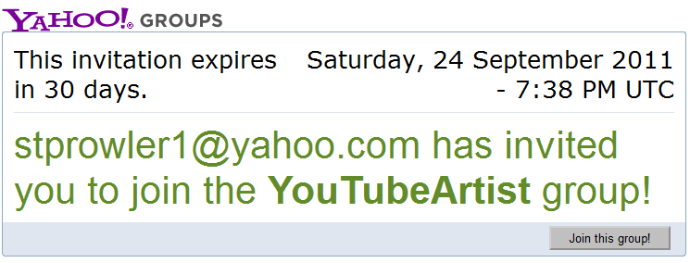
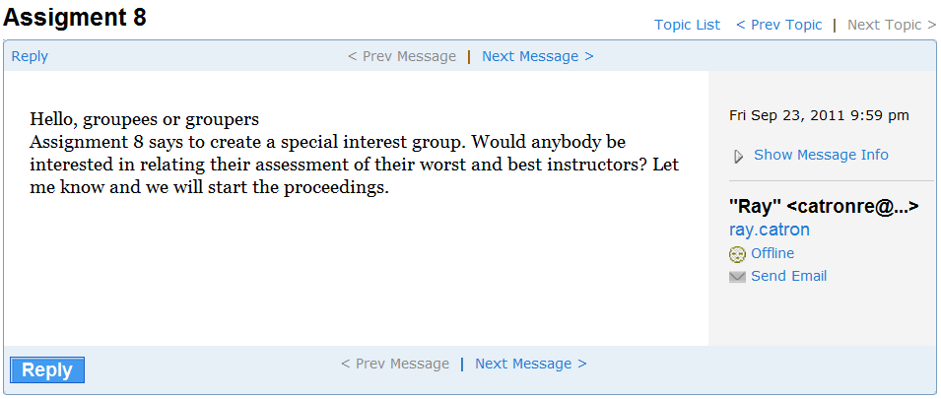
Asst: Yahoo Group
Notes:
Did you discard a few ideas or jump on the first one?
Who is your target audience?
How will you get in touch with them?
I am currently working with the Chancellor’s Office to try to get faculty talking about teaching and affordable learning material – will start with folks using a certain e-text as a pilot group.

Slide 47
Week 5

Slide 48
Quiz
You did better on quizzes, but
If the question asks how many are true, the answer is a number, no words.
If you write teeny weeny any more – name or answers – I will ignore it.
The questions have been posted.
Notes:
There is no need to re-copy the question.

Slide 49
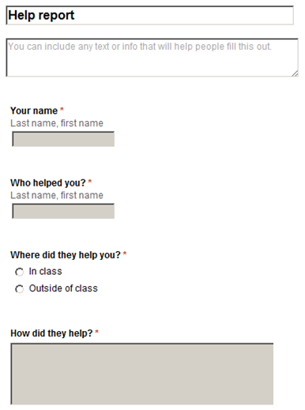
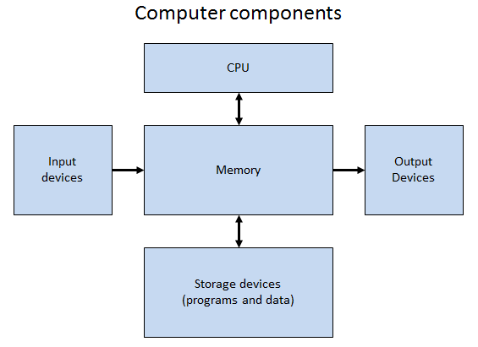
Help a friend and
file a help report
Notes:
Some people are still lost topic module on the functional components of a computer.
Help a friend and file a help report.
There are a lot of blank squares on the assignment sheet.
If you have not tried an assignment, try it.
If you have sincerely tried, get someone to help you with it.
You will each receive half of the credit for the assignment.

Slide 50
Assignment numbers – no more slack
Print it on top of the front page.
Notes:
I will not grade an assignment if it does not have your name and the assignment number printed clearly on the top of the front page.

Slide 51
Asst. 8 – Propose a Yahoo Group
Example: CSU Chancellor’s Office effort to create two focused pilot communities:
Biology 101 professors at CSU campuses
IT literacy professors at CSU campuses
These are focused, identifiable constituencies motivated by a strong common interest.
We will try to identify and invite all of them
We hope they will get to know each other and share experiences and very specific, practical tips and teaching material.
Notes:
I am working on a CSU Chancellor's Office initiative to foster community among faculty.
For the pilot effort, we are going with two, narrowly focused communities – teachers of Biology 101 and teachers of IT literacy classes such as ours.

Slide 52
Asst. 8 – Propose a Yahoo Group
Some questions to consider for your group:
Focused or broad topic?
How will you find members?
What is their motivation?
Local to DH, our class?
Are there related groups online already?
Do you care and are you curious or is it just an assignment you have to do?
Notes:
Perhaps you would like to revise your plan or team up with someone else after considering questions like those listed above.

Slide 53
Asst. 9 – Rating and reputation
3 parts:
One click rating
Rate a professor
Critically review the ratings of a professor (do you take them at face value and how do you explain the variation?)
Notes:
This assignment had three parts.
How did you format your answer?
About half of the people clearly indicated 1, 2, 3
A few answered all three, but in random order without making each part clear so I had to hunt through them.
The rest ignored one or more parts.
Among those who did the three parts, most ignored the questions raised in part 3.
You need to read carefully and think about the organization of what you write.

Slide 54
Asst. 10 – Google Docs WP
Best class at CSUDH
Which do you like better, Word or the Google Docs word processor?
What are the pros and cons of network applications versus stand alone applications?
Which does the future favor?

Slide 55
Addition to the presentation on retrieving a Web page

Slide 56
The client-server conversation
Client
Server
OK
Send page or error message
OK
I would like to open a connection
GET <file name>
Display response
Close connection
Notes:
You can think of the transaction as a conversation between the client and the server.
Network technicians often draw diagrams like this one.
The rules governing this sort of conversation between a client and a server are called a protocol.
They are spelled out in great detail.
For example, the request for a file must begin with the capital letters GET followed by a single space followed by the name of a file.
If the person writing the client program were to mistakenly have it send the lower case letters get, it would not work.

Slide 57





Protocols establish standards
Internet Explorer
Firefox
Chrome
Opera
Safari
Notes:
Protocols establish standards.
Any programmer or company can write a Web client.
If the program follows the protocol, it will work with any Web client.
This facilitates competition.

Slide 58
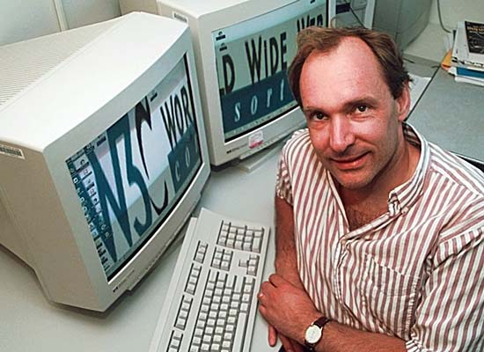
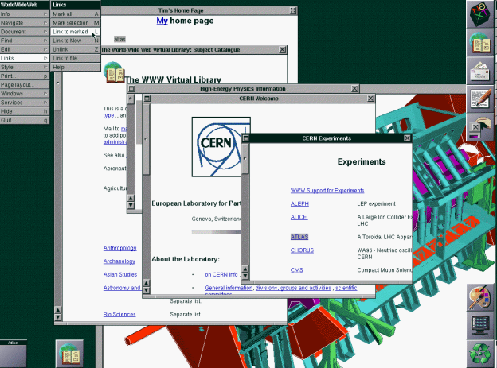

Who invented the Web client-server protocol?
Notes:
The protocol that governs the conversation between a Web client and a Web server was invented by Tim Berners Lee.
Here you see him, a screen shot from his first Web client and the first image on the Web.
Berners-Lee worked at CERN, a Swiss physics research facility, and he wrote his Web client and Web server software so physicists around the world could share and link to research reports.
He named his protocol HTTP, the hypertext transfer protocol.

Slide 59
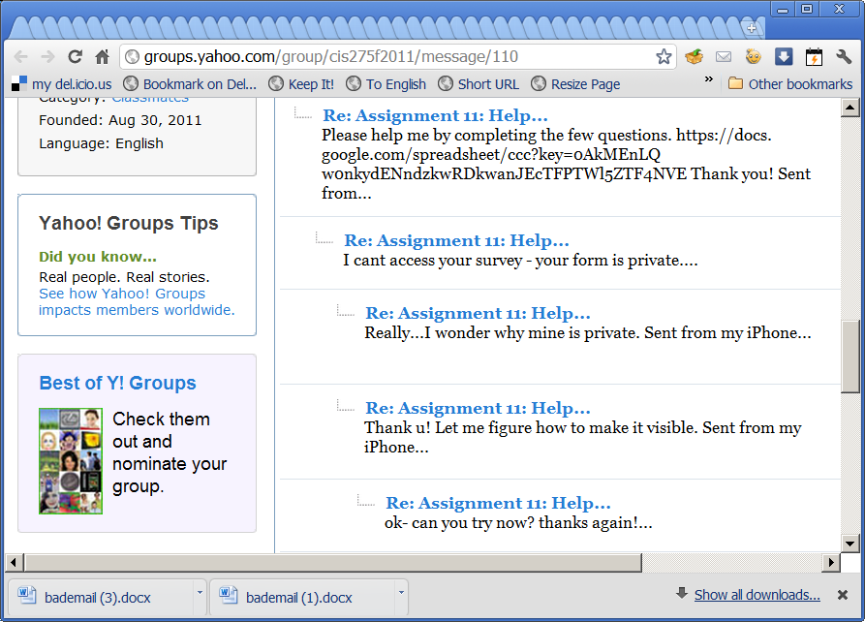
Notes:
This was a good example of an email conversation.

Slide 60
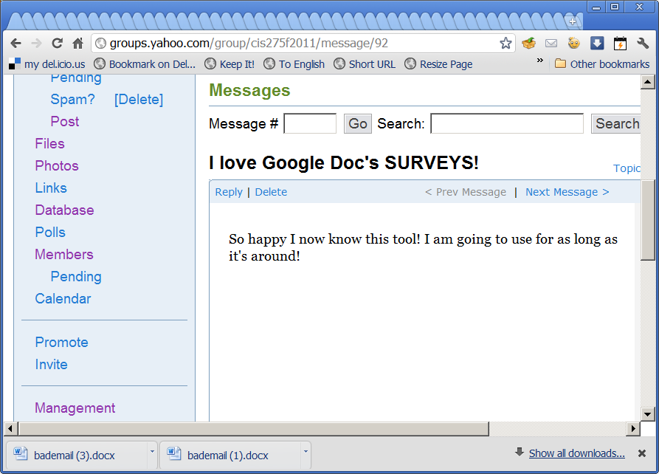

Slide 61
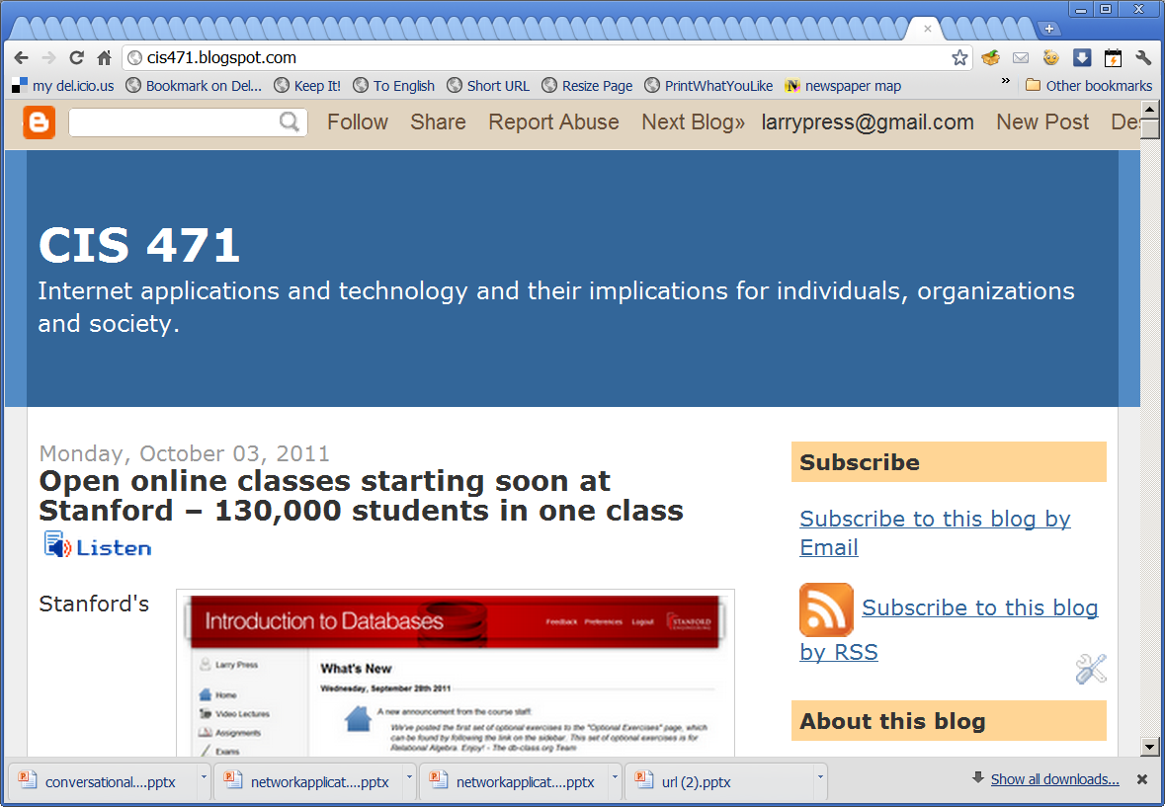

Slide 62
Week 6

Slide 63


Install programs from the Internet
Microsoft.com
Adobe.com
Microsoft App Store
Apple App Store
Amazon App Store
Notes:
Don’t confuse programs you download and install from the Internet with network applications.
For example, you can go to Microsoft.com and purchase, download and install Word.
But, that does not make Word a network application, since it is installed in your local storage and stores the documents you create locally as well.
When using portable devices, we often download and install programs (“apps”) from app stores.
App stores smoothly integrate selecting, purchasing, downloading and installing a program.
But, a program you download from an app store may or may not use the Internet for storage.

Slide 64
Web client helpers
Microsoft Windows
Web browser program
Web page with embedded video
Flash browser extension
Notes:
Network application programs that are downloaded run inside the Web client.
As such, they are limited by the capability of the Web client.
The first Web clients could not download and run programs at all.
Today’s Web clients can run programs, but they are still limited.
Installed applications are generally faster and can offer features that are not possible with network applications.
One way to add capability to network applications is to install add-ons that extend the capability of the browser.
For example, older Web clients lacked the ability to display videos.
Installing Adobe’s Flash player enables older Web clients to play videos.
But, Web clients are improved over time, and the newer ones can play videos without an extension.

Slide 65
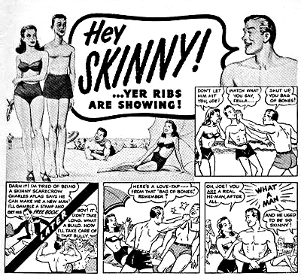
HTML 4
Stand-alone app
HTML 5
Notes:
Web pages are created using HTML (hypertext markup language), and the latest version of HTML, HTML 5, adds new capability.
For example, HTML 5 Web clients can play videos without a Flash extension.
HTML 5 tends to close the capability gap between networked applications and installed applications.
Furthermore, as network speed increases and client hardware becomes more powerful, the performance gap between network applications and stand alone applications narrows.

Slide 66
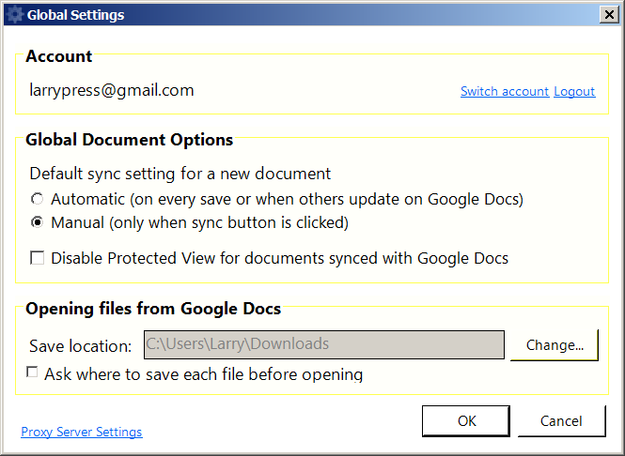
Google cloud connect
Notes:
Google cloud connect extends Microsoft Office.
It backs up your files in the cloud as Google Docs.
Backup can either automatic or manual.

Slide 67
Assignment 11
Everyone got the assignment number right :-).
Some people ignored your instructions on putting in their height in inches.
Be aware of the different question formats

Slide 68
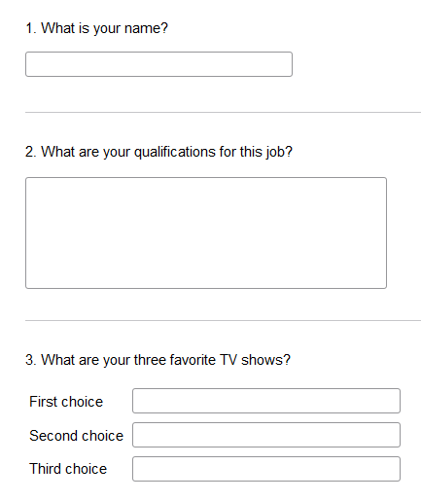
Open-ended questions
Single line of text
Free text
Imposed ranking
Notes:
Online survey services offer a selection of question formats.
Some are open-ended and others require a choice among fixed responses.
The ones shown here allow open-ended responses, and the respondents can interpret the question and reply as they see fit.
We get rich feedback from open-ended questions – often getting unanticipated replies.
Most systems do some checking on the type of the answer, for example restricting it to a being number or a legal email address.

Slide 69
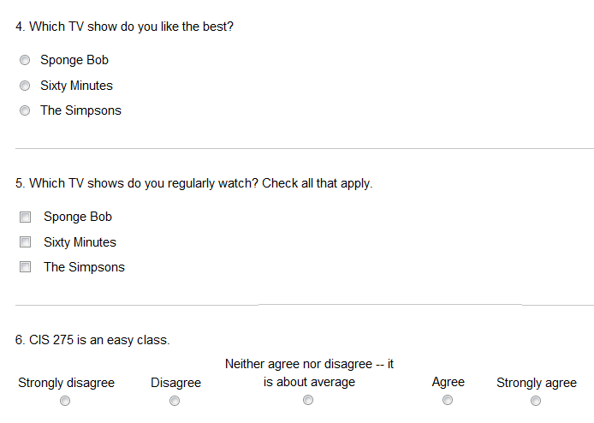
Limited-response questions
Multiple choice,
choose 1
Multiple choice,
all that apply
Five-level
Likert scale
Notes:
Limited-response questions are not as flexible as open-ended questions, but they allow for statistical analysis and reporting.
Since open-ended and fixed-response questions each have advantages, it is often a good idea to use both on the same topic.

Slide 70
Likert scale questions are flexible
A statement the respondent can agree or disagree with
strongly disagree
disagree
neither agree nor disagree
agree
strongly agree
Variation: How important is X? Responses: not at all important to extremely important.
Variation: respondent assigns one or more stars to something like a movie or TV show.
Notes:
Likert scale questions are a common limited-response format.
They’re flexible and also lend themselves to statistical analysis and presentation.
A Likert scale is symmetrical.
One typically makes a statement then allows five replies ranging from strong disagreement to strong agreement with a neutral response in the middle.

Slide 71
Study habit feedback
Did you review your survey plan with anyone else before typing it up and submitting it? (yes/no)
Did you consider more than one survey idea rather than taking the first one that came to mind? (yes/no)
Did you turn in the first draft of your survey plan as opposed to setting it aside for a day or more and revising it?
I asked you to cover a topic module on survey design before you did the assignment. Did you (list all that you did):
  Not look at it
  Look at the slides, but not read the notes
  Read the slides and notes on the screen
  Take notes on the presentation while reading it on the screen
  Print the presentation
  Study the presentation after printing it
  Take notes on the printed presentation.

Slide 77
Comm tech
http://csudh.uservoice.com
http://playwithimages.blogspot.com/

