Slide 1
Using Google Drive applications
Skills: use Google Drive applications
Concepts: we download and run programs inside our Web clients, wire-frame diagram, user interface, collaboration
This work is licensed under a Creative Commons Attribution-Noncommercial-Share Alike 3.0 License.
Notes:
This presentation introduces and demonstrates Google Drive (which used to be called Google Docs).
Its primary goal is to explore the capabilities of the Google applications, but we will also see that the application programs are downloaded from Google’s server and executed on our client computer.
Finally, we introduce the idea of a wire-frame diagram, which a programmer would use when developing a new program and a user can use when learning a new program.

Slide 2
Where does this topic fit?
Internet concepts
Applications
Technology
Implications
Internet skills
Application development
Content creation
User skills
Notes:
The presentation falls within the applications portion of the class.

Slide 3
Google Docs in plain English
Google Docs has been rebranded as Google Drive.
Watch the video (2:50)
Notes:
Pause and watch this video before going on.

Slide 4
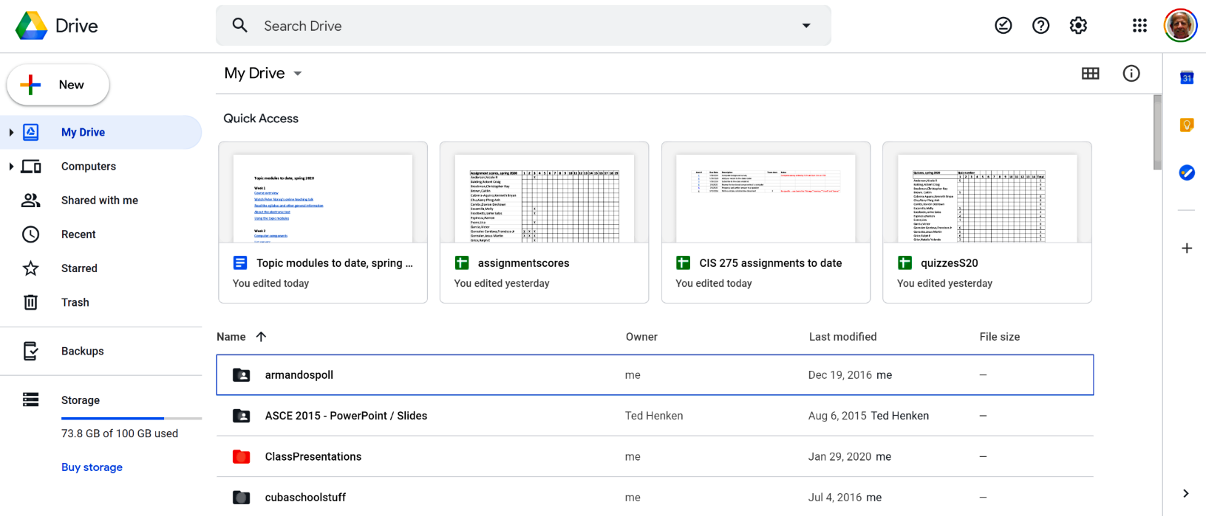
Logged into my account
Notes:
Once you are logged in to your account, you will see your Google Drive directory.
As you see here, I have several files and folders stored on my Google Drive.
If yours is a new account, the listing will be empty.

Slide 5
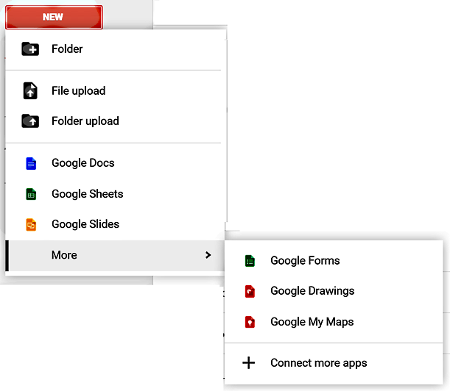
Google drive – programs and storage
&
15 GB
free storage
Programs
Storage
What does 15 GB mean? Google used to call this service Google Docs – why do you suppose they changed the name to Google Drive?
Notes:
Google drive consists of programs for creating and editing various types of document – including those shown here – and 15 GB of free storage on the Internet.
Note that you can also create folders and upload files and folders from your client computer.
Since the programs you use and the documents you create are stored on the Internet, the service is called Google Drive – your disk drive on the Internet.
Each account also comes with 15 GB of online storage – 15 billion bytes of storage.
Since Google designs their Chromebook laptops to be used online, they have less local storage capacity, but Google gives you 100 GB of free space on the Internet.
You can pay for more if you need it, but, since online storage is a highly competitive market and storage technology is improving rapidly, the free limit may be raised by the time you need more capacity.
This service was initially called Google Docs because it emphasized word processing documents, but Google provides several other programs now and, as we will see below, software developers can create new applications that store content on Google drive.

Slide 6
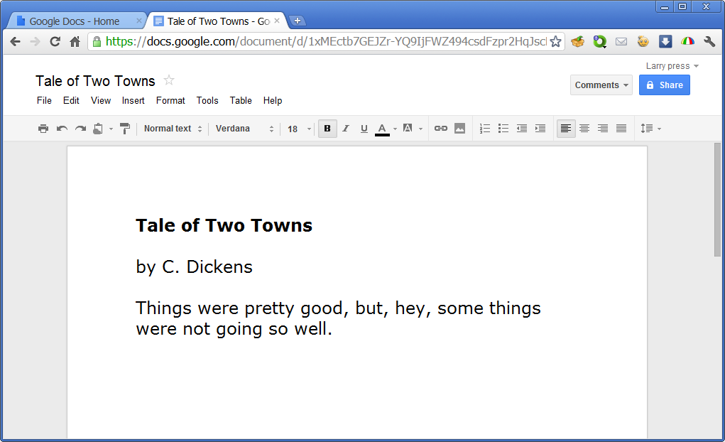
For example, one of the programs is a word processor.
It’s simpler than Microsoft Word, but Google constantly adds new features.
Compare this screen shot to today’s version of the program. What differences do you see?
Notes:
One of the programs is a word processor. It does not have as many commands as Microsoft Word, but it is sufficient for many documents and Google adds new capabilities over time.
You type and edit your document in the same way as you would with a desktop word processing program like Microsoft Word.
When you finish, you do not have to save the document – it is automatically stored on the Google Docs server, in the “cloud,” not in your computer’s storage.
If you want a local copy, you can download it using a command on the File menu.
It is simpler than Microsoft Word, but Google has steadily added new features as Internet technology has improved.

Slide 7
Demo/play
How do I …
Create a new spreadsheet?
Delete a file?
Upload a document?
Sort the files by title?
Share a file with others?
See only presentations?
Rename a file?
See files in a given folder?
Create a new folder?
Go to other Google apps?
Add comments to a Google doc?
In class – demonstrate document creating and editing.
Self study -- pause to play around with the program – can you answer these question?
Notes:
Play around with the program, answering these and other questions.

Slide 8
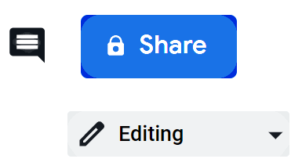
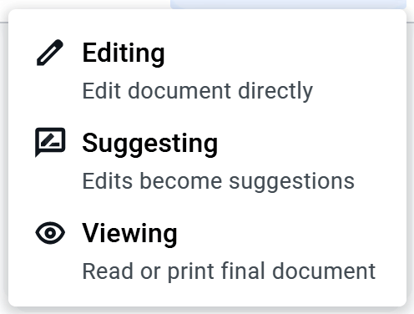
Collaboration tools
Filter notifications from collaborators and see/hide comment history
Determine who can see the document and what they can change

Slide 9
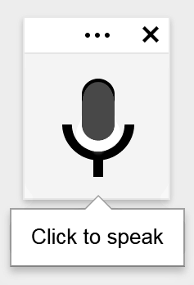
Google Drive is always current
You get new features like voice input as soon as they are released.
What technology improvements have made automatic updates feasible now when they were not earlier?
Is there a drawback to being always current?
Notes:
Each time you use a Google Drive application, you get the latest version.
You always have the most recent version of the program, but you need to learn new things and an update can introduce bugs.

Slide 10
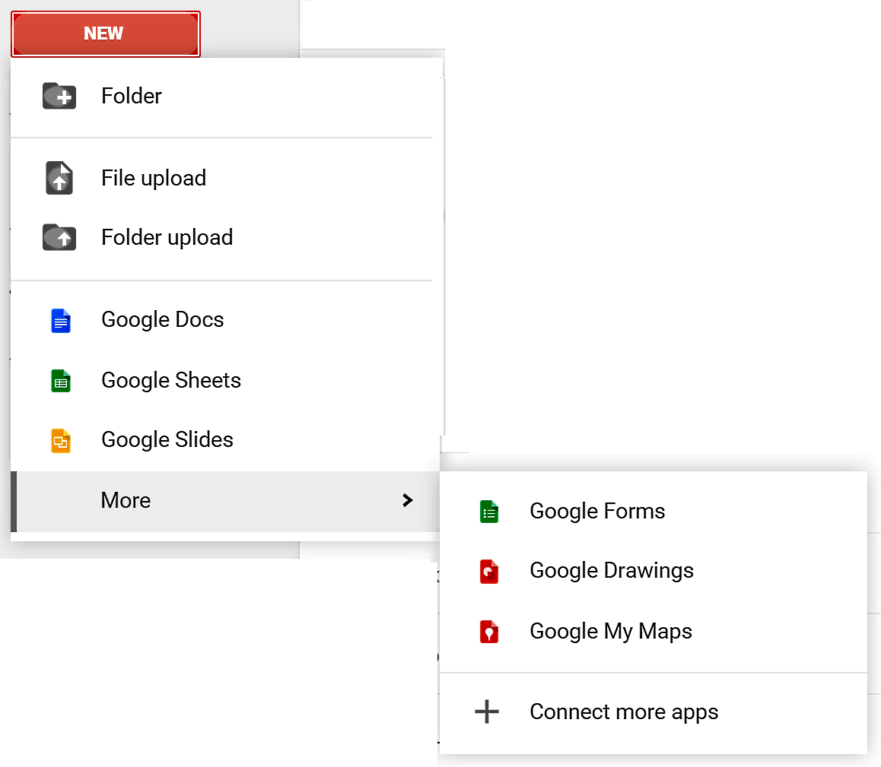
Google Drive is extensible
Google supplies programs for:
Word processing
Creating spreadsheets
Creating presentations
Creating surveys
Creating drawings
Creating maps
And …

Slide 11
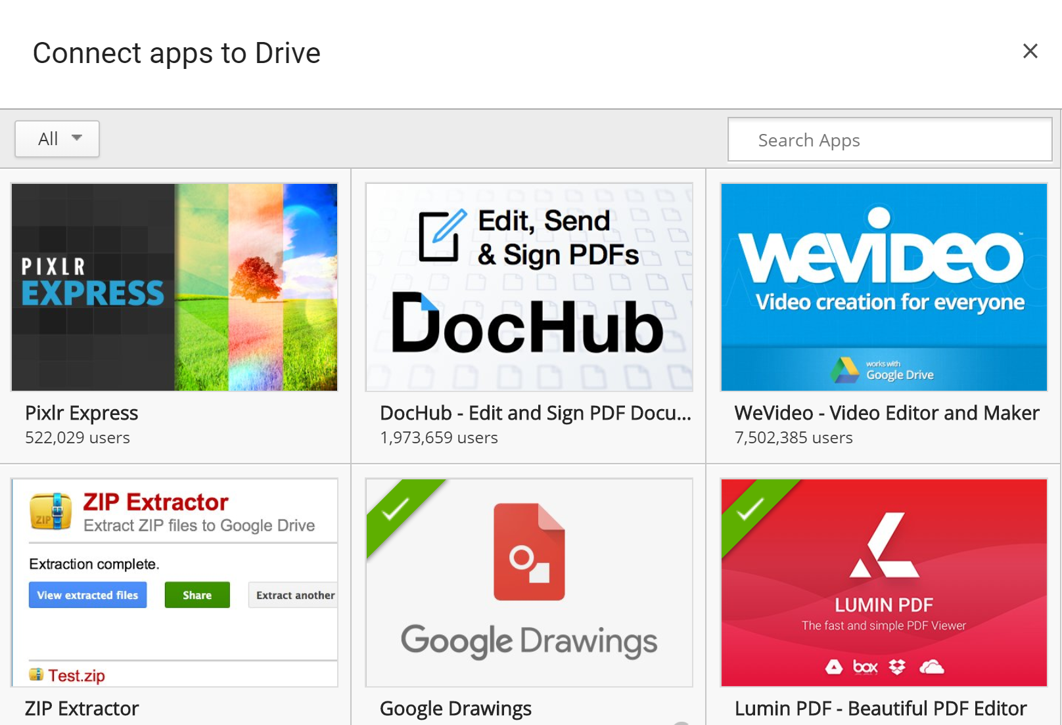
Google Drive is extensible
Why does Google let others add Drive applications?
Notes:
Google publishes an “application program interface” (API) so other developers can create apps that work with Google Drive.

Slide 12
Do what you do best and link to the rest.
Can you think of Web sites that integrate with other Web sites?

Slide 13
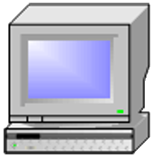
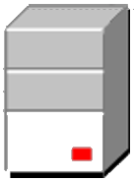
When you are using the Google Drive word processing program:
Where is the data you are working on?
Where is the data you have stored?
Where are the clients?
Where is the server?

Slide 14
Program: Google’s word processing program
Data: the documents you and others are writing

Slide 15
CPU
Input
devices
Output
Devices
Memory
(programs and data)
Storage devices
(programs and data)
What programs and data must be in the memory of your computer while you are using the Google Drive word processing program?

Slide 16
CPU
Input
devices
Output
Devices
Web client
Operating system
G. D. word processor
Your document
Storage devices
(programs and data)
At least four things must be In memory while working on a Google Drive word processing document. What else might be in memory?

Slide 17
Did you notice the term “operating system” on the previous slide? If so, do you know what it means? If not, why didn’t you ask?

Slide 18
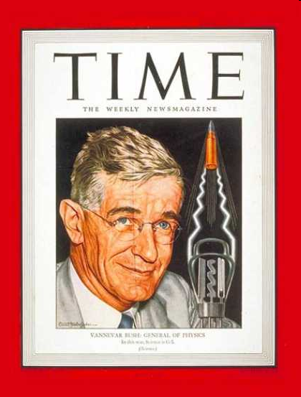
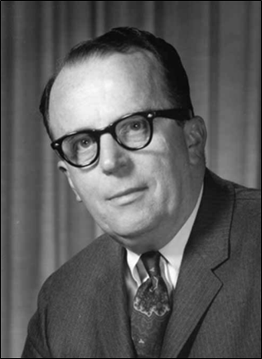
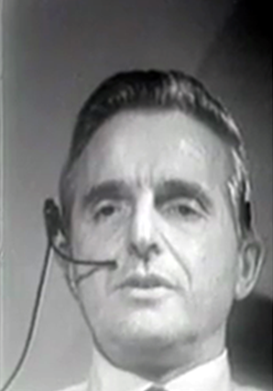
The fathers of networked collaboration
Vannevar Bush
J. C. R. Licklider
Doug Engelbart
Notes:
Drive enables collaboration through easy sharing of documents.
Vannevar Bush had the vision before world war 2, but did not foresee the technology.
In the early 1960s, J. C. R. Licklider realized that networked computers would be the appropriate technology for collaboration, so he articulated the vision and found funding for the research.
In addition to funding the research that led to the Internet and personal computer, Licklider funded the work of Doug Engelbart, who built research prototypes of the collaboration tools we use today.

Slide 19
Summary
Program: Google’s word processing program
Data: the documents you and others are writing
Notes:
We have looked at the user interface and functions of Google Drive and reflected on strategies for learning a new program.
The good news is that you know how to get started with a new program and know your way around Google Drive.
The bad news is that there are a lot of other Google Drive features that you have not yet discovered.
The good/bad news is that Google programmers will add features and make changes to the program in the future.
So, you have to keep exploring and keep learning – it’s up to you.

Slide 20
Resources
Google Docs:
http://docs.google.com
Getting started guide:
http://docs.google.com/support/bin/static.py?hl=en&page=guide.cs&guide=21008&from=21008&rd=1
Some Google Docs tips and tricks:
http://www.labnol.org/internet/office/google-docs-guide-tutorial/4999/

Slide 21
Self-study questions
Explore the options for sharing documents – what are they?
Describe a school situation in which you would like to share a document with someone else.
Describe a professional situation in which you would like to share a document with someone else.
There was a short pause after I clicked on “Create” a new document. What happened during that pause?
The Google Drive word processor program is copied into memory from a server on the Web. When is it loaded?
What are advantages of the Google Drive word processor over Microsoft word?
What are the advantages of Microsoft Word over the Google Drive word processor?
This presentation asked you to play with Google Drive until you were sure you knew how to do 11 things. What is one other thing you know how to do with Google Drive?
Why are some data files stored locally today – why not store them all on the Internet?
How do programmers use wire-frame diagrams?
How do users use wire-frame diagrams?

