Slide 1
Application characteristics
Skills: none
Concepts: two uses of the word “application,” networked vs. stand-alone, collaborative vs. personal productivity, synchronous vs. asynchronous, same vs. different place, fixed and portable vs. mobile
This work is licensed under a Creative Commons Attribution-Noncommercial-Share Alike 3.0 License.
Notes:
In this presentation, we classify applications in five ways, as shown here.
We also note that the term “application” is used in two, related ways.

Slide 2
Where does this topic fit?
Internet concepts
Applications
Technology
Implications
Internet skills
Application development
Content creation
User skills

Slide 3
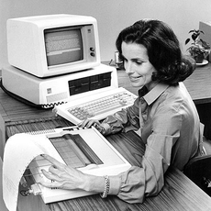
“Application” and “Application”
Program
Activity
Notes:
The word “application” is used for two separate, but related things.
Word processing is something you do with a computer, a task or activity.
Microsoft Word is a program for doing word processing – it is an application program.
Sometimes “application program” is shortened to “app.”
That is particularly common for applications that run on mobile computers.
Now lets look at five different ways to classify applications, starting with network versus stand-alone.

Slide 4
Five ways to characterize applications
Network versus stand-alone
Collaborative versus personal productivity
Synchronous versus asynchronous
Same place or different places
Fixed, mobile and portable
Notes:
Let’s look at five ways to characterize an application, beginning with network versus stand-alone.

Slide 5
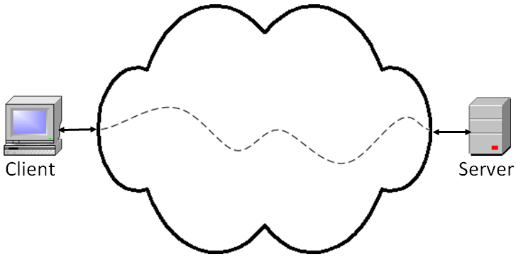
Network versus stand-alone applications
Stand-alone PC
Can you name a Web client program?
Can you name a Web server program?
Notes:
We can differentiate between stand-alone or desktop applications and network applications.
In a stand-alone or desktop application, the computer is not connected to the Internet, so both the program and the data it processes are stored locally.
In a networked application, either the program, the data, or both are stored on a server on the Internet.
People sometimes refer to network applications as being “in the cloud.”
Network applications involve a client and a server.
For example, when surfing the Web, you run a Web client program on your computer and it retrieves Web pages that are stored on a Web server.

Slide 6
Where is the program stored?
Where is the data stored?
When surfing the Web?
When editing a Google Doc word processing document?
Filling in a survey questionnaire?
Notes:
The program you are executing is always in memory, but where did it come from – where was it stored?
Where is the data you are working on stored?

Slide 7
Collaborative versus personal productivity
Give an example of a personal productivity application.
Give an example of a collaborative application.
Notes:
In collaborative applications two or more people work together on a problem.
In personal productivity applications, a single person is using the application.

Slide 8
Synchronous versus asynchronous
Same time
Different times
Give an example of a personal productivity application.
Give an example of a collaborative application.
Notes:
A collaborative application can be synchronous.
For synchronous applications, the collaborators must be online at the same time.
With asynchronous applications, they can be online at different times.
For example, conference calling is a synchronous application, and email an asynchronous application.
If collaborators are using a conference call tool like Skype, they must all be online at the same time.
If collaborators are communicating using email, they can work at different times.

Slide 9
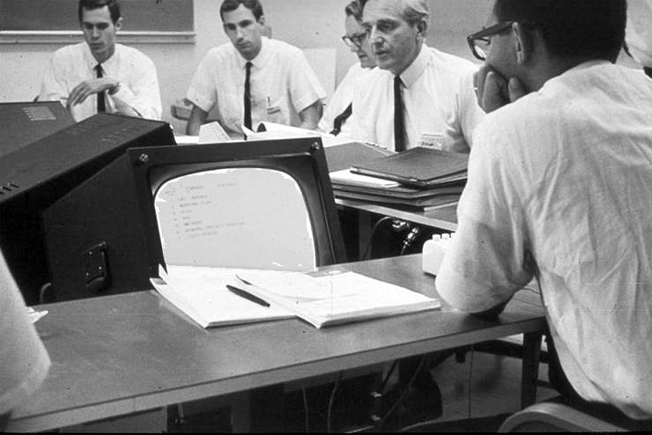
Same or different places
Give an example where users are in the same place.
Give an example where users are in different places.
Notes:
Collaborators may be in the same room, as shown here, or at remote locations.
Today, it is common for the professor to use a computer that is connected to the Internet during class meetings, and in many modern classrooms the students are also on-line.
This photo shows what must have been the first room in which collaborators used shared computers during a meeting.
It was taken in the mid 1960s in the lab of Doug Engelbart, second from the right.
Engelbart and his colleagues invented much of what we take for granted today – user-interface windows, editing live, formatted documents in those windows, the mouse, shared databases and document repositories and more.

Slide 10
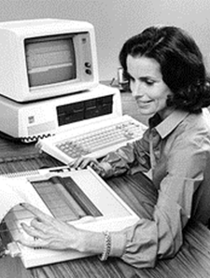
Fixed, mobile and portable
Fixed
Portable
Mobile
Name a few mobile applications.
Why are mobile applications suddenly catching on?
Notes:
Some applications, like word processing, are best done from a fixed location or a temporarily fixed location using a portable computer.
Other applications, like in-store price comparison or talking while walking are inherently mobile.
Mobile applications are increasing in importance as we get faster mobile connectivity and devices like smart phones and tablets.

Slide 11
Summary
Notes:
We have reviewed several characteristics of applications.
Applications may be networked, stand-alone, collaborative, for personal productivity, synchronous. asynchronous, fixed, portable, mobile and run in one or several places.

Slide 12
Self-study questions
Without looking back, can you list our application characteristics?
Give an example of a mobile application.
Give an example of an application in which the program is stored on the Internet, and the data is stored locally.
Give an example of an application in which the data is stored on the Internet, and the program is stored locally.
Give an example of an application in which both the program and data are stored on the Internet.
Give an example of an application in which both the program and the data are stored locally.
Using our characteristics, how would you classify email? (Repeat for other applications.)

Slide 13
Where does each of these collaborative applications fit in the following classification scheme?
Email
Chat
Teleconference
Screen share
Threaded discussion
Wiki
 | Same time | Different time
Same place
Different place
Notes:
We can classify collaborative writing tools as to whether they are used synchronously or asynchronously and at the same or different place.

