Slide 1
Audio compression
Skills: audio compression
Concepts: quality-file size trade off, capture-edit-compress, lossy versus lossless compression
This work is licensed under a Creative Commons Attribution-Noncommercial-Share Alike 3.0 License.
Notes:
We look at the audio processing work flow, noting that compression is done after editing and before you distribute your work on the Web, CD, in a presentation, and so forth.
We will consider a few compression examples, and see rules of thumb for quality in different applications.
We conclude by noting that all types of data can be compressed, and we can often tolerate some loss of information in the case of audio, video and image data.

Slide 2
Where does this topic fit?
Internet concepts
Applications
Technology
Implications
Internet skills
Application development
Content creation
User skills
Notes:
The presentations deals with audio content creation

Slide 3
Audio processing work flow
Record
Edit
Compress
Distribute
Notes:
This is our audio processing work flow.
You begin by recording some sound or perhaps copying a file from the Web.
Capture as high a quality original sound as you can.
In other words, capture as much information as you can.
Next you use your audio processing program to modify the recording to suit your application -- perhaps cutting out some uuuhms, rearranging the order of questions in an interview, and so forth.
When you finish editing, compress the audio, making the file as small as you can while maintaining the sound quality your application requires.
Note that this is the same work flow as with image or video processing.
Now, let’s listen to some compressed recordings.

Slide 4
Which recording is not compressed?
1
2
3
4
5
6
Notes:
Here is an uncompressed recording and five compressed versions.
The original recording was CD quality -- 44,100 samples per second and each sample was a 32 bit number.
Can you tell which is the original?
Which is most compressed?
Which sound the same to you, given your ear and your audio system.
Pause and listen to the recordings before going on.

Slide 5
Which suits your application?
No. | Data rate | File type | File size
1 | 320 kbps | .mp3 | 114 kB
2 | Original | .wav | 245 kB
3 | 64 kbps | .mp3 | 23 kB
4 | 16 kbps | .mp3 | 6 kB
5 | 128 kbps | .mp3 | 46 kB
6 | 8 kbps | .mp3 | 3 kB
Notes:
As you see, number two was the original file.
Could you hear the difference between it and number 1? Number 3?
As with any data compression, what is good enough depends upon the application.
If you are compressing a recording for the Web site of a classical music station, you want high quality sound, even if it means large files.
If your audience is on a slow connection to the Internet or will be listening to the recording on cheap PC speakers, you want low file size, even if it means giving up some sound quality.

Slide 6
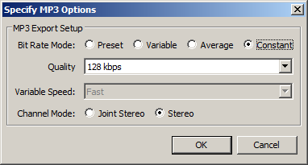
Compressing with Audacity
File > Export > Options
Notes:
When exporting an mp3 file, click on the options button in the lower right hand corner of File > Export dialog box.
That will bring up this dialog box, which you can use to select the level of compression.
You are selecting the number of bits per second.
Increasing the bits per second will generate a larger file, but the sound quality will also improve.
If you have not already done so, you will have to configure Audacity to export .mp3 files.
Instructions for doing that are in the topic module on configuring Audacity.
(See the link at the end of this presentation).

Slide 7
Quality rules of thumb
Bit rate | Quality
8 kbps | telephone
16 kbps | shortwave radio
32 kbps | AM radio
64 kbps | FM radio
96 kbps | near CD
128 kbps | CD
Notes:
As we saw, you specify bits per second when compressing mp3 files.
Here are some rules of thumb for selecting a playback rate.
The greater the number of bits stored for each second of sound, the higher the audio quality, but the larger the file.

Slide 8
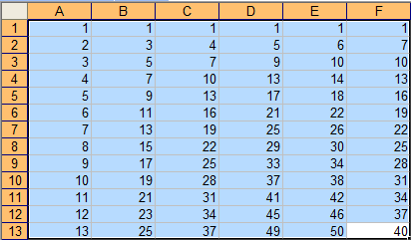
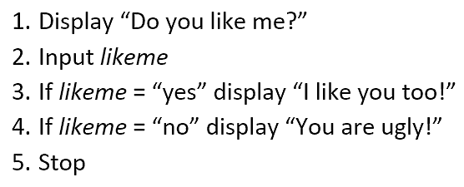
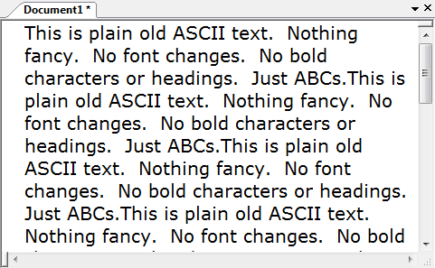
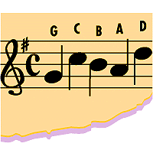
All files can be compressed
Image
Numeric
Program
Text
Audio
Video
Which require lossless compression?
Notes:
All data and program files can be compressed, and information may (or may not) be lost during compression.
In most image, audio and video applications, we can afford lossy compression, in which some information is lost.
With lossy compression, there will be a tradeoff between file sized and the quality of the result.
If we are compressing other data types, for example a program or text or numeric data, we require lossless compression.
With lossless compression, the file can be de-compressed to create an exact duplicate of the original.
No information is lost during compression.

Slide 9
Summary
Notes:
We saw the audio processing workflow and listened to several examples of compression.
We saw some rules of thumb on how much to compress a file and saw how to export a compressed .mp3 file using Audacity.
We saw that all data types can be compressed, and said lossy compression is typical for media files.

Slide 10
Self-study questions
How many bytes in a three minute, CD quality song?
How many bytes in a three minute telephone quality conversation?
What is the final step before distribution in audio, image and video processing?
If we do not lose information when doing lossless compression, what changed to reduce the size of the file? (Hint: see http://cis275topics.blogspot.com/2010/10/data-code-information.html).

Slide 11
Resource
Configure Audacity to export .mp3 files:
http://cis275topics.blogspot.com/2011/03/configure-audacity-to-export-mp3-files.html
Free software (reviews and links) for doing lossless compression:
http://www.techsupportalert.com/best-free-file-archiver-zip-utility.htm

