Slide 1
Internet audio overview
Skills: none
Concepts: introduction to history and future of music and speech processing, audio file formats, audio processing software and operations, the audio processing workflow
This work is licensed under a Creative Commons Attribution-Noncommercial-Share Alike 3.0 License.

Slide 2
Where does this topic fit?
Internet concepts
Applications
Technology
Implications
Internet skills
Application development
Content creation
User skills

Slide 3
When data types went mainstream
Data type | Decade
Numeric | 1950s
Alphanumeric | 1960s
Text | 1970s
Image | 1990s
Speech | 2000s
Music | 2000s
Video | 2000s
HD video | 2010s
Notes:
As hardware and programming techniques improve, we can afford to work with increasingly complex data types.
This table shows the rough dates when a data type made the transition from research and development to mainstream adoption.
Even though speech processing went mainstream before music, the early research on audio processing was with music.

Slide 4
Audio applications
Music
Conversation
Speech recognition and synthesis

Slide 5
Audio applications
Music
Conversation
Speech recognition and synthesis

Slide 6
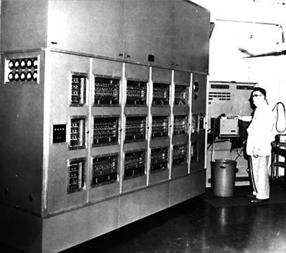
Music research, 1950s
Notes:
Although speech processing went mainstream before music, early research was with music.
Research on computer music dates back to the 1950s.
Lejaren Hiller, founder of the Experimental Music Studios at the University of Illinois, was perhaps the first computer music researcher.
He’s shown here in front of the Illiac computer at the University of Illinois.
Early researchers worked on programs to compose and synthesize music.
Their work paved the way for today’s electronic instruments.

Slide 7
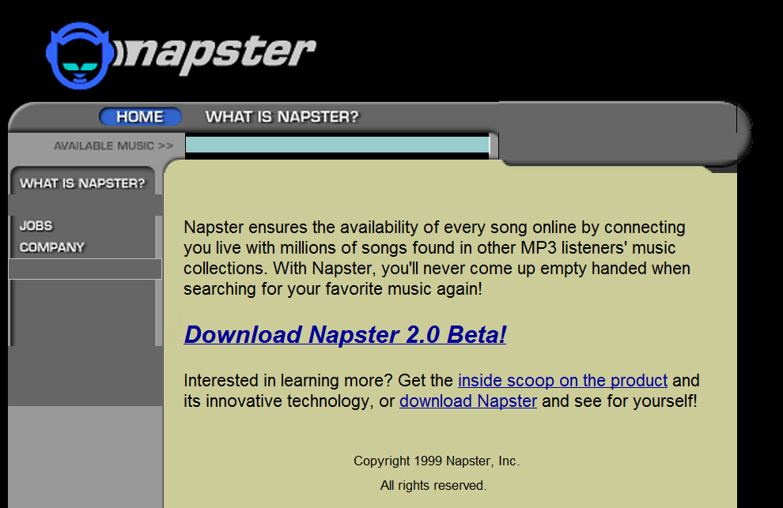
Napster, 1999-2001
Notes:
Napster was the first widely used program for distributing songs on the Internet.
It was shut down by a court order after two years of operation because of copyright violation, but it foreshadowed major changes in the music industry.

Slide 8
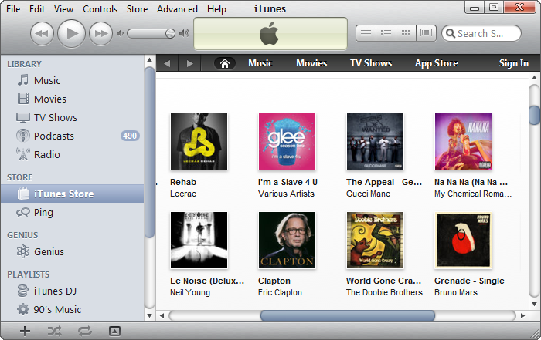
Apple iTunes store, 2001
Notes:
Internet music went mainstream with Apple’s iTunes store.
People could buy single songs at a reasonable price (99 cents).
You no longer had to buy an entire album to get the one or two songs you really liked.
This was cheap enough to discourage piracy, and Apple became the largest distributor of music in the US and sales of CDs are falling rapidly.

Slide 9
Music is moving to the cloud
Will users shift to the cloud as technology improves?
Notes:
While many people continue to download music from Apple and other vendors, others store their music in the cloud or subscribe to online music services.
Internet based music will become more attractive as network speeds improve, but it is also getting cheaper to store music locally.
Social music – sharing likes and play lists – requires a network application.

Slide 10
Audio applications
Music
Conversation
Speech recognition and synthesis

Slide 11
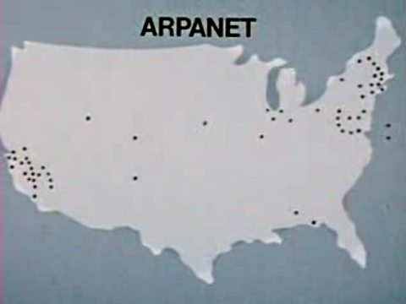
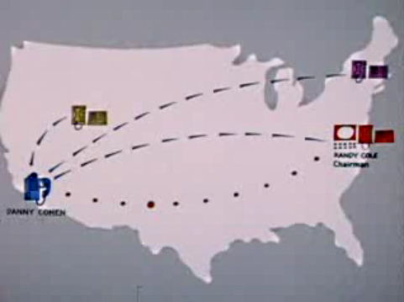
Packet voice conference, January 1978
Watch the video (5m 18s)
Notes:
Researchers began experimenting with voice transmission over computer networks during the 1970s.
This video shows the first research prototype for voice conferencing across the ARPANet.
This work was led by researchers at the USC Information Sciences Institute in Marina del Rey, California.
There are four conferees.
Only one can speak at a time and a special console is used for control of the conference.
I added the table of contents to the original video, which is on YouTube at: http://www.youtube.com/watch?v=MGat1jRQ_SM

Slide 12
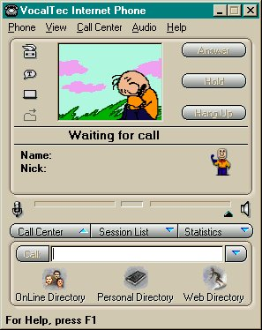
First Internet phone, Vocaltec, 1995
Notes:
The first program for voice conversation on the Internet was created by Vocaltec, an Israeli company.
As with the ISI confernceing system, only one person could talk at a time.
The sound quality was relatively poor, but Vocaltec demonstrated the feasibility and ease of network conversation.

Slide 13
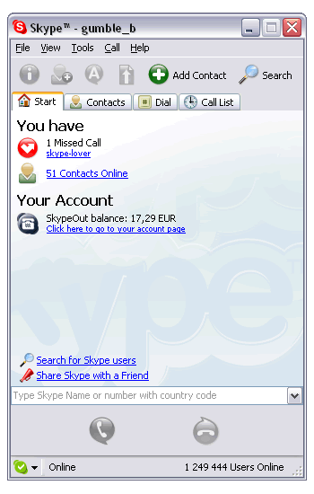
Internet conversation goes commercial, 2003
Notes:
Hardware capability improved, making relatively high quality voice conversation possible.
Voice over the Internet went mainstream when Skype became available in 2003.
Only two people could talk at first, but they could talk at the same time.
Skype also provided an online directory of user names.

Slide 14
Audio applications
Music
Conversation
Speech recognition, synthesis and translation

Slide 15
The future of speech editing
Text to speech
Voice mimicking
This experimental system makes speech editing a snap, but it also makes creating fake speech a snap.
Video

Slide 16
Text to speech and speech to text, with translation
Video
Are there times when this would be good enough? Do you use text translation software now?

Slide 17
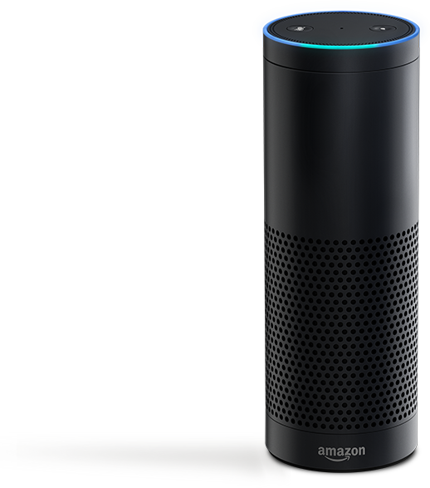
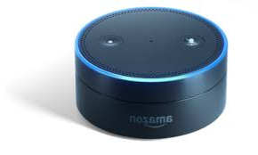
Speech interaction is becoming mainstream
Do you type or speak to your phone?
Do you talk to your car?
Do you have a speech recognition appliance in your home?
Notes:
I want a Kindle killer

Slide 18
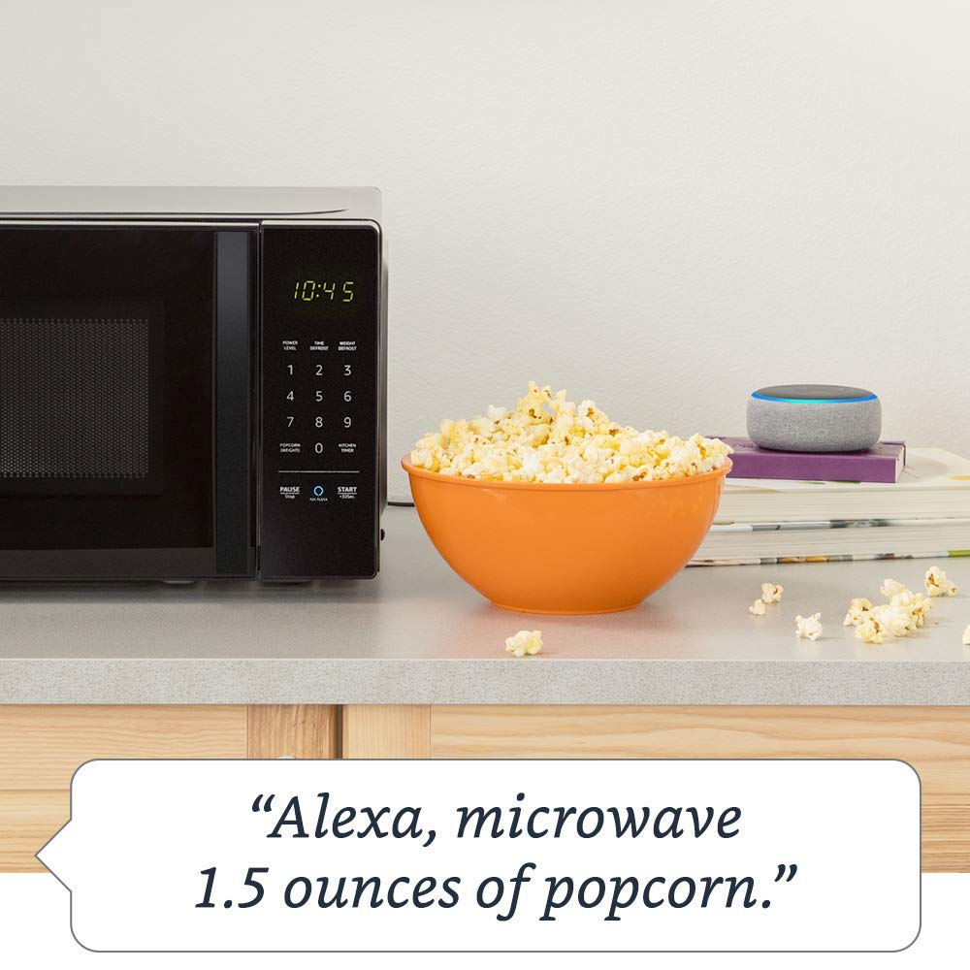
Speech interaction is being integrated into many devices
Kindle killer

Slide 19
Popular audio formats
WAV – usually uncompressed, large files
MP3 – compressed, variable size files
OGG – public domain
Notes:
As with text, images or any other type of data, a standard encoding scheme is needed to make sense of the data bits.
MP3 is the most popular audio format, but there are many others.
MP3 audio can be compressed.
The more the data is compressed, the lower the sound quality.
WAV is a popular format that is usually not compressed so the files are large.

Slide 20
Word processing operations
Select text
Cut text
Copy text
Move text
Delete text
Change fonts
Change text size
Change text color
Change footnote style
Check spelling
Compress a text file
Etc. etc.
These are word processing operations. Can you think of some audio processing operations?
Notes:
You are familiar with these word processing operations – operations on text data.
What sorts of things would you like to be able to do when working on image data?

Slide 21
Word and audio processing operations
Text data
Audio data
Select text
Cut text
Copy text
Move text
Delete text
Change fonts
Change text size
Change text color
Change footnote style
Check spelling
Compress a text file
Etc. etc.
Select sound
Cut sound
Copy sound
Move sound
Increase/decrease volume
Increase/decrease pitch
Increase/decrease speed
Fade in/out
Combine multiple tracks
Add echo
Add reverberation
Compress an audio file
Etc. etc.
Notes:
You are familiar with word processing operations, but may not be familiar with audio processing operations.
As you see here, some are analogous to familiar word processing operations.
To learn them, you will have to spend time experimenting with an audio processing program.

Slide 22
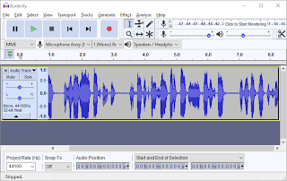
Audacity – the audio editor we will use
Open source for Linux, Windows and Macintosh
Audacity home page
Download the program
Documentation
Integrated help
Notes:
We will use Audacity, a popular audio processing program.
Using Audacity we can capture, edit and compress audio.
It is an open source program that was initially created by audio researchers at Carnegie Mellon University,
There are versions for Linux, Windows and the Macintosh operating systems.

Slide 23
Pause for a short demo

Slide 24
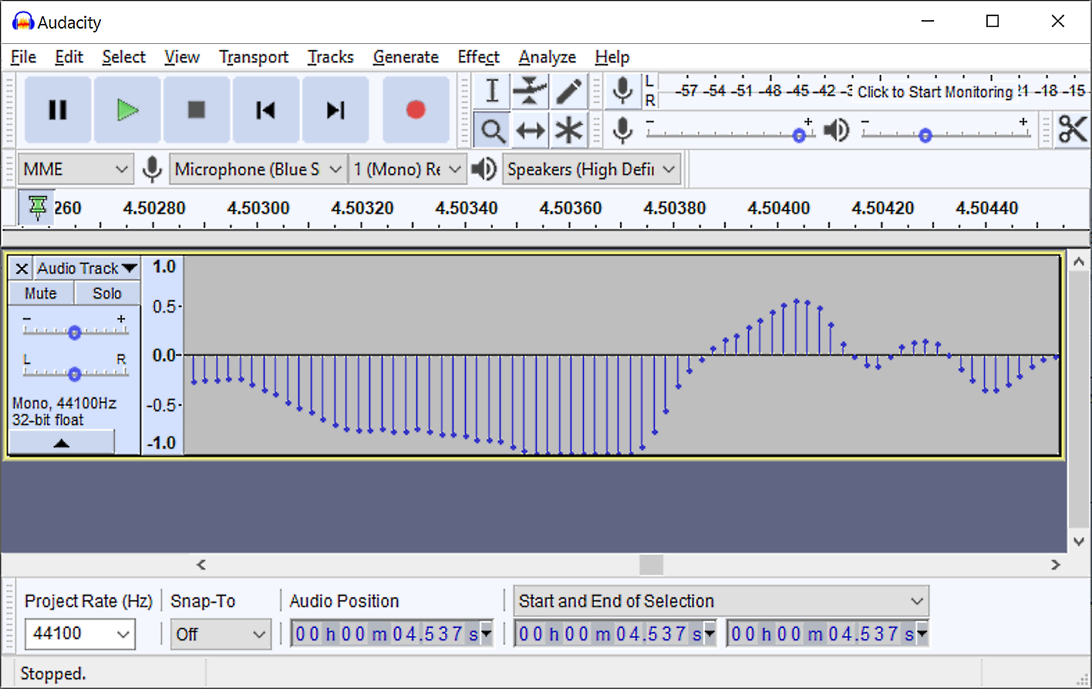
Zoom in
Time
Record mode

Slide 25
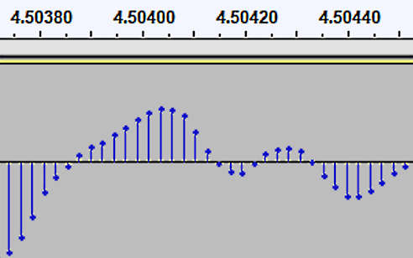
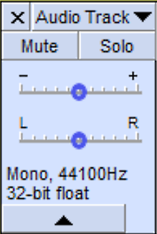
Time in seconds
44,100 samples per second
35 samples

Slide 26
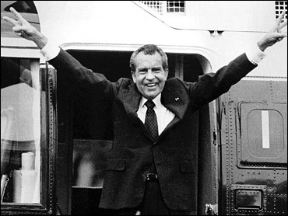
Audio editing example
Before
After
How did I do this?

Slide 27
Audio processing work flow
Capture
Edit
Compress
Distribute
Notes:
I will close with this audio processing work flow.
You begin by capturing audio – either importing it or recording it.
Capture as high a quality recording as you can.
In other words, capture as much information as you can.
Don’t worry about file size – you will eventually compress it before distribution.
Next use audio editing program to modify it to suit your application – perhaps editing out unwanted material, leveling the volume, adding a sound track, etc.
The last step before distributing the file is compression – making the file as small as you can while maintaining the sound quality your application requires.
The final step is distribution – include it in a report or presentation, post it on the Web, email it, and so forth.
The same work flow – capture, edit, compress and distribute -- applies when working with images or video data.
This is a fundamental slide – you should be sure you understand it.

Slide 28
Summary
Notes:
We’ve reviewed the history of digital audio – covering music, speech and speech-text hybrid applications.
We noted two popular audio formats and introduced the Audacity audio processing program which is able to capture, edit and compress audio data.

Slide 29
Self-study questions
We discussed three types of audio application – without looking back, what were they?
We discussed two types of hybrid application involving both speech and text – what were they?
If you listen to Internet music, do you download it or stream it?
What are the pros and cons of downloading versus streaming music?
Will future technology make downloading more or less attractive compared to streaming?

Slide 30
Resources
Audacity audio recorder and editor:
http://audacity.sourceforge.net/download/
Audacity audio recorder and editor, portable version:
http://portableapps.com/apps/music_video/audacity_portable
Audacity "how to" videos:
http://www.wonderhowto.com/search/audacity
Neil Young on the need for higher quality music audio:
http://www.wired.com/gadgetlab/2012/02/why-neil-young-hates-mp3-and-what-you-can-do-about-it/
Microsoft translation presentation with 7 minute video:
http://blogs.microsoft.com/blog/2014/05/27/microsoft-demos-breakthrough-in-real-time-translated-conversations/
Microsoft translation research:
http://research.microsoft.com/en-us/news/features/translator-052714.aspx

