Slide 1
Background survey
Skills: none
Concepts: Student’s background, topics covered
This work is licensed under a Creative Commons Attribution-Noncommercial-Share Alike 3.0 License.
Notes:
This presentation summarizes your answers to the background.
It will help you see how your background compares to that of the rest of the class.

Slide 2
Where does this topic fit?
Internet concepts
Applications
Technology
Implications
Internet skills
Application development
Content creation
User skills
Notes:
This presentation is about the class itself.
We surveyed covered our skill levels and the applications we use.
We also looked at connectivity – where we connect from and how we connect.

Slide 3
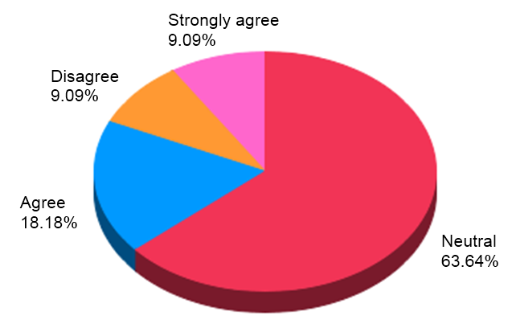
Previous experience
Neutral | 21
Agree | 6
Disagree | 3
Strongly agree | 3
I have more PC and Internet experience than the typical student
Notes:
Most people feel they are typical, and no one sees themselves as being far behind the typical student.
Note that there were 33 responses.

Slide 4
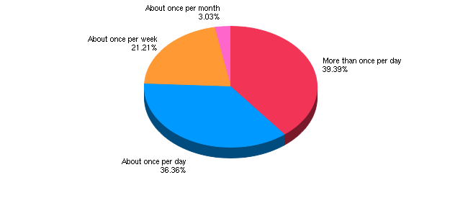
Email frequency
How often do you check and send email?
Notes:
You will need to check your email at least once a day while taking this class.
Do you use instant messaging and Facebook more than email?

Slide 5
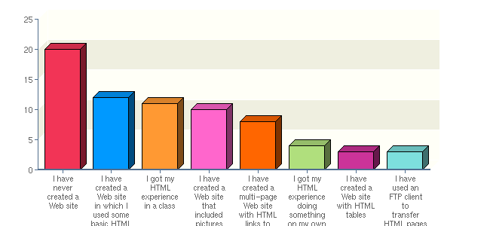
HTML experience
What is your experience creating Web sites and using HTML?
Notes:
There are many people who can help those with no experience.

Slide 6
Image processing experience
I have taken pictures using a digital camera that was not in a phone | 25 | 75.76%
I have done simple image processing like cropping and resizing pictures | 24 | 72.73%
I have taken pictures using the camera in my phone | 23 | 69.70%
I have drawn pictures, diagrams, etc. using a computer | 15 | 45.45%
I have compressed images | 13 | 39.39%
I got my image processing experience doing something on my own | 12 | 36.36%
I got my image processing experience in a class | 5 | 15.15%
I have no experience creating or processing images | 5 | 15.15%
I have created multi layer images | 3 | 9.09%
I got my image processing experience at work | 2 | 6.06%
What is your experience creating, editing and digital images?
Notes:
We will cover image processing basics.

Slide 7
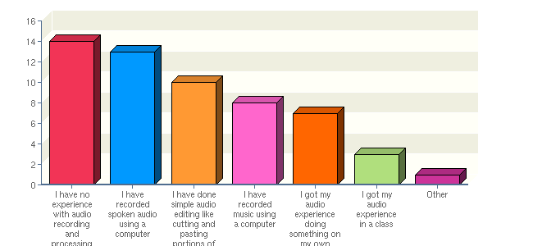
Audio processing experience
What is your experience with audio recording and processing?
Notes:
We will cover audio processing basics.

Slide 8
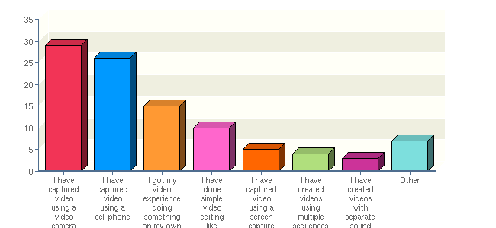
Video processing experience
What is your experience with video recording and processing?
Notes:
If we have time, we will do some video processing.
The paradigm is similar to audio processing – you edit on a timeline.

Slide 9
Experience with blogs
I have commented on blog posts | 22 | 66.67%
I have no experience with blogs | 10 | 30.30%
I regularly read at least one blog | 8 | 24.24%
I got my blog experience doing something on my own | 7 | 21.21%
I have created a blog in a class or as an experiment, but do not regularly post contributions | 6 | 18.18%
I got my blog experience in a class | 4 | 12.12%
I comment on blog posts more than once per month | 3 | 9.09%
I have one or more blog subscriptions that notify me of new posts via email | 2 | 6.06%
I got my blog experience at work | 1 | 3.03%
I have a blog to which I post regularly | 1 | 3.03%
I subscribe to one or more blogs using an RSS reader | 1 | 3.03%
What is your experience with blogs?
Notes:
You will create blogs.

Slide 10
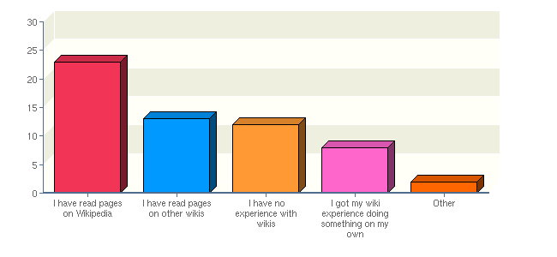
Experience with wikis
What is your experience with wikis?
Notes:
You will create wikis.

Slide 11
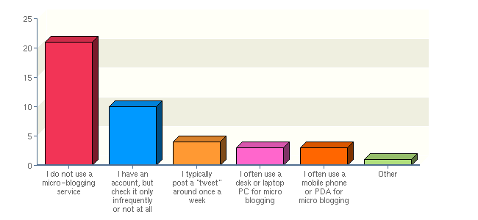
Experience with micro blogs
What is your experience with micro-blogging services like Twitter?
Notes:
You will create a Twitter feed.

Slide 12
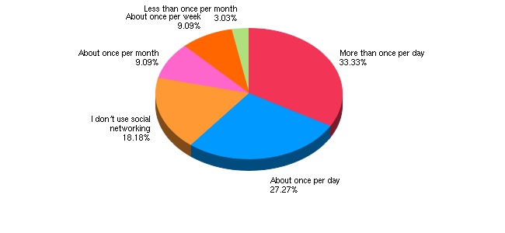
Social network experience
If you use a social networking site like Facebook or MySpace, how often do you check it and post things?
Notes:
Is Facebook replacing email in your daily life?
Do you use it professionally, for your personal life or for both?

Slide 13
Experience with other Internet services
I have not used any other Internet services | 24 | 72.73%
I have completed other Internet questionnaires like this one | 20 | 60.61%
I have created at least one Internet questionnaire | 12 | 36.36%
I have used a mapping program like Google maps | 8 | 24.24%
I have used an Internet bookmark sharing service like Delicious | 5 | 15.15%
I have used an Internet word processing service like Google Docs | 5 | 15.15%
I have used an Internet spreadsheet service like Google Spreadsheets | 5 | 15.15%
Other | 6 | 18.18%
What other Internet services you have used?
Notes:
There are many kinds of service on the Internet – we will use these too.

Slide 14
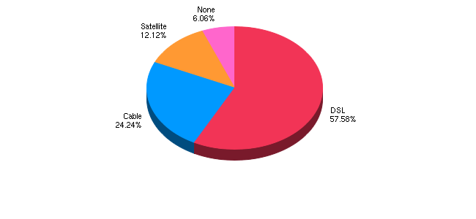
Home connectivity
What sort of Internet connectivity do you have at home?
Notes:
The future will be fiber, but it will take a long time before we all have it.

Slide 15
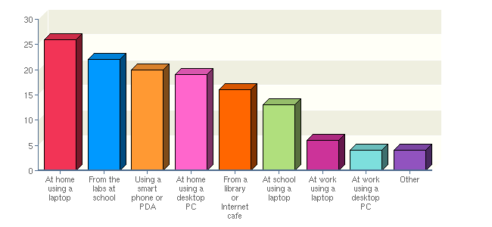
Internet access
How do you access the Internet?
Notes:
Many people access the Internet from more than one place and one computer.
Data and programs that are stored online are accessible from everywhere.
You can also get away with a less capable client device in some cases.

Slide 16
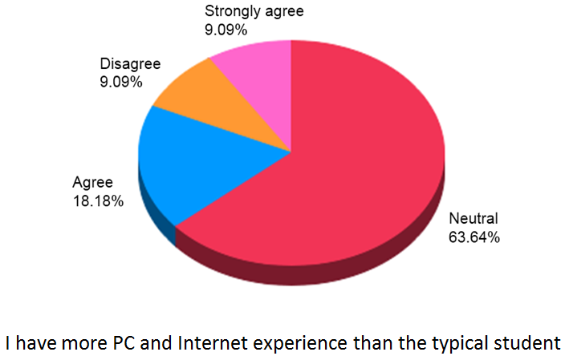
Summary
Notes:
The main purpose of this exercise was to let you see how your experience compares to that of your class mates.
In doing so, we also enumerated some of the topics we will be covering.

Slide 17
Self-study questions
In which topic areas are you best prepared for this class?
Do you plan to help others with those topics?
What are your weak spots?
How do you plan to compensate for those – where can you turn for help?

Slide 18
Resources
Full survey results:
http://app.sgizmo.com/reports/56627/522009/7X6VQEI36Z8PX0T3761MHUR34KYHHL/?ts=1297064758

