Slide 1
User interfaces (with Blogger as an example)
Skills: modifying and navigating a Blogger blog
Concepts: wire-frame diagram, profile, gadget (widget), property sheet, tabbed navigation scheme
Obsolete – blogger2.pptx
This work is licensed under a Creative Commons Attribution-Noncommercial-Share Alike 3.0 License.
Notes:
This presentation uses Blogger to illustrate wire-frame diagrams, profiles, gadgets (or as they are more commonly called widgets) and their property sheets, and a tabbed menu-navigation scheme.
My intent is to get you thinking about user interfaces and menu navigation schemes.

Slide 2
Where does this topic fit?
Internet concepts
Applications
Technology
Implications
Internet skills
Application development
Content creation
User skills
Notes:
We are using Blogger as an example, but the concepts we present are commonly found in application programs and services.
In addition to presenting those concepts, the presentation shows you how to alter the user interface.

Slide 3
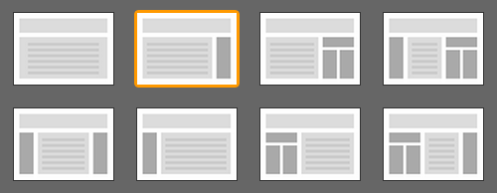
Typical blog user interfaces
P
P
P
P
P
P
P
P
Notes:
These are typical one, two, three and four column user interfaces.
The body of the post is in the area marked “p,” and ancillary information is displayed on the sides.
The two-column layout of our class blog is highlighted.

Slide 4
A two column interface
Post title and date
Post body
Additional
information
Footer
Notes:
This wire frame diagram shows the basic structure of the user interface of our class blog.
The body of the post is on the left, additional information is in the column on the right and there is a header and footer.
We use wire-frame diagrams in designing Web pages.
The screen “real estate” is limited, so one must plan carefully.
You can also use a wire-frame diagram when learning a new program.
After working with it for a little while, try drawing up its wire frame diagram showing how each portion of the screen is used.

Slide 5
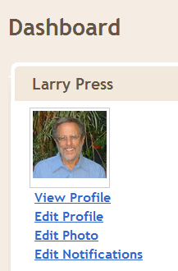
The link to your profile is on your Blogger dashboard
Notes:
You can create a Blogger profile including a photograph of yourself.
You should do so because the photo and profile engage users.
Readers are curious about the authors of the blogs they read.
You can also establish your professional qualifications in the profile.
Many services allow you to create a profile, and that leads to duplicate work and inconsistency.
One day we will have master profiles which any service we authorize can link to.
Companies like MicroSoft, Facebook and Google would both like to be the keeper of your master profile.

Slide 6
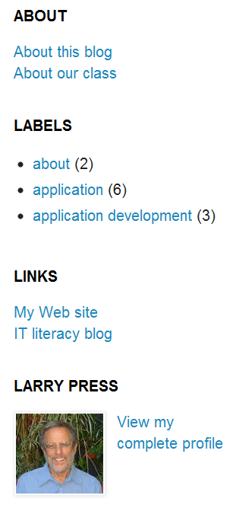
Gadgets on the right hand side of the Topic Module blog
Notes:
One can often extend the user interface of an application by adding gadgets or as they are often called widgets.
Taking our topic module blog as an example, we see four gadgets in the right-hand column.
If you have not played around with them, you should pause and do so now,
Let’s look at the way the gadgets were added to the page.

Slide 7
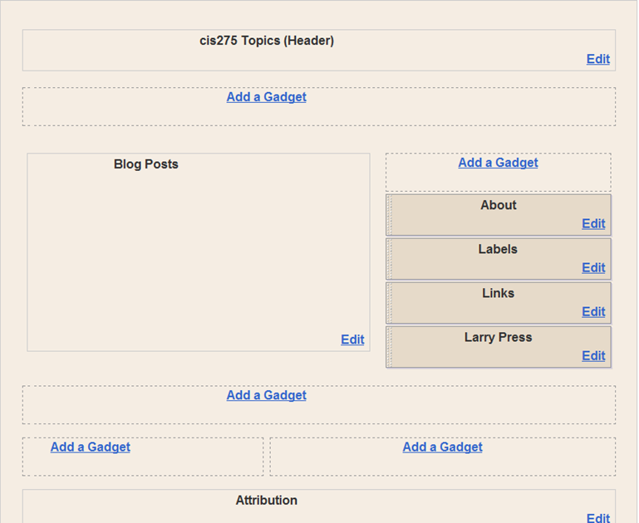
Add gadgets to a user interface
Notes:
If you go to blogger.com and click on Page Elements under the Design tab, you will see a wire frame diagram of the page.
This one is for our Topic Module blog.
In the shaded area, you see four entries that correspond to the four gadgets in the right hand column.
Blogger comes with a gadget library, which opens when you click on Add a Gadget .
You then chose the type of gadget you want to install and it will open a property box,
You set the properties to the values you wish and save them to create the gadget.
I added four gadgets to the user interface – let’s quickly look at each.

Slide 8
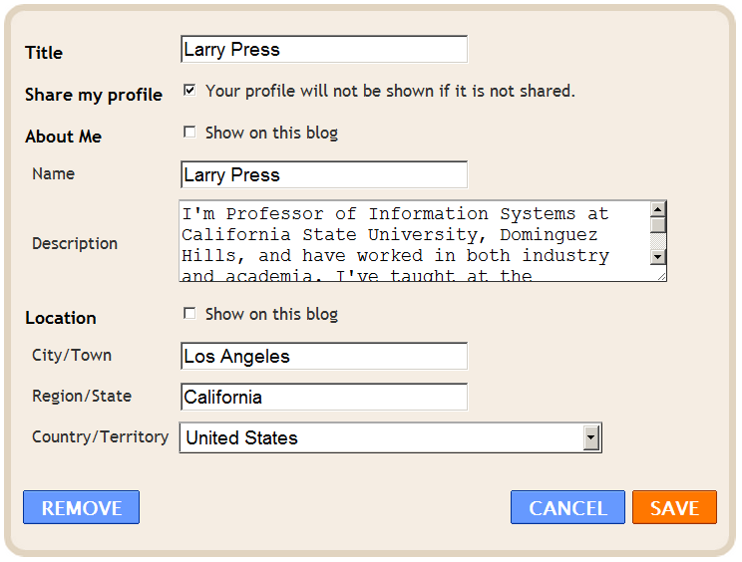
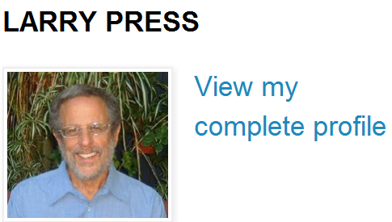
Profile gadget
Notes:
The Profile gadget causes my photo and a link to my complete profile to appear on the right hand side.
The property sheet shown here governs what will be displayed and the format.
For example, my name appears at the top of the gadget.
The property sheet contains fields for location and description, but these are not displayed because I did not check About Me and Location check boxes.
If I check them and save the property sheet, the display format will change.

Slide 9
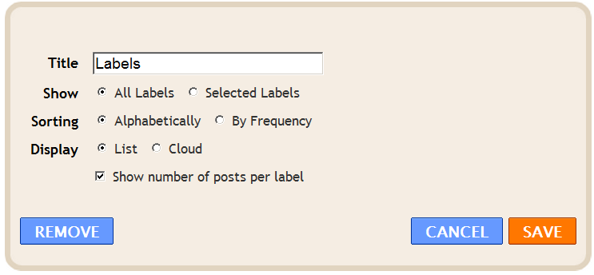
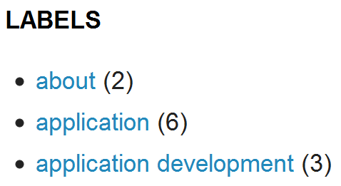
Label gadget
Notes:
The Label gadget lists the labels I have assigned to posts, and creates links to the posts that are tagged with a given label.
Again, I could change the gadget’s appearance by changing its property sheet.

Slide 10
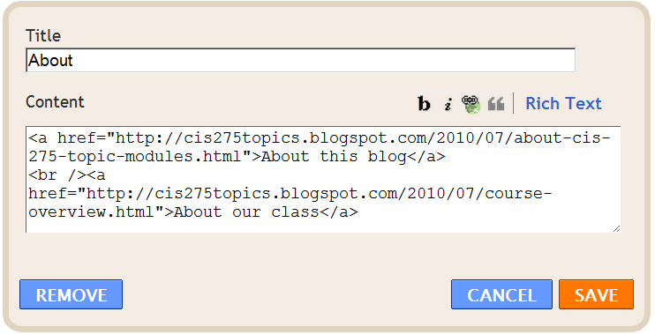
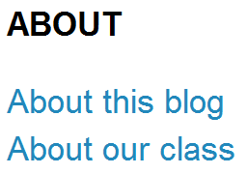
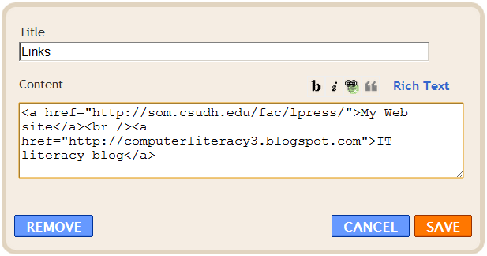
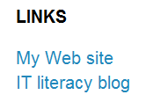
HTML/JavaScript gadgets
Notes:
The About and Links gadgets are both the same type of object, HTML/JavaScripts.
Each contains links to other Web pages.
They are coded in HTML, the Web’s Hypertext Markup Language.
HTML will be introduced in other presentations.
But if you pause the presentation, I bet you can figure them out.

Slide 11
Tabbed navigation scheme
Notes:
When you come to a new Web site or program, think about its command navigations scheme.
Blogger has a tabbed navigation scheme.
Each tab leads to a submenu.
The submenu choices, in this case New Post, Edit Posts and Edit Pages, are shown in the grey area below the tabs.
You can get an overview of the program by clicking on each tab and checking out the submenu commands.
You can move back and forth between them whenever you wish.
That makes Blogger and other programs with tabbed interfaces easy to learn and explore.

Slide 12
Summary
Post title and date
Post body
Additional
information
Footer
Notes:
We’ve looked at aspects of a user interface – wire-frame diagrams, profiles, gadgets and a tabbed menu-navigation scheme.
The purpose of the presentation was to get you thinking about user interfaces.
Pause, experiment with and think about the user interface of any site you plan to use fairly regularly – it will save you time in the long run.

Slide 13
Questions
What are the second level navigation choices under the Stats tag?
What is the effect of clicking Cloud or Label on the property sheet of the Labels gadget?
What happens if you uncheck About Me on the property sheet of the Profile gadget?
Explain the parallel between a person’s profile and a property sheet.

