Slide 1
Connecting the dots between Cambridge Analytica, the Mercers, Brexit and the US and Kenyan presidential elections
This work is licensed under a Creative Commons Attribution-Noncommercial-Share Alike 3.0 License.

Slide 2
Cambridge Analytica gathers and analyzes data to micro-target ads.
They claim to have been responsible for Ted Cruz’s Iowa surge during the 2016 Republican primary.
They claim to have demographic and psychological profiles of every American adult.
Billionaire Robert Mercer and his daughter Rebekah are financial supporters of Cambridge Analytica and Breitbart News.
Steve Bannon and Kellyanne Comway were advisors to the Mercers.
Cambridge Analytics worked on the Brexit, Trump and Kenyan election campaigns.
The Kenyan election was invalidated by the Kenyan Supreme Court.
Hillary Clinton suggests that hiring Bannon and Conway may have been tied to getting help from Cambridge Analytica.
Russians hacked Democratic accounts and Wikileaks disseminated the material they obtained.
The dots

Slide 3
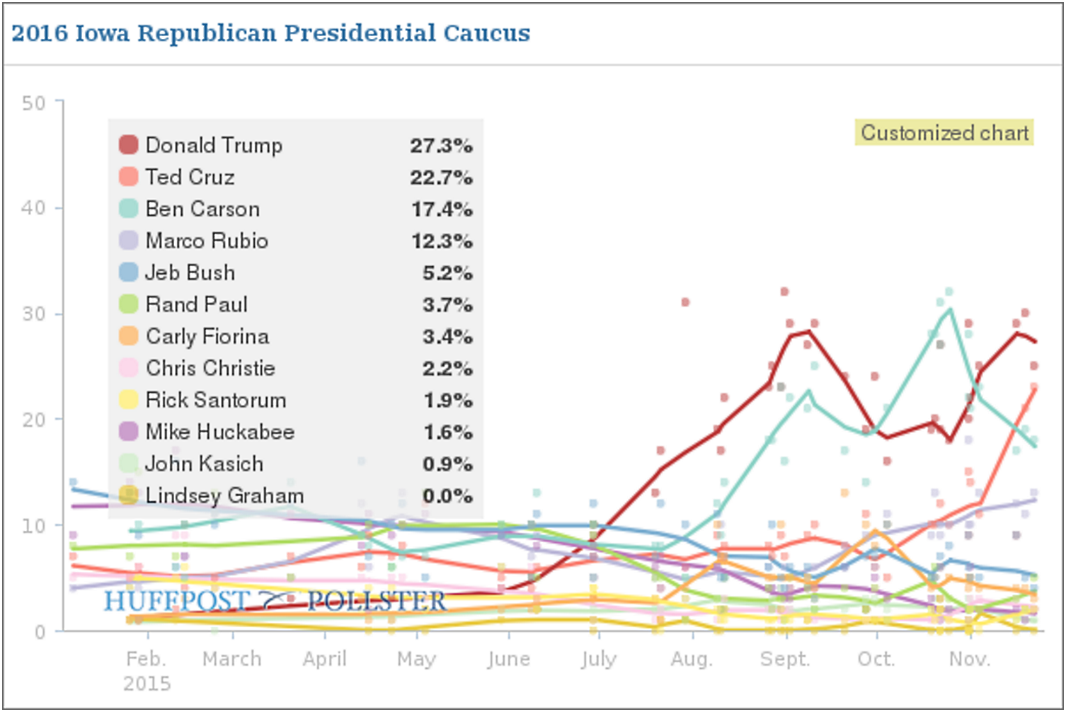
Cambridge Analytica micro-targeted ads
Demographics: age, education, sex, …
Psychographics: interests, opinions, values, …
Five personality traits: openness to experience, conscientiousness, extraversion, agreeableness, and neuroticism
Send the strong terrorism ad to a 64 year old, gun-owning medium-neurotic.
Claiming credit for Cruz Iowa gain, Source
How do they gather the information?
https://motherboard.vice.com/en_us/article/how-our-likes-helped-trump-win
Notes:
Cambridge Analytica targets ads using demographics, psychographics and personality traits. They say personality traits differentiate them from other Internet ad services.

Slide 4
“We have profiled the personality of every adult in the United States of America—220 million people.”
Source
“We are thrilled that our revolutionary approach to data-driven communications played such an integral part in President-elect Donald Trump’s extraordinary win.”
Source
Nix speech (11 min)
Do we want technique and data to determine our political leaders? Would they work for a Democrat?
Notes:
Cambridge Analytica CEO Alexamder Nix took credit for Ted Cruz’s surge in Iowa and explained their technology and data in this video.
The day after the election, he said they were “thrilled that their revolutionary approach to data-driven communication has played such an integral part in President-elect Trump's extraordinary win.”
While he claimed to have had a large role in the election, many disputed that claim: https://www.nytimes.com/2017/03/06/us/politics/cambridge-analytica.html?_r=1
I reached out to Cambridge Analytica, asking whether they would had or would accept a Democratic candidate, but did not receive a reply.

Slide 5
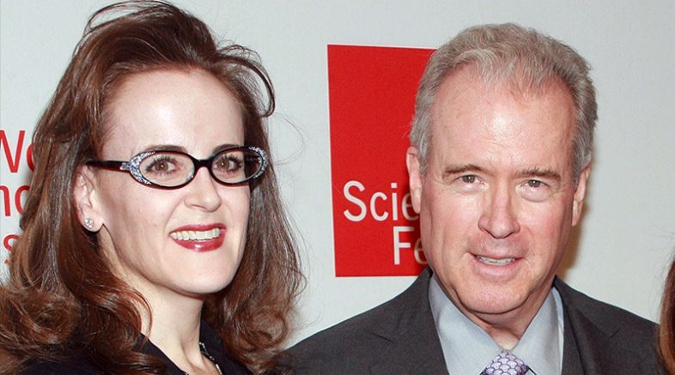
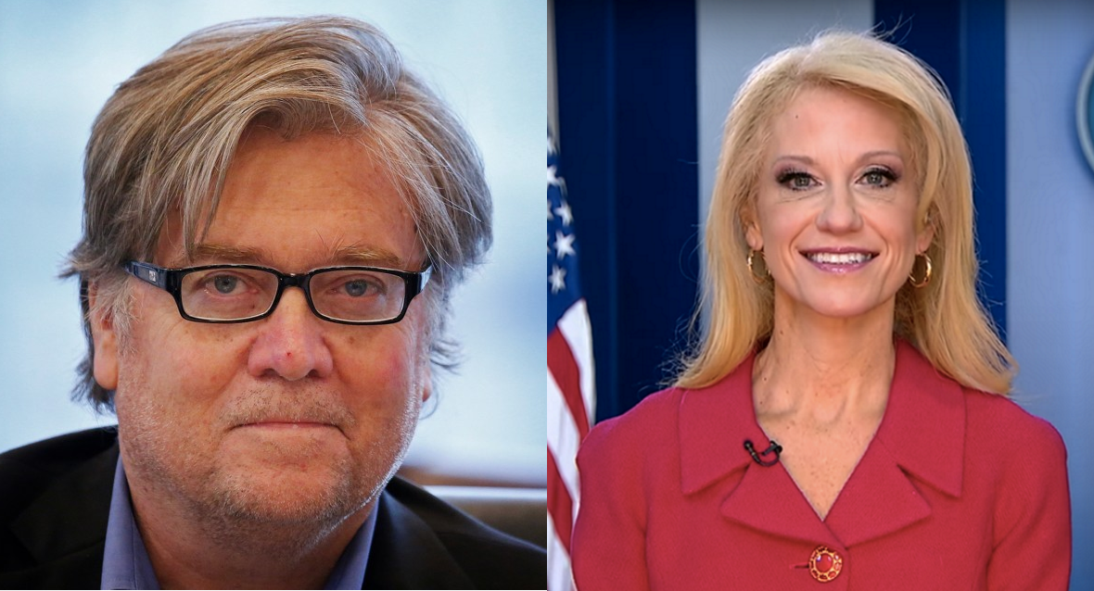
Who is running the show?
Robert Mercer-- $10 million to Breitbart News and $10 million to Cambridge Analytica
Rebekah Mercer -- quietly shaping Trump’s operation along with her father
Background and connections
Rebekah and Robert Mercer
Bannon and Conway were advisors to the Mercers.
Bannon ran Breitbart News.
Bannon and Conway are high-ranking Trump staff members.
Is Trump an easily maneuverable pawn?
Steve Bannon and Kellyanne Conway
Notes:
Podcast on Mercer:
http://www.newyorker.com/magazine/2017/03/27/the-reclusive-hedge-fund-tycoon-behind-the-trump-presidency?mbid=nl_TNY%20Template%20-%20With%20Photo%20(147)&CNDID=38756252&spMailingID=10643193&spUserID=MTMzMTg0NTA3NzYwS0&spJobID=1121383986&spReportId=MTEyMTM4Mzk4NgS2

Slide 6
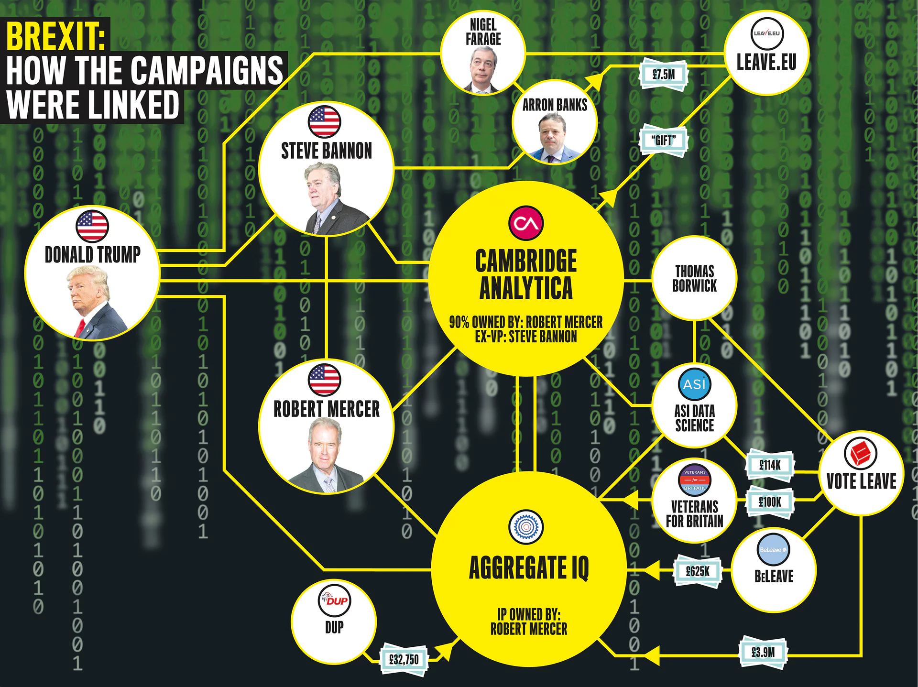
Brexit, Trump campaign links
Both used the same technology
Mercer backed both with hidden contributions
Source

Slide 7
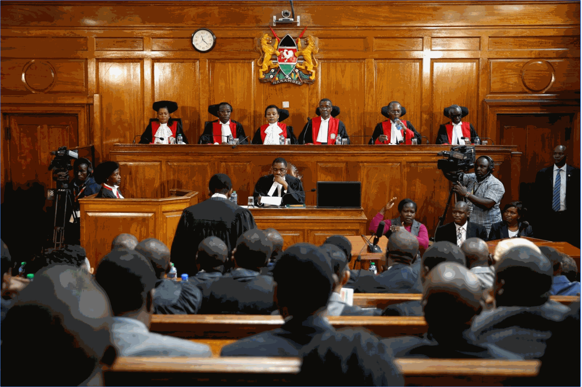
Cambridge Analytica worked on the Brexit, US and Kenyan elections
Kenyan Supreme Court overturns election
Cambridge Analytica worked on the Kenyan campaign
Hillary Clinton tentatively connects the dots
The court did not cite Cambridge Analytica in their decision – no “smoking gun.”
The Kenyan Supreme Court
Source

Slide 8
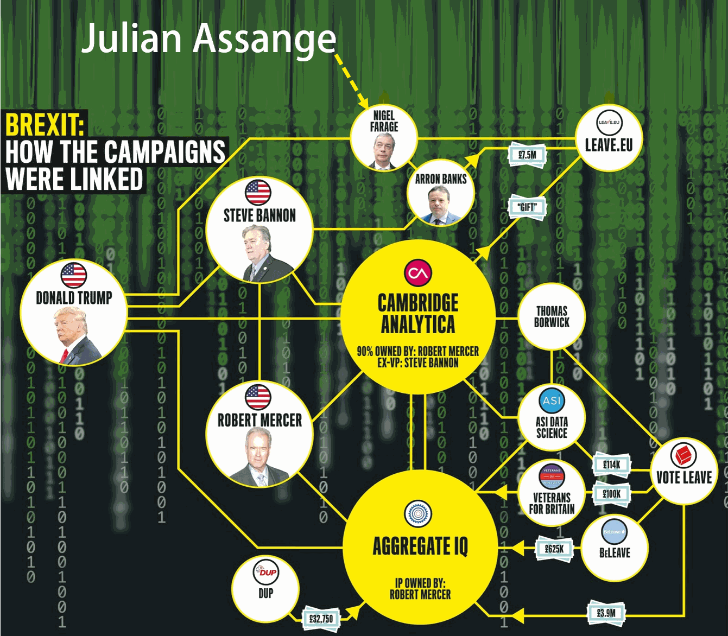
Wikileaks’ role
Brexit leader Nigel Farage, is a person of interest in the FBI investigation into Trump and Russia.
Farage met with Wikileaks founder Julian Assange at the Ecuadorian embassy March 9, 2017.
Wikileaks published hacked emails of John Podesta and the Democratic National Committee.
Notes:
Reader Mari Christian pointed out that Brexit leader Nigel Farage, who is a person of interest in the FBI investigation into Trump and Russia, met with Wikileaks founder Julian Assange at the Ecuadorian embassy March 9, 2017. Farage said he visited Assange at the behest of LBC Radio “with a view to conducting an interview” and that he had never even been to Russia. Wikileaks released emails of the Democratic National Committee (https://wikileaks.org/dnc-emails/) and John Podesta (https://wikileaks.org/podesta-emails/).

Slide 9
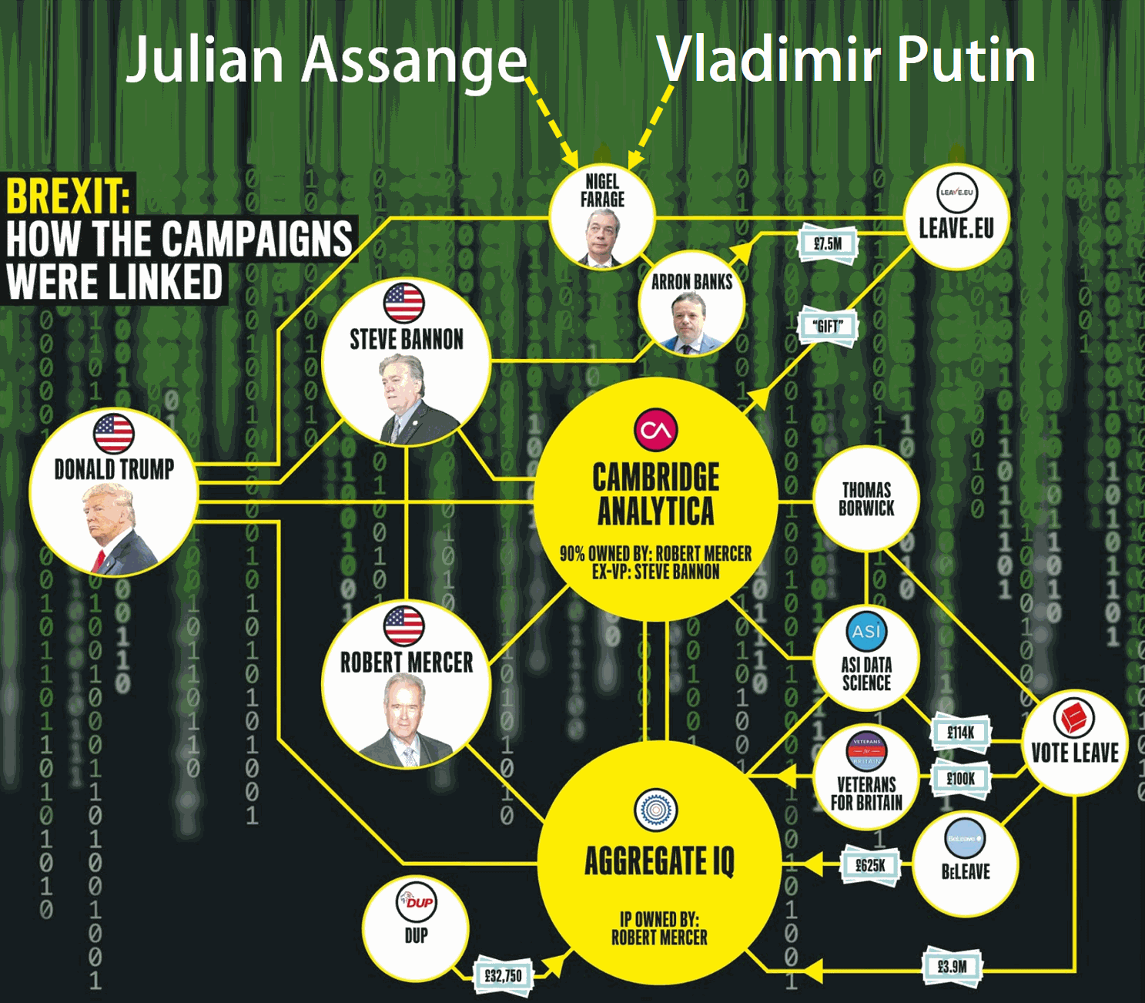
Russia’s role
Hacking the DNC and Podesta
Hacking states
Notes:
There is ample evidence that Russian Hackers were acquired the data that was published by Wikileaks, although it has not been proved that Putin or the Trump campaign were co-conspirators. There is a lot of evidence that Russians tried to influence our election – it remains to be seen whether the Trump campaign and/or Vladimir Putin were co-conspirators. Robert Mueller and congressional committees are investigating that allegation.

