Slide 1
Tools for communication and collaboration
(The Internet is the latest).
Skills: none
Concepts: pre Internet tools, key contributions to the development of the Internet, stages of invention (vision, engineering prototype, product, ubiquitous product), collaboration in other species
This work is licensed under a Creative Commons Attribution-Noncommercial-Share Alike 3.0 License.
Notes:
This will be a very high level survey of the evolution of collaboration tools from human language through the Internet.
It also highlights the contributions of a few people who were instrumental in the invention of the Internet.

Slide 2
Where does this topic fit?
Internet concepts
Applications
Technology (communication)
Implications
Internet skills
Application development
Content creation
User skills
Notes:
This presentation is on communication technology.

Slide 3
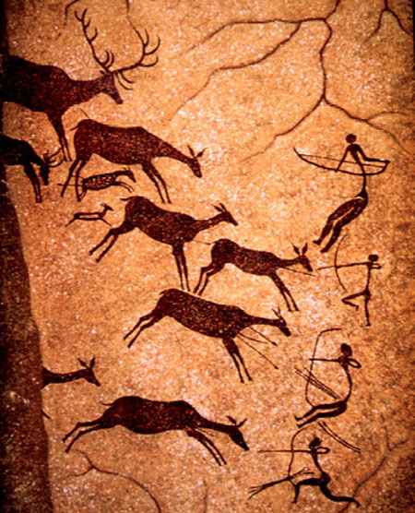
Lascaux Caves
15,000 years ago
What new tool did they use for communication and coordination?
Notes:
People have been collaborating since prehistoric times.
This painting from Lascaux Caves in southwestern France depicts cooperative hunting at least 15,000 years ago.
As you see, the people were using tools – bows and arrows.
But they used a more important tool, language, to coordinate their activity.

Slide 4
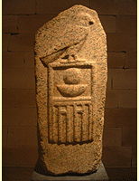
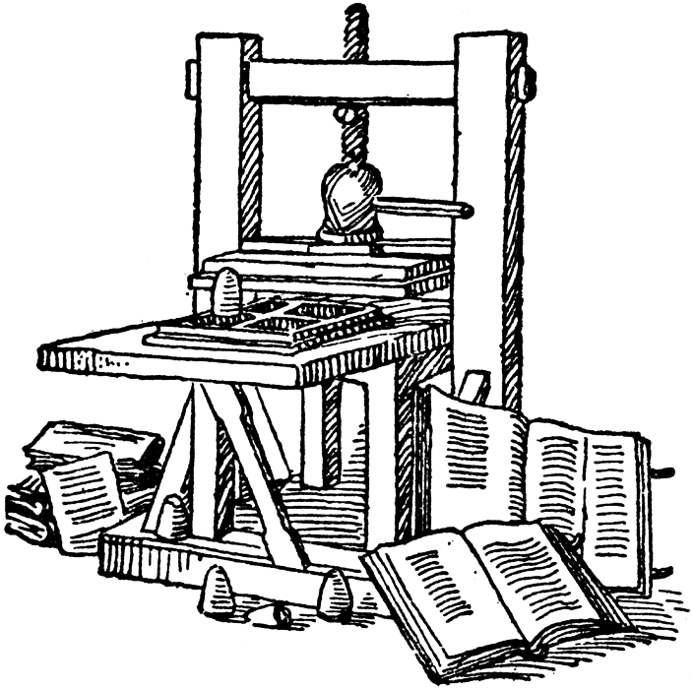
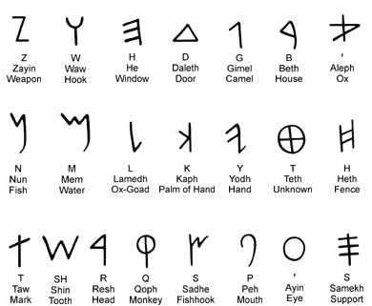
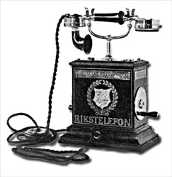
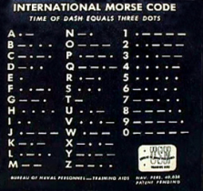
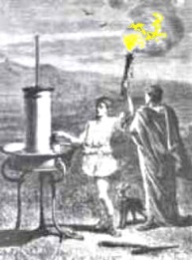
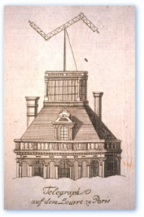
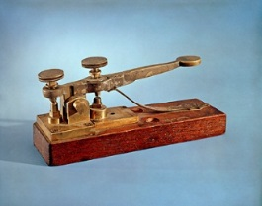
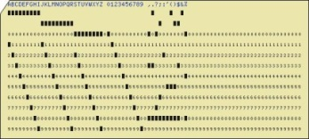
Can you identify these tools for communication and collaboration?
Notes:
Since that time, people have invented increasingly sophisticated tools for communication and collaboration, some of which are shown here.
Can you identify them?

Slide 5
Hieroglyphic writing
Phonetic writing
Gutenberg press
Telephone
Morse code
Greek torches
Chappe’s semaphore telegraph
Punch card storage
Electronic telegraph
Notes:
If you are curious about any of these technologies, you can find descriptions of them online – use Google search or check the Wikipedia.
The Internet is our latest tool for communication and collaboration – let’s look at a few key contributions which led to its invention and development.
As many inventions do, it started with a vision.
Vannevar Bush first envisioned a network to facilitate collaboration among scientists.

Slide 6
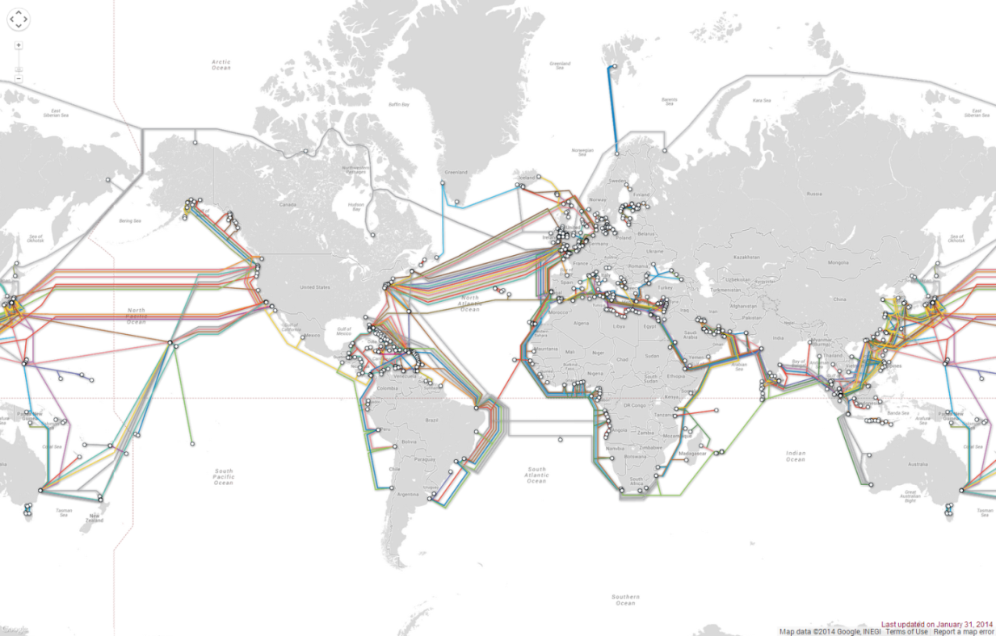
Our latest tool for collaboration -- the Internet
Vision … Research prototype … Useful tool … Ubiquitous tool
Can you identify these stages for other inventions, for example the airplane?
Notes:
Our latest invention for collaboration and communication is the Internet.
It was “invented” by many people, starting with a seemingly unrealistic , “science fiction” vision.
Next came research prototypes like the early work of Doug Engelbart.
An expensive tool used only by specialists – the ARPANET – came next and today we have a ubiquitous tool., the Internet.
Let’s take a quick look at each stage of the invention of the Internet and some of the key people – Vannevar Bush, Doug Engelbart and JCR Licklider.

Slide 7
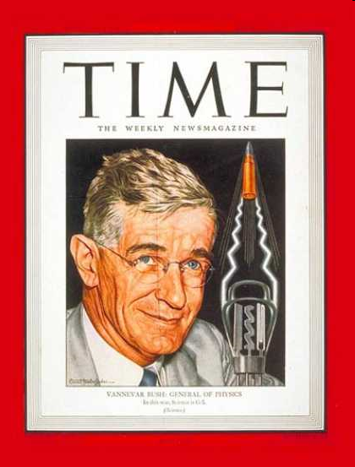
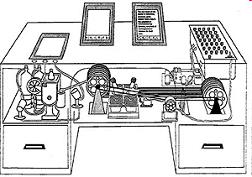
Vannevar Bush, the vision
Vannevar Bush
Artist’s conception of a “memex”
Notes:
Vannevar Bush, was an MIT professor and science advisor to President Roosevelt during World War II.
During the war, be began to think of ways to facilitate communication and collaboration among scientists.
After the war, he published an article entitled “As We May Think” in the Atlantic Monthly and it was reprinted in Life Magazine.
Both magazines were geared to the general public, not engineer and scientists.
In the article, Bush described a hypothetical machine he called a “memex.”
He predicted that future scientists would work at memex desks connected by a network.
He saw them publishing research results and linking their research papers to those of others.
The entire scientific community would be online and their publications linked.
Bush’s speculation about the technology that would be used was wrong – he thought it might be based on microfilm – but his vision was prophetic.

Slide 8
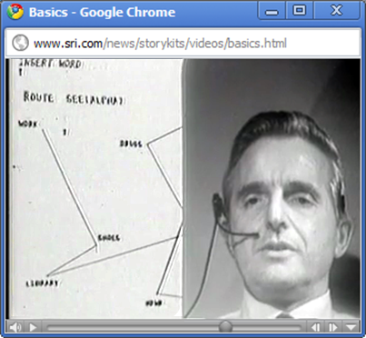
Doug Engelbart, the research prototype
The mouse
Hyperlinks
Video conferencing
WYSIWYG word processor
Multi-window user interface
Shared documents
Shared database
Documents with images & text
Keyword search
Instant messaging
Synchronous collaboration
Asynchronous collaboration
Chord keyboard
Notes:
Doug Engelbart read Bush’s article and, after being discharged from the Navy, decided to devote his career to implementing Bush’s vision.
He returned to school and by the time he finished his PhD in electrical engineering he realized that a recently invented machine – the computer – could be used to achieve Bush’s vision.
During the 1960s, Engelbart and his colleagues at the Stanford Research Institute built prototypes of many of the tools we use today, including linked documents, which are central to the Web.
This photo shows Engelbart during a famous 1968 demonstration at a computer science conference.
In this presentation, Engelbart unveiled inventions like the mouse, a user interface with windows, word processing in which documents were formatted on the screen the same way they would be formatted when printed, shared databases, synchronous and asynchronous collaboration, and more.
Known simply as The Demo, it inspired the work of the inventors of the personal computer and the inventors of the Internet.
Note that research is risky and often leads to failure.
Some of Engelbart’s inventions, like the chord keyboard he used in The Demo never caught on.

Slide 9
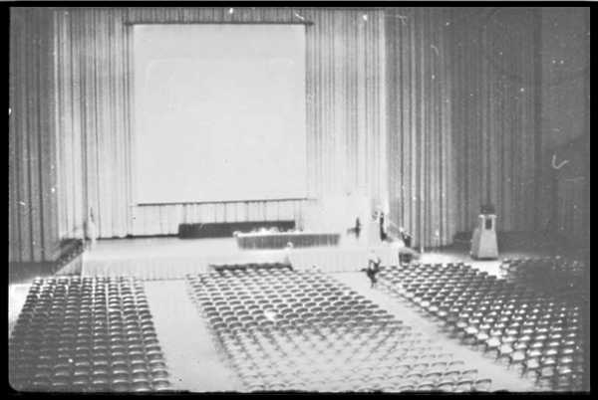
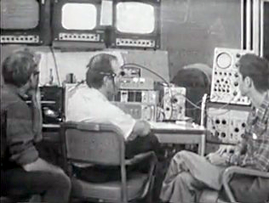
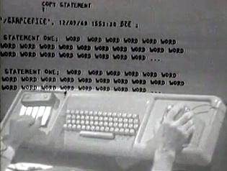
The Demo, 1968
http://bit.ly/SQx8VX
Clip 2: Vision of the future
Clip 3: Word processing
Clip 8: Graphics
Clip 12: Mouse
Clip 25, 26: Collaboration and windowed user interface
Notes:
Pause the presentation and watch these videos.
In addition to showing snippets of Engelbart’s pioneering work, they will give you an idea of the nature of a research prototype.
The hardware and software seem simple by today’s standards.
For example, the mouse is large and not as precise as today’s mice, and the keyboard and display are upper-case only.
But, once something is invented, people quickly improve on it and find interesting ways to use it.
The Demo was done in San Francisco, in the auditorium shown above.
The computer used in The Demo was back at Doug’s lab in Menlo Park, about 30 miles away.
The third photo shows the chord keyset, keyboard and mouse as Doug used them during The Demo.
The audience could see what he was typing as well as his hands.

Slide 10
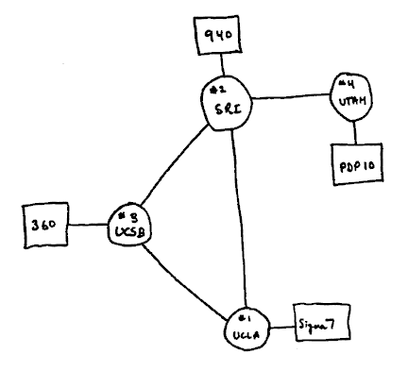
ARPANET
1969
Notes:
This is an historic sketch of the plan for the first 4-node ARPA net.
It grew rapidly into a nationwide research and development network.
The Internet was invented to connect the ARPANET with other experimental networks.

Slide 11
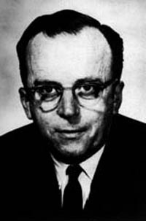
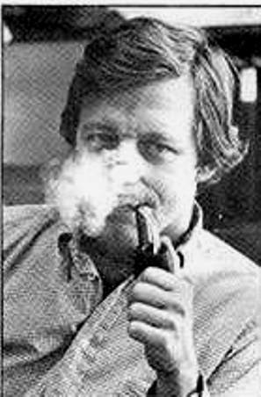
In a few years, men will be able to communicate more effectively through a machine than face to face.
What will on-line interactive communities be like? ... They will be communities not of common location, but of common interest.
Licklider and Taylor, 1968
JCR Licklider
Robert Taylor
Notes:
JCR Licklider was instrumental in funding the research by Engelbart’s research while he served as the head of the Information Processing Technology Office of the Advanced Research Projects Agency (ARPA) of the Department of Defense.
Robert Taylor succeeded Licklider at ARPA and went on to found and direct the Xerox Palo Alto Research Center, where the modern personal computer, portable computer, Ethernet local area network, laser printer and client-server computing were invented.
They also embraced Bush’s dream of a scientific network and described its use in a widely read paper – “The Computer as a Communication Device.”
Licklider allocated the funding of the research and development of ARPANET

Slide 12
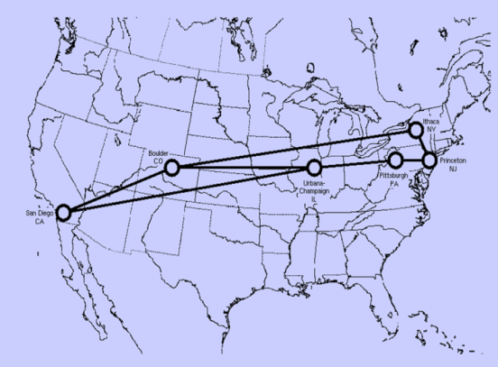
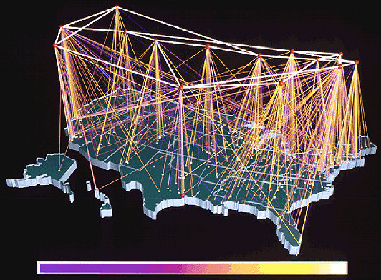
NSFNet – the start of ubiquity
1986
1991
Today
Notes:
The US National Science Foundation funded a network to US universities as well as education and research networks from other nations.
NSF support was later phased out and the commercial Internet was born.

Slide 13
Musicians collaborating
Over 75 Cubans around the world singing Guantanamera
Can you find other examples of collaboration using the Internet?
Notes:
The Internet was envisioned and built by researchers who saw it as a tool to facilitate collaboration among scientists and engineers. Bush and Engelbart were thinking of tools they themselves could use to facilitate their own work, to “scratch their own itch” or as the geek saying goes they wanted to “eat their own dogfood.”
https://en.wikipedia.org/wiki/Eating_your_own_dog_food
https://en.wikipedia.org/wiki/The_Cathedral_and_the_Bazaar (See lesson 1).
Of course, they understood other sorts of collaboration would be valuable – see Licklider’s quote about communities of common interest, above.
The Internet has indeed fostered collaboration in many areas – this slide illustrates one that I bet didn’t occur to licklider.
https://youtu.be/blUSVALW_Z4

Slide 14
Humpback whales’ use of spoken language
Humpback whales hunting (2:09)
Notes:
We have seen a few key collaboration tools, beginning 15,000 years ago with spoken language and ending with the Internet today.
Like early man, humpback whales use language to coordinate their hunting.
The pod spots schools of herring then dives below them, forming a circle.
They gather below the herring in a circle, blow bubbles that trap the herring in a “bubble net” and, upon a signal from their leader, race to the surface creating a large bubble which propels the herring into the air.
The whales catch herring in their open mouths as they fall back toward the sea.
The whales use sound to coordinate the hunt.
I wonder what whales will be up to in 15,000 years.

Slide 15
Summary
Notes:
We have seen the evolution of collaboration tools from language to the Internet and recognized a few of the people who were instrumental in the invention of the Internet.

Slide 16
Self-study questions
Research and briefly describe each of the tools illustrated in slide 4.
We described the contributions of a number of Internet pioneers – it is not possible to credit any one of them as the sole inventor of the Internet. Samuel Morse is often credited with the invention of the telegraph – was he the sole inventor of the telegraph? (Explain)
We focused on the Internet as a general collaboration tool – what are some of the specific Internet applications we use for communication and collaboration?

Slide 17
Resources
Communication using torches in ancient Greece:
http://www.mlahanas.de/Greeks/Communication.htm
Chappe’s semaphore telegraph:
http://people.seas.harvard.edu/~jones/cscie129/images/history/chappe.html
About hunting by humpback whales:
http://www.kpbs.org/news/2012/feb/20/nature-ocean-giants-deep-thinkers/
The evolution of writing systems:
http://www.ancientscripts.com/
As we may think, Vannevar Bush, Atlantic Monthly, July 1945:
http://www.theatlantic.com/magazine/archive/1945/07/as-we-may-think/3881/
Licklider and Taylor: The Computer as a Communication Device, 1968.
http://memex.org/licklider.pdf
The Demo, Doug Engelbart:
http://sloan.stanford.edu/mousesite/1968Demo.html

