Slide 1
Computer components
Skills: none
Concepts: computer components (input devices, output devices, memory, storage and CPU), information flow between them, program files and data files, where the Internet fits, unit of measure for the amount of data (the byte), storage services, changing technology for the same function
This work is licensed under a Creative Commons Attribution-Noncommercial-Share Alike 3.0 License.
Notes:
This presentation centers on the functional components of a computer – input and output devices, memory, storage and the central processing unit or CPU.
We’ll see the function of each component and the information flows between them.
We’ll distinguish between program and data files and look note that many different technologies can be used for storage technology.

Slide 2
Where does this topic fit?
Internet concepts
Applications
Technology
Implications
Internet skills
Application development
Content creation
User skills
Notes:
The presentation falls within the technology concepts portion of the class.

Slide 3
Computer components
CPU
Input
devices
Memory
(programs and data)
Output
Devices
Storage devices
(programs and data)
Notes:
This diagram shows the functional components of a computer.
Nearly all computers from the largest supercomputer to your cell phone have these components.
While technology has changed radically since the first modern electronic computers of the late 1940s and 1950s, this basic functional architecture has remained the same.

Slide 4
Data transfer rates
CPU
About 13,000 MB per second
Input
devices
Memory
(programs and data)
Output
Devices
About 500 MB per second
Storage devices
(programs and data)
What is the I/O device transfer rate?
What is transfer rate to and from the Internet?
Notes:
Data transfer between memory and the CPU is ,much faster than between memory and storage, but both increase with time. The speed of the Internet link depends upon cost of and technology used in the link. The speed between the local area network in your home and your Internet service provider is much lower than the speed of the link between our campus and our ISP.

Slide 5
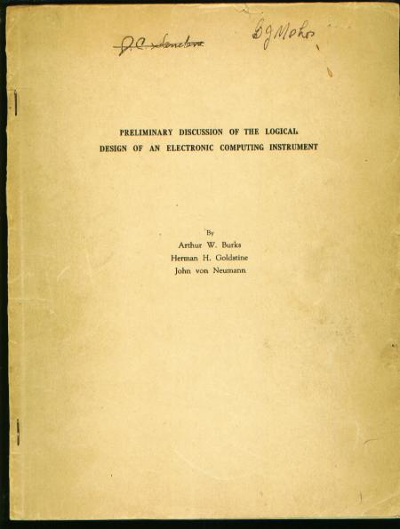
The functional diagram in the previous slide has not changed since 1946.
But the technology has changed and improved.
Notes:
This design was invented by a team at Princeton University headed by John Von Neumann.
While the design has remained constant, the technology has changed. For example, early computers used magnetic tape for storage, but that technology gave way to floppy and hard disk drives.

Slide 6
Name three computer input devices.

Slide 7
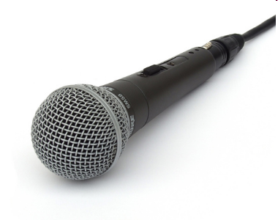
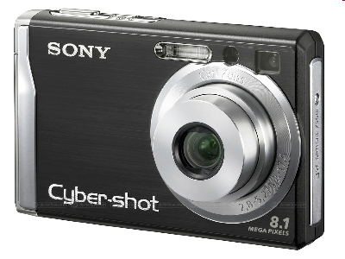
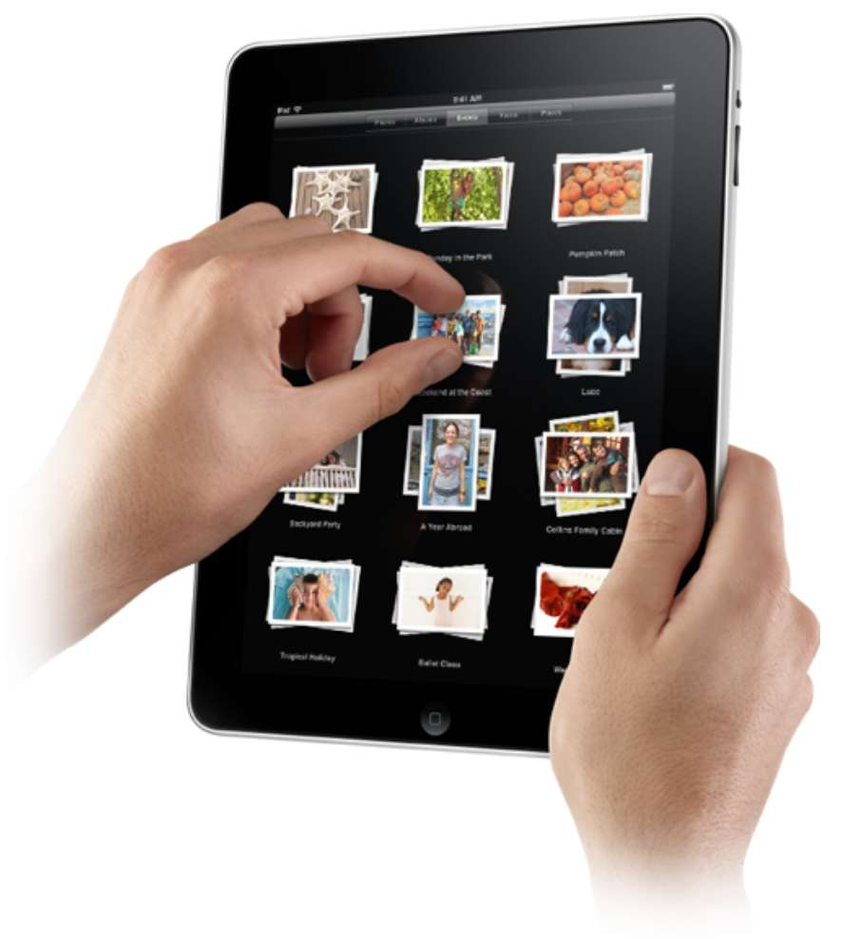
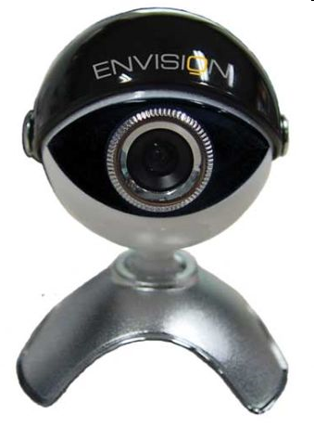
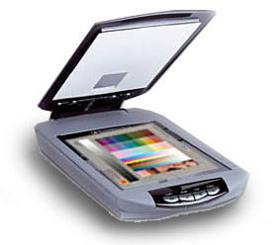
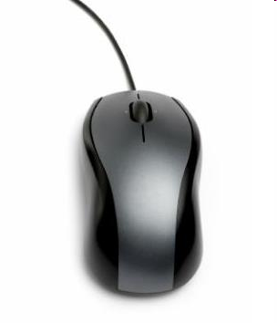
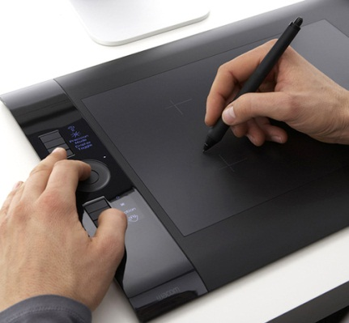
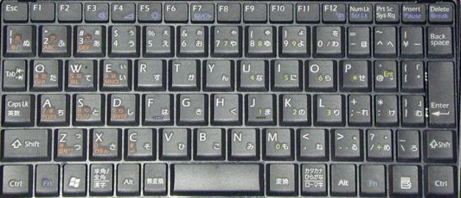
Input devices
Notes:
These are common input devices.
If you’re watching a video of this presentation, pause it and see if you can identify each of them.

Slide 8
Name three computer output devices.

Slide 9
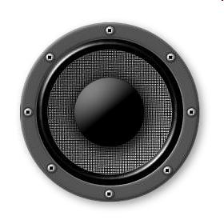
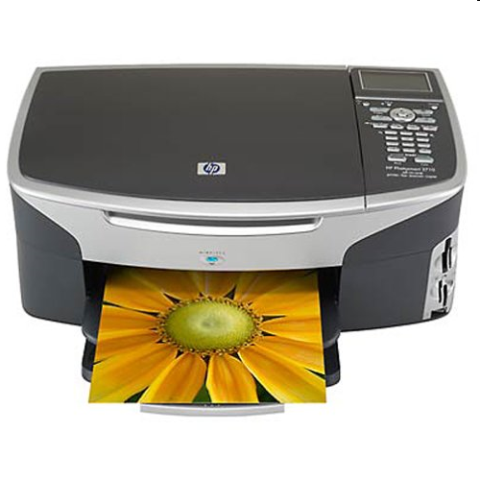
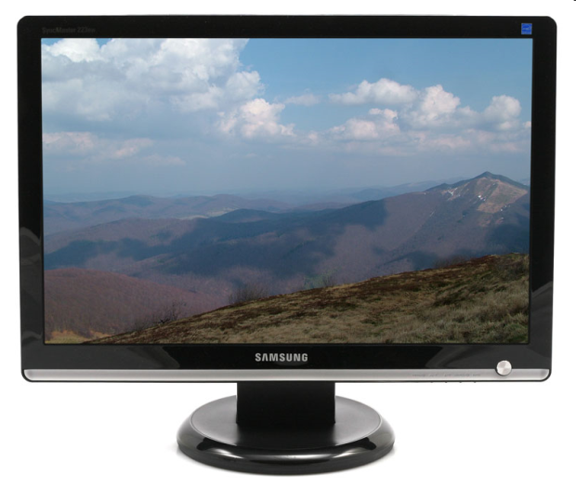
Output devices
Notes:
These are common output devices.
Note that the touchscreen on the iPad tablet functions as both an input and an output device.
Again, if you’re watching a video of this presentation, pause and be sure you can identify each device.

Slide 10
Name three storage technologies.

Slide 11
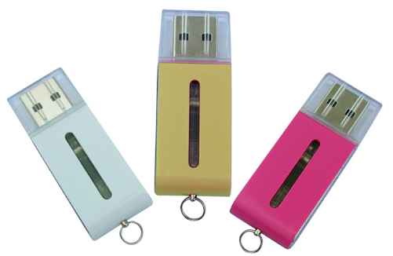
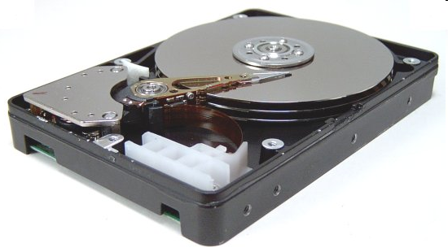
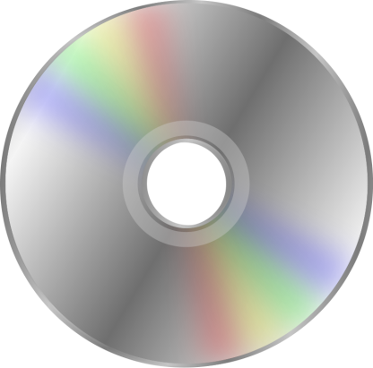
Storage technologies
Can you identify these three different storage technologies?
Notes:
Each of these storage devices – flash drives, hard drives and optical disk drives – utilizes a different storage technology.
Each has its own characteristics – capacity, speed, cost, and so forth.
You store both your programs and your data files on devices like these.
Note that even though the three devices shown here use different technology, they serve the same function – storing data and programs.

Slide 12
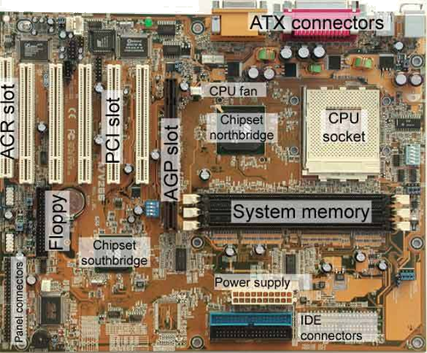
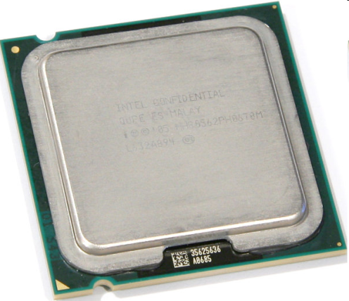
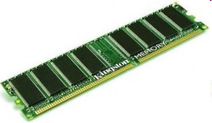
CPU and
Memory
Notes:
The CPU (central processing unit) and memory are electronic chips.
They’re installed on a circuit board inside the computer.
The photo at the bottom shows a portion of a circuit board. As you see, the wires that connect the devices are printed on the board.
Information is transferred at very high speed between the CPU and memory.
Memory and storage are sometimes confused.
The programs and data the computer is currently working with are in memory while they are being used, but all other programs and data files are in storage.
Storage capacity is generally much greater than memory capacity.

Slide 13
Misconception alert!
Students often confuse memory and storage.
Don’t be the one.
Notes:
If you are not clear about the difference between memory and storage, go back to the previous slide.
If it is not clear after reading that slide carefully, get help.

Slide 14
Computer components
CPU
Fast
Input
devices
Memory
(programs and data)
Output
Devices
Slow
Storage devices
(programs and data)
Notes:
Data transfer rates between the CPU and memory are much faster than between memory and storage.

Slide 15
Computer components – information flow
CPU
Input
devices
Memory
(programs and data)
Output
Devices
Storage devices
(programs and data)
Notes:
This diagram stresses the direction of information flows within a computer.
For example, whatever you type on a keyboard goes into memory and information in memory can be sent to an output device like a display or a printer.
Pay attention to the arrow heads. For example, information can move from storage to memory or from memory to storage.
For example, when you want to use a word processing program, it has to be copied from storage to memory, and, when you finish typing a document, you would copy it to storage for safe keeping or subsequent revision.

Slide 16
Misconception alert!
Is a flash drive an input device, an output device or a storage device?
Hint: go back to the functional components slide.
Notes:
If you are stuck or just guessing, get help

Slide 17
What is in the memory of my computer right now?
CPU
Input
devices
Output
Devices
Memory
(programs and data)
Storage devices
(programs and data)
Notes:
Two types of file in memory – files with programs and files with data

Slide 18
What is in the memory of my computer right now?
CPU
Input
devices
PowerPoint program and slide data
Output
Devices
Storage devices
(programs and data)
Notes:
Since I am showing a PowerPoint presentation, the PowerPoint program and the slide data must be in memory right now.
The program was copied in from the storage device on my computer when I clicked on PowerPoint.
The PowerPoint presentation data was loaded into memory from the Internet when I opened the presentation.

Slide 19
What is in the storage of my computer right now?
CPU
Input
devices
Memory
(programs and data)
Output
Devices
Storage devices
(programs and data)
Notes:
Two types of file in storage – files with programs and files with data

Slide 20
What is in the storage of my computer right now?
CPU
Input
devices
Memory
(programs and data)
Output
Devices
Many program and data files
Notes:
The PowerPoint program is in storage. (When you start a program, it is copied from storage to memory, not moved).
There would be other programs – perhaps Microsoft Word, game programs, etc. and other data files – perhaps Word documents, spreadsheets, videos, etc.

Slide 21
What is stored on your home computer’s internal hard or flash drive right now?
Notes:
Pause and list some of the things stored on you hard drive or flash drive.

Slide 22
Data files like …
Pictures of your dog
School
assignments
Email
messages
TV episodes
From iTunes
Jokes
Our class
syllabus
recipes
Term
papers
Songs
What else is on your hard drive right now?
Notes:
This is the sort of thing you might find on your hard drive – data you have stored.
But, what is missing? What else do you have stored on your computer?

Slide 23
Programs like …
Video
player
Image
editor
Pictures of your dog
School
assignments
Email
messages
TV episodes
From iTunes
Excel
Jokes
Word
Our class
syllabus
Powerpoint
recipes
Term
papers
Audo
editor
Songs
Music player
Web client
Notes:
You also have programs like your word processor, music and video players, image and audio editors and a Web browsing program or two.
(Web browser and Web client are synonyms).
We store both program and data files on our computers.

Slide 24
Where does the Internet fit in this picture?
Is it memory, storage, CPU, an input device or an output device?
Notes:
Where does the Internet fit in this discussion?

Slide 25
The Internet is a very large, slow, shared storage device
Programs and data
A relatively slow link
The storage capacity and link speed are improving – what will that change?
Notes:
You can think of the Internet as a large, but relatively slow storage device that is shared by every computer connected to it.
Today we use it to store relatively small programs and data files that don’t require high speed access.
We store large programs and critical data on local devices like hard drives or flash drives.
Technological change will affect this balance between the Internet and local storage.
For example, faster Internet connections favor storing information in the “cloud,” and falling prices of local storage devices favors storing information locally.

Slide 26
The Internet is a very large, slow, shared storage device
Programs and data
A relatively slow link
What is the data transfer rate between your home and the Internet?

Slide 27
Some online storage services
Google Drive
Apple iDrive
Amazon Cloud Drive
Microsoft One Drive
Dropbox
You may need less local storage in the future.
Notes:
Many services store their own data files on the Internet – for example Survey Gizmo questionnaires and responses, Amazon products for sale and Facebook profiles, pictures and posts.
Additionally, several companies offer storage space in the cloud for user’s data files.
They typically offer a minimal amount of storage for free and charge a monthly fee of additional capacity.
These are some of the big ones.

Slide 28
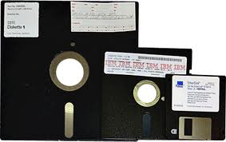
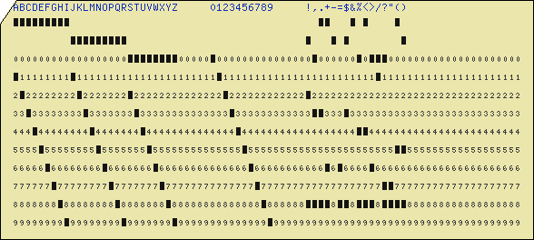
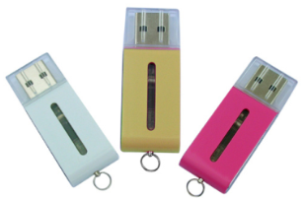
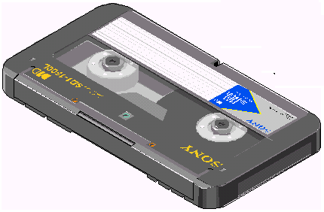
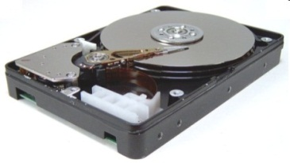
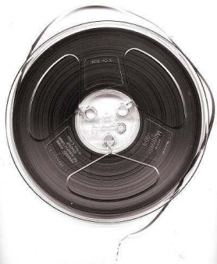
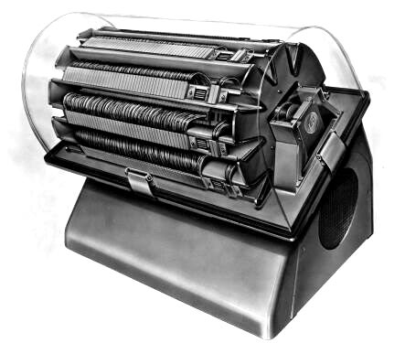
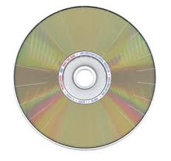
Many technologies, one function -- storage
Which are obsolete?
Notes:
A final point is that while all the functional architecture of computers remains the same, the technology does not. For example, since the 1940s, computers have had storage devices, but the technology we use has changed over time.
Here we see ten different storage technologies that have been in use during my career.
Which do you recognize? Which have you used? Which are obsolete?

Slide 29
Many technologies, one function -- storage
The Internet
Floppy disk
Punch card
Flash drive
Cassette tape
Hard disk
Magnetic tape
Magnetic drum
Paper tape
Optical disk
Which are obsolete?
Notes:
A final point is that while all the functional architecture of computers remains the same, the technology does not. For example, since the 1940s, computers have had storage devices, but the technology we use has changed over time.
Here we see ten different storage technologies that have been in use during my career.
Which do you recognize? Which have you used? Which are obsolete?

Slide 30
The byte: a unit of measure for storage and memory capacity
My gas tank has a capacity of 12 gallons.
My height is 70 inches.
My weight is 160 pounds.
My computer’s memory has a capacity of 8 billion bytes.
My computer’s storage has a capacity of 256 billion bytes.
What is a kilobyte, a megabyte, a gigabyte, a terabyte?
Notes:
The byte is a unit of measure for quantity of data.
A computer’s local storage capacity is greater than its memory capacity because the memory only has to hold the programs and data currently being used while the storage device holds all of the programs installed on the computer as well as all the data files that have been saved.
We will talk more about measures of data quantity (and transmission speed) in other topic modules.

Slide 31
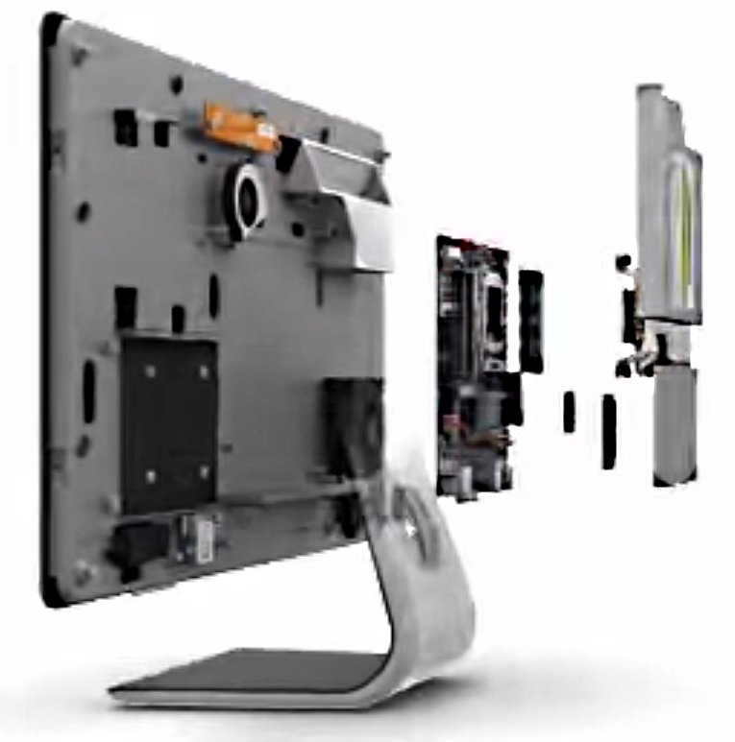
Assembling a computer
Memory
Optical drive
Hard drive
CPU
Video showing assembly steps (4:49)

Slide 32
Summary
CPU
Input
devices
Memory
(Programs and data)
Output
Devices
Storage devices
(programs and data)
Notes:
Well, that concludes our presentation on computer components.
We’ve seen the functions of each type of component and the direction of information flow between them.
We noted that storage devices, including the Internet, hold both program and data files.
Finally, we saw that a given function may be achieved using various technologies and new ones obsolete older ones.

Slide 33
Self-study questions
Name the five functional components of a computer system. (Try first without looking back at the presentation).
Can you reproduce our diagram of a computer system, showing the direction information flows between components? (Try first without looking at presentation).
What are the two types of file we store on our computers?
Give an example of a program that is stored on the Internet instead of the local storage of the client computer.
What is one application where the data is stored on the Internet?
What is the capacity of your computer’s memory?
What is the capacity of your computer’s storage?
Which would you want to have greater capacity – memory or storage? Why?
High capacity is desirable for a storage device. What other factors need to be considered in characterizing a storage device?
Can information coming from an input device like a keyboard go straight to storage or a display without passing through memory?
Name the input and output devices on an Apple iPad computer.
What is the cost trend for memory, storage and CPU chips?
What limits the rate of data input from a keyboard to memory?
Is a flash drive an input device, an output device or a storage device? Explain your answer.

