Slide 1
Connectivity overview
Skills: none
Concepts: mobile vs fixed connectivity, local area network (LAN), Internet service provider (ISP) wired versus wireless, Internet vs the phone network, backhaul, terrestrial versus satellite wireless, connectivity options within the LAN, router
This work is licensed under a Creative Commons Attribution-Noncommercial-Share Alike 3.0 License.
Notes:
We’ll differentiate between home, organization, mobile and backbone connectivity and discuss the technologies they use.
We’ll also differentiate between wide and local area networks and conclude with a summary of network topologies.

Slide 2
Where does this topic fit?
Internet concepts
Applications
Technology (communication)
Implications
Internet skills
Application development
Content creation
User skills
Backbone
Notes:
The presentation concerns communication technology.

Slide 3
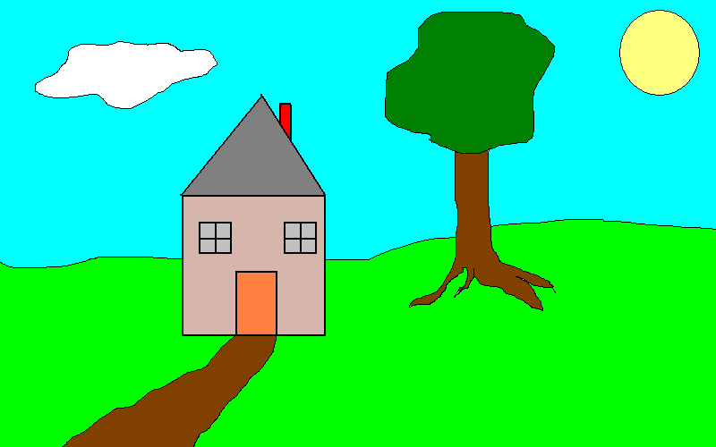
Mobile and fixed connectivity
Mobile
Fixed – home, office, hotspot, etc.
Notes:
We connect to the Internet from our homes, stores, offices and when moving around.
There are different connectivity considerations and options for each case.

Slide 4
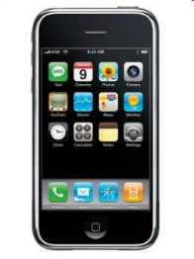
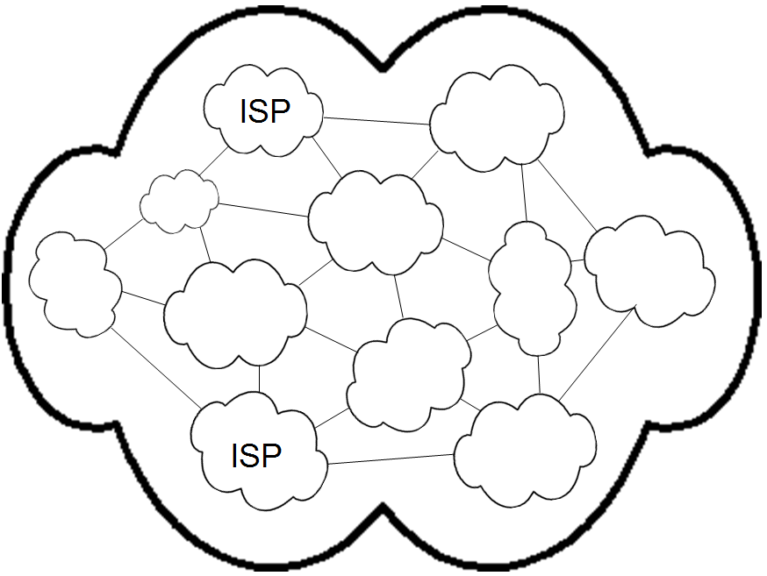
Internet service providers
Mobile
LAN
Fixed
What company is your mobile ISP? Your home ISP? Your work ISP?
Notes:
Users connect through Internet service providers or ISPs.
Mobile users connect directly to their ISP.
A home or organization that has more than one computer, will build a local area network (LAN).
A LAN is restricted to an area like a single building or campus and is generally owned by a single organization, which is responsible for its operations and maintenance.
Home and organization users connect to their LANs, and the LAN connects to the ISP.
Note that we can distinguish between mobile and portable connectivity.
A user with a mobile phone, tablet or laptop would connect directly when outside and connect through a LAN when in a home, office or a public access point like a “hotspot” in Starbucks or an airport.
Let’s consider both cases, starting with the mobile user.

Slide 5
Mobile connectivity
The Internet
mobile user
How does the mobile user connect to the Internet?
Notes:
When away from their home or organization LANs, mobile users connect directly to their ISPs, through the cell phone network.
Cellular networks were originally deployed for voice calls using our cell phones.
But, today, the primary use of our cell phones is for Internet access.
Eventually, all voice communication will be over the Internet using services like Skype and WhatsApp, and traditional phone calls will disappear.

Slide 6
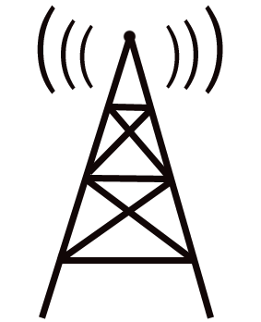
The path to the Internet – 1-4G
Radio
Fiber
Base Station
Internet
What would slow the connection?
Notes:
The radios in our mobile and portable devices connect to cell company radios. The backhaul connection to a cell company office is usually over over fast fiber – extra speed is needed because many users may be sharing a cell radio at a given time. In rural areas the backhaul might be over high-speed terrestrial or wireless links.
If the user is making a phone call, the connection is switched to the phone network; if they are working with data, the connection is switched to the Internet.
To roll out a new technology generation, cell companies must change the equipment at each base station as well as the offices the base stations connect to – a big capital investment.

Slide 7
The path to the Internet – 1-4G
Congestion
Radio
Fiber
Base Station
Distance
Congestion
Internet
Notes:
Radio signals deteriorate – lose power – with distance. Geeks say the signal is “attenuated.”
The same thing happens with your car radio as you drive out of town.
As the signal weakens and is harder to detect, transmission errors occur and packets must be retransmitted.
If too many users are using their mobile devices at once, the fiber connection to the cell company central office becomes the bottleneck.
The cell company investment strategy is a balancing act between customer satisfaction and cost.
Which areas get new equipment first? Last?

Slide 8
The path to the Internet – 1-4G
Radio
Fast
radio
Base Station
Internet
In some rural or developing areas
Notes:
In some rural and developing areas, high-speed, point-point, terrestrial radio or satellite links are used for backhaul to the Internet.

Slide 9
The path to the Internet – 5G
Radio
Fiber
Small
Cell
Base Station
Internet
Notes:
The radios in our mobile and portable devices connect to cell company radios. The backhaul connection to a cell company office is usually over over fast fiber – extra speed is needed because many users may be sharing a cell radio at a given time. In rural areas the backhaul might be over high-speed terrestrial or wireless links.
If the user is making a phone call, the connection is switched to the phone network; if they are working with data, the connection is switched to the Internet.
To roll out a new technology generation, cell companies must change the equipment at each base station as well as the offices the base stations connect to – a big capital investment.

Slide 10
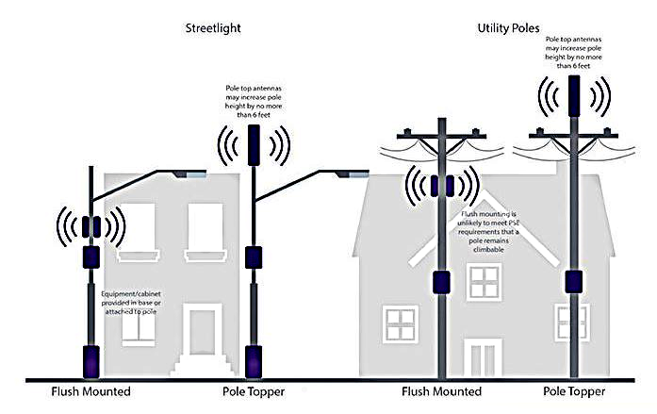
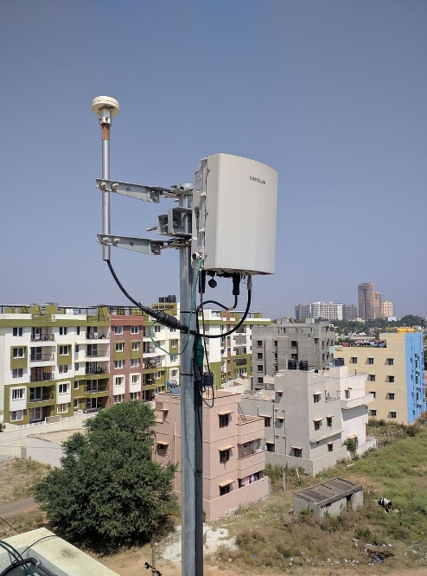
5G Small cells
Source

Slide 11
5G Small cells
High frequency
Fast transmission
Rapid attenuation
Poor penetration
Easy to install
Source

Slide 12
The path to the Internet – 5G
Radio
Fiber
.
Base Station
Small cell
Data center
Internet
Notes:
Since high frequency signals do not carry for long distances, many small cells are needed to cover an area,

Slide 13
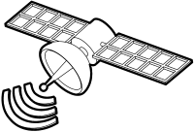
The path to the Internet
Radio
Fast
radio
Base Station
Internet
In some rural or developing areas in the future
Notes:
A handful of developing nations are using links through SES medium-Earth orbit satellites today.
This may become relatively common practice in the future because major investments are being made in low and medium orbiting satellites.
Look for the beginning of low-Earth orbiting satellite service next in 2020 and widespread deployment by the middle of the next decade.

Slide 14
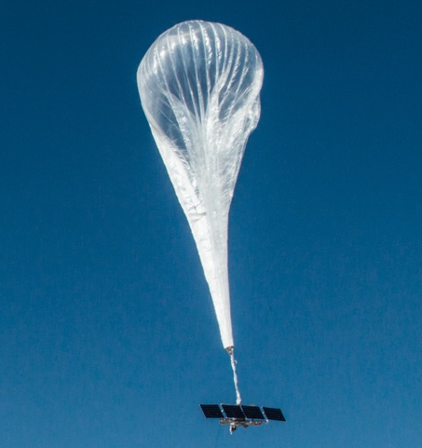
The path to the Internet
Radio
Fast
radio
Base Station
Internet
In some rural or developing areas in the future
Notes:
People are also experimenting with various “high-altitude platforms” like airplanes, blimps, balloons and drones.

Slide 15
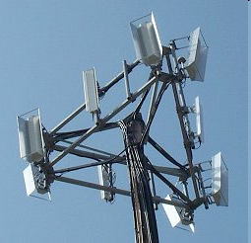
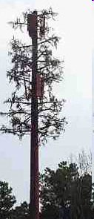
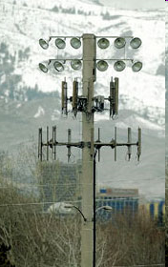
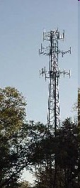
Cell
radios &
towers
Notes:
Cell radios are on roofs, towers, hill tops, etc – look for them. Cell companies pay for the right to put up towers and antennae and sometimes they are required to disguise them. A tower may be shared by two or more companies.

Slide 16
Verizon mobile prices
All sizes include unlimited talk and text.
What does 3GB/$45 mean?
Do you know what your mobile plan and bill are?
Why are text messages and phone calls free?

Slide 17
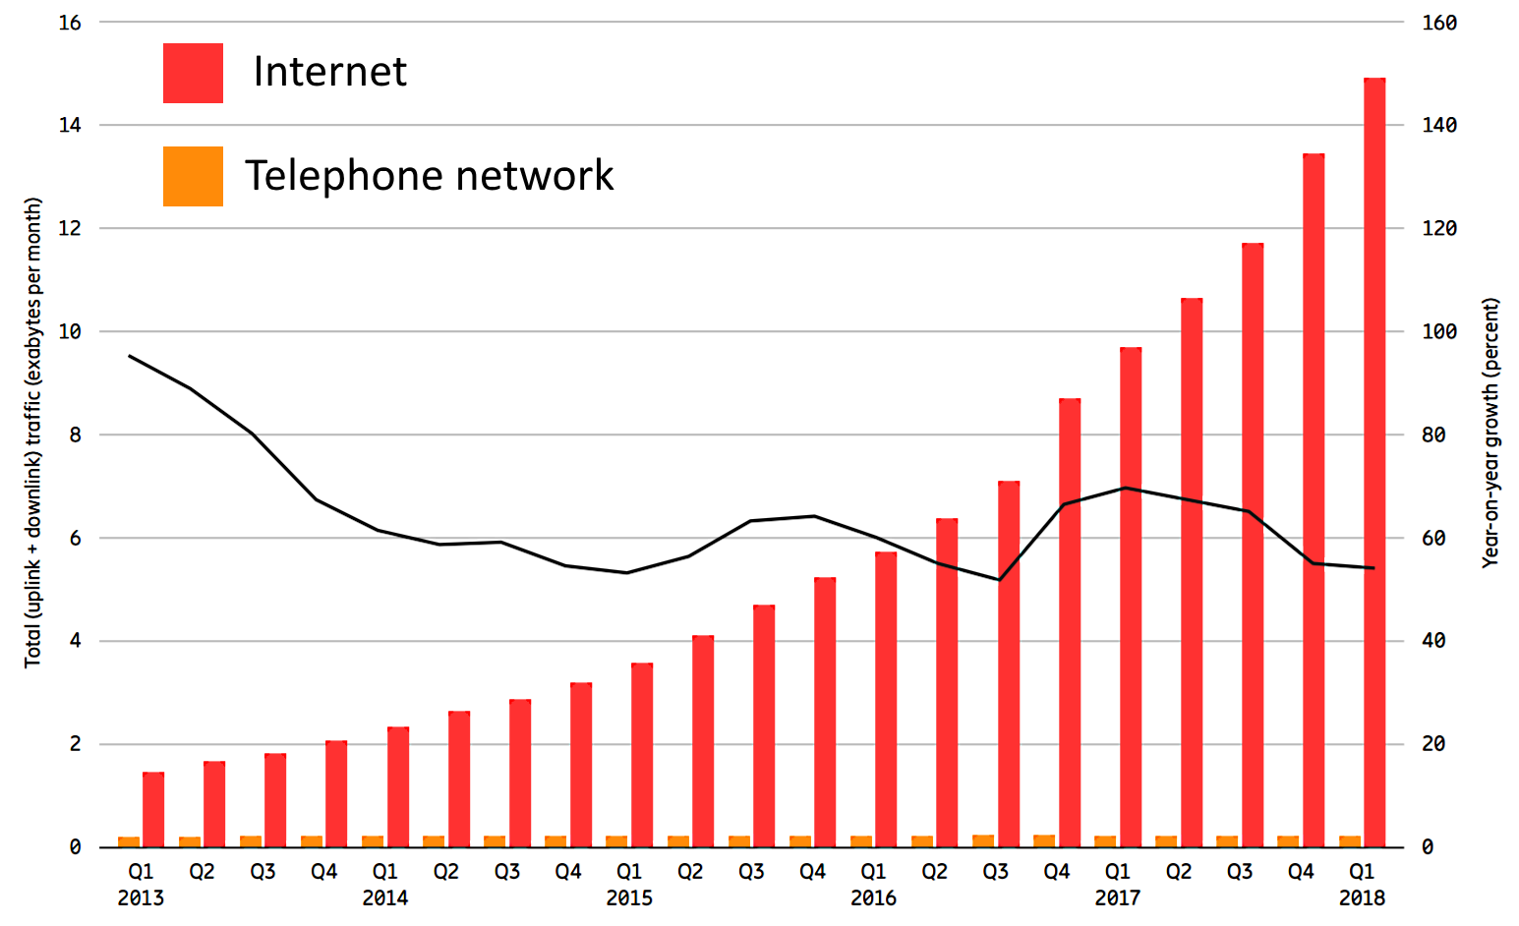
Mobile network traffic is increasingly Internet data.
Source
When you surf the Web are you using the Internet or phone network?
Do voice calls use the Internet or telephone network?
Where does WiFi fit in this picture?
What is the unit of measure for the quantity of data transmitted?
Notes:
We have two separate networks – the Internet and the telephone network.
Today’s mobile device are not “telephones,” but “mobile computers.”
You are using the Internet when you access a Web page or send email.
Voice conversations can use the telephone network or use Internet applications like Skype or WhatsAp.
The same goes for text messages -- they can be sent as telephone “SMS” messages or by an Internet messaging program.
Note that the Y axis on this graph shows petabytes per month – a petabyte is a unit of measure for the quantity of data.
A petabyte is a lot of data – it is 1,000,000,000,000,000 bytes.
If your data is text, that is about 1,000,000,000,000,000 characters.

Slide 18
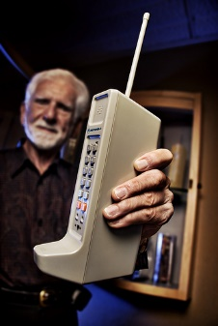
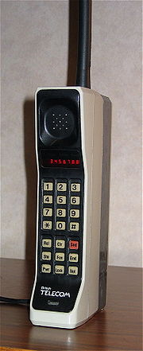
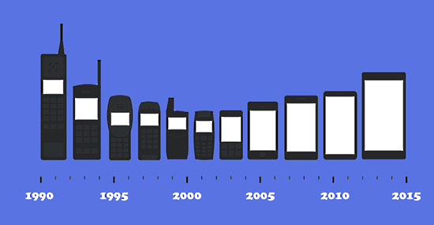
Cell phone product stages
Research prototypes
Expensive products
Vision
Mass market products
4 “generations”
Source
1973
Source 1984
Notes:
The vision – Dick Tracy, a comic book detective with a 2-way wrist radio and Startrek’s Captain Kirk with his flip-phone communicator.
Research prototypes were developed by Motorola, Bell Labs and others, culminating in the first cell phone call by Motorola engineer Martin Cooper in 1973.
Motorola refined that phone and in 1984 offered a $3,995 commercial phone.
There have been 4 generations of mass-market phones since then.

Slide 19
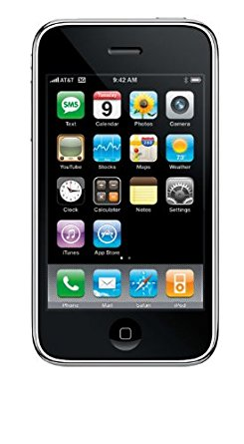
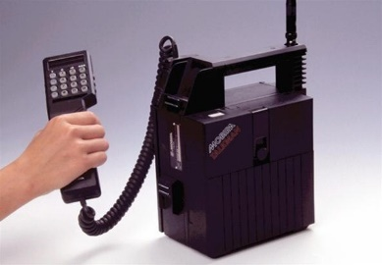
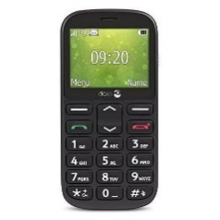
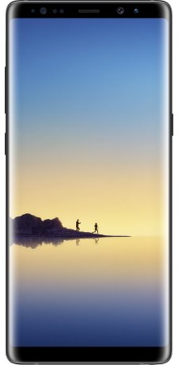
Mobile phone “generations”
New technology enables new applications
What comes after 4G?
1
3
2
4
Why is “generations” in quotation marks?
Notes:
Mobile “generations” are a combination of marketing hype and new technology.
Mobile technology improves continuously, so it is perhaps best to define “generations” by the applications they enable.
First generation, 1980s – analog technology, talk and text
Second generation, 1990s – digital, talk, text, small images
Third generation, 2000s – digital talk, text, large images, slow video, simple interactive apps and Web sites
Fourth generation, 2010s – digital, talk, text, large images, fast video, more complex interactive apps and Web sites
Fifth generation, 2020s – much faster, Internet of things (like cars and thermostats), fixed and mobile
Generations overlap since large investments in infrastructure and phones must be made.

Slide 20
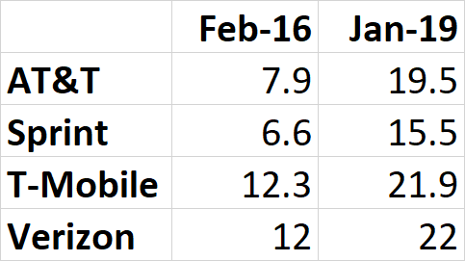
Speeds increase within generations.
Average US 4G download speed, Mbps 2018-9
July 2019 US speed and coverage report
Notes:
Speeds increase within generations.

Slide 21
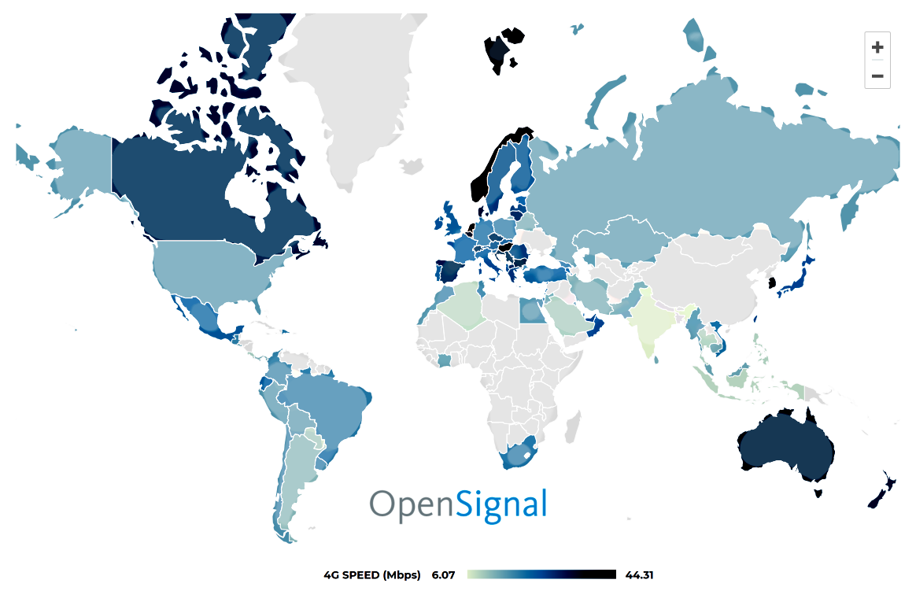
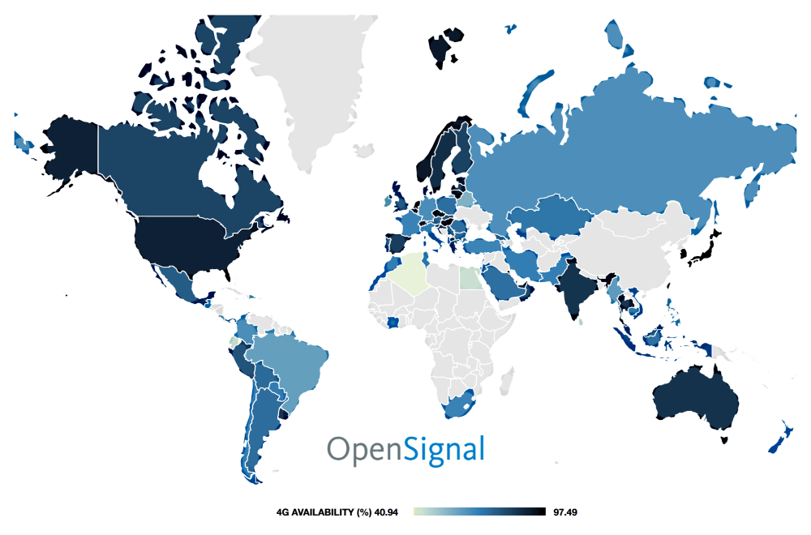
4G speed and availability, February 2018
Speed
Availability
Interactive maps
Is there a mobile digital divide? How is the US doing on speed and coverage?

Slide 22
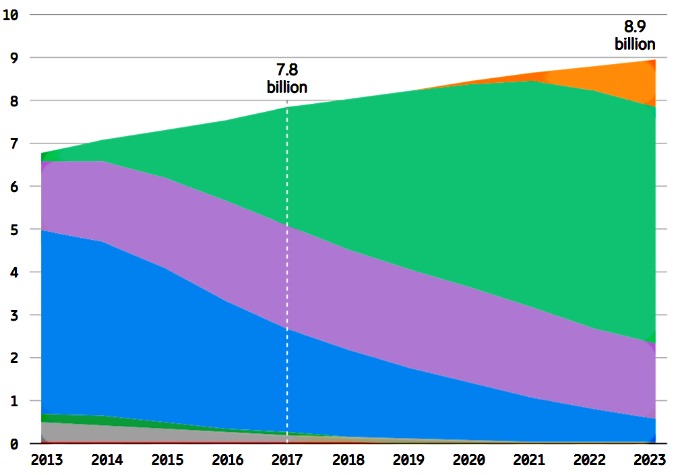
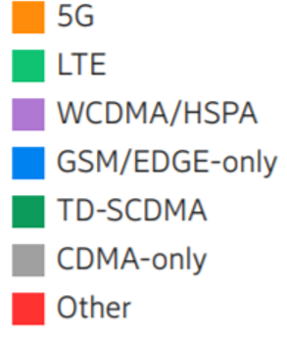
Mobile subscriptions
Source
Possible new 5G applications
Mobile broadband, like streaming movies
Fixed broadband, competing with fiber and cable to homes
Low latency, like autonomous vehicles
Internet of things, like thermostats and traffic signals

Slide 23
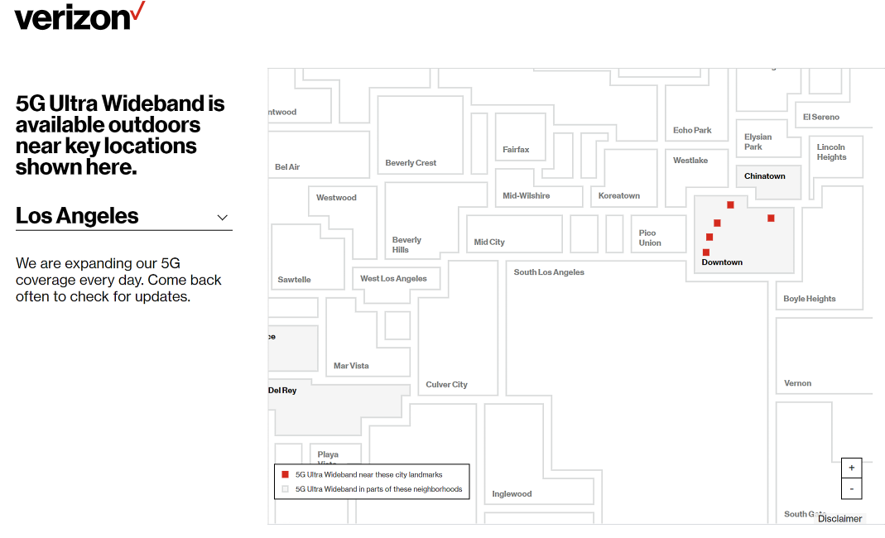
2/14/2020
Why is it only “outdoors?”
Source

Slide 24
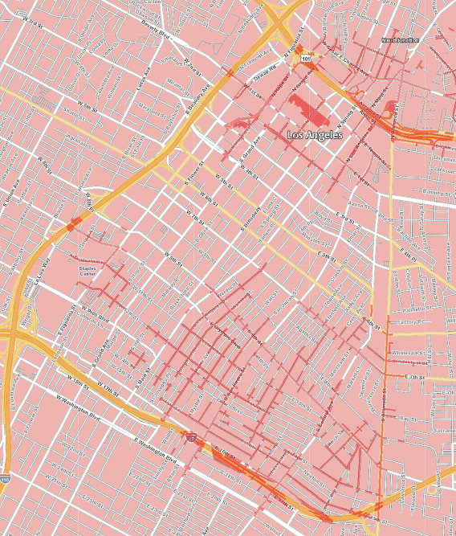
5G coverage detail
Pink: 4G
Red: 5G
Yellow: Freeways
White: Streets
Why downtown first?

Slide 25
That is the end of discussion of connectivity between a LAN and the Internet. What comes next?
Are you mindful, present and thinking actively or are you zoning out and being passive? If so, take a break and start over later.

Slide 26
Fixed connectivity
The Internet
LAN
Fixed users usually connect through a local area network (LAN).
Notes:
Users connect through Internet service providers or ISPs.
Mobile users connect directly to their ISP.
A home or organization that has more than one computer, will build a local area network (LAN).
A LAN is restricted to an area like a single building or campus and is generally owned by a single organization, which is responsible for its operations and maintenance.
Home and organization users connect to their LANs, and the LAN connects to the ISP.
Note that we can distinguish between mobile and portable connectivity.
A user with a mobile phone, tablet or laptop would connect directly when outside and connect through a LAN when in a home, office or a public access point like a “hotspot” in Starbucks or an airport.
Let’s consider both cases, starting with the mobile user.

Slide 27
Two fixed-connectivity questions
1. How does the LAN connect to the Internet?
LAN
the Internet
2. How are computers connected inside the LAN?
Two questions – think about the answers before continuing.
Notes:
When we connect from home, public access hotspot or an organization, we connect to a LAN that is connected to an ISP.
In this case, we have to consider two connectivity issues – how do the computers connect inside the LAN and what sort of connection is used between the LAN and the ISP.
Let’s start with the connection between the LAN and the Internet (your ISP).

Slide 28
1. Connection between LAN and ISP
LAN
The Internet
Copper (DSL or CATV), Fiber or wireless
When would we use a wirelss link between a LAN and the Internet?
Notes:
The link from the LAN to the ISP can be wired or wireless.
Generally speaking, wireless connections are only used when wired connectivity is not available, for example in a rural area or developing nation.
The wireless link could be terrestrial or via satellite.
A home or small organization could use a phone company technology called DSL or TV cable, but larger organizations have faster fiber optic connections.
In limited areas, fiber is available to homes, but it is expensive.
For example, Google had an active project, Google Fiber, installing fiber to homes in selected US cities, but it was not economically viable so they have ended it:: http://cis471.blogspot.com/search/label/google%20fiber

Slide 29
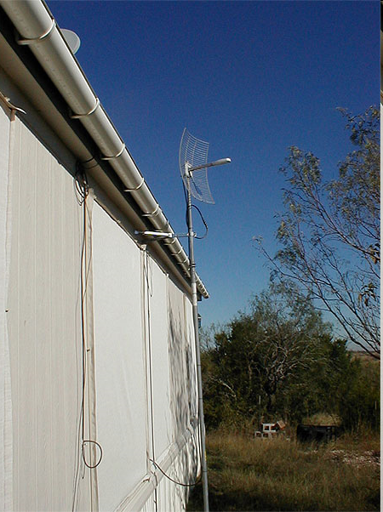
When do we use terrestrial wireless?
This antenna is used for a radio link to an ISP in Austin Texas.
There are many wireless ISPs in rural areas.
Notes:
I took this picture at the home of a friend. Running a cable from his ISP to his home was prohibitive, so he tried a satellite link, but that was too slow.
He switched to a terrestrial wireless link to his ISP in Austin.
The link went in two stages – from his house to an antenna on a nearby hill top and from that hill top to his ISP in Austin.

Slide 30
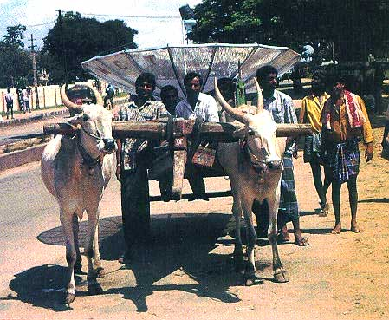
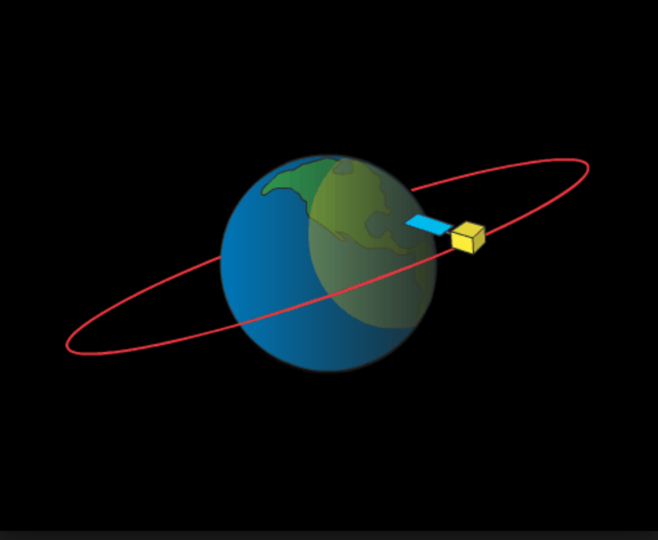
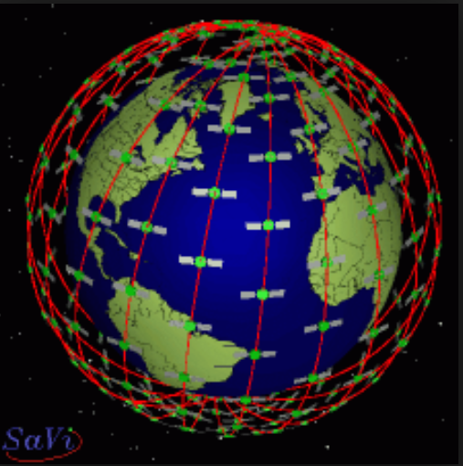
Satellite connectivity, yesterday, today and tomorrow (maybe)
Source
Animate
Animate
Geostationary orbit
35,786 km, above the equator
Geostationary orbit
low-Earth orbit (LEO)
2,000 km or less
Notes:
All things being equal, wireline connections are preferred to wireless connections, but in rural or inaccessible areas, satellite or terrestrial wireless may be your only option.
Today, geostationary satellites are used for slow, expensive Internet connectivity and video broadcast.
Tomorrow, Low-Earth orbit satellites may bring fast, affordable, global Internet connectivity.
Note that the “yesterday" image was initially posted on a server belonging to the Indian education and research network around April 24, 1999. That server is no longer online, but the image was stored by the Internet Archive: https://web.archive.org/web/20150116071541/http://www.iimahd.ernet.in:80/~jajoo/techsang.htm
The “tomorrow” animation was made in the 1990s when Bill Gates and two partners planned a LEO constellation, but the project failed because the technology at that time was not good enough.

Slide 31
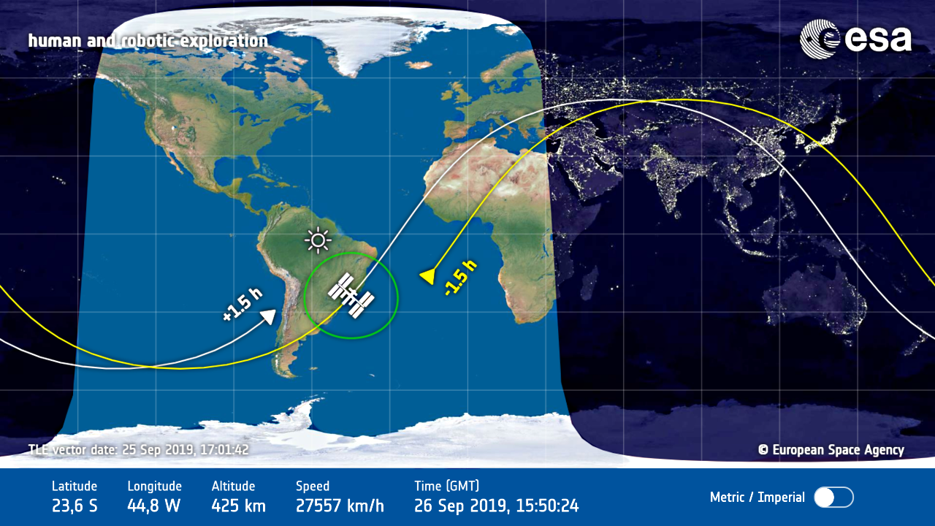
The International Space Station
Low-Earth orbit below the altitudes of the planned Internet-service constellations
Live map

Slide 32
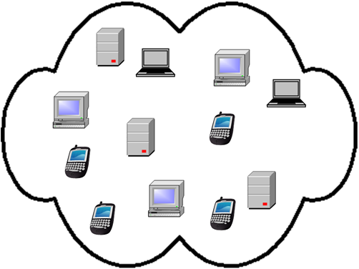
2. Connectivity inside the LAN
To your ISP
How does your cell phone connect to the router when you are home or at a Starbucks store? How does your desktop PC connect at home?
Notes:
Inside a home or organization LAN, we have a mixture of desktop, laptop, tablet and mobile computers.
The all connect to the LAN router, a specially programmed computer at the edge of the network.
Data coming into the LAN or going out, passes through the router.
It connects to the router of your ISP.
Some of the computers inside the LAN connect to the router wirelessly others are connected with cables.
Desktop computers are usually connected by cables, while mobile and portable typically computers connect wirelessly.
We will talk about the connection from your LAN router to your ISP and the rest of the Internet in another presentation.
What data communication standards are used inside the LAN?

Slide 33
Two popular standard protocols are used for communication within LANs – one is used for wireless links, the other for wired links. You have heard their names -- can you name them?

Slide 34
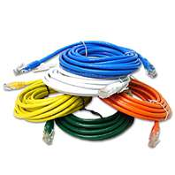
Most common inside the LAN
WiFi
Ethernet
When using your cell phone in a coffee shop are you better off connecting to the Internet LAN via WiFi or connecting directly to the telephone network?
Notes:
The most common wireless LAN technology is a standard called IEEE 802.11, but you probably know of it by its trade name Wifi.
Nearly all laptops, smart phones and tablets have WiFi radios in them, so they can connect to WiFi LANs.
Wired connections inside a LAN are nearly always done using another standard technology called Ethernet.
There are several variations on WiFi and Ethernet, but we don’t need to spell them out in this overview.
We typically run Ethernet cables to desktop computers and use WiFi connections with our laptops, tablets and phone since they are portable.
We could use the cell network from our homes and offices, but when available, we through the WiFi to the LAN because WiFi data does not count against cell transmission caps and it is generally faster.

Slide 35
Possible ambiguity on fixed vs. mobile connectivity
When you use your cell phone to surf the Web at home, are you using the mobile phone network or WiFi?

Slide 36
If I move my laptop from one room in my house to another or move to a different table at Starbucks connectivity is to a fixed location.
I would still connect through a local area network.

Slide 37
Summary
Mobile
Fixed – home, office, hotspot, etc.
Notes:
We saw that mobile connections are through the cellular network to your ISP when you are moving around and through a local area network when at a fixed location like your home or office.
Connections may be wired or wireless and the computers inside a LAN connect to a router, which connects to your ISP’s router.

Slide 38
Self-study questions
Do cell phones use terrestrial or satellite connections?
Which wireless technology is commonly used in homes?
Can you think of a network that uses a one-many topology?
Which topology does the Internet use?
If you have a LAN at home, how many computers are connected to it?
About how many computers are connected to our campus LAN?
Do the computers on our campus LAN use wired or wireless technology?
What is driving the rapid increase in mobile connectivity?
What must happen to attain high growth rates?
Internet video competes with cable TV. What do you think ISPs will do to meet that competition?
What is the advertised speed of the connection between your home and the campus?
How much do you pay per month? How does your connectivity speed and price compare to that in Hong Kong?
What alternative do you have at your home?
We mentioned two characteristics of a local area network as opposed to a wide area network. Do you recall what they were?
What is the network topology of our campus LAN? Of the CALREN network?

Slide 39
Resources
Announcement that data outpaced voice traffic on the cellular network for the first time: http://www.youtube.com/watch?v=LAZsma-JrNo
The rapid growth of mobile data as opposed to mobile voice traffic: http://gigaom.com/2010/03/24/mobile-milestone-data-surpasses-voice-traffic/ and http://gigaom.com/2010/02/09/cisco-the-mobilpocalypse-is-coming/
Cisco wireless data projection for 2018: http://www.cisco.com/c/en/us/solutions/collateral/service-provider/visual-networking-index-vni/white_paper_c11-520862.html
Ericson mobility report: http://www.ericsson.com/mobility-report
Akami State of the Internet report: https://www.stateoftheinternet.com/downloads/pdfs/2015-q1-state-of-the-internet-report.pdf
Mobile Internet growth faster than fixed: http://gigaom.com/2010/04/12/mary-meeker-mobile-internet-will-soon-overtake-fixed-internet/
Connectivity infrastructure policy: http://cis471.blogspot.com/search/label/policy
Erikson video on the mobile data/voice crossover: http://www.youtube.com/watch?v=LAZsma-JrNo
Data is 85% US mobile traffic and 39% of revenue: http://gigaom.com/broadband/data-now-85-of-mobile-traffic-but-39-of-revenue-what-gives/
Greg’s interactive global submarine cable map: http://www.submarinecablemap.com/
Telegeography interactive global submarine cable map: http://www.submarinecablemap.com/
Google Fiber – may bring ISP competition to the US: http://cis471.blogspot.com/search/label/google%20fiber
Status of low-Earth orbit satellite Internet service constellation projects
Low-Earth Orbit (LEO) Satellite Internet Service Developments

