Slide 1
The data link layer
Skills: none
Concepts: LAN, data link functions – moving data within a LAN and medium access, data link protocols – Ethernet and WiFi, why protocols standards win
This work is licensed under a Creative Commons Attribution-Noncommercial-Share Alike 3.0 License.
Notes:
The data link layer is responsible for moving data within a local area network.
We will see the major functions provided at the data link layer – data transmission, error checking and resolving medium access conflicts.
We will also see the two most common protocols families – Ethernet and WiFi and discuss why they came to be dominant.

Slide 2
Where does this topic fit?
Internet concepts
Applications
Technology (communication)
Implications
Internet skills
Application development
Content creation
User skills

Slide 3
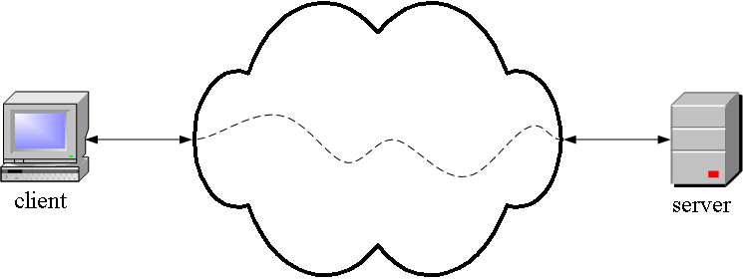
TCP/IP from the outside
Application
Program, for
example, a
Web client
Application
Program, for
Example, a
Web server
A TCP/IP network
Notes:
Application programs like Web clients and servers run in computers that are connected to the edges of the Internet.
Application programs on different hosts communicate using a collection of programs called “TCP/IP.”
People writing application programs don’t have to worry about how information is sent from client to server and back – that’s taken care of by lower level software.
This presentation focuses on the TCP/IP data link layer.

Slide 4
The data link layer
Layer | Function
Application | Do useful work like Web browsing, email, and file transfer
Transport | Transport data between application programs running on two hosts
Internet | Route packets between networks (inter network)
Data link | Send data within the local area network
Physical | Specify hardware characteristics and ways to differentiate between ones and zeros
Notes:
The data link layer passes data within the sending and receiving local area networks.
Let’s take a closer look.

Slide 5
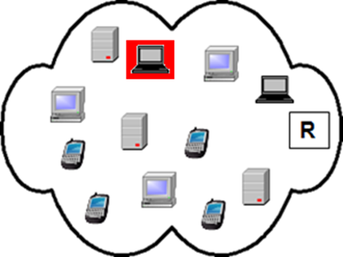
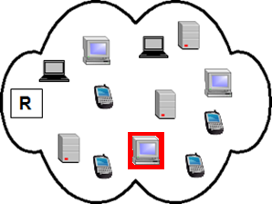
Moving data within a LAN
Notes:
As shown here, the data link layer is responsible for moving data from a particular host within a local area network to the router at its edge.
At that point, the Internet layer takes over and routes it across the Internet.
When it arrives at its destination network, the data link software delivers it across the LAN to the appropriate program on the destination host
The data link layer does error checking and correction within the LAN.

Slide 6
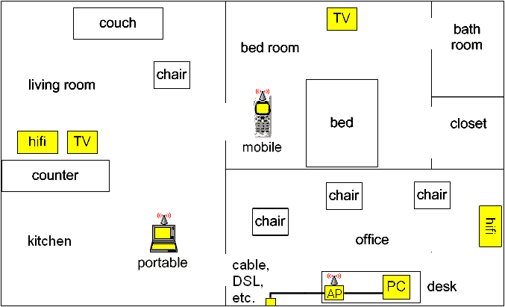
A home local area network
To and from the Internet
Notes:
The LAN might be a fairly simple one in a home.
This example shows a LAN with a personal computer, a portable computer and a handheld computer.
The hifi and television sets are also connected to the LAN.
The router at the edge of the network leads to the Internet.

Slide 7
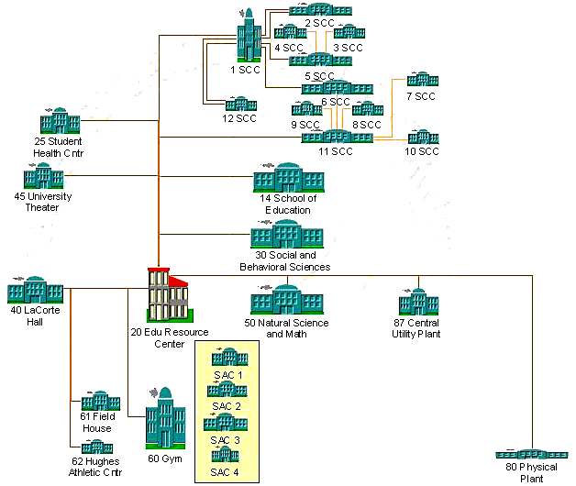
An organization local area network
Notes:
A LAN may also be complex, linking many buildings and computers.
This is our campus LAN.
Every building is connected to the Educational Resource Center (the old Library) where our edge router is located,
A fiber optic cable runs from there to a CSU data center in downtown Los Angeles.

Slide 8
Transfer data and check for errors
101011010101010101101010111010101011
101011010101010101101010111010101011
Notes:
The data link layer transfers data and also checks for and corrects errors within the LAN.

Slide 9
Medium access control
Notes:
In addition to transmitting data and correcting errors, the data link layer also controls medium access.
What protocol do we use when two kids want to talk at the same time?
They raise their hands and wait for the teacher to choose one of them.
Similar situations may arise when two hosts try to send data over a shared medium.
For example, say two WiFi radios both try to transmit at the same frequency in nearby locations.
Interference between the signals will cause data transmission errors.
When the data link software discovers an error, it is programmed to wait a random amount of time, then retransmit.
The probability is high that the second try will succeed, but, if it does not, it will do the same thing again.
The effect of these retransmissions is to slow the throughput of the link.

Slide 10
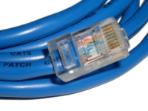
Data link layer protocols
Ethernet (copper and optical fiber)
WiFi (physical and data link)
Notes:
Ethernet and WiFi data link protocols dominate today’s LANs .
Ethernet is used over copper wires or optical fiber and WiFi for wireless links.
Why did Ethernet and WiFi succeed in the marketplace?
You can even think of WiFi as wireless Ethernet.

Slide 11
Open, dynamic standards win
Open
Dynamic
(WiFi was also license free)
Notes:
At one time, there were several prominent Ethernet competitors.
Each had its technical pros and cons, but each was invented and controlled by a single manufacturer.
By contrast, Ethernet was an open standard.
Anyone could build Ethernet equipment without paying a license fee.
That brought many competing Ethernet manufacturers into the marketplace.
Turning the Ethernet standard over to a professional society also ensured that it would continue to evolve and improve.
Today there are many Ethernet – allowing a wide choice of speeds and link lengths.
WiFi had similar advantages.
It was launched in 1988 as a wireless network among cash registers in stores, but the inventor, National Cash Register, turned control over to a professional standard.
WiFi had another advantage over competing wireless networks.
It operated in a frequency band that did not require one to have a broadcast license as long as power was kept below a specified limit.
Higher powered radio transmitters require government licenses.
In the US, our Federal Communication Commission issues licenses to transmit at specified frequencies in specified locations.
Many people think we should have more license-free frequency bands in the US and around the world.

Slide 12
Summary
Notes:
We’ve seen that data is moved across local area networks at the data link layer.
In addition to sending and receiving LAN data, the data link layer checks for errors and resolves medium access conflicts.
We saw that Ethernet and WiFi are dominant data link protocol families, and discussed the reasons the beat the competition in the market place

Slide 13
Self study questions
Since the data link protocols detect and correct errors, why does the TCP transport protocol also detect and correct errors?
Which two standards dominate data link protocols?
What are the three main functions at the data link layer?
Why did Ethernet and WiFi come to dominate the market for connectivity with local area networks?
Can you name another wireless protocol that is used in short range local area links?
Can you think of other wireless devices than WiFi radios that are license free?
Can you think of wireless devices that do need licenses?
Why are licenses required for many radio transmitters?

Slide 14
Resources
The WiFi Alliance certifies equipment and markets:
http://www.wi-fi.org/
IEEE develops and ratifies technical standards like Ethernet:
http://www.ieee802.org/3/
And
WiFi:
http://www.ieee802.org/11/

