Slide 1
Application deployment evolution
Skills: none
Concepts: server, blade server, data center, virtual machine, infrastructure as a service, public versus private cloud
This work is licensed under a Creative Commons Attribution-Noncommercial-Share Alike 3.0 License.
Notes:
In the early days of the Internet, one needed specialized skills to develop or deploy new applications.
Both developing and application and deploying it on the Internet have become easier with time.
This presentation shows the evolution of application deployment using my school as an example.

Slide 2
Where does this topic fit?
Internet concepts
Applications
Technology
Implications
Internet skills
Application development
Content creation
User skills
Notes:
This is a technology topic

Slide 3
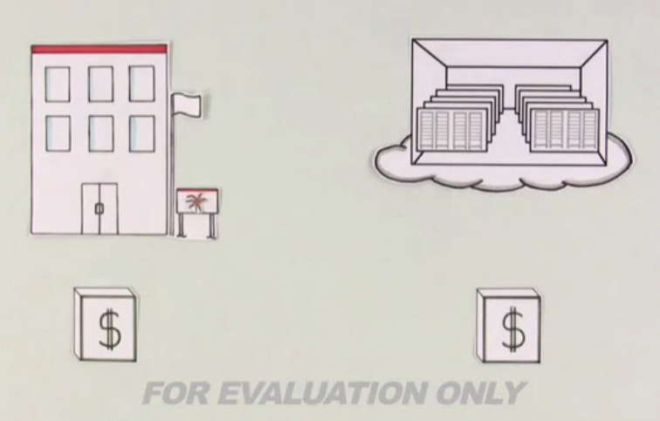
Watch this video
Cloud Computing in Plain English (3:00)
Notes:
Pause and watch this video before going on.

Slide 4
Developing applications keeps getting easier
Batch processing and time sharing
Personal
computer
Internet
And so does deploying applications
Notes:
There have been several major changes in the way we develop and deliver IT applications.
We began with batch processing in the 1950s and progressed to time sharing, personal computers and now the Internet.
With each new platform, application development has become easier.
You had to be a nerd in the days of batch processing and time sharing, and applications took months or years to build.
The personal computer enabled business men and others to develop their own applications.
Today, one can develop a complex application like a blog, database or wiki with little effort.
But, that is only half the story – deploying them is also cheaper and easier.

Slide 5
Deploying a Web server
The server
Web server program
Web site content
Notes:
It is not enough to develop an Internet application, you must also deploy it for others to use.
Let’s say you want to deploy a Web site.
You need a computer (a server) that is running Web server software and is connected to the Internet.
The Web site content must also be online.
The content might be on the same computer, as shown here, or on a separate computer.
Fortunately, deploying Internet applications has become cheaper and easier over time.
Let’s use the evolution of my school’s Web site to illustrate application deployment options.

Slide 6
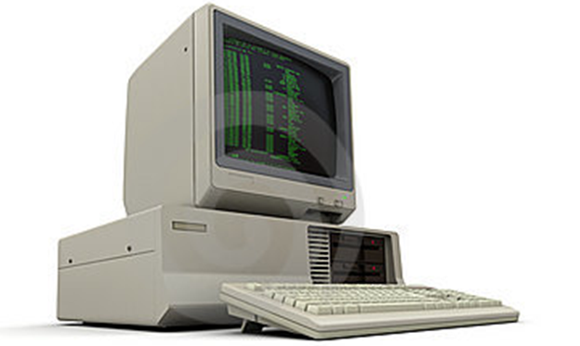
PC server
Notes:
Our school Web server started out on a Windows 3.0 desktop PC in my office.
I installed the Web server software and my students and I created the content -- pages for each professor, etc.
It was connected to the Internet through the school network.
I left the computer running 24 hours a day so people could visit the Web site when I was not around.
When I was in my office, I used the computer for things like word processing and spreadsheets.
There were not many Web users, so it didn’t slow down very much while I was using it.
In those days many people ran Web servers on home PCs, connected through their home ISP.

Slide 7
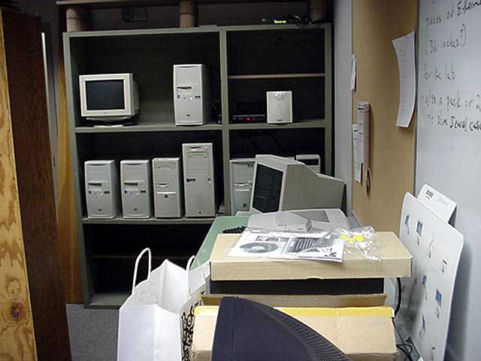
An early server room
Notes:
My desktop Web server was fast enough to keep up with the demand at first, but it became inadequate as the number of “hits” grew.
It also crashed frequently, and it stayed off line until I got there to restart it.
So, we moved it to the school server room, which looked something like this.
The computers were running Web servers, database servers, file transfer servers, and so forth.
Most important to me, they were the responsibility of a paid network administrator who kept them running and backed them up.
I was off the hook, but the university had to hire an employee and tie up a room.

Slide 8
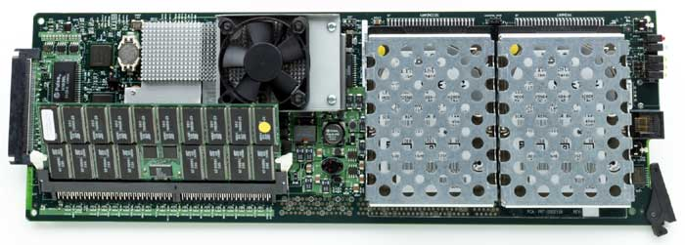
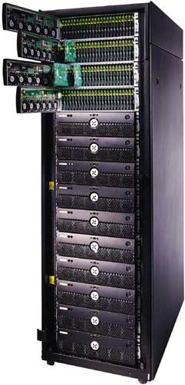
Servers on blades in racks
Notes:
Eventually, the number of servers grew to the point where the school installed a server rack like the one shown here.
The computers are mounted on “blades” that slide into racks in a cabinet.
This blade has two CPUs and two disk drives and the rack hold up to 280 blades.

Slide 9
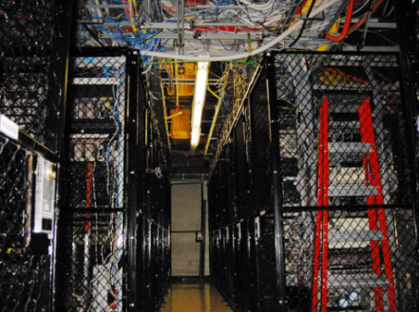
Servers in a data center
Notes:
While my school kept their servers on campus, other organizations moved theirs to data centers like this.
In a data center, you still own your own servers, but the physical space, Internet connection, air conditioning and backup power are taken care of for you.
Data centers also offer a speed advantage.
Data can be routed from one network to another at very high speed since they connected at the same location.
As such, these are sometimes referred to as colocation centers.

Slide 10
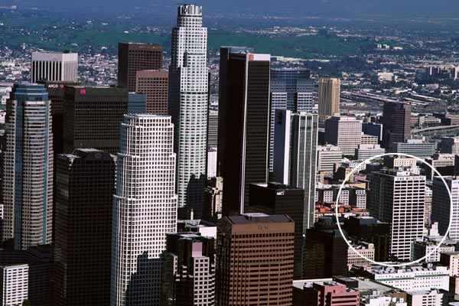
One Wilshire -- outside
One Wilshire -- inside
Notes:
One Wilshire is a large building in downtown Los Angeles. From the outside, it looks like an office building, but inside it is filled with racks of equipment and cables. Several hundred tenants connect with each other and the outside world at One Wilshire. Large organizations and ISPs exchange traffic (IP packets) at data centers like this one and there are similar buildings in cities around the world.
In addition to exchanging traffic, data centers often host servers for organizations. The data center staff are responsible for connectivity, power, security, fire protection, etc., but not the content. The content is maintained by the owner of the server. This service is typically very good, but the price is high.

Slide 11
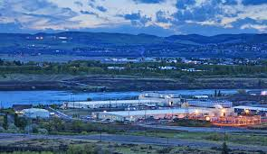
Google data center at The Dalles Oregon
Why is the data center next to the Columbia River?

Slide 12
Inside a Google data center
Source

Slide 13
Virtualization
Operating system 1
Operating system 2
Programs
Data
Programs
Data
Notes:
Virtualization was the next step for my school.
Since today’s computers have large memories and storage devices, it is possible to run two or more completely independent operating systems on one physical machine.
These are called virtual machines since a single physical computer can appear to be two or more independent machines.
This can be more efficient, bringing us closer to using 100 percent of the capacity of the hardware.
It also allows us to quickly vary the number of CPUs and the amount of memory and storage available to a given virtual server as demand rises and falls.
But, we still have the responsibility of housing and maintaining the servers and keeping them connected to the Internet.
The next step is to move virtual servers to the cloud, providing what Amazon and other vendors call “infrastructure as a service.”

Slide 14
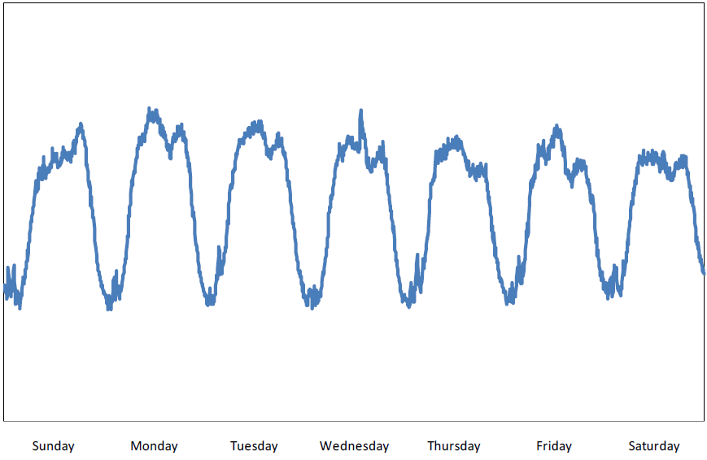
Typical weekly traffic to amazon.com
Notes:
This is a typical traffic pattern at Amazon.com.
There are daily peaks and troughs and each day is a bit different than the others.
If you have enough server and bandwidth capacity to handle peak loads, you have idle capacity during low periods.
This Amazon data was presented by Jon Jenkins in a talk at the O’Reilly Velocity Conference, 2011-06-16

Slide 15
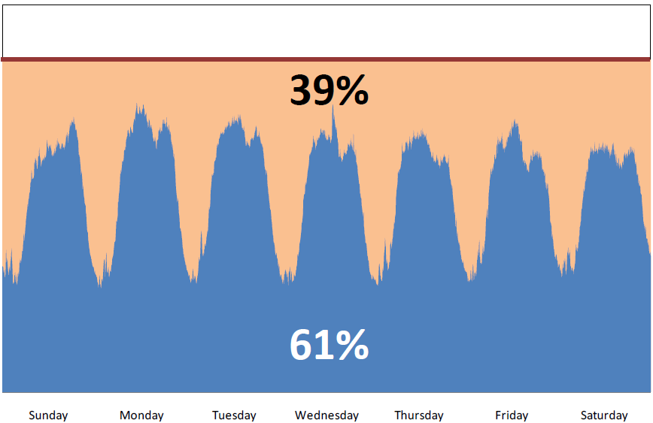
Expected traffic peak + 15%
Notes:
If Amazon added sufficient capacity to handle surges 15% over typical peaks, they would have 39% idle time.

Slide 16
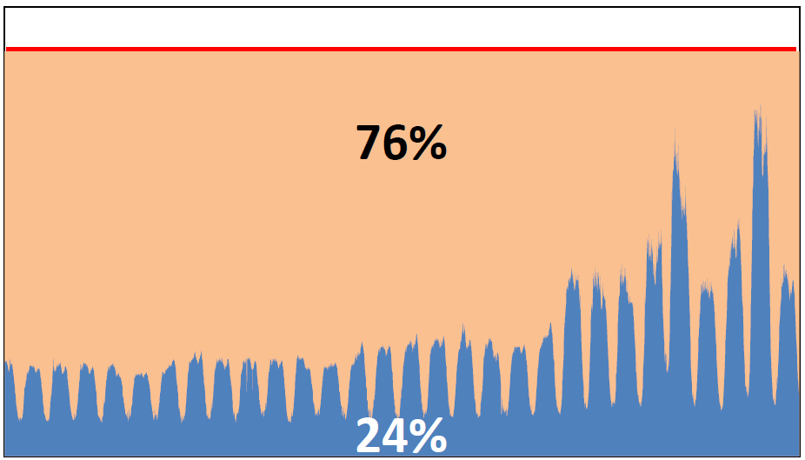
November traffic for amazon.com
Notes:
The problem is even worse around holidays.

Slide 17
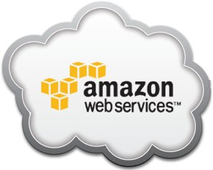
Virtual servers in the cloud
Notes:
Today, Amazon and other companies have very large pools of computers in data centers.
An individual can quickly create (geeks say “spin up”) a virtual server with a given amount of memory, storage and CPU speed.
If your load diminishes – perhaps over the weekend – you can kill your virtual server or reduce its capacity.
Amazon owns the computers and is responsible for maintaining them, backing them up and keeping them connected to the Internet.
A user can create a virtual machine and install their applications in a matter of minutes, and Amazon bills them only for the resources they use.
Let’s look at an example.

Slide 18
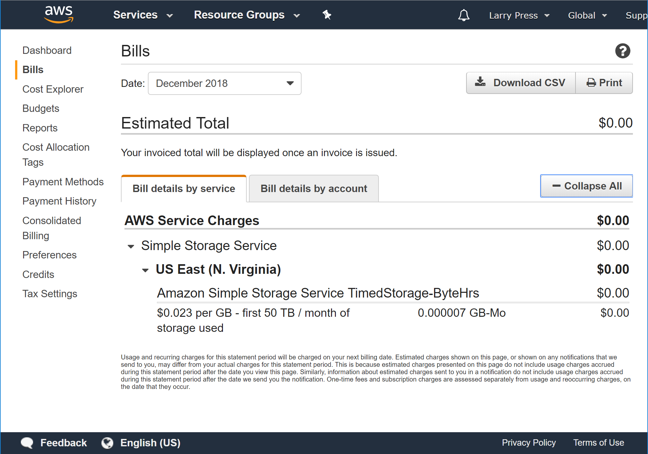
My latest Amazon cloud server bill
Why is this bill so low?
Notes:
Amazon let’s people use their computers as servers.
I have a server “in the cloud” at Amazon Web Services.
It is running a Web server, a blog server and a wiki server software.
Since neither I nor anyone else has used it this month they have charged me very little.
(Actually I have temporarily switched it off, so it has been unreachable).
I can turn it back on by logging in to a “management console” program.

Slide 19
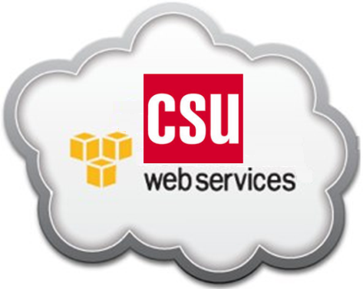
A private cloud
Notes:
Amazon and others offer public cloud service to any paying customer.
A large enterprise or organization can also offer the same sort of service from its own private cloud.
My school has not yet moved their Web server to the cloud, but that may be the next step.

Slide 20
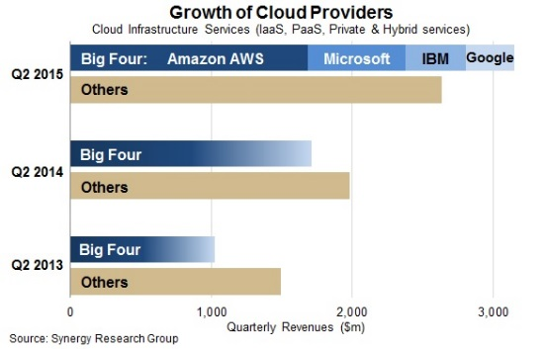
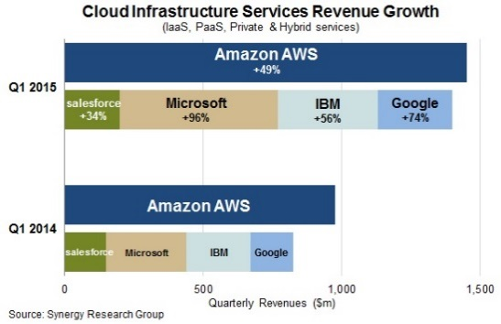
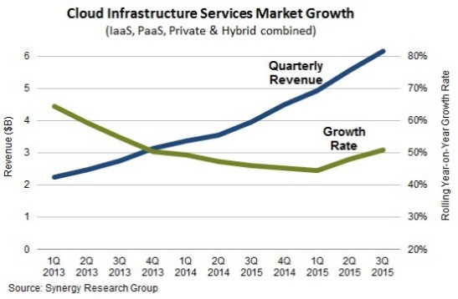
Platforms for developing and delivering applications: dominant companies
Batch processing (IBM computers)
Timesharing (IBM computers)
Personal computer operating systems (Microsoft, Apple)
Data centers (Several companies)
Mobile computer operating systems (Apple, Google)
Cloud computing (Amazon)
Notes:
People think of Amazon as a huge online retailer, which they are, but they are a dominant infrastructure company as well, While Amazon has competitors, they are the dominant cloud computing company..
https://www.srgresearch.com/articles/quarterly-cloud-service-revenues-top-6b-growth-rate-increases
https://www.srgresearch.com/articles/aws-still-bigger-its-four-main-competitors-combined-despite-surging-growth
https://www.srgresearch.com/articles/big-four-cloud-providers-are-leaving-rest-market-behind

Slide 21
Four cloud computing benefits
Reduce fixed costs
Speed innovations to market
Scale flexibly
Extend collaboration
Match the icons with their captions.
Notes:
I took these icons and captions from an IBM magazine ad on the advantages of their cloud computing services.
Can you match the captions with their icons?
Collaboration is facilitated because single copies of the data and documents the team is working on are accessible at all times from any device connected to the Internet.
Fixed costs are reduced because you can start with one small virtual server and add more as demand increases.
You can quickly add or remove servers as demand rises and falls.
You can configure a server to deploy and test a new application from your desktop with a few keystrokes.

Slide 22
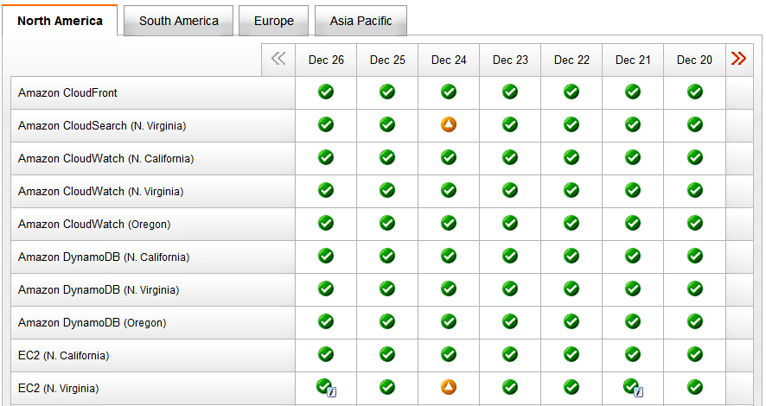
Notes:
Cloud applications are not invulnerable.
For example, on the afternoon of Christmas Eve, 2012, two Amazon cloud hosting services in their Northern Virginia data center had performance issues, causing Netflix (and other services) to be down for some US users.
This interruption came at a bad time – many people were probably home watching Netflix videos.
Amazon customers like Netflix have the option of paying extra for redundant servers in separate data centers if they feel the extra reliability is worth the price.
Of course, on premises servers or servers in data centers can also go down.

Slide 23
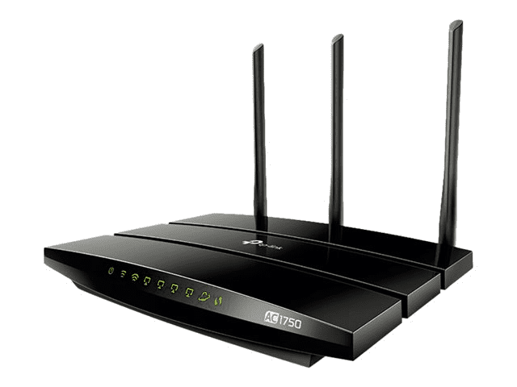
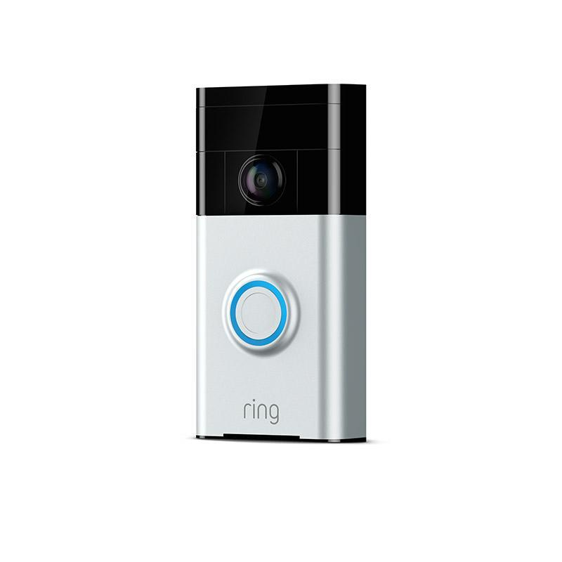
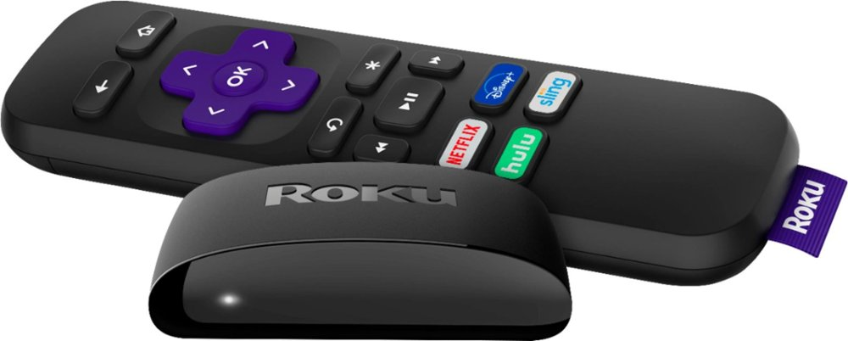
Servers inside of things
Notes:
When you configure your doorbell, home WiFi router, Roku video receiver or other things connected to the Internet, you are talking to a Web server inside the device you are setting up.

Slide 24
Summary
Operating system 1
Operating system 2
Programs
Data
Programs
Data
Notes:
We have seen the evolution of my school’s Web server, beginning in the early 1990s from
A single desktop computer in my office
A single desktop computer in our server room
A rack-mounted computer in our server room
A virtual computer in a rack in our server room
The next step will be to move it to a virtual computer in the private cloud that serves all of the campuses in university system.
(It has never been run from a colocation center).

Slide 25
Self-study questions
What are the key advantages of cloud hosting?
What are the key disadvantages of cloud hosting?
We have seen that applications hosted in the cloud are not 100% reliable – are applications hosted in house more reliable?
Check the Bitnami Web site and see how many applications are ready to install with a single click.

Slide 26
Resources
Amazon service status page: http://status.aws.amazon.com/
Article on Amazon’s Christmas Eve problems: http://nyti.ms/VgjMm7
Amazon’s post mortem summary of the Christmas Eve outage (http://amzn.to/Vherff).
Amazon Web Services case studies:
http://aws.amazon.com/solutions/case-studies/
Video of Jon Jenkins talk at the O’reilly Velocity Conference (17 minutes): http://velocityconf.com/velocity2011/public/schedule/detail/20176
Bitnami: http://bitnami.org/
Step by step creation of the server in this presentation:
http://cis275topics.blogspot.com/2012/05/deploying-applications-in-cloud.html
Screencast: deploying an Amazon server using Bitnami:
http://www.youtube.com/watch?v=HqW-05cAUpc

Slide 27
Server demo
http://larrypress.bitnamiapp.com
Notes:
Creating and managing virtual cloud servers is getting easier and easier.
This demo server is running on the Amazon cloud.
I configured it using Bitnami, a service that simplifies deploying a virtual server and installing applications on it.
I was able to create a virtual server running the Linux operating system plus Web, Wiki and Blog server programs in about ten minutes.
I did all of that by completing a few screen forms and checking off the applications I wanted to install.
The server is now running in the Amazon cloud at the URL shown above.
Stop at this point and go to the server – try posting something to the blog or editing the wiki.

Slide 28
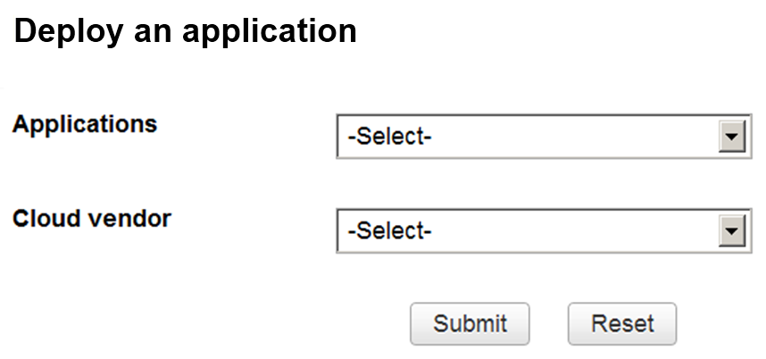
The next step?
Notes:
Deploying cloud-based applications will become even cheaper and easier.
Eventually, we may deploy applications using something as simple as this form.
You will choose your applications and vendor, and a virtual machine running your applications will automatically spin up.
Resources will automatically be added or deleted depending upon the traffic.
If that happens, your grandmother will be her own system administrator .

