Slide 1
Development and deployment trends
Skills: none
Concepts: evolution of application development and deployment, levels of abstraction
This work is licensed under a Creative Commons Attribution-Noncommercial-Share Alike 3.0 License.
Notes:
It has become progressively cheaper and easier to develop applications as we have moved from batch processing to time sharing, the personal computer and now the Internet.
The same goes for deploying applications on the Internet.
It is now possible to deploy cloud-based servers running applications in minutes and it will be still simpler in the future.

Slide 2
Where does this topic fit?
Internet concepts
  Applications
  Technology
  Implications
Internet skills
  Application development
  Content creation
  User skills
Notes:
This is a technology topic

Slide 3
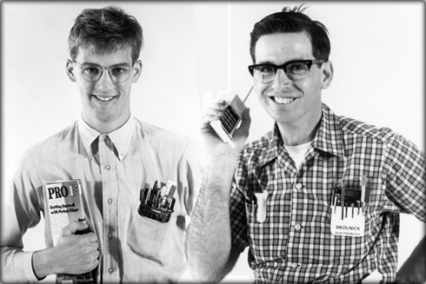


Lowering the application development bar
Batch processing and time sharing
Personal
computer
Internet
Notes:
There have been several major changes in the way we develop and deliver IT applications.
We began with batch processing in the 1950s and progressed to time sharing, personal computers and now the Internet.
With each new platform, application development has become easier.
You had to be a nerd in the days of batch processing and time sharing, and applications took months or years to build.
The personal computer enabled business men and others to develop their own applications.
Today, one can develop a complex application like a blog, database or wiki with little effort.
For more on the democratization of application development, go to: http://cis275topics.blogspot.com/2011/10/democratization-of-application.html

Slide 4
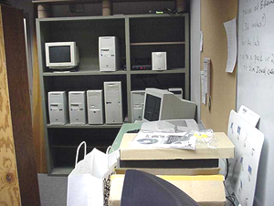
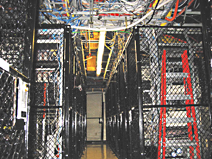
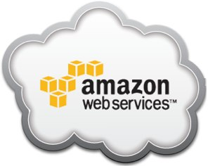
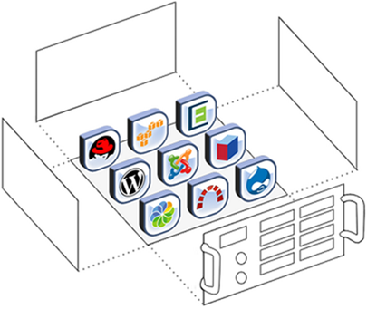
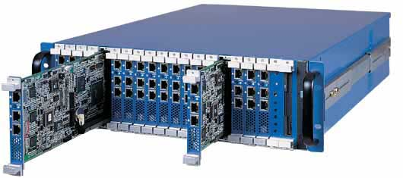
Lowering the application deployment bar
Servers on shelves
Servers in datacenters
Virtual servers in the cloud
Servers on blades
Virtual servers
Notes:
Once developed, an application must be deployed on the Internet, and that is also getting easier and cheaper.
In the early days, you needed a computer to run the service and a connection to the Internet.
It might have been a personal computer in your bedroom or on a shelf in a server room.
If your load grew, you could afford denser server blades in racks, but you were still responsible for maintenance and connectivity.
You could take care of the connectivity part by moving your server into a data center, but it was still your server.
As personal computer power increased, we were able to borrow a page out of the mainframe book and partition a single physical server into several virtual servers.
Amazon and others took care of scaling and connectivity by offering virtual servers in their data centers, but it still took a geek to configure and manage them
Today, the level of abstraction is moving still higher and lowering the geek bar.
It is possible to deploy a server with installed applications in just a few minutes.
Let’s look at an example.

Slide 5

Demo server
http://larrypress.bitnamiapp.com
Notes:
To demonstrate the ease of deploying applications, I created a virtual machine on the Amazon cloud and installed Web, wiki and blog servers.
Visit the server and check the three applications.
It only took about ten minutes because I used Bitnami, a service that simplifies deploying a virtual server and installing applications on it.

Slide 6
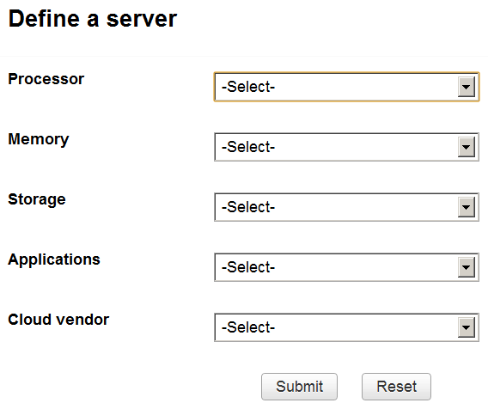
Notes:
Bitnami and others like it are raising the abstraction level.
Soon we may be able to describe a virtual machine – its speed, memory and storage – and deploy it and its applications using a form like the one shown here.
In addition to specifying the server and its applications, this hypothetical form allows one to select cloud vendors.
Today, Bitnami is tied to Amazon’s cloud, but one can imagine making a simple choice of cloud vendors.

Slide 7
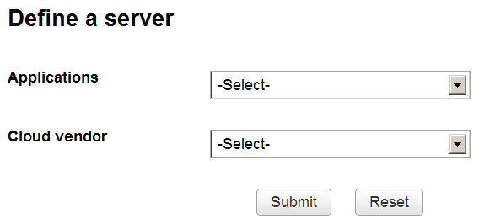
Notes:
The abstraction level could go higher, automating the dynamic allocation of resources needed to run the applications.
In that case, one could just pick a vendor and select applications.
If that happens, your grandmother will be her own system administrator.

Slide 8
Summary
Notes:
We have seen that both application development and application deployment have become easier with time.
This drastically cuts the investment in time and money needed to create and deliver a new application.
We demonstrated the creation of a virtual machine with a blog, wiki and Web server.
We created it in the Amazon cloud using Bitnami’s packaging service.

Slide 9
Self-study questions
Select one of the case studies at:
http://aws.amazon.com/solutions/case-studies/
And briefly describe what they did and why they did it.
What do people mean when they say applications deployed in the cloud are scalable?
If deploying servers and application becomes even easier, do you see any advantages to operating your own server with your data and applications? Explain.

Slide 10
Resources
Bitnami:
http://bitnami.org
Amazon Web services:
http://aws.amazon.com/
Video (8:27) demo of server creation and application launching:
http://www.youtube.com/watch?v=HqW-05cAUpc
Democratization of application development:
http://cis275topics.blogspot.com/2011/10/democratization-of-application.html
Step by step creation of the server in this presentation:
http://cis275topics.blogspot.com/2012/05/deploying-applications-in-cloud.html

