Slide 1
Fair use of copyrighted material
Skills: none
Concepts: four considerations in determining fair use
This work is licensed under a Creative Commons Attribution-Noncommercial-Share Alike 3.0 License.

Slide 2
Where does this topic fit?
Internet concepts
Applications
Technology
Implications
Internet skills
Application development
Content creation
User skills

Slide 3
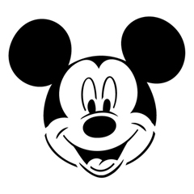
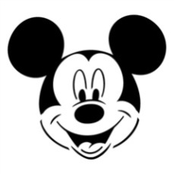
This image is copyrighted.
May I use it?
Notes:
The image of Mickey Mouse is copyrighted, but you can still use it under some conditions.
For instance, my purpose in using it here is educational and my use of the image is not costing the copyright holder revenue or licensing opportunities.
I am pretty sure a court would consider this fair use of the copyrighted image, though one can never be sure since “fair use” is not rigorously defined.
Courts consider four factors in deciding fair use claims: The nature of the copied work, its purpose and character, the amount and substantiality of the portion used and the effect on the work’s value.
Let’s take a quick look at each factor.

Slide 4
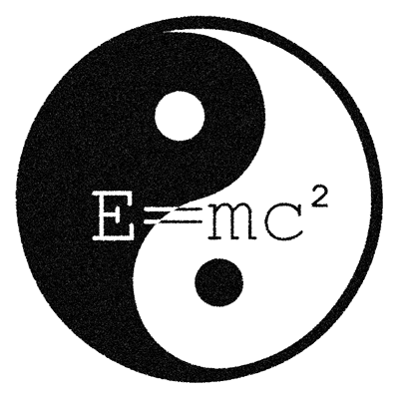
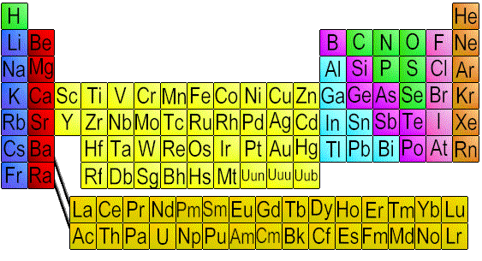
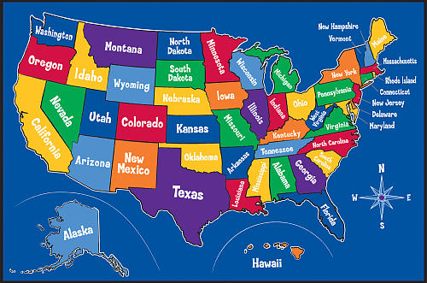
The nature of the copied work
Facts and ideas can not be copyrighted — only their specific expression can be protected.
Notes:
A fact or idea can not be copyrighted, only a particular expression of the fact or idea.
In these examples, the ideas behind the map of the US, the periodic table of the elements or the equivalence of mass and energy are not copyrighted, but the specific expressions are.
You could not reproduce the US map as is, but you could do your own map with different colors and type fonts.
The same goes for the specific colors and layout of this version of the periodic table and you could come up with your own illustration for E=MC^2, you could not use this exact yin-yang image.

Slide 5
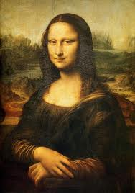
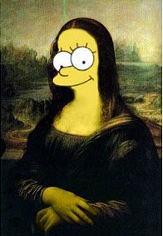
Purpose and character
Is the purpose commercial or non-profit education?
Does it add something new or is it just derived from the original to make a profit.
Notes:
It is obvious that the image on the right is not designed to fool anyone and substitute for the Mona Lisa.
The original has been significantly modified and it purpose is to entertain and amuse the viewer.
My purpose in using these images is educational – to illustrate the idea of fair use.

Slide 6
Amount and substantiality of the portion used
If an insubstantial portion of the copyrighted work is copied, that is fair use. You should only copy as much as you need for your purpose. For example, quoting from a book or movie when writing a review is OK.
Notes:
If you use an small, unsubstantial portion of a copyrighted it may be fair use.
In this example, the well known Mona Lisa smile or eyes could be used to illustrate a review of the painting or a portion of a biography of the painter.

Slide 7
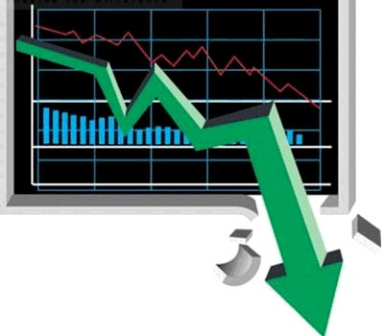
Effect on the work's value
It would not be fair use if a copy were a direct substitute for the original work, competing with it in the marketplace. Even if it was copied for non commercial use, it would not be fair use if it deprived the owner of licensing fees.
Notes:
The effect on the works value is the final consideration.
If you sell your copy to the same people as the original, your use is not fair.
Even if you give it away for education, the new material might be infringing because you deprive the copyright holder. For example, a professor cannot just copy articles or chapters of books to pass out in class.

Slide 8
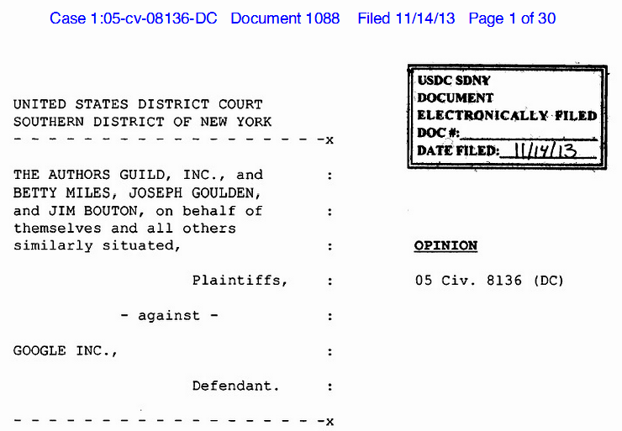
A sample case: Google book scanning
US Circuit Judge Denny Chin Ruled that Google’s book scanning was fair use because it is “highly transformative” and did not harm the market for the original work.
Notes:
Here is an example of a court ruling on fair use.
Google was scanning copyrighted books for use in search.
They were not displaying or selling the full works, just showing them in search results.
They were sued by the Authors Guild, but the judge ruled that the scanning was fair use.

Slide 9
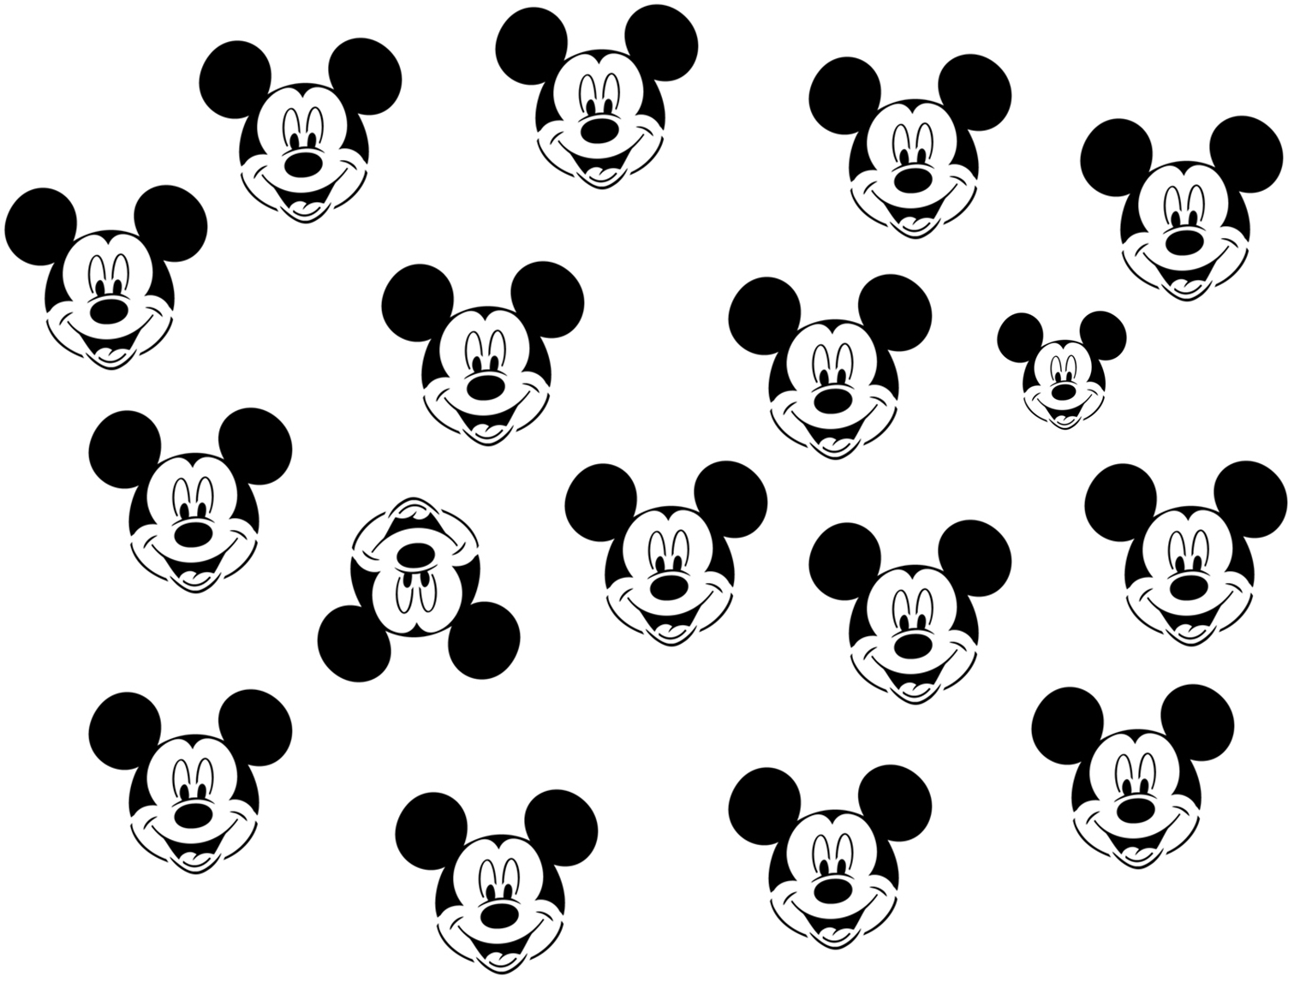
Summary
Notes:
We have seen four factors a court would consider in deciding whether or not use of some copyrighted material was “fair” -- The nature of the copied work, its purpose and character, the amount and substantiality of the portion used and the effect on the work’s value.
We also noted the Google book scanning case, in which the court ruled that scanning copyrighted books for use in search was fair use.

Slide 10
Self-study questions
Without looking back, can you recall the four factors a court considers when deciding fair use cases?
For each of the four factors, give an example of something that you believe should qualify for fair use.
For each of the four factors, give an example of something that you believe should not qualify for fair use.
Would you consider my use of two YouTube videos in the topic module at http://bit.ly/AaBWC2 to be fair use? Explain your answer.

Slide 11
Resources
Wikipedia article on fair use: http://en.wikipedia.org/wiki/Fair_use
Measuring Fair Use: The Four Factors:
http://fairuse.stanford.edu/overview/fair-use/four-factors/
The Google book scanning case:
http://gigaom.com/2013/11/14/google-wins-book-scanning-case-judge-finds-fair-use-cites-many-benefits/
http://business.time.com/2013/11/15/google-just-won-one-of-its-most-important-victories-ever/
Larry Lessig video on copyright history and impact in the US:
http://randomfoo.net/oscon/2002/lessig/free.html

