Slide 1
Who am I?
Who are you?
What is this class about?
How does the class work?
Notes:
Let’s discuss these four questions.

Slide 2
Who am I?
Who are you?
What is this class about?
How does the class work?
Notes:
Let’s discuss these four questions.

Slide 3
CSUN
USC
University of Lund
CSUDH
IBM
System Development Corporation
Consulting company
Notes:
I’ve worked in industry and academia and have done consulting.
First I worked at IBM and the System Development Corporation.
Then I taught at USC and the University of Lund, Sweden.
Then I had a consulting company.
Now I teach at CSUDH – this class only
A longer resume and list of publications is at http://som.csudh.edu/fac/lpress/

Slide 4
Consulting company clients
Computer Usage Corporation | IBM Corporation | Beatrice Foods Corporation
NASA Goddard | Los Angeles City Schools | Los Angeles Library
Mount St. Mary's College | Rexon Business Machines | Perfect Data Corporation
IMS International | Texas Instruments | Santa Monica College
Philips, Austria | Sony Corporation | National Bureau of Standards
John Wiley and Sons | Lehman Brothers Kuhn Loeb | MicroPro International
Apple Computer | SoHaR, Inc. | Rome Air Development Center
Surpass Software Systems | SCOPUS Tecnologia | Van Nostrand Reinhold
Software Technology | Clancy Associates | EIES
Softel | California State University | RAND
UN Development Programme | Department of Defense | Toyota of America
Giga Information Services | Colson, Hicks, Edison, et al | Matrix.Net (was MIDS)
Int’l Telecommunication Union | Hyundai Motors of America | Lantronix
UNCTAD | Democracy Council | California State University
USAID | Internews | US Trade Commission
Most recent: State Department task force on the Internet in Cuba
Notes:
I’m still consulting and teaching one class at CSUDH.
If you are curious, you can see a longer resume and list of publications is at http://som.csudh.edu/fac/lpress/

Slide 5
Commercial data processing, multi-processor operating systems, simulation, decision table translation, simulation of concept acquisition, multivariate data analysis, pattern recognition (discriminant analysis), study of problem solving behavior in executives, computer applications in education, computer art, teleconferencing, office automation, the history of computing, product management, local area networks, expert systems, computer-human interfaces, software import/export, networks in developing nations, study of the global diffusion of the Internet, municipal networking, telecommunication policy, computer support of cooperative work, and Internet strategy and implementation.
Things I have worked on

Slide 6
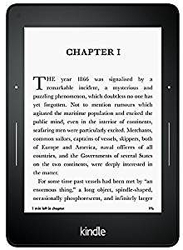
What do professors do?
Professors learn new things, then they write about and teach them.
How has the Internet changed the job?
It’s a very cool job. Learning, writing and teaching have all been changed by the Internet.
Short academic bio
Find information and people to collaborate with
3.3 million blog views
E-text and publication
Notes:
I use the Internet to find information and, more important, to find people with relevant knowledge and interests. We then use the Internet to collaborate.
I have switched my focus from academic papers and articles to social media – primarily blogs, Twitter and Reddit.
I teach with electronic texts because they allow me to cover what I consider relevant and important and they can be continuously revised. The latter is important because significant parts of this course change every semester. I also publish online, for example, this paper went online earlier this week: https://www.ascecuba.org/c/wp-content/uploads/2020/01/v29-asce_2019_10press.pdf

Slide 7
Do you remember the next question we are asking today?
Notes:
If not, you are not paying sufficient attention – focus and be mindful in class. You should be aware of the organization of a lecture, not just the details. Ask questions if something is confusing and offer relevant comments when you have something to add.

Slide 8
Who am I?
Who are you?
What is this class about?
How does the class work?
Notes:
Let’s discuss these four questions.

Slide 9
Majors
12 General business
3 Business analytics
2 Information systems
One each:
Accounting
Computer Tech: Homeland Sec
Earth Science
Global Log & Sup Int Track
History
P.E.:Pre-Physical Therapy
Political Sci:General
Computer science
Year in school
Freshman 2
Junior 8
Senior 15
How will this variety affect our class?
Notes:
Don’t worry if you do not have a geek major.
There are no hi-tech prerequisites for this class. I assume you can do basic word processing, create simple presentations, Web searches and email. You are doubtless familiar with other programs and Internet services – collectively you are familiar with more of the Internet than I am. (For example, I seldom use Facebook).

Slide 10
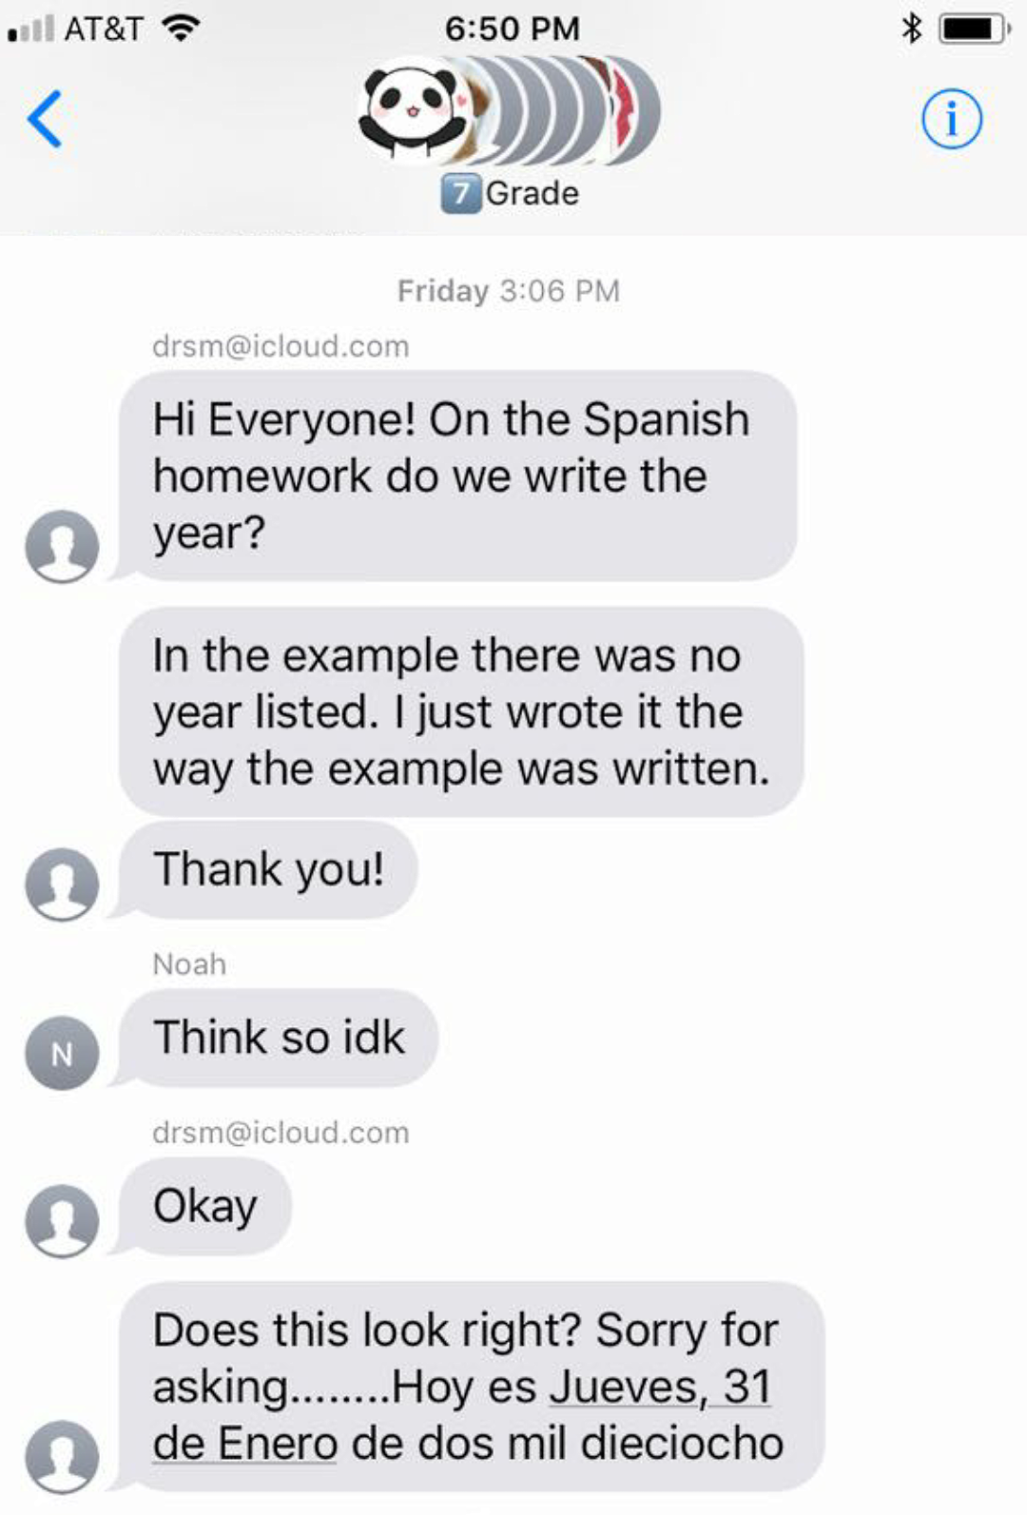
The Internet is a collaboration tool. Use it in this class.
Notes:
Everyone thinks of the Internet as a news source, place to buy things, keep track of friends, etc., but it’s most important professional and educational use is as a tool for collaboration.
This example students using the Internet to collaborate came from my 7th-grade grand daughter Sofia.

Slide 11
Do you remember the next question we are asking today?

Slide 12
Who am I?
Who are you?
What is this class about?
How does the class work?
Notes:
Let’s discuss these four questions.

Slide 13
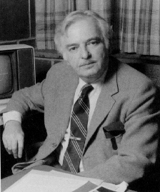
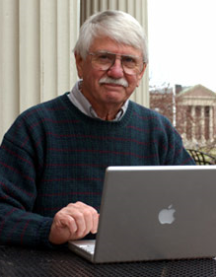
These guys invented our class
We will cover concepts and skills needed for success as a student and after graduation as a citizen and a professional.
John Kemeny
Thomas Kurtz
Why are some of the words on this slide bold-face?
Notes:
Kemeny and Kurtz taught the first ever “computer literacy “ course at Dartmouth in the 1960s.
The course was intended to be taken by all students, regardless of their major.
As technology evolved, the course changed, but the goal has remained the same.
We are now in the Internet era in which computers are communicate with each other, so we have renamed the class “Internet Literacy.”
We will spend time on both skills and concepts.
Background historical material if you are interested: not required for our class:
Final report to the funding agency, the National Science Foundation:
https://files.eric.ed.gov/fulltext/ED024602.pdf
Computers in Higher Education. Report of the President's Science Advisory Committee. President's Science Advisory Committee. Washington. D.C. Pub Date Feb 67:
https://files.eric.ed.gov/fulltext/ED029518.pdf
Dartmouth computer center brochure:
http://dtss.dartmouth.edu/brochure/pages/page01.html

Slide 14
Concepts
Applications
Implications
Technology
Skills
Creating content
Developing applications on the Internet platform
User skills

Slide 15
First the concepts, then the skills
Internet applications and technology and their implications for individuals, organizations and society
Let’s look at each of these terms, starting with applications.
Notes:
These terms are found in the tagline for our class – you should make them part of your active vocabulary.
It is not enough to be able to passively understand these words when you read or hear them, you must be able to use them in your own speaking and writing.
If you understand and can use these terms, you will see where given topics fit in the framework of our class.

Slide 16
Internet applications and technology and their implications for individuals, organizations and society
By applications I mean things we use computers and the Internet for, for example:
Watch movies
Listen to music
Write reports
Buy things
Plan terror attacks
Play games
Talk with friends
What are some other applications? Which of these things is not like the others?
Notes:
The word application is used in two ways – to describe something we use the Internet for and to refer to the programs we use to do those things. For example, you do word processing with Microsoft Word or network with your friends using Facebook. In this class, we are concerened with the the things people use computer and the Internet for.
Note that not all applications are positive.
When the Internet began, we were naïve and did not anticipate that, like any other tool, it could be used for good or bad for good and bad.

Slide 17
Note that people also use the word “application” or “app” to describe a specific program.
But in this case, I am using it to describe something people use the Internte for, like search or streaming movies.

Slide 18
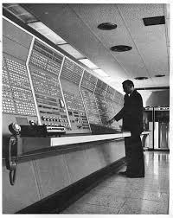
Internet applications and technology and their implications for individuals, organizations and society
Communication
Storage
Memory
Processing
Is the improvement slowing down?
The computer I used for my dissertation research
Notes:
The computer I used for my dissertation was not in a room, the room was the computer.
The computer in your phone is faster and has more memory and storage than this one.
Technology in all four areas improves rapidly and is doing so at an increasing rate.
This class is not highly technical, but I want you to understand enough about computers and the Internet so as not to be intimidated and to know to be able to ask questions when something does add up. In other words, I don’t want you to be intimidated by the technology.

Slide 19
Internet applications and technology and their implications for individuals, organizations and society
What has changed because of the Internet?
What will change because of the Internet?
How has the Internet changed your life? Changed an organization you know of? Changed society?
Notes:
We will look at changes the Internet has made to date and speculate on we can expect in the future.

Slide 20
We’ve covered the concepts, now the skills
We will cover concepts and skills needed for success as a student and after graduation as a citizen and a professional.

Slide 21
Skills
Application development
Content creation
User skills – focus on collaboration

Slide 22
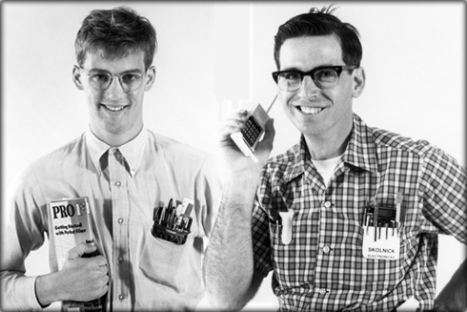
Skill -- application development
Batch processing and time sharing
Personal
computer
Internet
Four computing eras -- application development keeps getting easier, but we do more complex things.
Notes:
As technology improves, our tools improve and the kinds of applications we can create become more powerful.
During the early days of computing, we shared large, expensive computers by connecting terminals to them or submitting jobs in batches and waiting – usually several hours – to get the results.
In those days, programs were written by specialized engineers.
With the advent of personal computers, managers, teachers and others were able to develop applications using tools like spreadsheets or personal database managers.
Today, the general public can easily develop simple applications using tools like blogging, survey, database development services.
Modern technology makes new, complex applications possible and, while it is easier to develop simple applications, professional programmers are still needed to develop complex applications.
New programs were written by professional programmers in those days and I
This enables us to develop simple applications easily and frees us to develop previously impossibly complex applications.

Slide 23
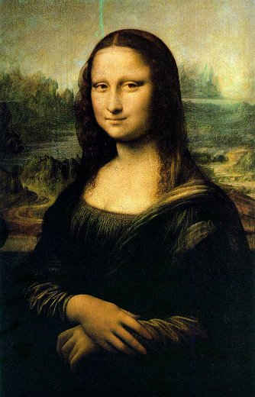
Skill – content creation
What are the four data types we will work with?

Slide 24
Skill – content creation
Text
Video
Audio
Image
Notes:
These are the four data types we will be working with.
We’ll start with text – writing.
The Internet has increased the importance of professional writing – we do conversational writing, collaborative writing and write short documents.
You already know the mechanics of text and word processing, but we can draw attention to Internet writing.

Slide 25
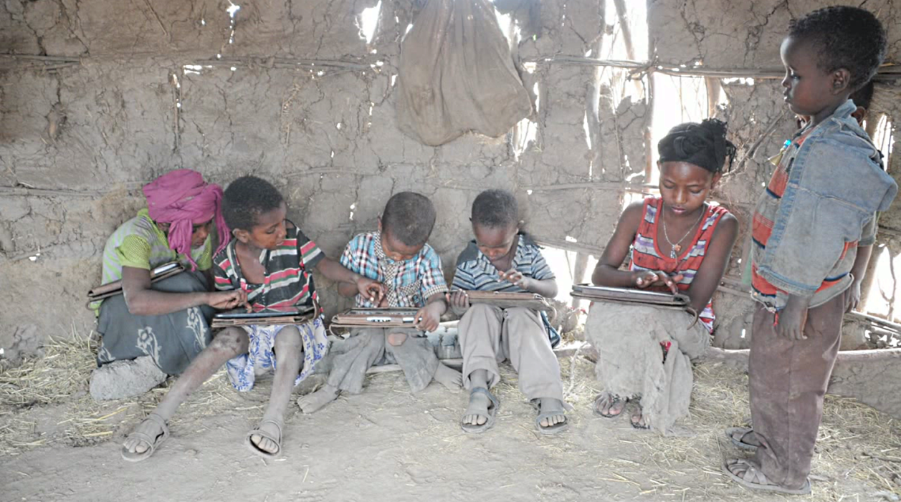
Skill – user skills
Students teaching students new skills
Notes:
You will pick up some tricks and skills with programs you use – students are as likely to teach them to you as I am.
Collectively, you know about all sorts of things that I don’t and I know a few that you don’t.

Slide 26
We will cover concepts and skills needed for success as a student and after graduation as a citizen and a professional.

Slide 27
As a student
As a student, how have you used the Internet?
Notes:
.

Slide 28
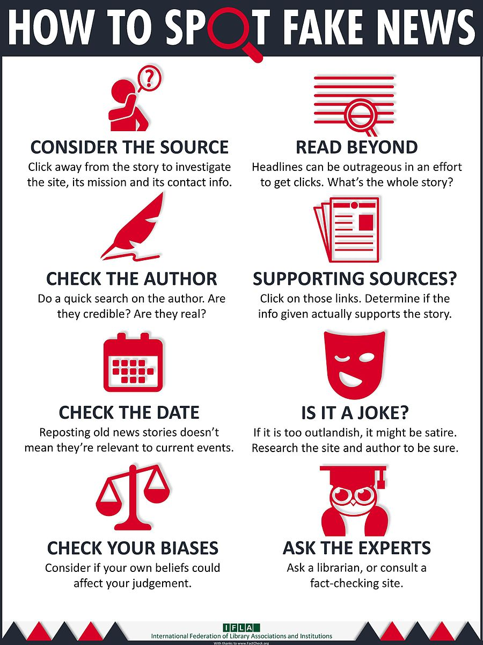
As a citizen
How does the Internet impact politics? Give positive and negative examples.
Notes:
During the last few years, we have realized the significance of the Internet in politics. Like all tools, the Internet can be used for good and bad. For example, news can be fake or true and well documented.
How to spot fake news: https://www.ifla.org/publications/node/11174

Slide 29
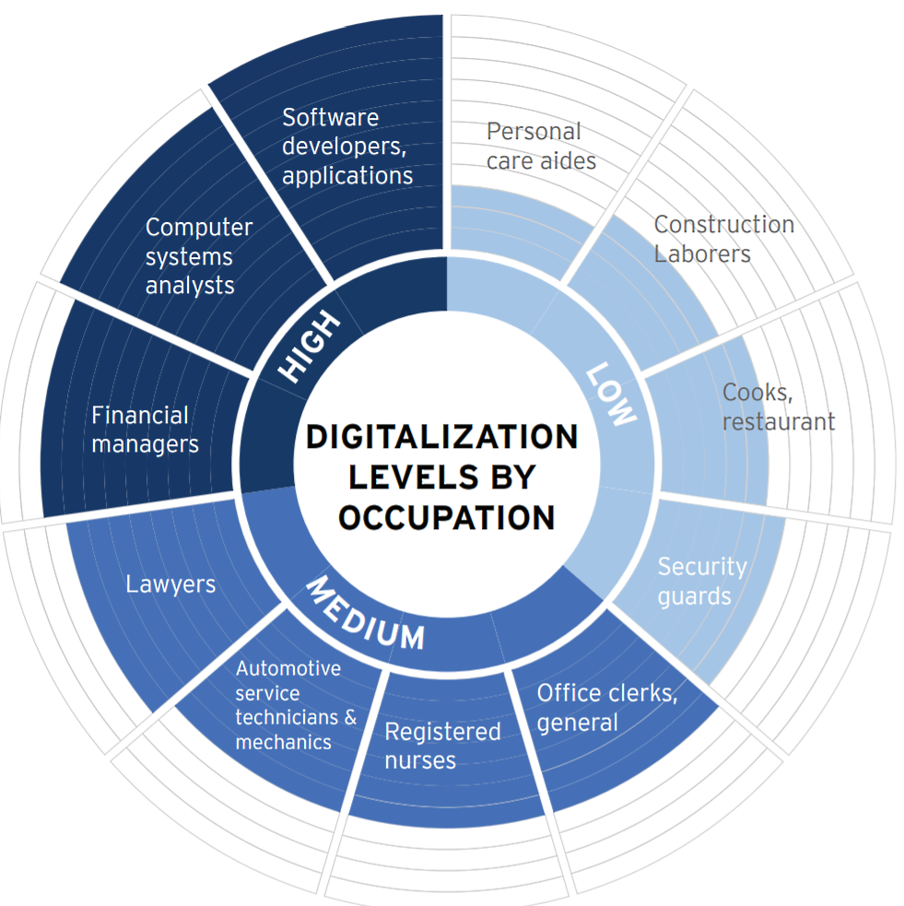
As a professional
Which jobs have been/will be changed by digital technology?
Notes:
This figure is from the Brookings Institution report Digitalization and the American workforce:
https://www.brookings.edu/research/digitalization-and-the-american-workforce/

Slide 30
Do you remember the next question we are asking today?

Slide 31
Who am I?
Who are you?
What is this class about?
How does the class work?
Notes:
Let’s discuss these four questions.

Slide 32
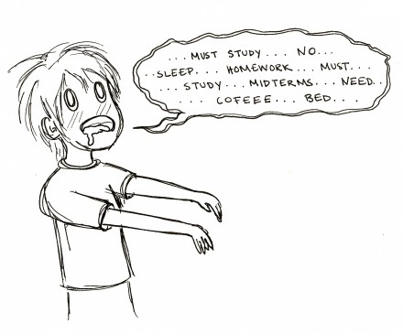
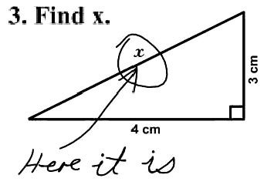
How does the class work?
Grading
Assignments 30%
Midterm & final 50%
Quizzes 20%
Notes:
Grades will be based on assignments, exams and quizzes.

Slide 33
How does the class work?
Assignments
Full credit
half credit
no credit
Assignment format and ground rules
Notes:
We will have many small assignments with a simple grading system.
Assignments are due before class on the due date and must be typed, not hand written, and your name(s) and the assignment number must be printed on the first page.
Turn in each assignment separately and if one is more than one page, staple them together.

Slide 34
Assignment ground rules
Strict because we are careless online
Assignments must be typed or printed -- no hand writing.
Type your name (s) on the front page.
Type the assignment number and title on the front page.
Staple each assignment separately.
Don’t bother making a separate cover page unless you want to
There will be some group assignments.
Notes:
These are the assignment ground rules.
If you do not follow them, your assignment will be incorrect.

Slide 35
How does the class work?
Exams
Midterm 15%
final (cumulative) 35%
Notes:
The midterm will be a little after the middle of the class to get it out of synch with your other classes.
The final will be cumulative.

Slide 36
How does the class work?
Quizzes
Quiz questions online
Help to focus studies
Collectively, you know all the answers
Why do you think I give quizzes each week?
Notes:
We will have weekly quizzes on the material covered during the previous week – lectures, topic modules, class blog posts, and the discussion presentation.
The quizzes are for self-diagnosis – they will show you where you are shaky.
If you collaborate and teach each other, you can answer all of the quiz questions correctly.
After a quiz is complete, I will post the questions on the quiz-questions blog.
You can review them alone, with friends or as a class.
Perhaps you can use the Internet to organize this study collaboration.
Some of them will be on the midterm and final.

Slide 37
Questions at work vs. questions at school
School failure: getting the wrong answer
Work failure: not knowing how to get the right answer
Play this excerpt, 1 min 4 sec
The quizzes are for self diagnosis -- getting the right answer requires that you know you are lost.
Full presentation by Cathy Davidson, Duke University
Notes:
Cathy Davidson tells us why employers have trouble training college graduates.
On the job, knowing what you do not know and then asking the right question is important.
In school you have a chance to learn and practice that skill.
The purpose of self-diagnostic questions is to let you know you are lost.
Once you know you are lost, you need to figure out how to get the right answer. You have many resources – friends, classmates, Google, review of class prsentations, etc.
If you like what professor Davidson says, listen to the entire talk.

Slide 38
The grade curve
Blog post: curve relative to the highest score
Notes:
We will curve relative to the top person in the class, so you are not competing with each other.
If you help someone, you will learn more than they do.

Slide 39
For taking responsibility of the conduct of the class.
Small things from time to time
Something big – 15%
Notes:
I may give a little extra credit from time to time.
If you want to dig into a topic that is relevant to this class – learn about it and present it in one way or another, you can get up to 15% extra.
Note that this can only improve your grade and you can get a 100% A without extra credit. (Extra credit will not change the grade of the top person in the class at all).

Slide 40
Each week
Discussion presentation
Topic modules -- our “textbook”
Assignments – due the following week
Notes:
Topic modules are like sections of chapters in a textbook – focused on a single topic. Most are PowerPoint presentations. Be sure to read the text accompanying the slides!
Assignments will almost always be due by the start of class on the following week.

Slide 41
Discussion presentation
Last week’s class
Anonymous study-habit surveys
Assignment feedback
Current events
Notes:
I will start each class with a discussion presentation. This is the sort of thing it will contain. Current events is my favorite part and they weill become required material – watch for them on exams and quizzes.

Slide 42
Anonymous study habit survey
What grade do you expect to get in this class? (A-F)
Notes:
We will have periodic anonymous study habit surveys.
They will have no effect on your grade, but will give you feedback on your study habits relative to your classmates.

Slide 43
Electronic text
A topic module
The corresponding assignment
2013 Sloan-Merlot award for information technology teaching material
Notes:
Our e-text consists of narrowly focused topic modules and corresponding assignments, which are linked together.
Our e-text won a national award in 2013.
You can think of the topic modules as the rough equivalent of a section in a textbook chapter.

Slide 44
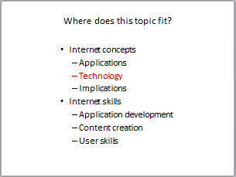
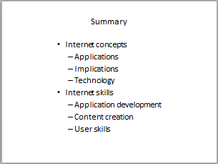
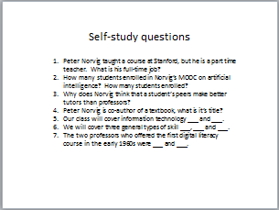
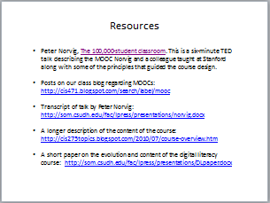
Presentation format
The presentation slides …
Notes:
Nearly every presentation will begin with a slide listing the skills and concepts it covers, followed by a slide showing where it fits in our class outline.
They will conclude with a summary slide, self-study questions and links to other resources on the topic.
The self-study questions are just that – not assignments to turn in.
Use the list of skills and concepts and the self-study questions to be sure you understand the presentation.

Slide 45
Slide format
Notes:
Many slides have text annotation.
To understand a presentation, you must study the annotations as well as the slides.
Some students print the slides with annotation and assemble a paper “textbook” in a folder.

Slide 46
Where do you find this stuff?
The class Web site
Notes:
Follow the links on our class Web site for more on the class mechanics.

Slide 47
Zen and the art of going to school
At the start of this presentation, I said we would answer four questions. Do you remember them?
Be present and focused – it makes the time go faster and you might get interested in something new.

Slide 48
Summary
We’ve seen that the class covers Internet applications, implications and technology, gotten to know a little about each other and learned how the class is structured and graded.

