Slide 1
Using Google Drive/Docs
Skills: use Google Drive/Docs
Concepts: we download and run programs inside our Web clients, wire-frame diagram, user interface, collaboration
This work is licensed under a Creative Commons Attribution-Noncommercial-Share Alike 3.0 License.
Notes:
This presentation introduces and demonstrates Google Drive (which used to be called Google Docs).
Its primary goal is to explore the capabilities of the Google applications, but we will also see that the application programs are downloaded from Google’s server and executed on our client computer.
Finally, we introduce the idea of a wire-frame diagram, which a programmer would use when developing a new program and a user can use when learning a new program.

Slide 2
Where does this topic fit?
Internet concepts
Applications
Technology
Implications
Internet skills
Application development
Content creation
User skills
Notes:
The presentation falls within the applications portion of the class.

Slide 3
Watch this video
Google Docs in Plain English (2:51)
Notes:
Pause and watch this video before going on.

Slide 4
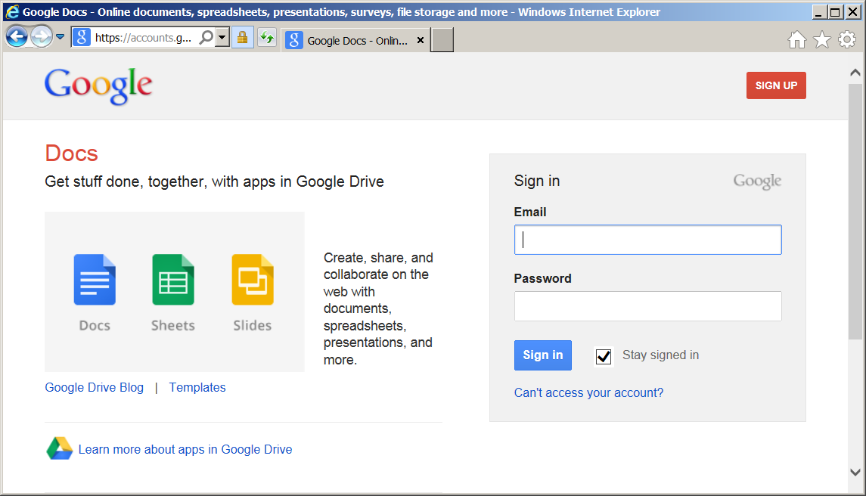
Google drive/docs
What do they mean by “get stuff done, together, with apps in Google Drive?”
Notes:
Browse to either docs.google.com or drive.google.com.
If you do not yet have a Google account or are not signed in to your Google account, you will see this screen.
If you do not yet have a Google account, create one by clicking on the sign up button.
If you already have an account, sign in.
The slogan is saying you and others can collaborate by working together on text documents, spreadsheets, slide presentations and more.

Slide 5
Google drive/docs
Why did Google change the name from Docs to Drive?
Notes:
Google changed the name from docs to drive to emphasize that the documents you are creating, working on and sharing are stored on the Internet or as they say “in the cloud.”

Slide 6
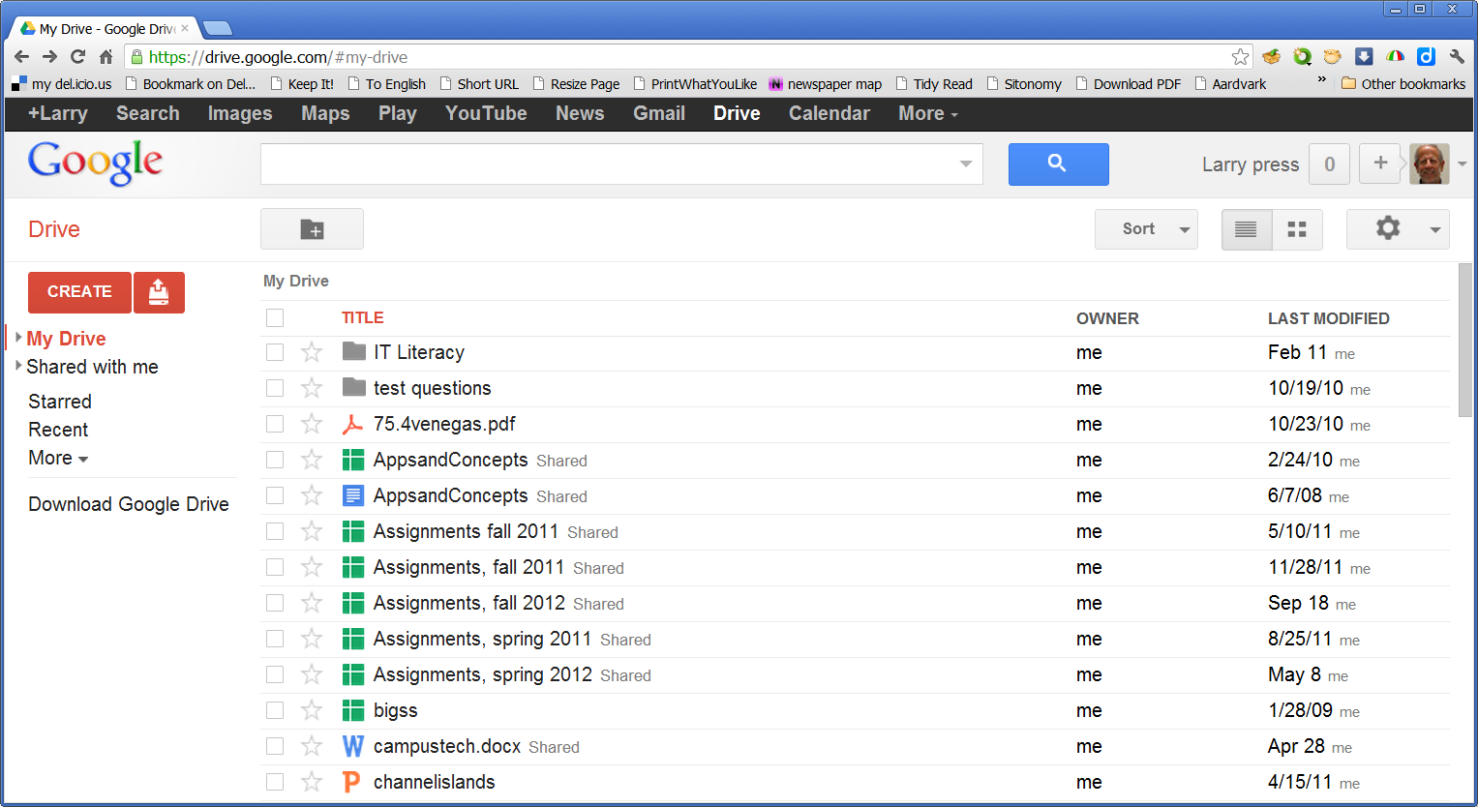
Logged into my account
Notes:
Once you are logged in to your account, you will see your Google Drive directory.
As you see here, I have several files and folders stored on my Google Drive.
If yours is a new account, the listing will be empty.
Let’s stop now and play around with Google Docs.

Slide 7
Demo/play
How do I
Create a new spreadsheet?
Delete a file?
Upload a document?
Sort the files by title?
Share a file with others?
See only presentations?
Rename a file?
See files in a given folder?
Create a new folder?
Go to other Google apps?
Add comments to a Google doc?
Pause to play around with the program. Be sure you discover the answers to these questions.
Notes:
Play around with the program, answering these and other questions.

Slide 8
Reflect after playing around with a new program.
Notes:
After you play around with a new program (or watch a demonstration), pause to reflect on what you have been doing.
Reflect back on the process, think about data flow between the client and server, the program’s user interface and the ability to share a file with collaborators.
Let’s step back and look at the user interface.
For example, what program are we running during when using Google Docs?
After you play around with a program (or watch a demonstration), reflect on what you have been doing.
Reflect back on the process, think about data flow between the client and server and the program’s user interface.
Let’s start our fAnswer on the next slide.

Slide 9
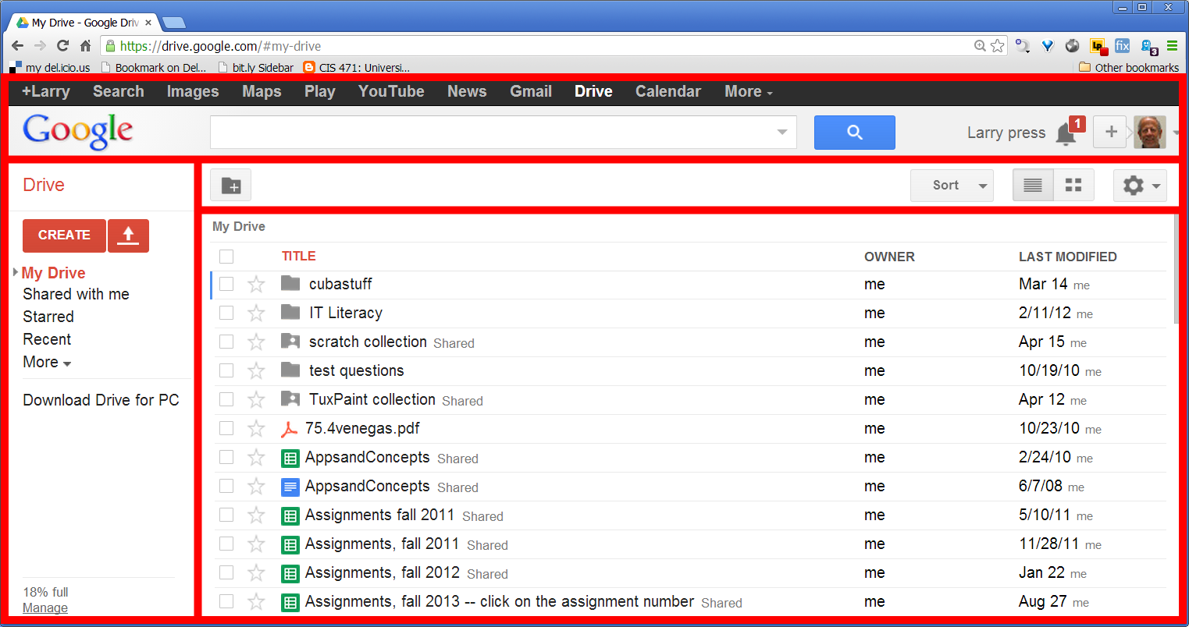
The user interface – a wire-frame diagram
Notes:
Programmers plan user interfaces of new programs using wire-frame diagrams.
Wire-frame diagrams are also useful to someone learning to use a program – making one will help you see the way the user interface is organized.

Slide 10
A
B
D
C
Listing of your files and folders
Links to other Google applications
Settings for this program
Actions for this program
Match the descriptions with the areas within the wire-frame diagram.

Slide 11
A
B
D
C
Listing of your files and folders (D)
Links to other Google applications (A)
Settings for this program (B)
Actions for this program (C)

Slide 12
A
B
D
C
Match the descriptions with the areas within the wire-frame diagram.

Slide 13
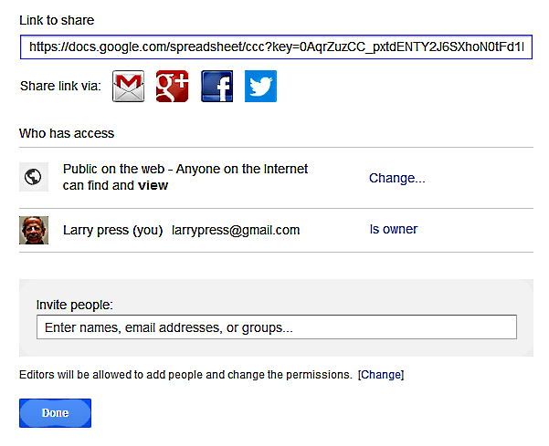
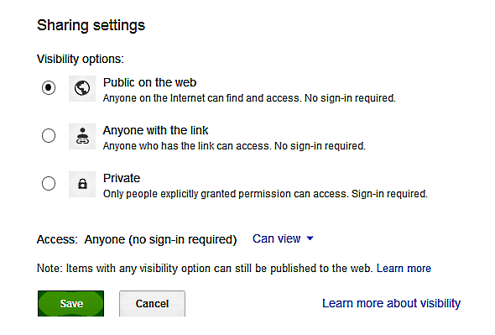
Collaboration
Visibility
Permission
Notes:
Since we save Google Docs on the Internet, we can easily share them with collaborators.
You can control the visibility of a file, keeping it private– even hiding it from search engines -- or sharing it with others.
If you choose to share a file, you can set permissions, controlling whether others can modify the file or not.
You can invite people to share a file by sending them a link or notify them on a social network.

Slide 14
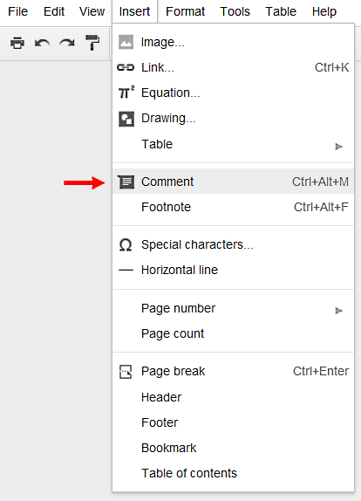
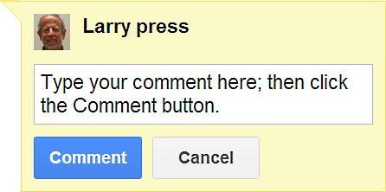
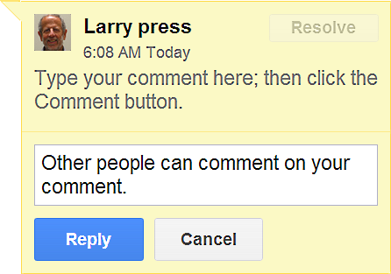
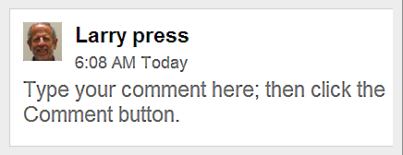
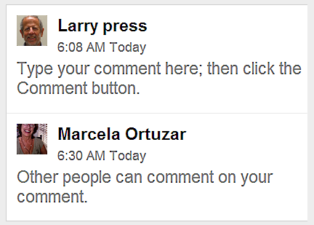
Adding comments
Notes:
To add a comment, place the cursor where you want the comment to appear and select the Insert > Comment command.
You can enter a comment at that point and others can add their comments to your comment.
That might be useful when elaborating something or in deciding between different ways of resolving a disagreement.

Slide 15
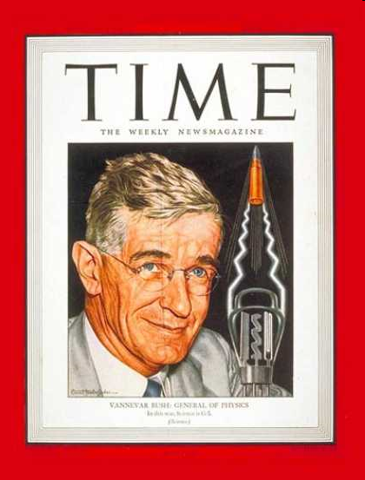
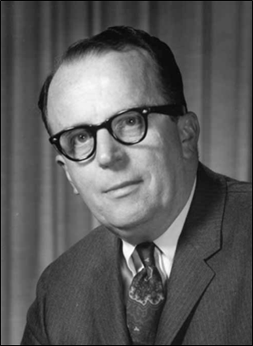
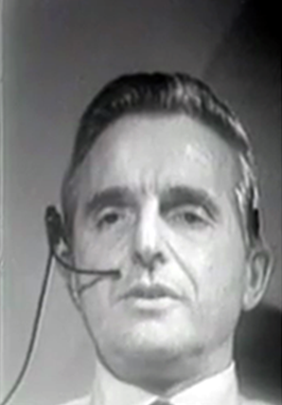
The fathers of networked collaboration
Vannevar Bush
J. C. R. Licklider
Doug Engelbart
Notes:
Vannevar Bush had the vision before world war 2, but did not foresee the technology.
In the early 1960s, J. C. R. Licklider realized that networked computers would be the appropriate technology for collaboration, so he articulated the vision and found funding for the research.
In addition to funding the research that led to the Internet and personal computer, Licklider funded the work of Doug Engelbart, who built research prototypes of the collaboration tools we use today.

Slide 16
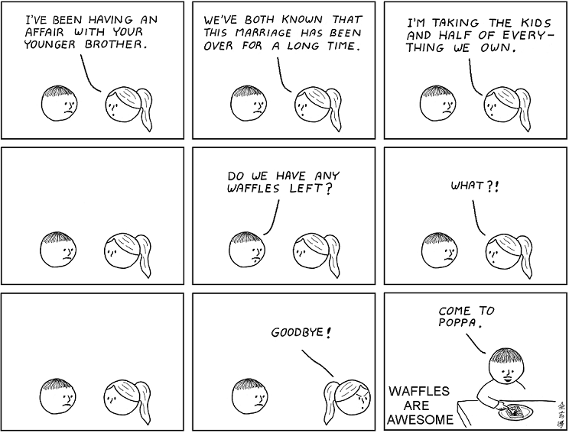
Good news, bad news
(This slide needs a better joke– can you find a good one?)
Notes:
We have taken a quick look at Google Docs.
The good news is that you know how to get started with a new program and know your way around Google Docs.
The bad news is that there are a lot of other features that you have not yet discovered.
The good/bad news is that Google programmers will add features and make changes to the program in the future.
So, you have to keep exploring and keep learning – it’s up to you.

Slide 17
Summary
A
B
D
C
Notes:
We have looked at the user interface and functions of Google Docs.
We also reflected on strategies for learning a new program.

Slide 18
Self-study questions
Why are some data files stored locally today – why not store them all on the Internet?
How do programmers use wire-frame diagrams?
How do users use wire-frame diagrams?
Describe a school situation in which you would like to share a document with someone else.
Describe a professional situation in which you would like to share a document with someone else.
The Google Docs word processor program is loaded from a server on the Web. When is it loaded?
What are advantages of the Google Docs word processor over Microsoft word?
What are the advantages of Microsoft Word over the Google Docs word processor?
(Continued on next slide)

Slide 19
How is each Google Docs user-interface region used?
A
B
D
C

Slide 20
Resources
Google Docs:
http://docs.google.com
Getting started guide:
http://docs.google.com/support/bin/static.py?hl=en&page=guide.cs&guide=21008&from=21008&rd=1
Google Docs in plain English:
http://www.youtube.com/watch?v=eRqUE6IHTEA&feature=player_embedded
Some Google Docs tips and tricks:
http://www.labnol.org/internet/office/google-docs-guide-tutorial/4999/

Slide 21
Self-study questions
Explore the options for sharing documents – what are they?
Describe a school situation in which you would like to share a document with someone else.
Describe a professional situation in which you would like to share a document with someone else.
The Google Docs word processor program is loaded from a server on the Web. When is it loaded?
What are advantages of the Google Docs word processor over Microsoft word?
What are the advantages of Microsoft Word over the Google Docs word processor?

