Slide 1
Using the Google Docs word processor
Skills: familiarity with Google Docs, creating and sharing text document on the Internet
Concepts: stand-alone applications versus networked applications, downloading programs from Web sites
This work is licensed under a Creative Commons Attribution-Noncommercial-Share Alike 3.0 License.
Notes:
This presentation shows how to use the Google Docs word processor create and share documents.
It is an example of a networked application in which both the program and data are stored on the Internet.

Slide 2
Where does this topic fit?
Internet concepts
Applications
Technology
Implications
Internet skills
Application development
Content creation
User skills
Notes:
This presentation shows how to create a shared text document.

Slide 3
Watch this video
Google Docs in Plain English (2:51)
Notes:
Pause and watch this video before going on.

Slide 4
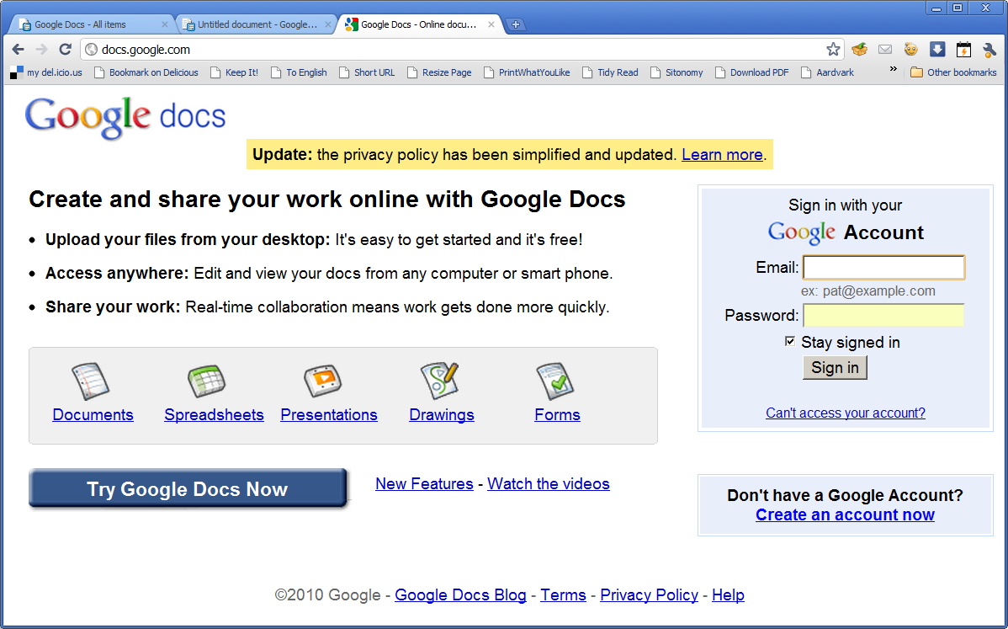
Google Docs
http://docs.google.com
Notes:
Google Docs is a collection of Internet-based productivity applications.
Desktop productivity suites like Microsoft Office typically include word processing, spreadsheet, presentation and database programs.
Google Docs is an Internet service that includes word processing, spreadsheets, presentation, form preparation and drawing applications.
This presentation focuses on the word processing application, but the others are similar.
Go to docs.google.com and create an account if you do not already have one.
If you are creating a new account, think about the account name because you will be using it for many years.

Slide 5
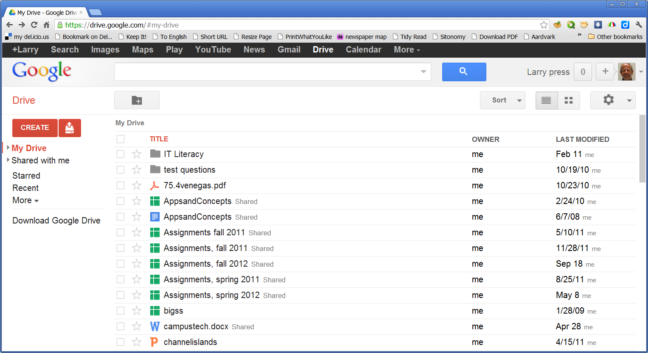
Google Docs home page – your Google drive
Notes:
My Google Docs home page shows documents that I have created and that others have shared with me.
The left hand column allows me to create (or upload) a document (red box) or apply a filter so I only see some of my documents listed.
All of these data files are stored in my space on a Google server – in the “cloud.”
The right hand three columns show the document name and type (using a small icon), the owner of the document and when and by whom it was last modified.
I can open a document by clicking on its title.

Slide 6
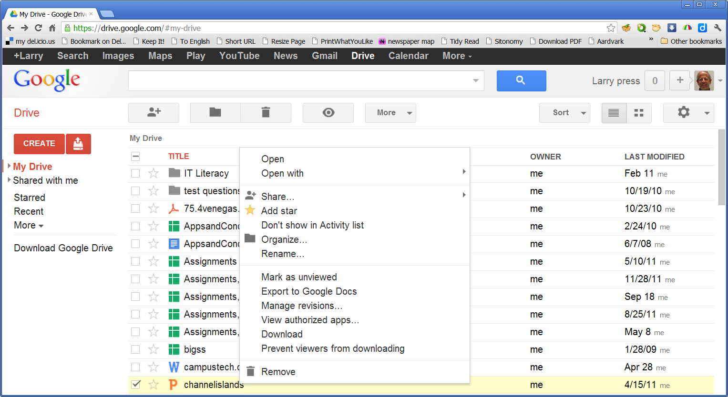
Commands
Notes:
If I right click on the document name, a menu listing optional commands appears.
I can open it, delete it, change its name, and so forth.
Note that a row of command icons has also appeared above the list of file names.

Slide 7
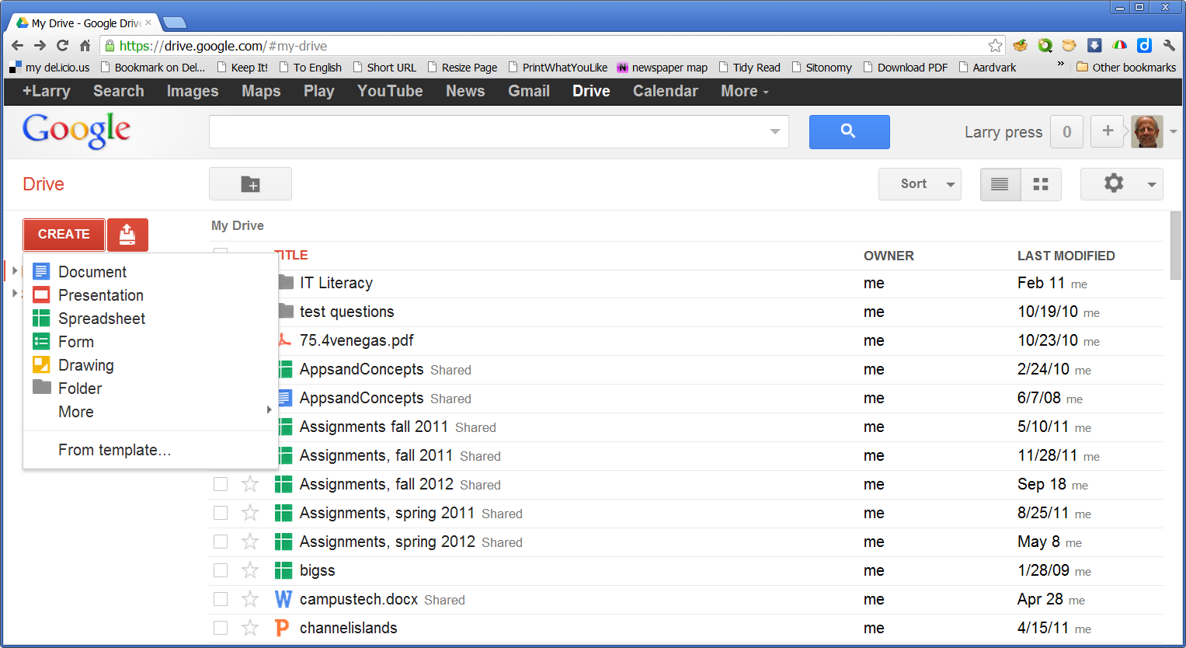
Create a new document
Notes:
Clicking the red “Create” button on the left gives me a choice of new document types.

Slide 8
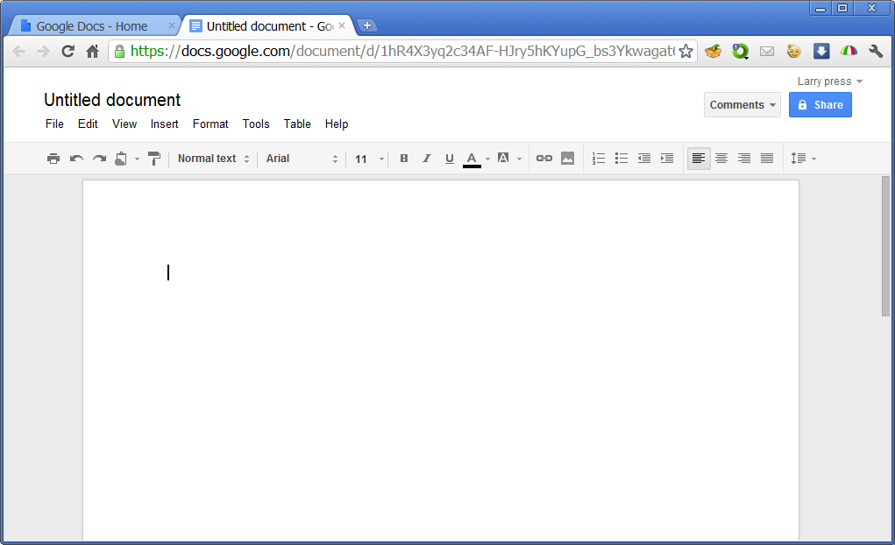
A blank word processing document
Notes:
An empty document window opens inside a stripped down word processing program.
(I added the red outline to highlight the document window).
Note that the document is inside the browser.

Slide 9
A word processing program
Notes:
The word processing program does not have as many commands as Microsoft Word, but it is sufficient for many documents.

Slide 10
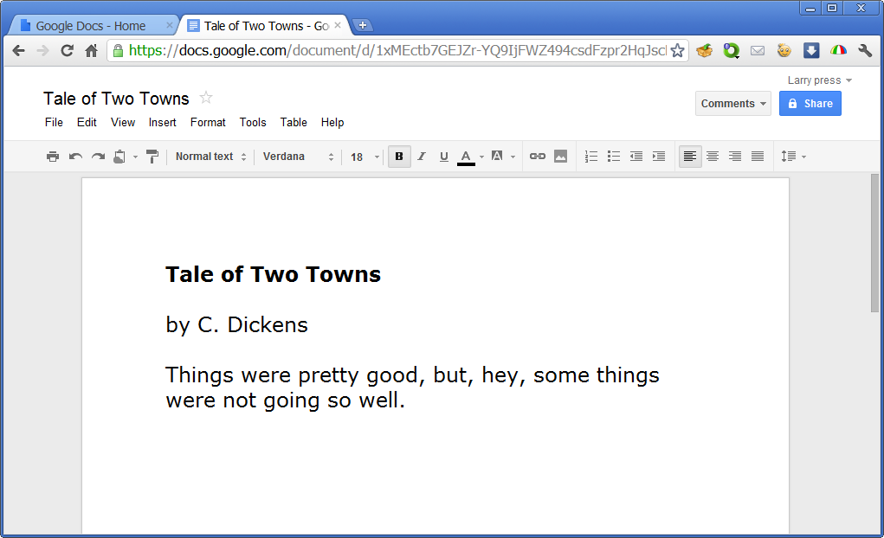
Using the word processing program
Notes:
You type and edit your document in the same way as you would with a desktop word processing program like Microsoft Word.
The word processing program does not have as many options as Microsoft Word, but I was able to create a document, change fonts, add a bold face title, and so forth.
When you finish, you do not have to save the document – it is automatically stored on the Google Docs server, in the “cloud,” not in your computer’s storage.
If you want a local copy, you can download it using a command on the File menu.

Slide 11
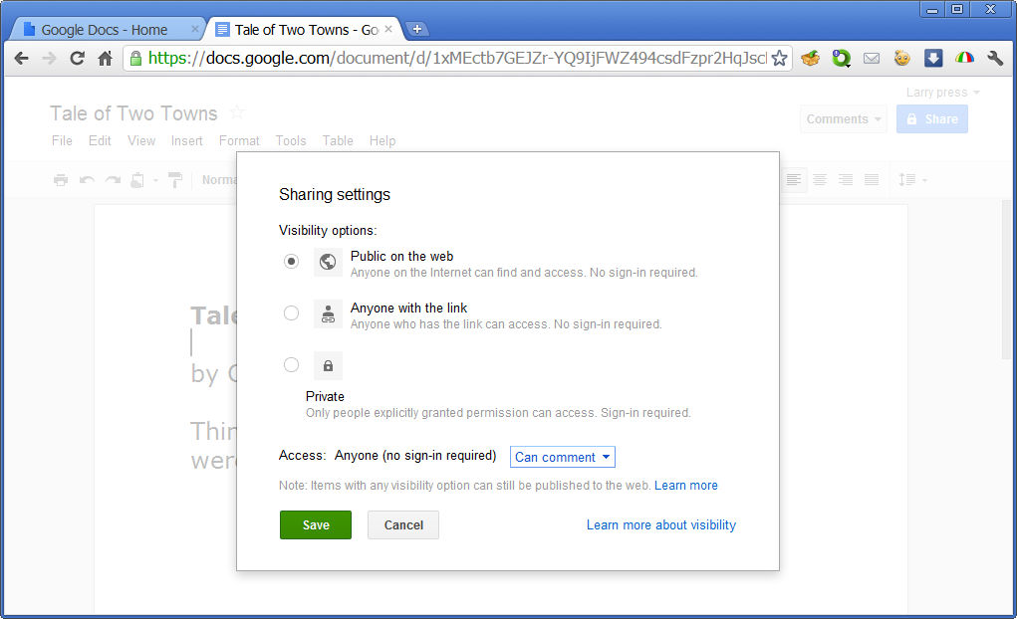
Sharing
Notes:
Since documents are stored on Google’s server on the Internet, you can share them with others.
Clicking on the green Share button shows me options for sharing with others.
I have elected to let anyone on the Web view this document and add comments, but they cannot edit it.
You can use Google Docs for collaborative writing if you give your colleagues permission to edit a shared document.

Slide 12
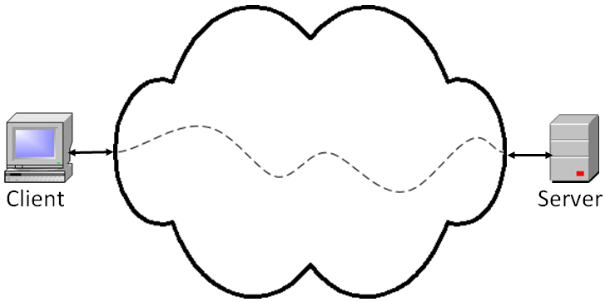
Networked versus stand-alone applications
Stand-alone PC
Notes:
If we define a networked application as one in which either the program or the data files it works with are stored on the Internet, the Google Docs word processor is clearly a networked application.
Both the program and the documents you create using it are stored on the Internet.
With a stand alone application, like Microsoft Word, both the program and the data files it creates are stored locally.

Slide 13
Summary
Notes:
Google Docs is a suite of networked applications for word processing, spreadsheets, presentations, forms and drawings.
We used the word processor as an example, and saw that it worked very much like a stand alone word processor.
But, unlike a stand-alone word processor like Microsoft Word, the program and the documents you create are stored on Google’s server, not your computer.
That makes this a networked application.
Since the documents are stored on the Internet, you can collaborate with others by giving them permission to read and even change what you have written.

Slide 14
Resources
Google Docs:
http://docs.google.com
Getting started guide:
http://docs.google.com/support/bin/static.py?hl=en&page=guide.cs&guide=21008&from=21008&rd=1
Google Docs in plain English:
http://www.youtube.com/watch?v=eRqUE6IHTEA&feature=player_embedded
Some Google Docs tips and tricks:
http://www.labnol.org/internet/office/google-docs-guide-tutorial/4999/
http://www.labnol.org/internet/photoshop-and-google-docs/18730/

Slide 15
Self-study questions
Explore the options for sharing documents – what are they?
Describe a school situation in which you would like to share a document with someone else.
Describe a professional situation in which you would like to share a document with someone else.
The Google Docs word processor program is loaded from a server on the Web. When is it loaded?
What are advantages of the Google Docs word processor over Microsoft word?
What are the advantages of Microsoft Word over the Google Docs word processor?

