Slide 1
Google Plus
Skills: Google Plus navigation, Google Plus postingds
Concepts: Change in network applications, wire frame diagram, permalink
This work is licensed under a Creative Commons Attribution-Noncommercial-Share Alike 3.0 License.
Notes:
We describe Google Plus, comparing it to Facebook, Twitter and blogs.
We introduce the idea of a wire-frame diagram and cover five of Google Plus pages: Home, Profile, Circles, Hangouts and and presenting a high-level overview of the user interface.
We look at writing Google Plus posts and retrieving them using their permalink.

Slide 2
Where does this topic fit?
Internet concepts
  Applications
  Technology
  Implications
Internet skills
  Application development
  Content creation
  User skills
Notes:
We focus on Google Plus user skills.

Slide 3




Notes:
Google Plus is a bit like a blog, a bit like Facebook and a bit like Twitter.
Where Twitter limits you to 140 characters, a Google Plus post can be as long as you like.
On the other hand, Google Plus posts cannot be as complex as Blog posts.
For example, you cannot insert images or videos in the middle of your posts and the editor is limited.
As with Facebook, you can establish "circles" of people -- personal friends, school colleagues, work colleagues, people interested in knitting, etc. -- and send posts to one circle or a group of circles or all of your circles if you wish.
You might send one post to your family and another to colleagues working a certain project.
Similarly, you can elect to view posts by people in certain circles and not others.
There are other features -- you can search for people with interest in a topic, share your circles with others, participate in "hangouts" -- ad hoc video chats with up to ten people, etc.
For the time being, I am using it as something between Twitter and Blogger. Sometimes I post the same thing on both on a blog and Google Plus. Any time I do a blog post, I link to it from Google Plus and from Twitter.
I do not use Facebook.

Slide 4
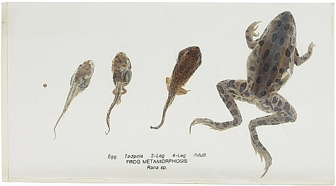
Rapid change
Notes:
That being said, Google Plus is changing rapidly.
Since the program is downloaded from Google every time you visit the visit the Web site, it can be continuously updated – adding features, changing the user interface or fixing bugs.
For example, Google changes their search algorithm around 500 times a year.
The most recent major change was the addition of Communities – online meeting places where people with a common interest can post and discuss material.
We will create a Google Plus Community for our class.

Slide 5
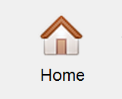
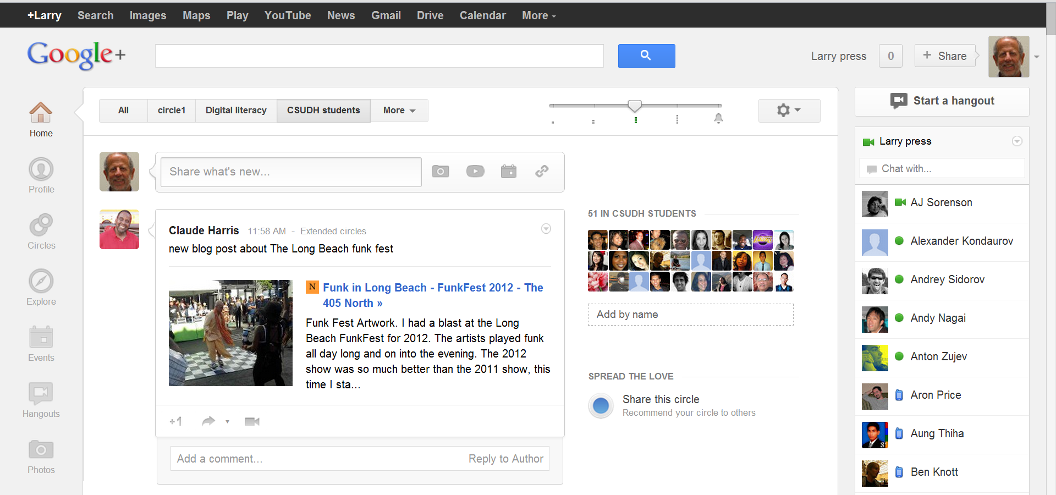
Sample Google Plus home page
Notes:
This is a screen shot of the main or home page.
There are ten others, shown as icons on the left of the screen shot and you can switch between them.
(You must click more to see them all).
This is a little complex, so let’s look at a wire-frame diagram of the page.

Slide 6

Wire-frame diagram
Notes:
Here we see a wire-frame diagram superimposed on top of a Google Plus home page.
Let’s look at the function of each area.

Slide 7
Wire-frame diagram
Google+ search
User
Filter which posts you see
Settings
Create a new post
Selected circle
Real time communication
Menu of pages
A received post
Enter post feedback
Notes:
This is a wire frame diagram of the home page.
The list of available pages is shown on the left.
Next to that are the posts you have received from others and a place to create one of your own.
You can comment on, share and vote up on in a feedback area beneath each post.
If you are receiving too many posts, you can filter the stream by circle and also control whether you get all of the posts from a circle or just some of the more highly rated ones.
The people in the selected circle are shown to the right of the posts.
Above that we see a Google Plus search box and a picture of the user and related options.
In the settings area you have options to change several program characteristics, send feedback to Google, and get help.
The right hand column is for striking up chats and hangouts with people.
That is it for the home page – let’s take a look at others, beginning with the profile page.

Slide 8
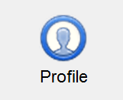

The profile page
Notes:
Your past posts are shown on your Google Plus profile page.
The about tab displays information on some of your characteristics like education, employment history, where you have lived and more.
Your photos and videos are also found on the Profile page along with the posts you have liked well enough to give them a +1.

Slide 9
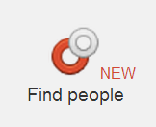
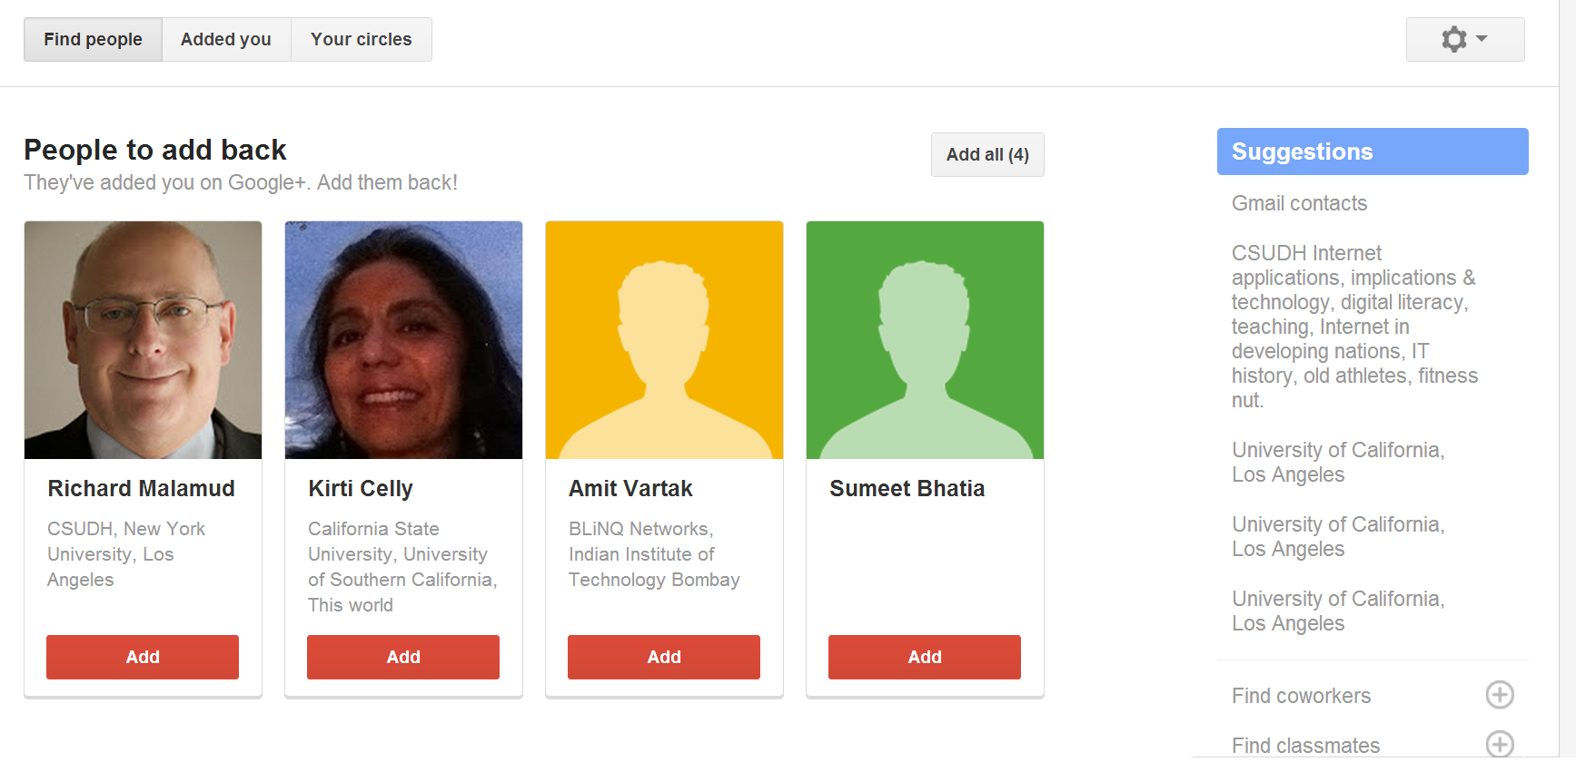
Find people
Notes:
It is both your and Google’s interest to help you find people you would like to include in your circle and follow.
This page suggests people you might like to communicate with, based on signal Google “knows,” what signals they have about you and the other people.
Scrolling the page down or following links on the right hand side of the screen will show other suggestions.
Note the word “new” on the icon.
The Find People link was recently added and Google wants to call my attention to it.
The user interface was changed in this case, but no new features were added.
Note that this page has three tabs – find people, Added you and Your circles.
Your circles contain the people you are interested in communicating with.
Let’s check it out.

Slide 10
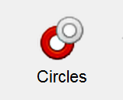
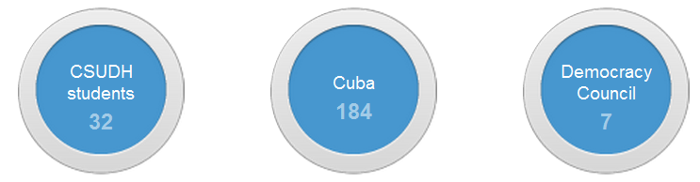
Your circles
Notes:
You create circles of Google Plus users who share some common interest – one circle for your family, another for work colleagues, another for a hobby, etc.
When you create a post, you can decide which circle(s) to show it to.
Similarly, you can look at the stream of posts by all of the people in your circles or filter them and look at just posts from people in one circle.

Slide 11
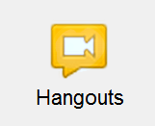
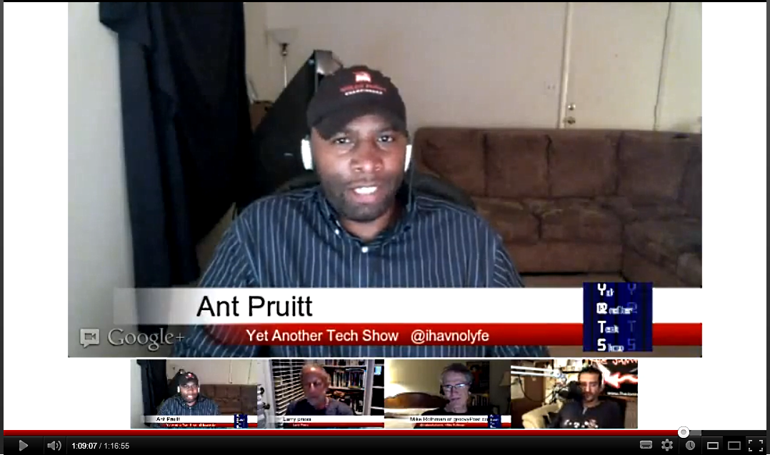
Google Plus hangouts
Notes:
Here we see a Google Plus hangout in progress.
There are four people in the hangout – they are shown at the bottom of the video window.
The software automatically discovers who is speaking and shows him or her in the larger window.
Participants can also share their screens in that large area.
The buttons at the bottom of the screen let you mute microphones, select the video image, change settings, etc.
Hangouts are limited to ten active participants, but any number of others can watch.
The hangout can also be automatically captured and uploaded to YouTube when it finishes.

Slide 12
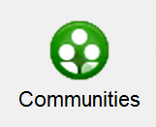
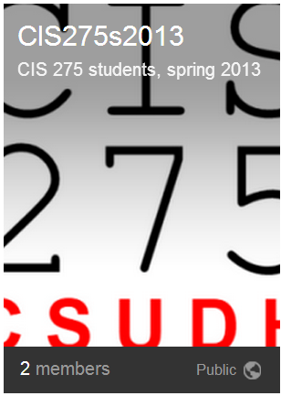
Google Plus communities
Notes:
A Google Plus community is a cross between a blog and a threaded discussion forum.
Community members are notified whenever a group member posts something.
When you create a post, it can be designated a general discussion post or any number of community defined sub-discussions.
Members can view and comment on all of the past messages or only those in a particular sub-discussion.

Slide 13
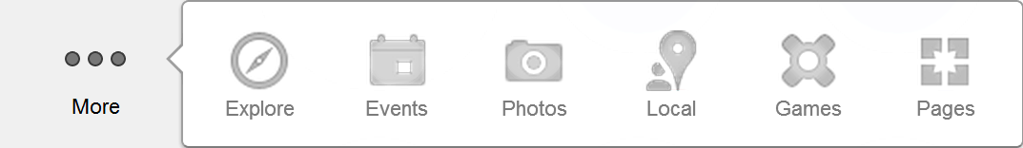
More pages
Notes:
You can see the remaining pages by clicking More.
The user is free to move page icons in and out of the More list and to arrange them in any order.

Slide 14
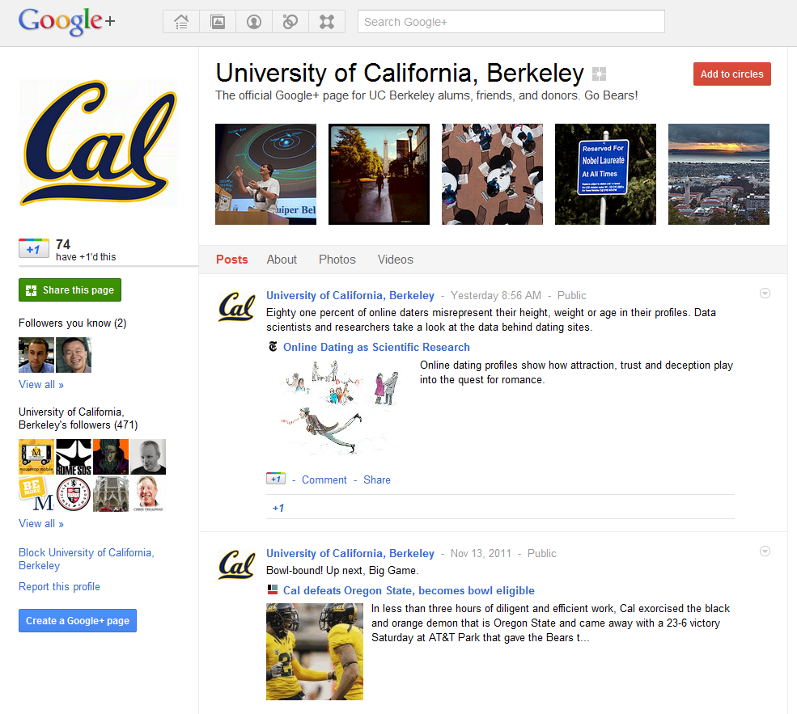
Notes:
As shown here, organizations can have Google Plus accounts as well as individuals.
One sees the organization profile, images and video along with a stream of posts.
Organizations can be in people’s circles, but they do not have circles, participate in hangouts or chats, etc.

Slide 15
+Larry Press
Notes:
Your Google Plus ID for searches, links and communication is your account name preceded by a plus sign.
Note that there is no space between the “plus” and your name.
This use of the plus sign is like the @ sign in Twitter.

Slide 16
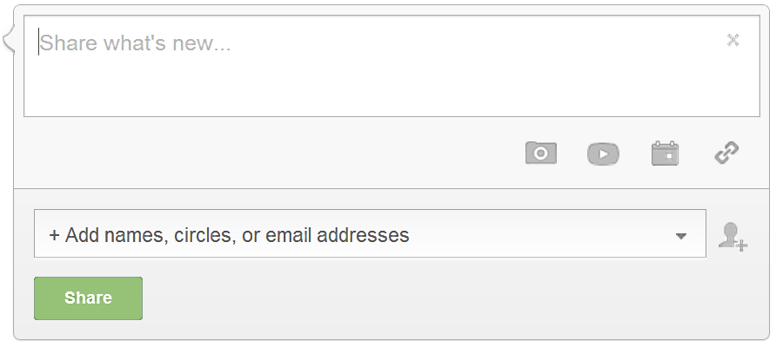
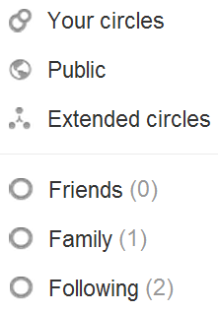
Compose and share a post
Notes:
You enter the body of the post in the “Share what’s new” text box.
Clicking on the grey icons, you can add images, videos, links and events to your post.
You can share the post with specifically named people and any number of your groups.
If it is marked “public” it will show up in search results and be visible to anyone on your profile page.
If you mark it “extended circles,” it will be visible to people in your circles and people in their circles.

Slide 17
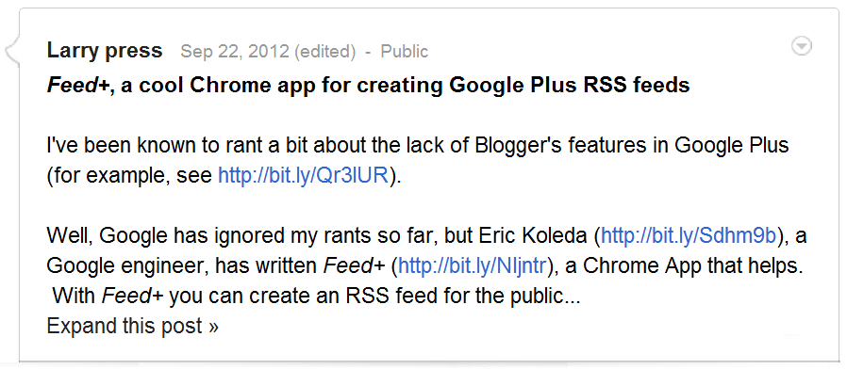
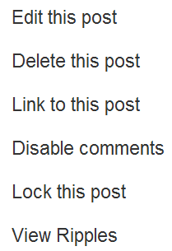
Permalink
Notes:
When viewing a post you have created, you have certain options.
Clicking on the date gives you a permalink to the post.
The faint down-arrow leads to options.

Slide 18
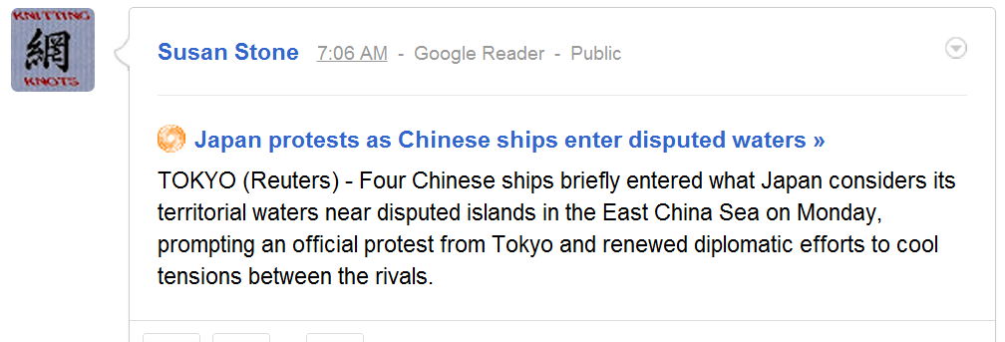
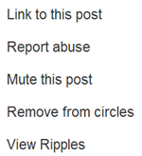
Permalink
Notes:
When viewing a post someone else created, you have the options shown here.
As before, clicking on the date gives you a permalink to the post.

Slide 19
Summary
Notes:
We have seen an overview of the Google Plus user interface.
We constructed a wire-frame diagram of the Google Plus home page and looked more superficially at the profile, hangout, pages and community pages.
We concluded with slides on creating and commenting on posts.

Slide 20
Self-study questions
Without looking back can you name the five pages we discussed?
Briefly describe each page and its use.
Since it is a network application, the Google Plus program can change frequently. We spoke of three sorts of improvement – state what they are and give an example of each.

Slide 21
Resources
Get a Google Plus account at:
http//plus.google.com
Google Plus help:
http://www.google.com/support/plus/?hl=en
Five things Google Plus does better than Facebook or Twitter: http://bit.ly/tHS3xd
Hangouts on air help:
https://support.google.com/plus/bin/answer.py?hl=en&answer=2553119&topic=2553242&rd=1

