Slide 1
Google Plus Hangouts
Skills: Start a Hangout on Air, invite participants, conduct Hangout
Concepts: none
This work is licensed under a Creative Commons Attribution-Noncommercial-Share Alike 3.0 License.
Notes:
We will begin with some examples of Google Hangouts on Air, then look at the menu structure and options when starting or participating in a hangout.
We will also discuss the processing and communication requirements of hangouts and video in general.

Slide 2
Where does this topic fit?
Internet concepts
Applications
Technology
Implications
Internet skills
Application development
Content creation
User skills

Slide 3
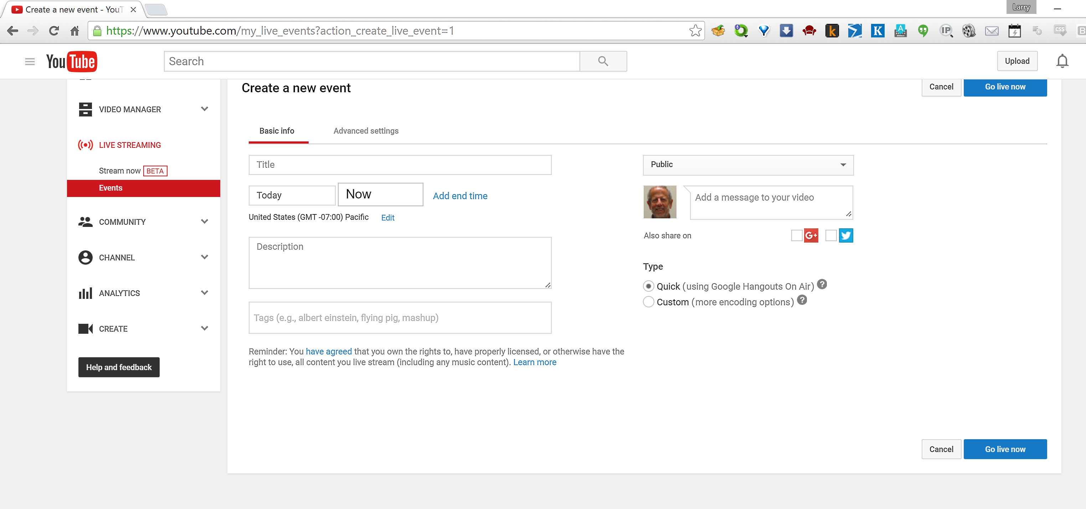
Starting a Hangout on Air
Log in to your personal Google account, not your school student account.
Go to Create a new event.
(If you see a screen with a button saying Enable live streaming, click it and agree to the conditions).
When screen shown here appears:
Enter a title and description.
Select Now as the start time.
Select the Quick type option.
Click Go live now.
Click OK in the Ready to go! Dialog box that comes up next.
Advanced options and applications
Notes:
This Quick Hangout is only one application of YouTube live video. Other options for relatively professional streaming of live events, see this documentation: https://support.google.com/youtube/topic/2853712?hl=en&ref_topic=4355169.

Slide 4
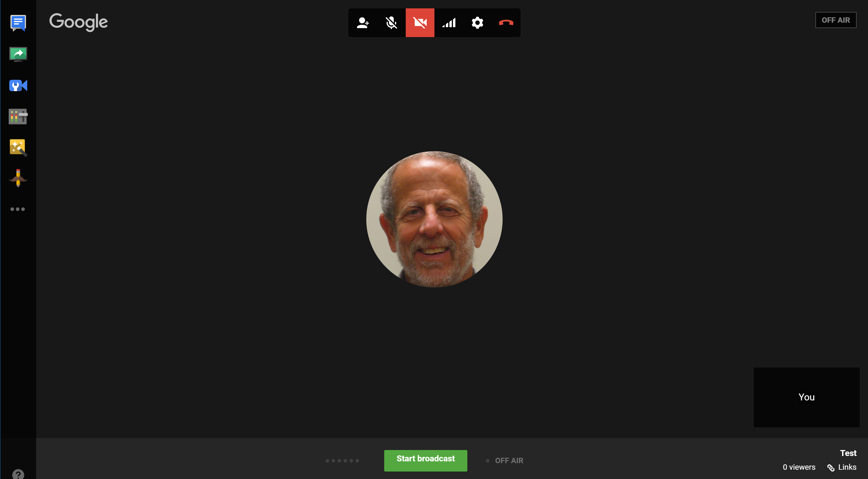
After a few seconds, you will see a screen like the one shown here.
Move the cursor toward the center of the screen to show the icons on the left side and top of the screen.
When you are ready to go, click Start broadcast.
A dialog box will appear -- click OK when you are ready to start the broadcast.
Why is the video-camera icon at the top of the screen red?
Notes:
The red video camera icon at the top of the screen indicates that your camera is turned off by default.
Clicking it will turn it on and your video will appear in the center are of the screen.
If it does not, you need to trouble-shoot your video.

Slide 5
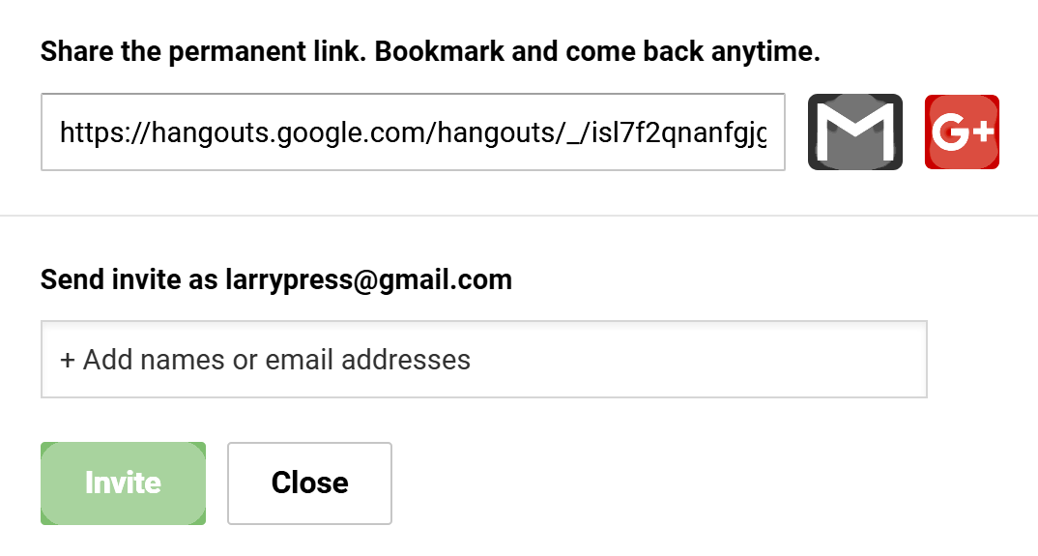
Inviting people to the hangout
To invite people to join the hangout, click the add-people icon at the top of the screen. (Roll the cursor to the top of the screen if it is not visible).
You can send email to invite participants or post a link with the hangout Web address (URL).

Slide 6
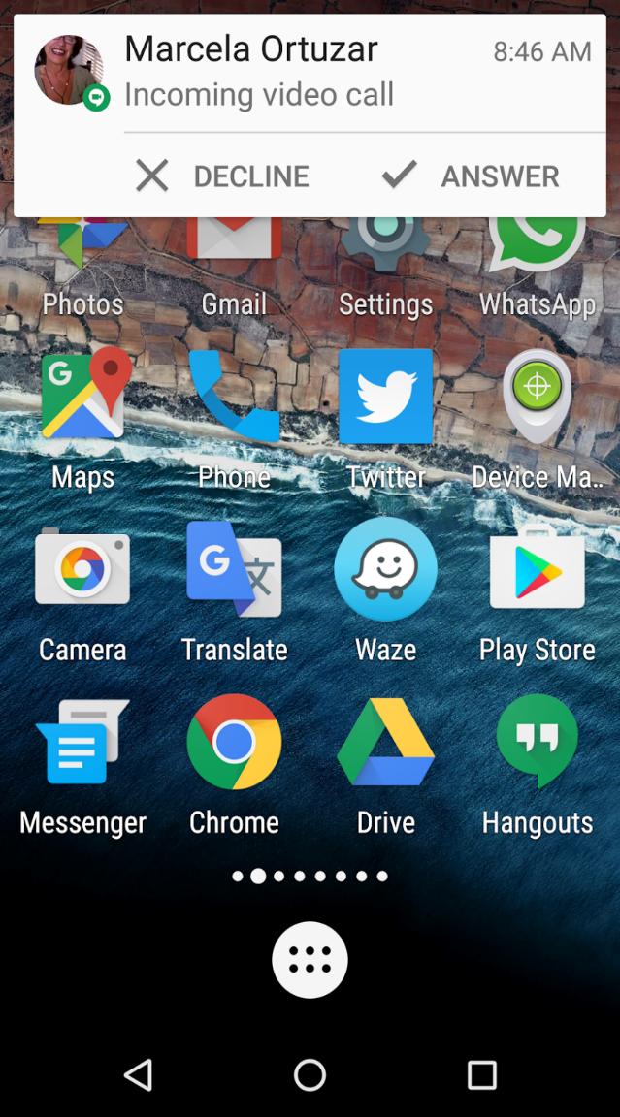
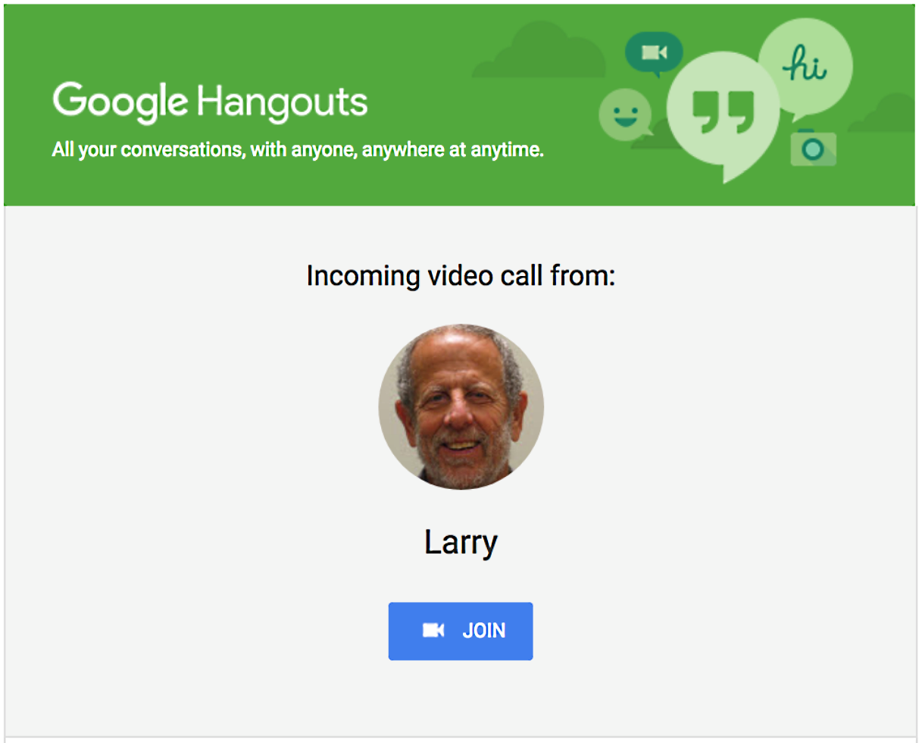
Notifications
The person you invite will receive a notification, but it is a good idea to also send an email in case they miss the notification.
Notes:
The recipient of the invitation is notified on a computer or on a mobile phone. If he or she does not answer while the notification is “ringing,” it will be waiting at hangouts.google.com or in Hangouts app on the mobile phone.
To be safe, also send invitees emails with links to the hangout.

Slide 7
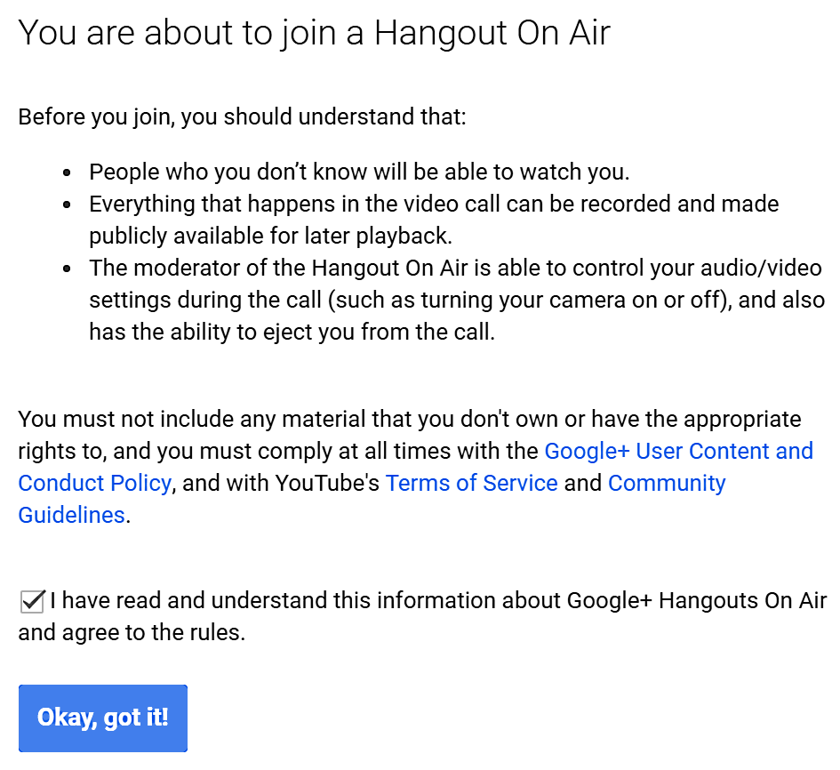
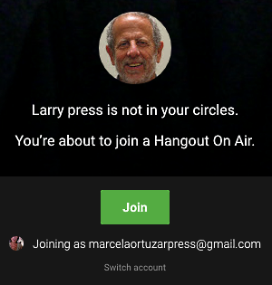
When the invitee accepts the invitation, they see this dialog box.
Don’t forget to check the agreement.
Now, lets look back at the commands available during the Hangout.
If the person starting the hangout is not in one of your circles, you will be notified and asked to confirm your wish to join.

Slide 8
When you are ready to broadcast, click the start broadcast button
and confirm that you are ready to go for up to 8 hours.

Slide 9
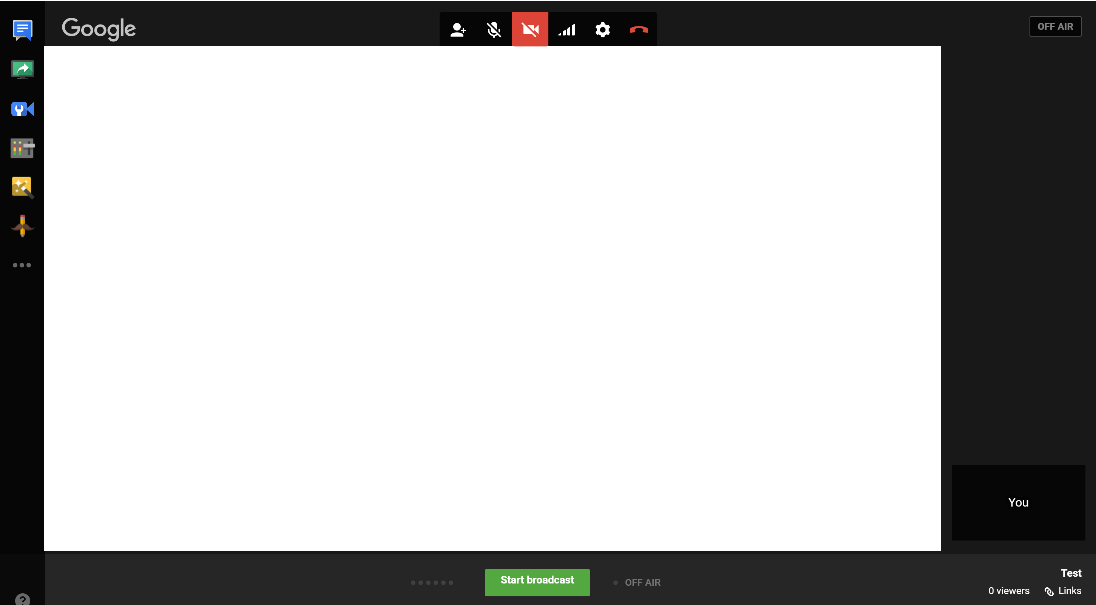
The leader’s UI
Video stream
What does “UI” mean?
Notes:
During a hangout, the video stream is shown in the middle of the screen, with attendee thumbnails at the right bottom.
When an attendee speaks, he or she is automatically shown in the video stream area.
The commands on the top and left appear when you roll your mouse onto the video window.
The Start Hangout button appears only on the leader’s screen.
When he/she clicks it, the status in the upper right becomes On Air, and recording begins.
The other participants have nearly the same UI.
UI means “user interface.”
This, like most of the programs you use, is a graphical user interface (GUI).
Some programs have a command-oriented UI.
They are usually harder to learn, because you must remember the available commands and what they do, but they are preferred by technical people for many applications.

Slide 10
Common commands
E A C D F B
Mute/unmute microphone
Leave hangout
Turn camera on/off
Adjust bandwidth usage
Invite people
Settings

Slide 11
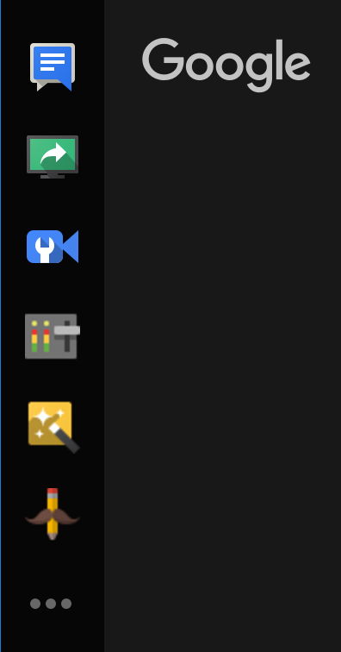
Start chat
Start chat
Share screen
Extensions
Notes:
There are six built-in commands, supplied by Google. Clicking the top icon opens a chat window and the second allows one to share either their full screen or a window. The ellipsis (. . .) at the bottom opens a new window (next slide) offering extensions written by independent developers.
The other four are less important to me, so you can play around yourself to learn what they do.

Slide 12
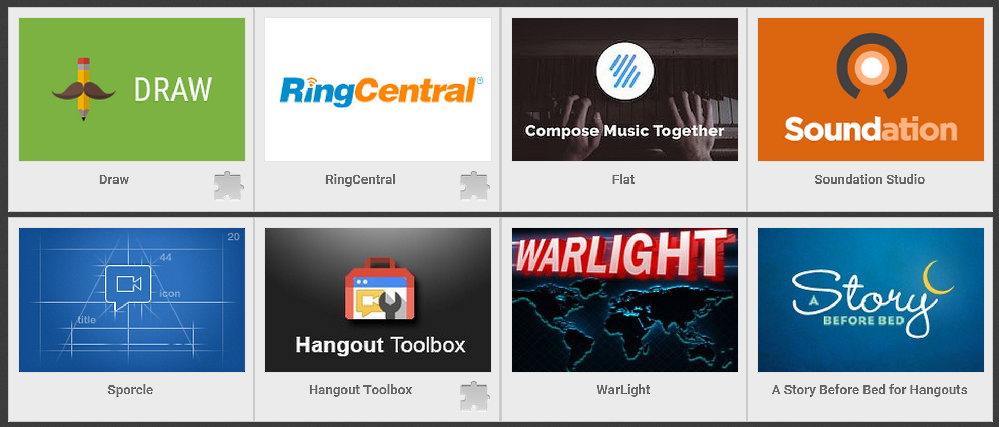
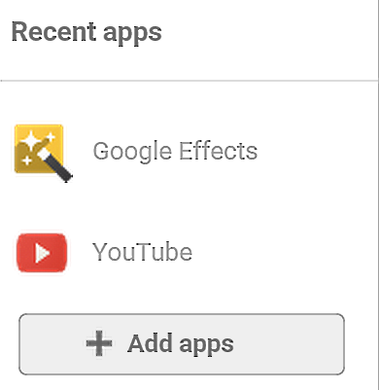
Click the ellipses (…) for more commands.
Platform
Standard
Ecosystem
Application programming interface (API)
Notes:
Google and third parties supply Hangout extensions.
You can see a few by clicking on the ellipses and see more by clicking + Add Apps.
Hangouts is an extensible application – Google or others can create new extensions like these.
Google publishes a standard “application program interface,” so anyone can create an add-in.
Thus, we say that Hangouts is an extensible platform and the platform plus the add-ins people write create an ecosystem.

Slide 13
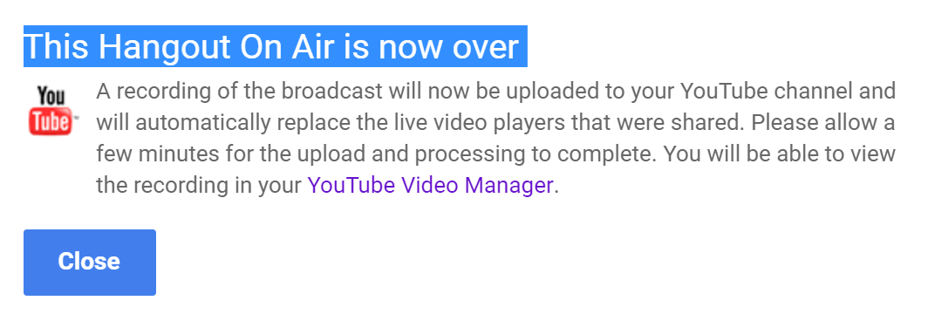
Stop broadcasting and publish on YouTube
When the leader clicks the Hang Up icon the podcast video will be processed and uploaded to YouTube.
Notes:
When you are finished, click Stop Broadcast.
If you wish, you can continue talking with the folks in the conference, but it will no longer be recorded.
When the leader clicks the Hang Up icon the podcast video will be processed and uploaded to YouTube.

