Slide 1
Google Plus Hangouts on Air
Skills: use Google Hangouts on air
Concepts: Hangout applications, processing and communication speed requirements, extensibility, user interface
This work is licensed under a Creative Commons Attribution-Noncommercial-Share Alike 3.0 License.
Notes:
We will begin with some examples of Google Hangouts on Air, then look at the menu structure and options when starting or participating in a hangout.
We will also discuss the processing and communication requirements of hangouts and video in general.

Slide 2
Where does this topic fit?
Internet concepts
Applications
Technology
Implications
Internet skills
Application development
Content creation
User skills

Slide 3
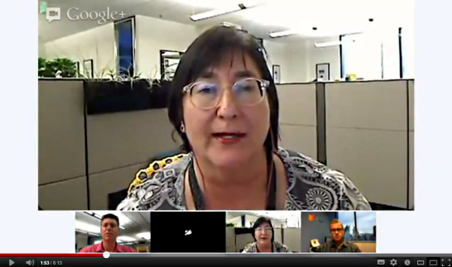
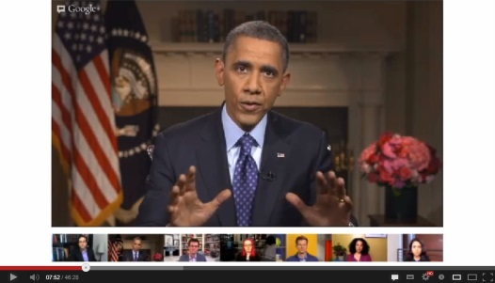
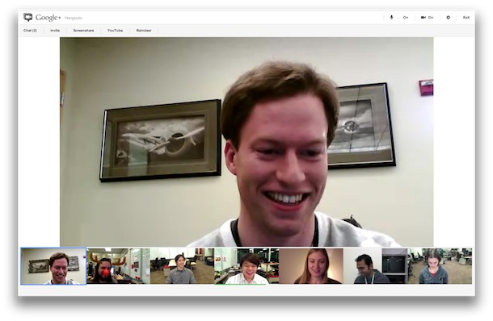
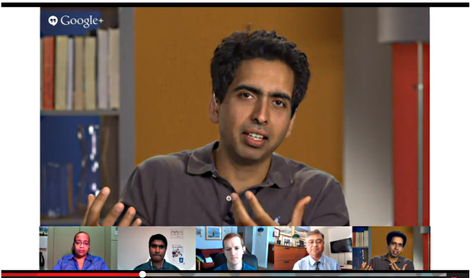
Some examples
Note that the screen layout has changed slightly since I picked these examples.
Notes:
Hangouts are video online meetings.
Up to ten people may participate in a Hangout.
Let’s look at a few examples of ways people use them.

Slide 4
Virtual field trips
School field trips
Notes:
This video illustrates educational applications of Hangouts.

Slide 5
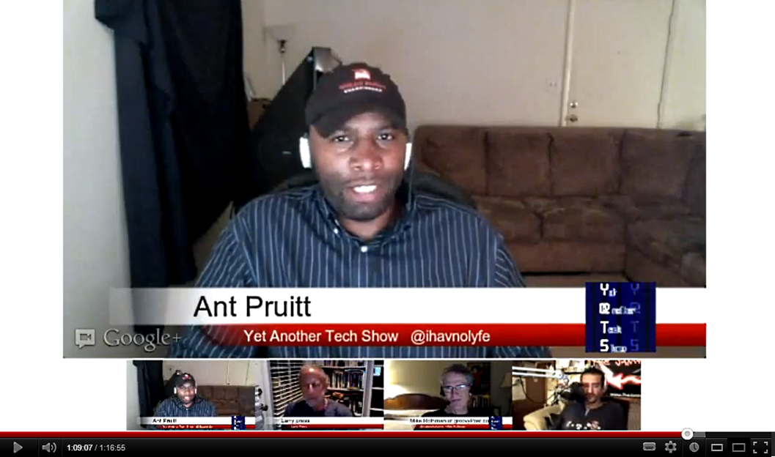
Podcasts
Notes:
Here we see a Hangout being used for a regular weekly podcast.
There are four people in the hangout – they are shown at the bottom of the video window.
The software automatically discovers who is speaking and shows him or her in the larger window.
Participants can also share their screens in that large area.
Hangouts are limited to ten active participants, but any number of others can watch.

Slide 6
News 2.0?
LA Times interview
How would the print LA Times or radio or TV news handle this story? Which do you prefer? What is the business model?
Notes:
Two LA Times columnists and an energy price expert in an 8 minute 13 second Hangout interview.
Print story at http://lat.ms/RJKDYN

Slide 7
Political discussion
Watch the hangout
Notes:
Discussion of politics and issues between President Obama and a diverse group of experts and citizens after the State of the Union address..

Slide 8
Conversation with an expert
Conversation with Sol Khan
Notes:
Sol Khan met discussed education for an hour with four co-panelists.

Slide 9
Business or project meeting

Slide 10
Hangouts on air
Ten participants
Unlimited viewers
Recorded
Stored on YouTube at end
Up to 8 hours long
Why does Google offer automatic recording when Skype and other video chats do not?
Notes:
There are two kinds of Hangout.
Regular Hangouts are garden variety video chats, but Hangouts on Air have important additional features.
Google can do this because they also own YouTube.
Let’s see how to start a Hangout on Air, invite people to it, and finally, end it.

Slide 11
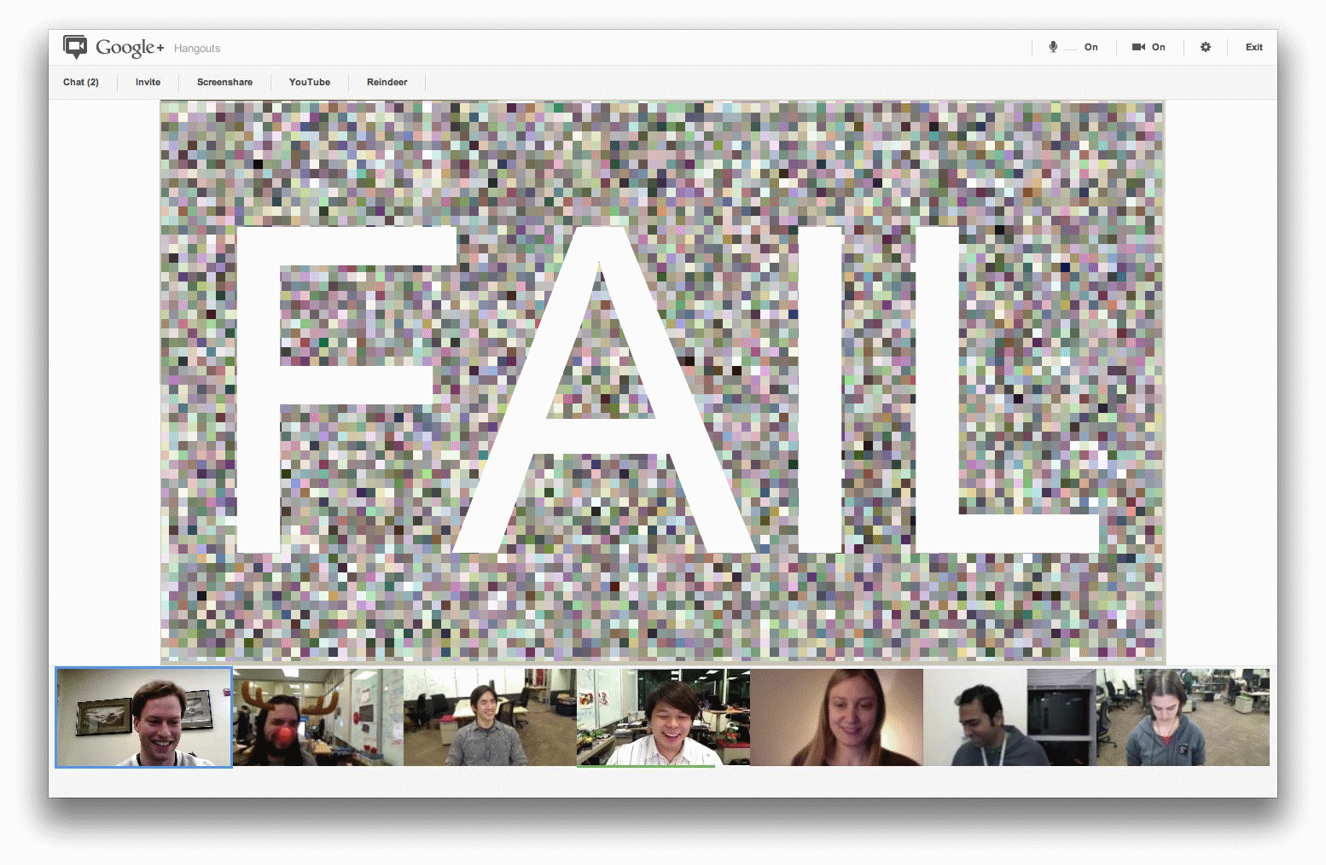
Video requires speed
Problematical class session
Notes:
We tried a class session using a Hangout on air last term and it failed due slow hardware and connections to the Internet.

Slide 12
How much speed?
Minimum CPU speed:
Dual core processor with a clock speed of at least 2GHz
Operating system required:
Current or two previous versions of a major operating system
Internet connection speed:
Upstream: 900kbps
Downstream, with five participants: 2mbps
Downstream, with ten participant with 10 participants: 3mbps
Is your CPU fast enough for a Google hangout? Is your Internet connection? Is your operating system compatible with Google Plus?
Will this be an issue in five years?
Notes:
These are the Hangout hardware requirements.

Slide 13
Summary
Notes:
We saw several examples of Hangouts and looked at the user interface and commands.
We looked at the added capability in a Hangouts on Air and noted the communication and CPU hardware requirements for a Hangout.
We also saw that Hangouts is extensible, providing a platform for developers of add-in applications.

Slide 14
Resources
Google Plus help: http://www.google.com/support/plus/?hl=en
Five things Google Plus does better than Facebook or Twitter: http://bit.ly/tHS3xd
Hangouts on air help: https://support.google.com/plus/bin/answer.py?hl=en&answer=2553119&topic=2553242&rd=1
Hangouts on Air community on Google Plus: https://plus.google.com/communities/102931411942843961321/stream/24e0d2d5-f486-40f9-9177-511a4d73ccdd
Google hangout class – Fail: http://cis471.blogspot.com/2013/05/google-hangout-for-synchronous-class.html
12 Ways to Connect, Create, and Collaborate Using Google Hangouts:
http://www.copyblogger.com/google-hangout-content/
Why Businesses Should Use Google Apps: Part 5 – Google+ Hangouts: http://paysimple.com/blog/2013/08/29/businesses-use-google-apps-part-5-google-hangouts/

Slide 15
Self-study questions
What is the difference between a hangout and a hangout on air?
What is the CPU speed of your PC – is it fast enough for a Hangout?
What is the upstream speed of your home Internet connection? The down stream speed? Are they fast enough for a Hangout?
List as many ways as you can think of to use hangouts in education.
Which do you think would be most effective? Why?
Write a summary of the above two questions.
How could a study team in school use Google Hangouts?
You can share and edit Google Drive documents during a Hangout – how could a study team in school use that capability?
You can share a Youtube video during a Hangout – how could you use that capability for fun?

