Slide 1
Demo: use Paint.net to create a “head shot”
Skills: selecting, cropping, resizing and sharpening an image, using the tool setting and status information in Paint.net
Concepts: image size, information in an image
This work is licensed under a Creative Commons Attribution-Noncommercial-Share Alike 3.0 License.
Notes:
This presentation is an image processing demonstration.
I’ll create a 200 by 200 pixel image of a face, a “head shot.”
In doing so, I’ll be selecting, cropping, resizing and sharpening the image.
I’m using Paint.net in this demonstration, but any image processing program will be able to do those operations.

Slide 2
Where does this topic fit?
Internet concepts
Applications
Technology
Implications
Internet skills
Application development
Content creation (image)
User skills
Notes:
The presentation falls within the content creation portion of the class, and of course we’re working with image data in this case.

Slide 3
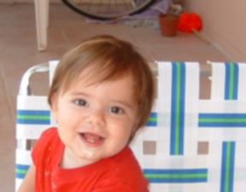
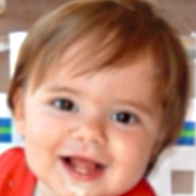
Original and final images
Notes:
I took the picture on the left with a digital camera.
I want to produce a tightly cropped, 200 by 200 pixel picture, as shown on the right.

Slide 4
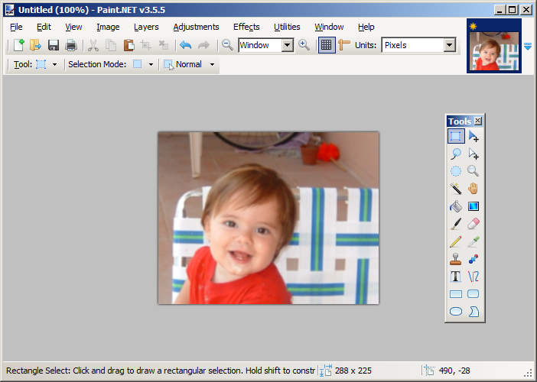
Tool settings and status line
Notes:
I began by opening the original image in Paint.net
Then I selected the Rectangular Select tool.
Note that the tool settings are shown near the top of the screen.
The status area at the bottom of the screen displays a short description of the tool, a help hint, and the size of the image.
The settings and status line change for each tool.
It’s important to focus on them when learning to use Paint.Net.

Slide 5
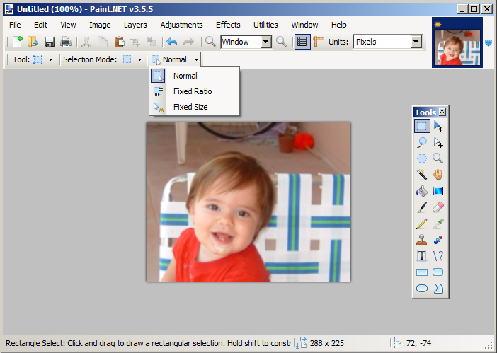
Change tool settings
Notes:
Since I want to end up with a 200 by 200 pixel image, I changed the setting of the Rectangular Selection tool from normal to fixed size.

Slide 6
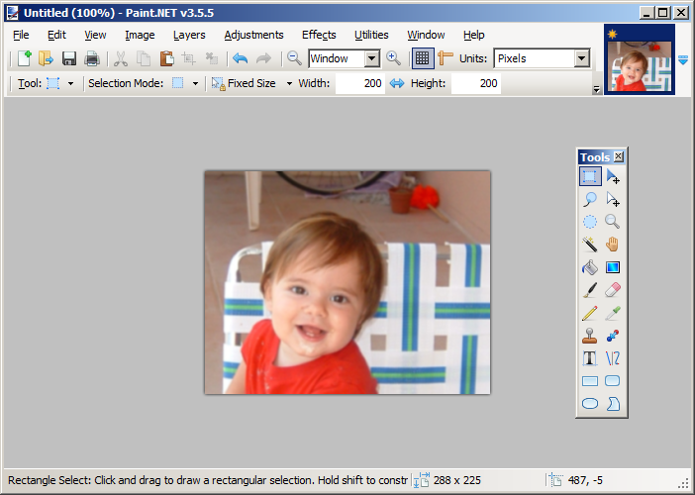
Set fixed size to 200 by 200 pixels
Notes:
When I switched the setting to fixed size, I was able to enter the height and width of the selection.
Note that the unit of measure for the size of the selection area is pixels.
(Alternatively, I could have chosen inches or centimeters).

Slide 7
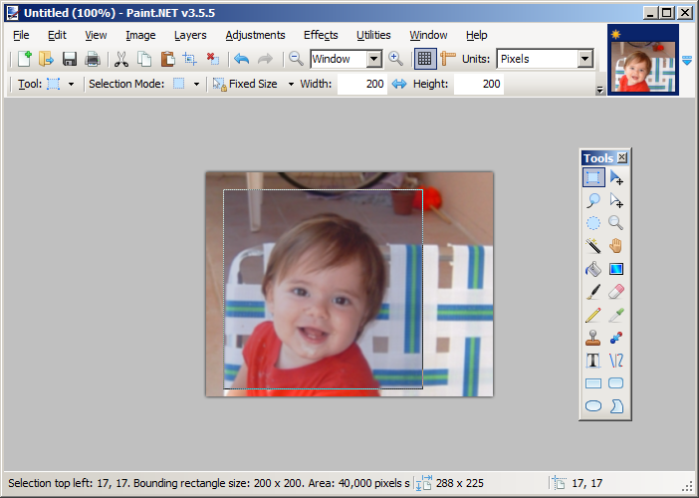
Make selection
Notes:
Next I moved the 200 by 200 selection window until it was over Lucas’ face.

Slide 8
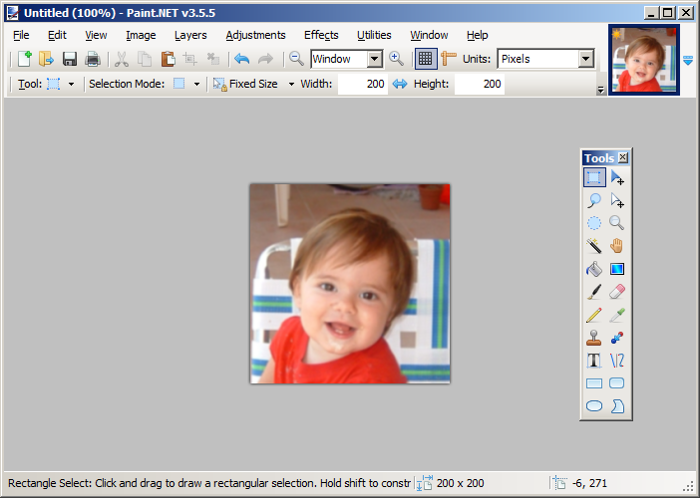
Crop to the selection
Notes:
Then I cropped to the selection.
The image was 200 by 200, but my goal was to show just his face, to eliminate most of the background.
I had to make the picture larger using the Resize command.

Slide 9
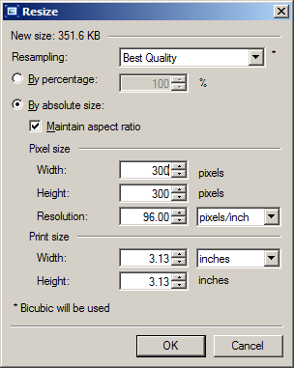
Resize the image
Notes:
The resize command pops up this properties box.
I increased the size from 200 by 200 to 300 by 300.
(Note that I selected Maintain aspect ratio in order to avoid distortion.

Slide 10
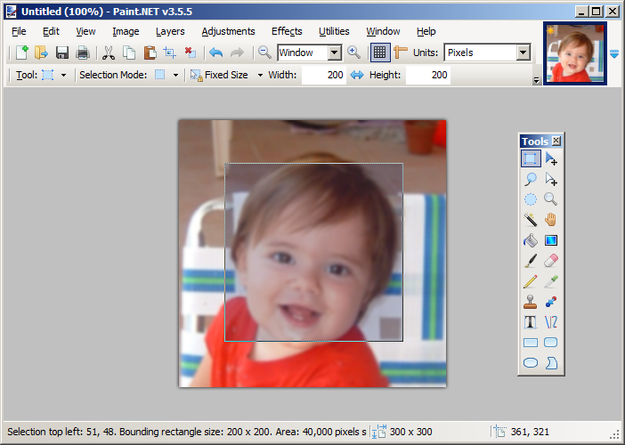
Select 200 by 200
Notes:
I then went back to the Rectangular Selection tool with a fixed size of 200 by 200.
Since we increased the size of the image, the select window now fits tightly over Lucas’ face.

Slide 11
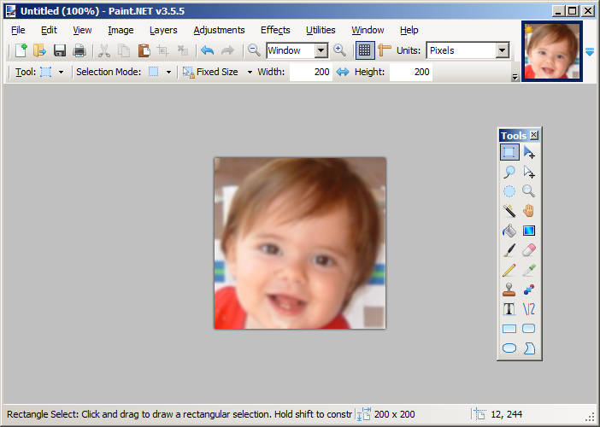
Crop to selection
Notes:
When I cropped to the new 200 by 200 selection, I noticed that the image was blurrier than the original.
I did not create any new information by resizing the picture to make it larger, I just spread the original information out on the screen.
The amount of information I captured was determined by the quality setting on the camera I used to take the picture.
My camera offers choices of low, medium and high quality images.
I’d used the high quality setting, but it still didn’t capture enough information to avoid becoming blurry when the image was enlarged this much.

Slide 12
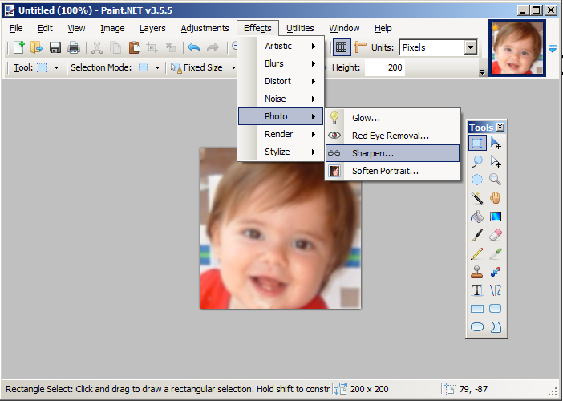
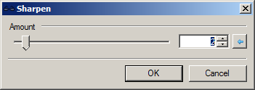
Apply the Sharpen command
Notes:
There was no way to go back and get new information at this point, but the Sharpen effect sounded like it might improve the image a bit.
I chose it and it opened this dialog box with a slider in it.
I watched the image change as I adjusted the slider, and clicked OK when I though it was as good as it could get.

Slide 13
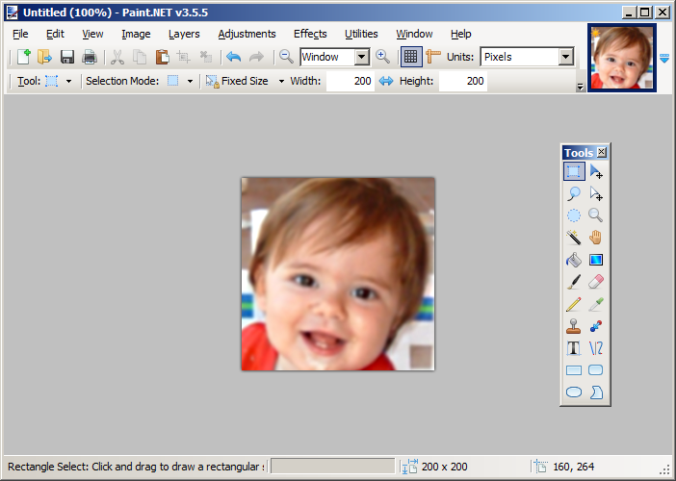
The image sharpened
Notes:
This is what it looked like after sharpening.
That’s my final result, ready to distribute.

Slide 14
The final result
Notes:
I saved it and now it’s ready to put on a Web page, include in a document or presentation, email to Lucas’ mom or whatever else I chose to do with it.

Slide 15
Summary
Notes:
In summary, we started with a somewhat larger picture and produced a tightly cropped 200 by 200 pixel image.
In doing so, we had to select, crop, resize, and sharpen the image.
We had to enlarge Lucas’ face to fill the 200 by 200 window, and, since no new information was created, it appears a bit blurry.
We also saw the way the tool settings and status lines are used in Paint.net.

Slide 16
Self-study questions
When using the Paint.net selection tool, we used pixels as the unit of measure for size. What are the other options for size unit?
We used the Sharpen filter in this example. Pick another filter, experiment with it and describe what it does.
Selection mode is one of the Rectangular Selection tool settings. Which selection mode did we use throughout this example?
What are the other selection modes?
Experiment with them, and state what each does.
The status line changes every time you change tools. What status information is displayed when you begin to move the Rectangular Selection tool around to make your selection?
What was the size of the original image?

