Slide 1
Sample image processing problems
Skills: Using several image processing tools and commands
Concepts: image processing tools, image processing operations
This work is licensed under a Creative Commons Attribution-Noncommercial-Share Alike 3.0 License.
Notes:
This presentation steps through three image processing tasks.
In doing so, we will use several tools and commands.

Slide 2
Where does this topic fit?
Internet concepts
Applications
Technology
Implications
Internet skills
Application development
Content creation (image)
User skills
Notes:
The presentation falls in the image content creation portion of the class.

Slide 3
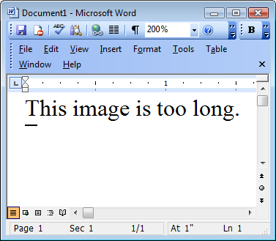
How can I shorten the image on the left so it looks like the one on the right?
Notes:
The image on the left was too long to fit where I wanted to use it in a PowerPoint presentations.
Let’s see how I shortened it, as shown on the right.

Slide 4
Select the lower part of the image.
Notes:
I used the Rectangular Selection tool to select the lower part of the image.

Slide 5
Slide the bottom section up, being careful to align it with the upper portion of the image.
Zooming in on the image may help with exactly aligning the two portions.
Notes:
I slid the selection up using the Move Selected Pixels tool.
Zooming in on the image helped with precisely aligning the two portions of the image.
As you see, it left the original location of the selected portion transparent (checker board pattern).

Slide 6
Select the upper portion and crop to the final size.
Notes:
Finally, I selected just the portion I wanted and cropped the image.
I zoomed in when making the selection in order to get exactly the pixels I wanted.

Slide 7
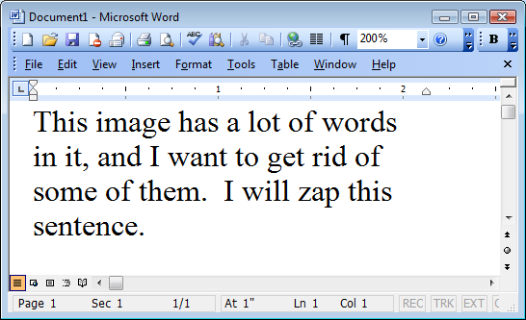
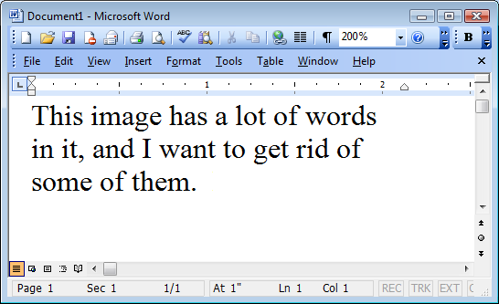
How did I erase the unwanted words?
Notes:
I had an image that included some text, which I wanted to include in a Web page,
But, I noticed that the words were incorrect – how could I edit out the last sentence?

Slide 8
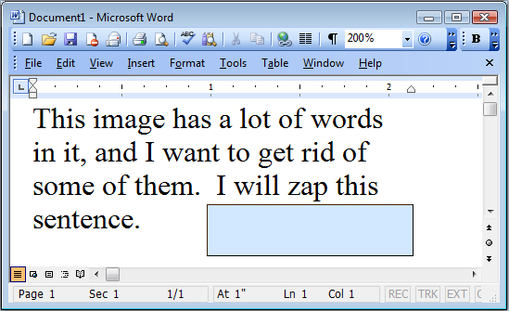
Select a white area in the image.
Notes:
I began by selecting a white area using the Rectangular Select tool.

Slide 9
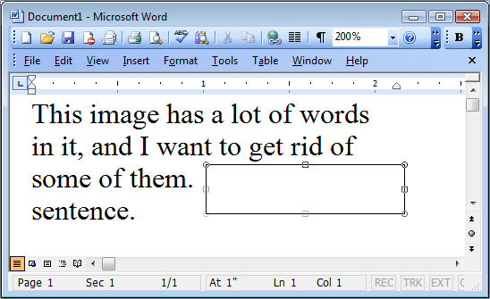
Notes:
Next I made a copy (Ctrl-c) of the white area and pasted it back in the same place (ctrl-v).
Then I used the Move Selected Pixels tool to drag the white copy till it covered the words I will zap this.

Slide 10
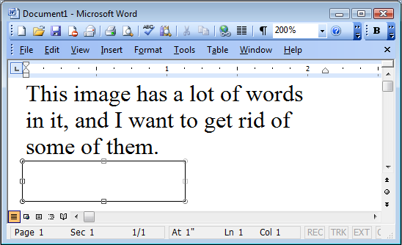
Notes:
Finally, I made a second copy of the white area and drug it over the word sentence.

Slide 11
How did I erase the oarlock?
Notes:
I wanted to include this image in a brochure, but wanted to clean it up by removing the oar lock.

Slide 12
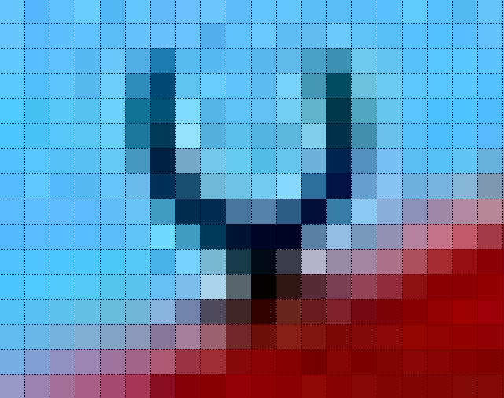
Notes:
I began by zooming way in.
That enabled me to edit individual pixels.
Note that zooming in does not alter the image, it just changes your view of it.

Slide 13
Notes:
I selected and moved a group of pixels as in the earlier examples.
I repeated that until I had only a few pixels left to change.

Slide 14
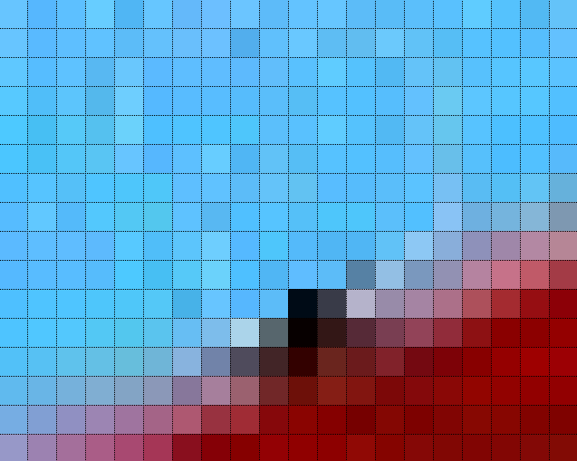
Notes:
I changed the remaining pixels one at a time using the Color Picker (eyedropper) and Pencil tools.

Slide 15
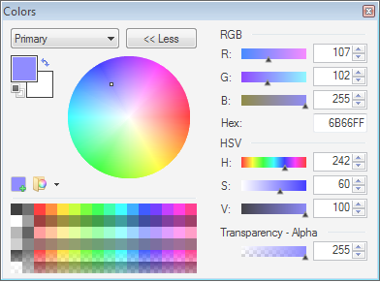
The currently selected color
Click the Eyedropper tool on a pixel to select its color.
Notes:
The color picker, allows us to select the color of a single pixel.

Slide 16
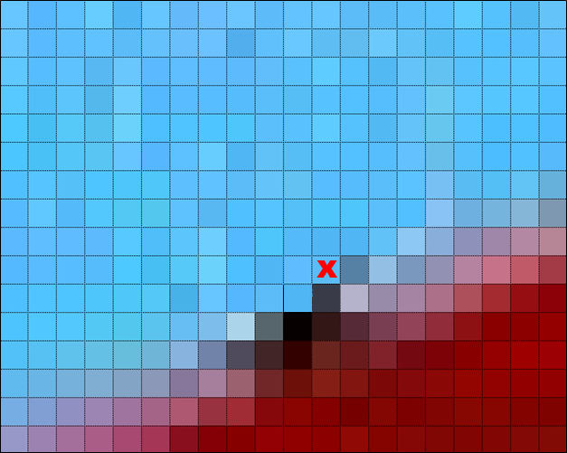
Notes:
We then use the pencil to change the color of a single pixel to the selected color.
As you see here, we’ve replaced the black pixel, which had been part of the oarlock, with a blue one (marked X).

Slide 17
Notes:
After changing the colors of eight pixels, the oarlock is gone.
Working at the pixel level is a bit slow, but it gives you total control.

Slide 18
Questions
What are the setting options for the Rectangle Select tool?
What shows up on the status line when you are using the Rectangle Select tool?
What are the setting options for the Move Selected Pixels tool?
What shows up on the status line when you are using the Move Selected Pixels tool?
What are the setting options for the Pencil tool?
What shows up on the status line when you are using the Pencil tool?
What are the setting options for the Color Picker tool?
What shows up on the status line when you are using the Color Picker tool?

