Slide 1
Image characteristics
Skills: none
Concepts: pixel, compression, image characteristics: size, shape (aspect ratio), resolution, amount of information, flat versus photographic, and file type
This work is licensed under a Creative Commons Attribution-Noncommercial-Share Alike 3.0 License.
Notes:
This presentation focuses on six characteristics of an image, its size, shape, resolution, amount of information, file type and whether it is flat or photographic.
We also define pixels and discuss image compression.

Slide 2
Where does this topic fit?
Internet concepts
Applications
Technology
Implications
Internet skills
Application development
Content creation (image)
User skills
Notes:
The presentation falls primarily within the content creation portion of our class.

Slide 3
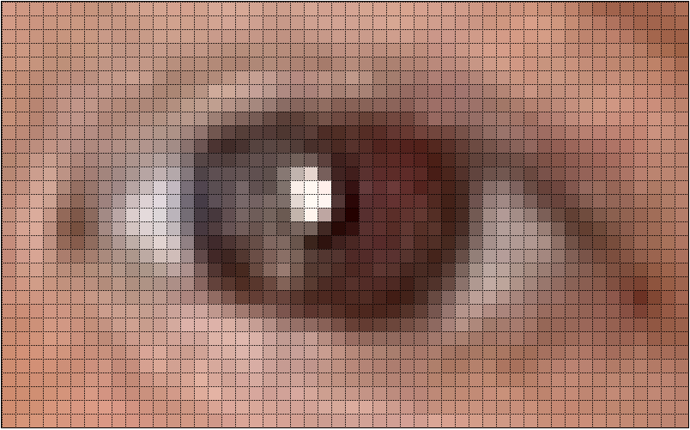
images are made of dots
called “pixels”
Notes:
Before we discuss image characteristics, we must note that they’re made of dots.
Each dot has a specific color.
The dots are called “pixels,” which is short for “picture elements.”

Slide 4
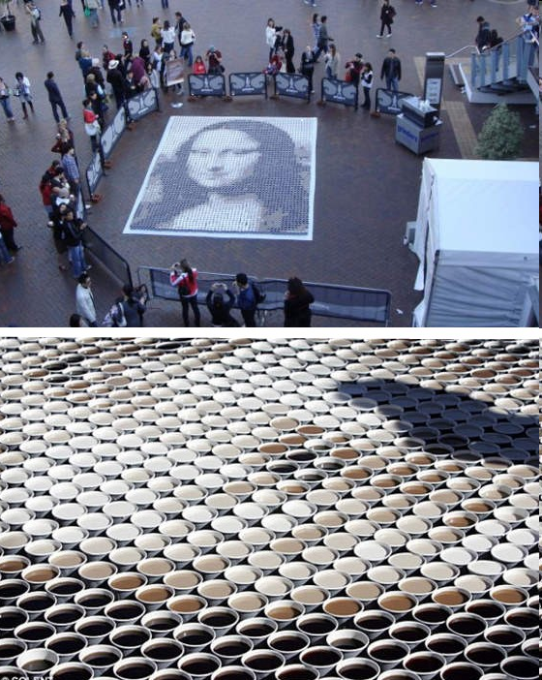
Coffee cup
pixels

Slide 5
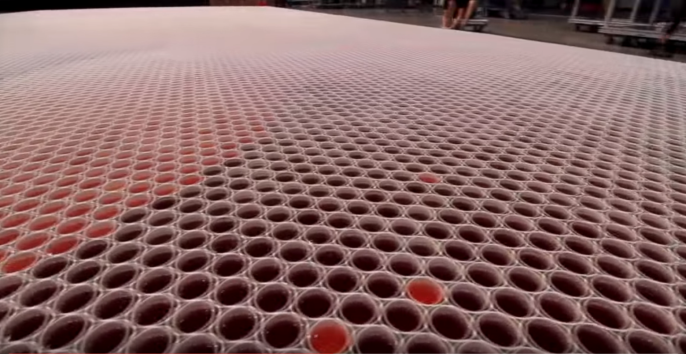
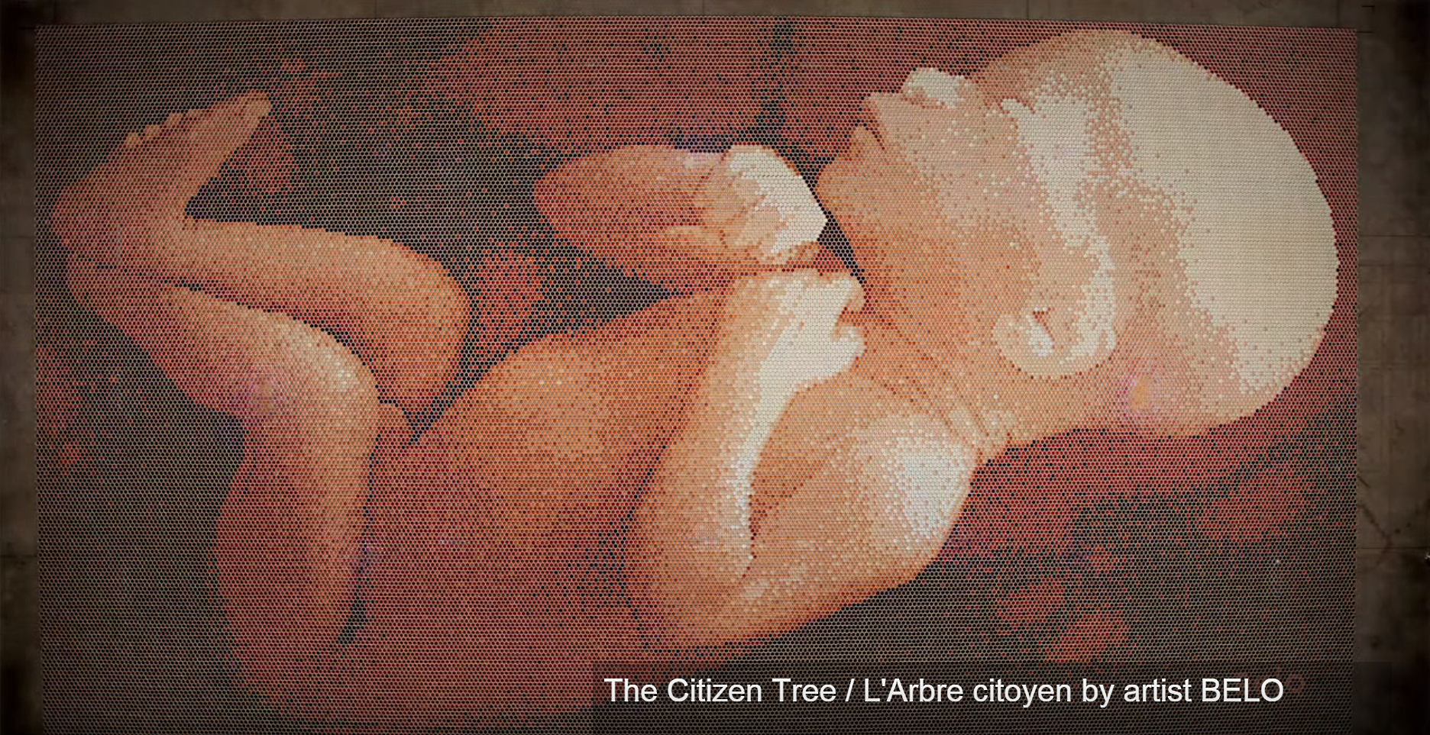
One more
Making it, 2:06 video

Slide 6
Image
size
398 by 530 pixels
152 by 202 pixels
Notes:
One characteristic of an image is its size.
The image on the left has been resized, making it smaller.
Since they’re both shown on the same screen, the smaller image must have fewer pixels.
The image was made smaller by deleting some pixels.
Information was lost.
We typically measure image size in numbers of pixels.
The image on the left is 398 by 530 and the image on the right is 152 by 202 pixels.

Slide 7
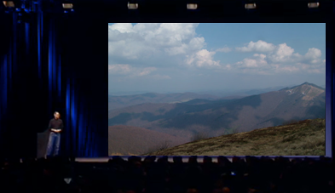
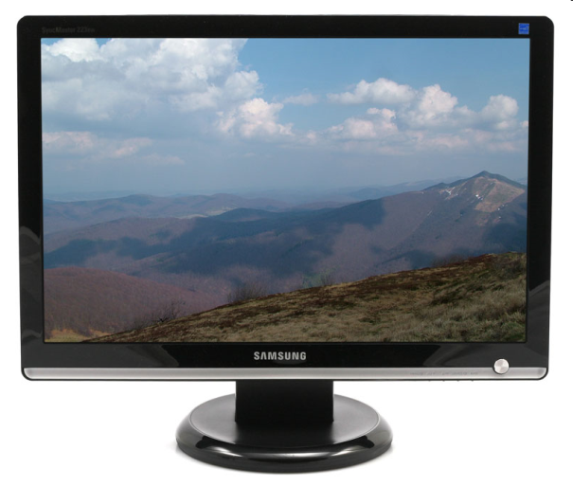
Same size image, different screen sizes
What would happen if I displayed the same image file on both of these screens?
Notes:
Don’t confuse image size with screen size.
One of these screens is much larger than the other, but both are displaying the same image file with the same number of pixels.
The image on a cell phone screen would be even smaller.
The image on the smaller screen will appear sharper when viewed close because the pixels are smaller.
The same goes for print.
An image printed at 1,200 dots per inch will be smaller, but sharper than one printed at 300 or 600 dots per inch.

Slide 8
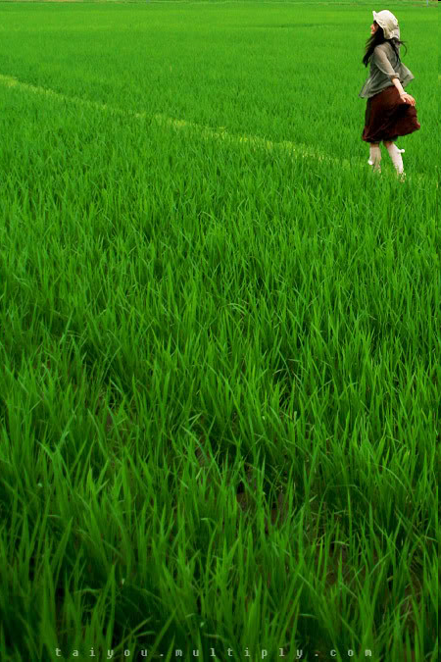
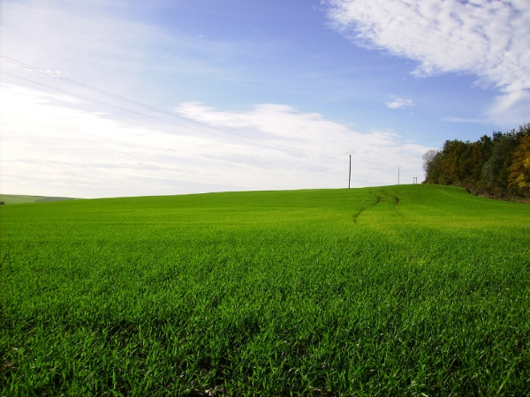
Image
shape
Notes:
A second image characteristic is its shape – is it tall and thin, short and wide, square?
But, tall and thin is vague; we need to be more precise about the shape of a rectangular image.

Slide 9
Aspect ratio – width:height
2
1
1
1
2:1
aspect ratio
1:1
aspect ratio
Notes:
We can be more specific about the shape of an image.
We call the ratio of the width of an image to its height its aspect ratio.
The image on the left is twice as wide as it is tall, so its aspect ratio is two to one.
The image on the right is square, so its aspect ratio is one to one.

Slide 10
4
Common
aspect ratios
3
4:3
16
6
9
4
6:4
16:9
Notes:
Aspect ratios vary widely, but older computer monitors and television screens often had aspect ratios of 4 to 3.
An aspect ratio of 16 to 9 is common on newer wide-screen monitors and television sets.
A handheld device might have an aspect ratio of 6 to 4.
The images in this presentation have a 4 to 3 aspect ratio.

Slide 11
Resize, same aspect ratio
Notes:
Here we’ve resized an image, making it larger, but keeping the aspect ratio constant.
The larger version has more pixels, but the ratio of width to height is unchanged.

Slide 12
Resize, changed aspect ratio
Notes:
Here we increased the width, but not the height.
The aspect ratio changed so the image is distorted.

Slide 13
Resolution
200 x 200 =
40,000 pixels
100 x 100 =
10,000 pixels
50 x 50
2,500 pixels
High resolution
Medium resolution
Low resolution
What is the unit of measure for resolution?
Notes:
Resolution, a third image characteristic, is a function of both the physical size of an image and the number of pixels making it up.
Each of these images is the same physical size, but the one on the left has more pixels than the others.
Its resolution -- the number of pixels (dots) per inch (or other measure of length) -- is higher.

Slide 14
Amount of information
Which image has the most information? Explain your answer.
Notes:
In the previous slide, we saw that these images had different numbers of pixels.
The one on the left has more data than the one on the right, but that does not necessarily mean it has more information.
But in this case, we can see that the image on the left is sharper than the others, leading us intuitively to select it as having more information.
We will revisit the distinction between the amount of data (number of bits) and the amount of information in other topic modules.

Slide 15
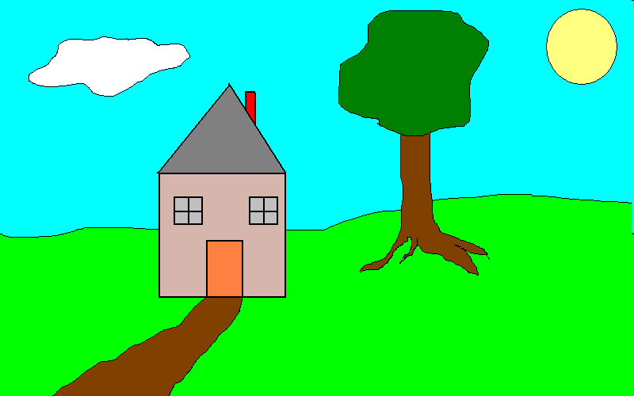
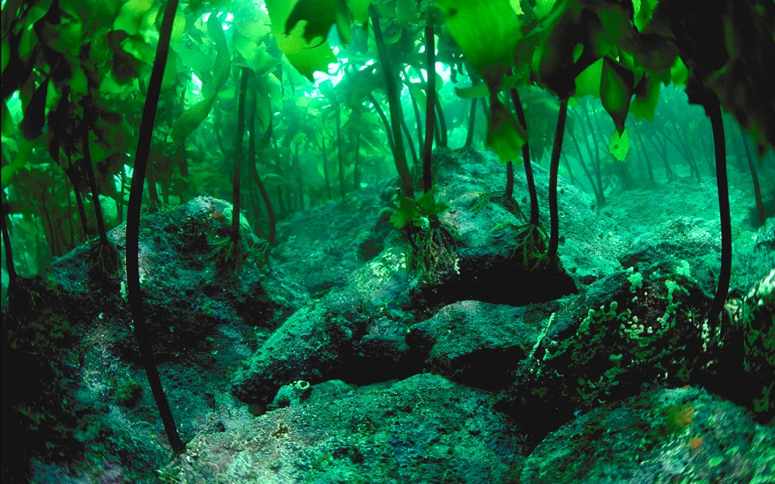
Flat versus photographic images
Logos and other images with a limited color palette
Photographic images with continuous tone variation
Notes:
We can distinguish between flat and photographic images.
Flat images have limited color palettes.
Photographic images have more continuous tone variation.
The distinction is a bit arbitrary.
Logos and drawings are typically flat and pictures you take with a camera photographic.

Slide 16
Common Internet image file types
.gif: Used for logos, cartoons and other flat art with up to 256 different colors. Images can be animated. Very small files.
.png: Suitable for complex flat art and photographic images. Lossless compression.
.jpeg (or .jpg): Suitable for photographic images. Lossy compression.
.TIFF: Uncompressed format used for high quality images.
Lossy compression: information is lost when the file is compressed.
Lossless compression: the file is identical to the original when decompressed.
Notes:
The distinction between flat and photographic images is important in choosing a file type.
Here we see four image types that are common on the Internet today.
All but Microsoft Bitmap are compressed.
In compressing an image, the file size is reduced but so is quality.
We will return to compression in another topic module.

Slide 17
Summary
Notes:
We covered six image characteristics size, shape, resolution, amount of information, file type and whether it is flat or photographic.
To do so, we had to introduce the idea of pixels, and we also discussed image compression.

Slide 18
Self-study questions
We covered six characteristics of an image – without looking back, do you recall them?
State what each characteristic means in your own terms.
Two images have the same aspect ratio, but they are different sizes. How can that be?
Image size can be measured in number of pixels, inches, centimeters, etc. Why do we typically work with number of pixels?
If you try to take a picture immediately after taking another with a digital camera, there is a slight delay. Why?
An image is 800 pixels wide and 200 pixels high. What is its aspect ratio?
An image is 640 pixels wide and 480 pixels high. What is its aspect ratio?
An image is 800 pixels wide and 400 pixels high, and I resize it to 100 pixels high, while maintaining the aspect ratio. What is the new width?
If an image has a 1:1 aspect ratio, and it is 10 inches wide, how tall is it?
If an image has a 2:1 aspect ratio, and it is 10 inches wide, how tall is it?
If an image has a 4:3 aspect ratio, and it is 10 inches wide, how tall is it?
If an image has a 16:9 aspect ratio, and it is 10 inches wide, how tall is it?
The resolution of an image is determined by the number of pixels it contains and ___.
Google introduced WebP, a new image format that they say is superior to JPEG. What might keep it from catching on even if it is better?
Which image format should I choose when I scan an image from a magazine?
Which image format should I choose when I post a picture of family on the Web?
Which image format should I choose for my company logo?

Slide 19
Which of these images has the largest pixels?
200 x 200 =
40,000 pixels
100 x 100 =
10,000 pixels
50 x 50
2,500 pixels

Slide 20
Resource
Image file formats:
https://en.wikipedia.org/wiki/Image_file_formats

