Slide 1
What is image processing?
Skills: image processing work flow
Concepts: history of image processing, evolution of technology from prototype to mainstream, image processing programs, image processing examples, image processing operations
This work is licensed under a Creative Commons Attribution-Noncommercial-Share Alike 3.0 License.
Notes:
We will present an overview of the evolution of image processing from research labs to the mobile phone cameras we carry today.
We will also see some examples of image processing and look at image processing programs and the operations they do.
We also present a high level overview of the image processing workflow.
This workflow is particularly important because we follow the same steps in audio and video processing.

Slide 2
Where does this topic fit?
Internet concepts
Applications
Technology
Implications
Internet skills
Application development
Content creation (image)
User skills
Notes:
Image processing is an important application and we use it in content creation.

Slide 3
When data types went mainstream
Data type | Decade
Numeric | 1950s
Alphanumeric | 1960s
Text | 1970s
Image | 1990s
Speech | 2000s
Music | 2000s
Video | 2000s
HD video | 2010s
Why did’t image processing or video go mainstream in the 1950s?
Notes:
These are common IT data types.
The table shows the rough dates when a data type made the transition from research and development to mainstream adoption,
This presentation deals with image processing, which became widely affordable in the 1990s, but had its beginnings back in the early 1960s.

Slide 4
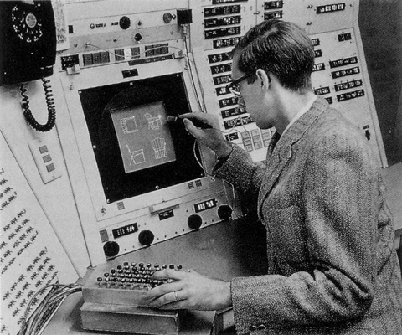
Image processing in 1962
Sketchpad video: http://youtu.be/495nCzxM9PI
Notes:
Image processing began in the 1960s.
This is Ivan Sutherland using Sketchpad, the first significant image processing program.
Since technology improves rapidly, researchers like Sutherland develop prototypes on expensive equipment, assuming it will be affordable in the future.

Slide 5
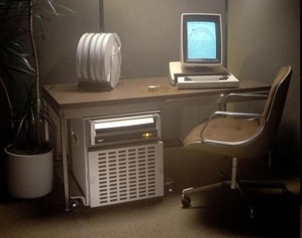
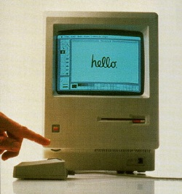
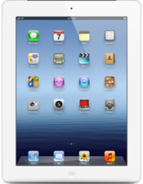
From research prototype to product
…
Research prototype
Expensive, limited market
Mass market product
Ubiquitous product
Can you identify any of these computers?
Notes:
Sketchpad foreshadowed much of today’s image processing and user interfaces.
This is typical of technological development – researchers build prototype systems using very expensive equipment.
With time, technology improves and the prototypes are refined and become products.
They are often expensive and for specialized markets at first, but with time and further technological improvement and product evolution, they eventually become part of the mainstream.
In this sense, Sketchpad is the grandfather of the iPad.

Slide 6
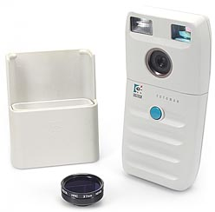
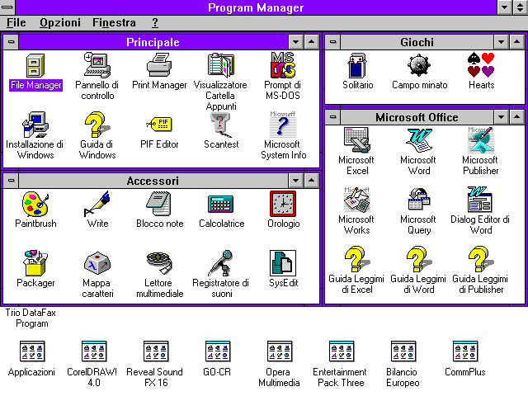
Digital cameras, 1990
Notes:
Image processing went mainstream in the 1990s with the advent of the digital camera.
The Logitec FotoMan, shown here, was perhaps the first consumer-oriented digital camera.
Digital camera quality improved dramatically during the 1990s, and cost dropped rapidly.
At the same time, computers like the Macintosh or a PC running Windows 95 were becoming fast enough to make image processing quick and easy.

Slide 7
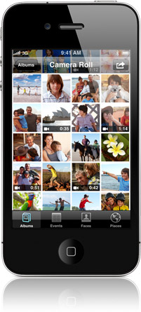
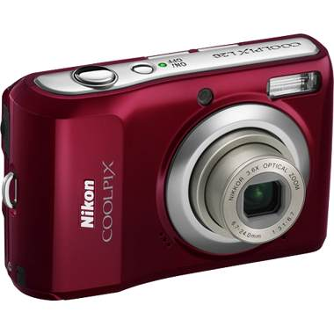
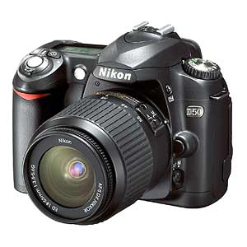
Cameras in phones
Do you own a digital camera in addition to the one in your phone? If so, why?
Notes:
Today, many people have phones with cameras.
Do we still need separate digital cameras?
Perhaps not for snapshots that will be emailed or posted on Twitter then discarded, but stand-alone cameras still have lens quality and other features that are not available on phones.
Of course, both phones and digital cameras are improving over time.

Slide 8
Cameras everywhere
Notes:
Today, millions of people carry cameras in their pockets.
It is easy to capture and share a family snapshot or a political demonstration.
Let’s look at some examples of image processing.

Slide 9
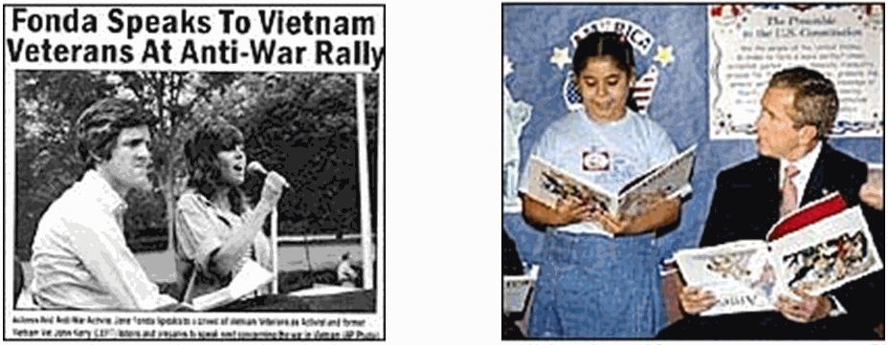
Political deception
Notes:
Image processing can be used for deception.
These are both doctored photographs.
One shows Jane Fonda and presidential candidate John Kerry at an anti-war rally together.
It was a fake, made by combining separate photos of each of them.
The other shows President Bush, who appears to be holding his book upside down, but that too is a fake.
Do you think political candidates touch up their pictures in ads?
Do you think political candidates touch up their opponents pictures in negative ads?

Slide 10
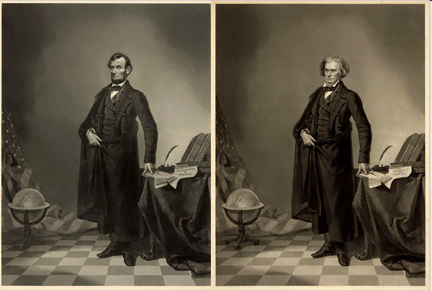
Abraham Lincoln’s head on John Calhoun’s body
Notes:
Here we see “Honest Abe” Lincolns head on John Calhoun’s body.
People made fake photographs before computers were invented, but everyone can do it today.

Slide 11
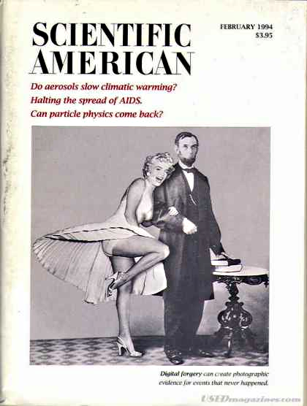
Abraham and Marilyn
Notes:
28

Slide 12
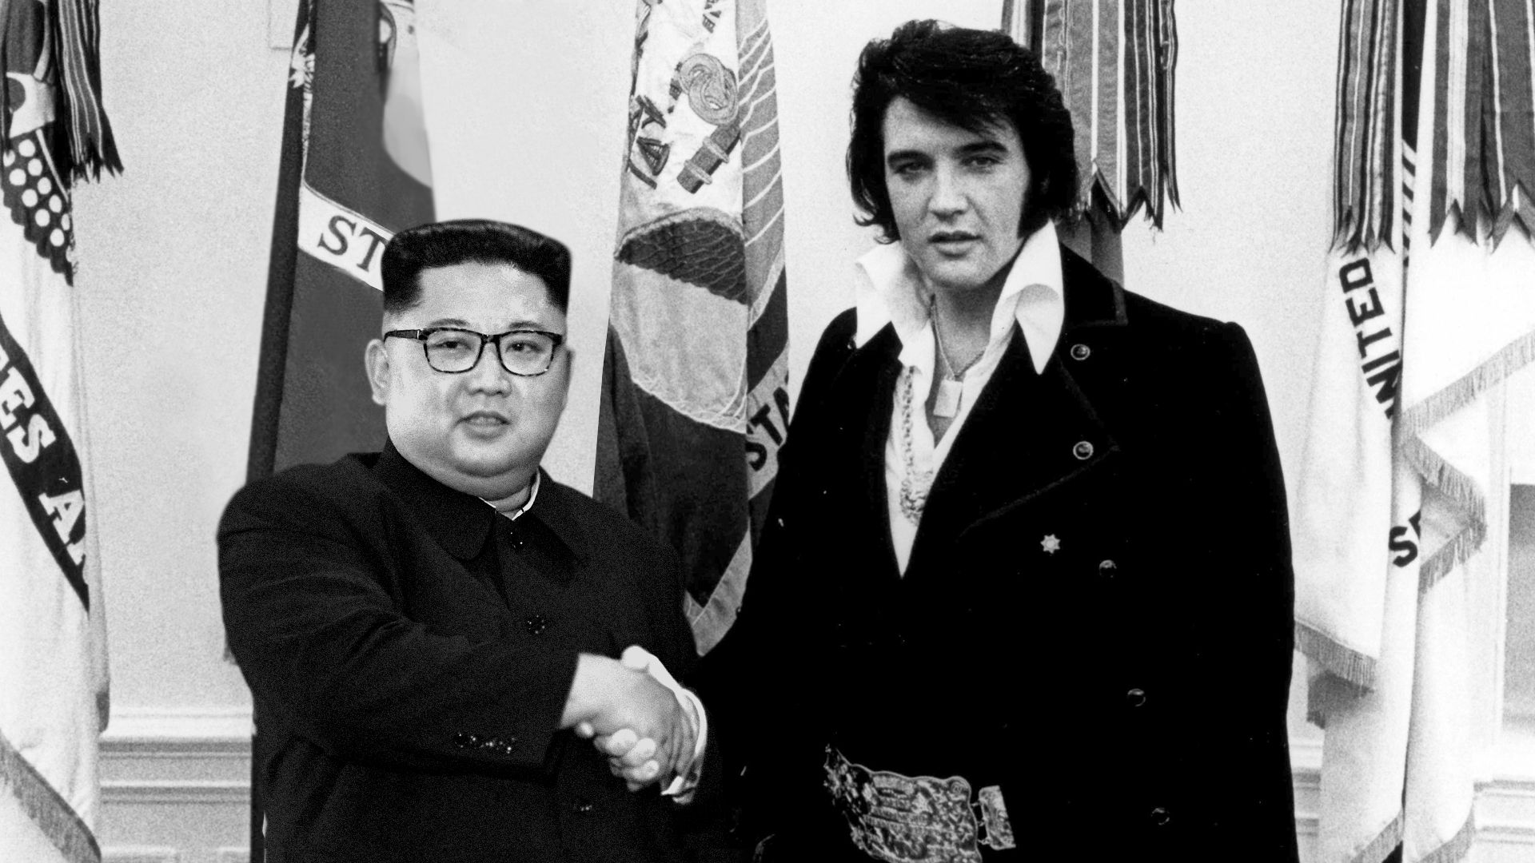
Little Rocket Man meets The King
Source

Slide 13
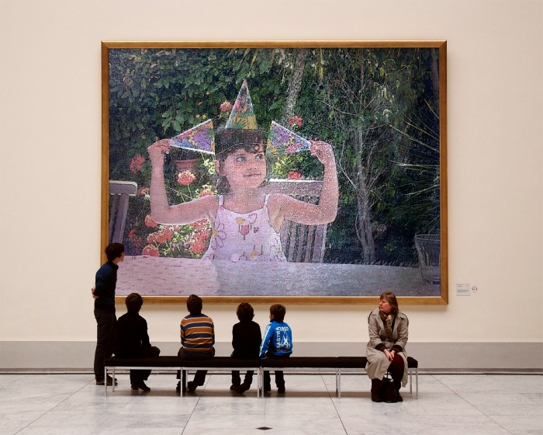
Play with images
Notes:
There are many programs and services that let one play around with images.
Here I have superimposed a picture of my grand daughter Sofia on a picture of a museum.
Let’s look at the kinds of things you can do with an image processing program.

Slide 14
Word processing operations
Select text
Cut text
Copy text
Move text
Delete text
Change fonts
Change text size
Change text color
Change footnote style
Check spelling
Compress a text file
Etc. etc.
These are word processing operations. Can you think of some image processing operations?
Notes:
You are familiar with these word processing operations – operations on text data.
What sorts of things would you like to be able to do when working on image data?

Slide 15
Word and image processing operations
Text data
Image data
Select text
Cut text
Copy text
Move text
Delete text
Change fonts
Change text size
Change text color
Change footnote style
Check spelling
Compress a text file
Etc. etc.
Select a portion of the image
Crop an image
Copy a portion of an image
Move a portion of an image
Delete a portion of an image
Resize an image
Rotate an image
Change image brightness
Change image contrast
Change colors
Compress an image file
Etc. etc.
Notes:
You are familiar with word processing operations, but may not be familiar with image processing operations.
As you see here, some are analogous to familiar word processing operations.
To learn them, you will have to spend time experimenting with an image processing program.

Slide 16
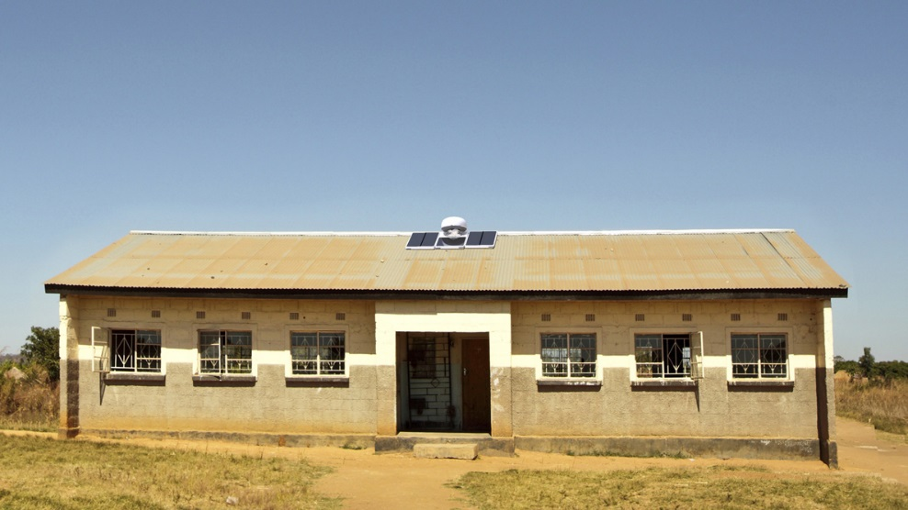
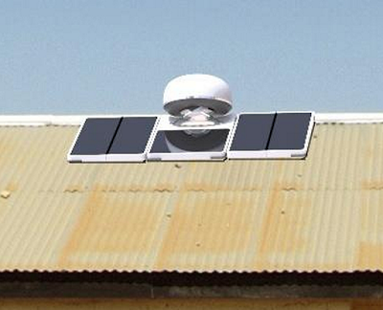
Operations
Crop
Resize
Sharpen

Slide 17
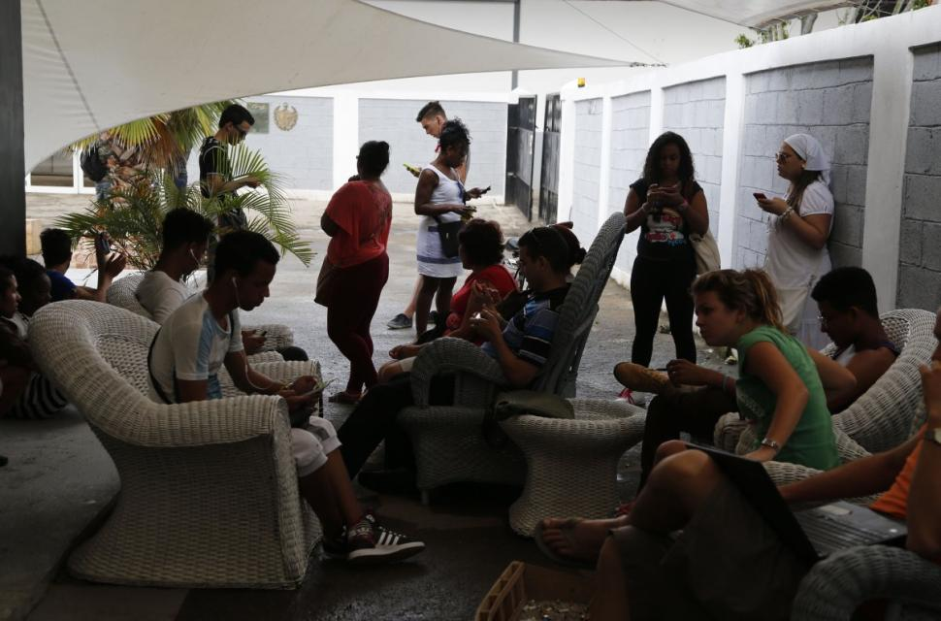
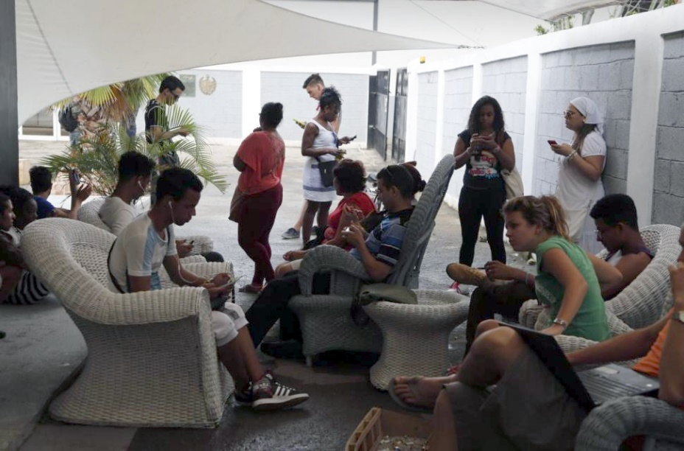
Operations
Auto level
Adjust brightness/contrast
Sharpen

Slide 18
Operations
Select suitcase color
Paint over red letters
Resize three logos
Create second layer
Paste logos on the top layer

Slide 19
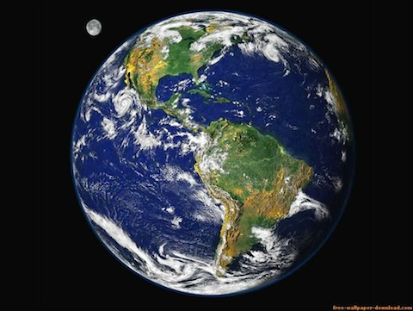
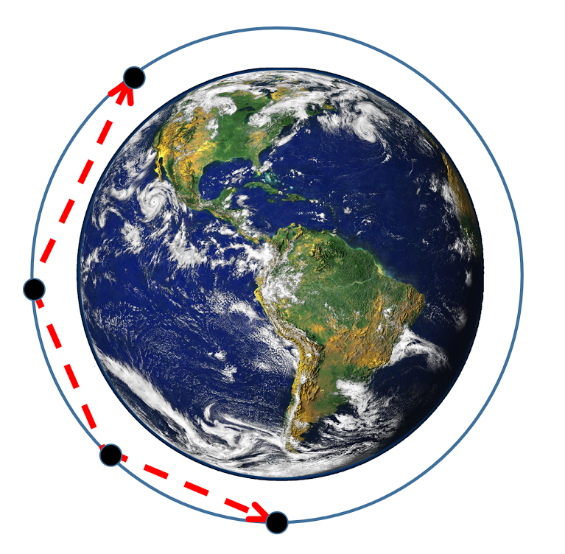
Operations
Draw circle
Select dark area (Magic Wand tool)
Cut to make transparent
Create second layer
Create circle on bottom layer
Move globe to top layer
Add arrows
Add dots (large text periods)
Notes:
Draw circle, Select dark area (Magic Wand tool), cut to make transparent, combine circle and globe on separate layers, add arrows and dots (large text periods)

Slide 20
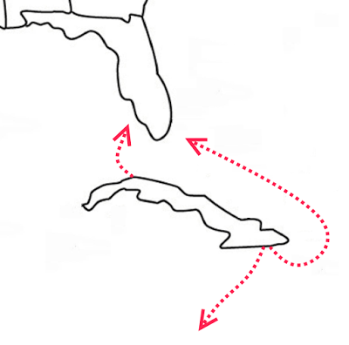
Operations
Add second layer
Draw curved, dashed arrow
Notes:
Add curved lines with arrow heads

Slide 21
Popular image processing programs
Adobe Photoshop (proprietary, stand-alone) expensive – for professionals
Paint.net (open source, stand alone)
just right
Photoshop.com (proprietary, in browser)
too slow and lacking in features
Adobe Photoshop Express (proprietary phone app)
small screen, too slow and lacking in features
How might this change in the future as technology improves?
Notes:
There are many image processing programs.
Adobe Photoshop is the leading program for graphics professionals.
It is a stand-alone program and is expensive and proprietary.
The browser-based version of Photoshop or the free phone app is not yet fast and powerful enough for me
Paint.net is a free, open-source program that is flexible, fast and easier to use than Photoshop.
It does not do everything Photoshop does, but it is fine for what I do – personal photos, presentations, Web pages, and so forth.

Slide 22
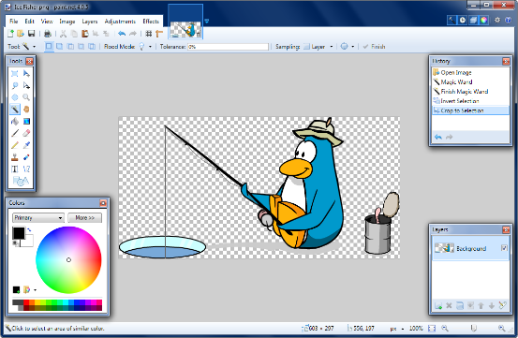
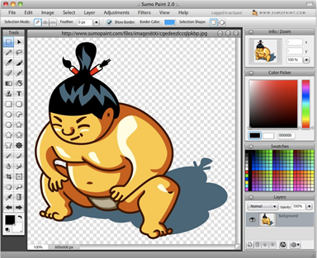
Pixlr
Paint.net
Has the gap between Paint.net and online image processing programs closed?
If so, why didn’t it close sooner?
SumoPaint
Notes:
Five years ago, installed image editing programs like Paint.net were significantly faster and more powerful than online image editors.
But, communication technology has improved significantly since that time and as communication speed increases, storing and retrieving online images and downloading programs on demand becomes faster. Larger memories and faster processors have also narrowed the speed gap between installed programs and those that run inside a browser.
Have online programs like Pixlr and SumoPaint caught up with Paint.net?

Slide 23
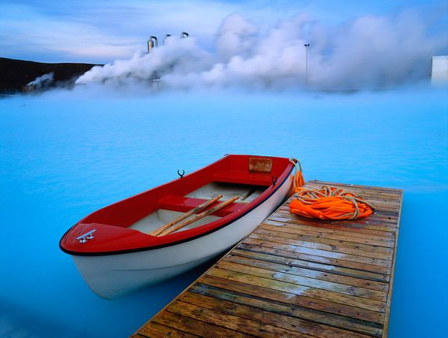
How good do you need to be?
Few users aspire to be artists.
The rest of us only need to become good enough to create images we can be proud to include in documents, presentations and so forth.

Slide 24
Image processing workflow
Capture
Edit
Compress
Distribute
Notes:
I will close with this image processing work flow.
You begin by capturing an image – perhaps by drawing, using a camera or scanner or by copying it from the Web.
Capture as high a quality original image as you can – set your camera to high quality or use a high-resolution scanner.
In other words, capture as much information as you can.
Don’t worry about file size – you will eventually compress the image.
Next use your image processing program to modify the image to suit your application -- perhaps touching it up, cropping and resizing it, changing the contrast and so forth.
The last step before distributing the image is compression – making the file as small as you can while maintaining the image quality your application requires.
The final step is distribution – include it in a report or presentation, post it on the Web, email it, and so forth.
The same work flow – capture, edit, compress and distribute -- applies when working with audio or video data.
This is a fundamental slide – you should be sure you understand it.

Slide 25
Summary
Notes:
We began with a look at the history of image processing and saw some examples.
We also noted the way technology progresses – from research prototypes to products.
We mentioned some network and stand-alone image processing programs and saw the sorts of operations they support.
Finally, we went over the image processing work flow, from the capture of an image to its distribution.

Slide 26
Self-study questions
Why didn’t image processing take off until the 1990s if we had been doing it since the 1960s?
We listed several word processing operations. Without looking back, can you recall some of them or list them based on your experience?
We listed several image processing operations. Without looking back, can you recall some of them or list them based on your experience?
We mentioned three image processing programs, what were the characteristics of each?
What were the steps in our image processing workflow? Do you understand each?
What are the step is an audio processing workflow?
What technology changes might lead me to one day switch from Paint.net to a networked image processor like Potoshop.com?

Slide 27
Resources
Ivan Sutherland demonstrating Sketchpad, narrated by Alan Kay:
http://www.youtube.com/watch?v=mOZqRJzE8xg&feature=related
Dove billboard video:
http://www.youtube.com/watch?v=iYhCn0jf46U
Deception with image processing:
http://cis471.blogspot.com/2010/06/digital-manipulation-in-politics-and.html
Humorous fake images:
http://www.worth1000.com
A brief history of fake photography:
http://www.nytimes.com/slideshow/2009/08/23/weekinreview/20090823_FAKE_SS_index.html
Image play:
http://www.nytimes.com/2011/03/10/technology/personaltech/10basics.html?_r=1&nl=todaysheadlines&emc=tha26
For Paint.net and other image processing programs, see the resources section at:
http://som.csudh.edu/fac/lpress/netapps/image/
Google image study:
http://code.google.com/speed/webp/docs/c_study.html
Google research on compression using the WebP format:
https://developers.google.com/speed/webp/
Can a cell phone replace a digital camera?
http://www.pcmag.com/article2/0,2817,2394863,00.asp

Slide 28
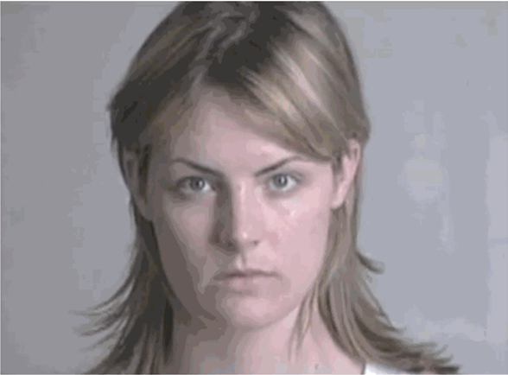
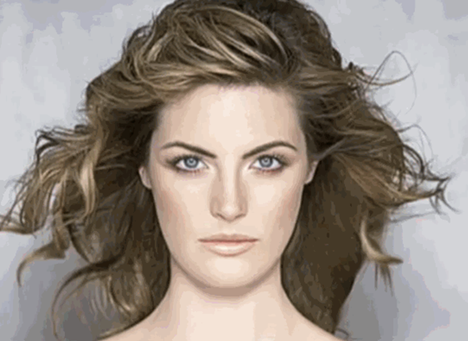
Image for a Dove soap billboard
Video of the transformation, 1m 15s
A similar video, 2m 14s
Notes:
Here is an example of image processing in action.
Makeup, hair styling and image processing were used to prepare an image for a billboard.
Watch the video to see the transformation unfold.

