Slide 1
Information flow inside the computer
IT skills: none
IT concepts: computer components (input devices, output devices, memory, storage and CPU), program file vs. data file, bootstrap, multitaking, virtualization
This work is licensed under a Creative Commons Attribution-Noncommercial-Share Alike 3.0 License.
Notes:
In this presentation, we will trace the information flow inside the computer when we switch it on and use a word processing program to create, print and save a document.
We will review the components of a computer, distinguish between the operating system, application program and data files and see what is meant by bootstrapping, virtualization and multitasking.

Slide 2
Where does this topic fit?
Internet concepts
Applications
Technology
Implications
Internet skills
Application development
Content creation
User skills
Notes:
This presentation falls within the technology concepts portion of the class.

Slide 3
What happens inside the computer when you
turn the computer on
write a word processing document
print and save the document
turn the computer off
Notes:
Let’s see how information moves within a computer when we first turn it on, then load a word processing program to create, print and store a document, and turn the computer off.
Be sure you have a clear picture of what is going on at each step.

Slide 4
Computer components
CPU
Input
devices
Memory
Output
Devices
Storage devices
(programs and data)
Notes:
This is our diagram of the components of a computer.
Pause before you go on, review the diagram to make sure you recall and understand the function of each component and the direction of information flow between them, as shown by the arrows.

Slide 5
Power is off
Operating system
WP
prog
WP
doc1
Notes:
Here we see the state of the computer when power is off.
Memory is empty and storage contains the operating system, application programs and data files.
In this simplified example, we show only one program, a word processor, and one data file -- a word processing document that had been created earlier.
In practice one would store hundreds of programs and thousands of data files on a laptop or desktop computer.
Note that an operating system like Linux, Windows or Mac OS is also a program.

Slide 6
Power on – copy OS to memory (bootstrap)
Operating system
Operating system
WP
prog
WP
doc1
Notes:
When power is switched on, the operating system is copied from storage into memory.
This is called “bootstrapping” or simply “booting,” and it can take anywhere from a few seconds to a few minutes depending upon the speed of your computer and the size of the operating system program.

Slide 7
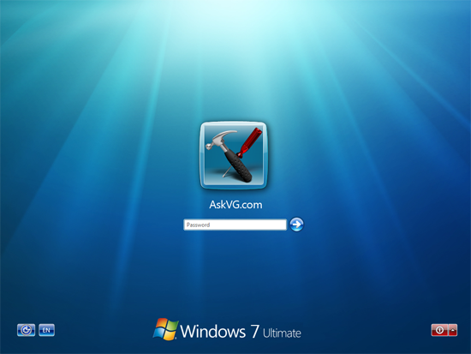
OS displays the login screen
Keyboard,
Mouse
Display
Operating system
Operating system
WP
prog
WP
doc1
Notes:
Once it is loaded into memory, the operating system program takes control of the computer and displays a login screen.
The user then types a password and clicks enter.

Slide 8
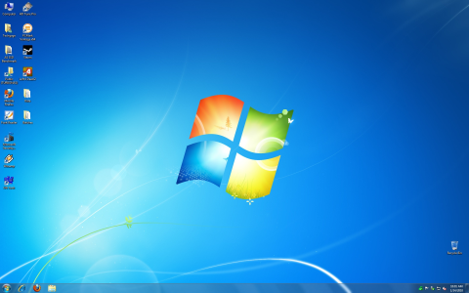
After login, the OS displays the desktop
Display
Operating system
Operating system
WP
prog
WP
doc1
Notes:
After the user logs in, the operating system displays the desktop and waits for the user to enter a command.
With Windows, the command is usually given by clicking on a program icon or file name.
With other operating systems, the user might tap an icon or type or type or even say a command.

Slide 9
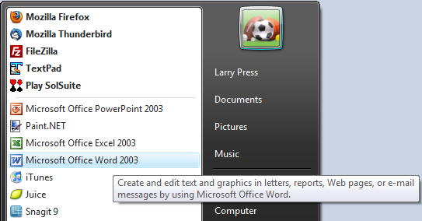
Starting a word processing program
Notes:
Let’s see what happens if we decide to work on a word processing document.
In this example, we are using Microsoft Word running under the Windows operating system.
The user begins by double clicking on the name of the program.

Slide 10
Copy word processing program into memory
Click the mouse
Display
Operating system
1
WP
Prog
2
Operating system
WP
prog
WP
doc1
Notes:
When the user clicks on Word, Windows locates the program in storage and copies it into memory.

Slide 11
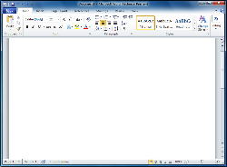
WP program displays a blank document
Display
Operating system
WP
Prog
Operating system
WP
prog
WP
doc1
Notes:
Once Word is in memory, the operating system runs it.
Word begins by displaying a blank document and waiting for the user to begin typing.

Slide 12
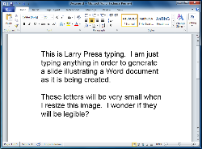
Enter and display the document
Keyboard
Mouse
Display
Operating system
WP
Prog
New
WP Doc
Operating system
WP
prog
WP
doc1
Notes:
The user types and edits the document.
It might look as though the characters are going directly from the keyboard to the display, but they are first placed in memory, and then Word outputs them to the display.

Slide 13
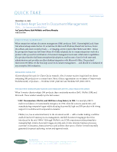
Print the document
Mouse
Printer
Operating system
WP
Prog
New
WP Doc
Operating system
WP
prog
WP
doc1
Notes:
Once the document is complete, the user clicks on the Print command of the word processing program.
That causes the document, which is now in memory, to be output to the printer.

Slide 14
Save the document
Mouse
Display
Operating system
WP
Prog
New
WP Doc
Operating system
WP
prog
WP
doc1
New
WP Doc
Notes:
Next the user clicks on the Save command, and the word processing program copies the document from memory to storage.

Slide 15
Turn power off
Operating system
WP
prog
WP
doc1
New
WP Doc
Notes:
Finally, the user turns the computer off.
The contents of memory are lost at that time, but the new word processing document is safely stored.

Slide 16
What is in memory?
Operating system (master control program)
Data
Data
Data
Data
Program
Data
Program
Data
Data
Data
Notes:
We have been focusing on one program, but in practice you run many programs at the same time.
One of the functions of the operating system is keeping track of where programs and data are in memory.

Slide 17
Virtualization
Prog
Doc
…
Prog
Doc
...
Prog
Doc
...
Operating system 1
Operating system 2
Operating system 3
Notes:
Since today’s computers have large memories and storage devices, it is possible to run two or more completely independent operating systems on one machine.
This can be more efficient, bringing us closer to using 100 percent of the capacity of the hardware.
If one virtual machine crashes or stops, the others keep going – they are independent of each other.

Slide 18
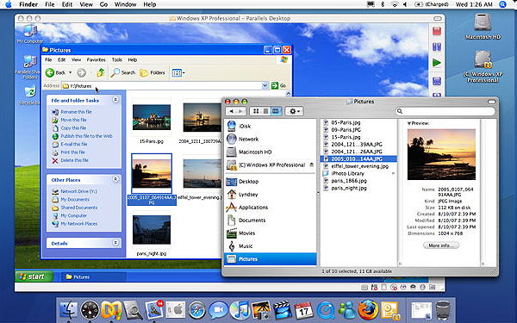
Windows and Mac OS-X
But, virtualization is primarily used on servers.
Notes:
Here we see a Macintosh computer running both the Mac operating system and Windows.
This can be handy, but virtualization is primarily used on servers.
A cloud platform provider like Amazon let’s users add virtual machines whenever they need more capacity.

Slide 19
Summary
CPU
Input
devices
Memory
Output
Devices
Storage devices
(programs and data)
Notes:
We’ve traced the flow of information inside a computer – from input devices, to and from memory and storage, and to output devices when you turn it on, create, print and save a word processing document and turn it off.
This is a self-test presentation.
Think about these information flows the next time you use your computer and if you cannot envision what is happening inside while you use it, ask for help.

Slide 20
Self-study questions
I have two laptops, both running Windows 7. One takes 32 seconds to boot and the other takes nearly 3 minutes. What could explain the difference?
In this example, we loaded and executed Microsoft Word by double-clicking the name of the program in the Start menu. What would we have done if instead of creating a new document, we wanted to go back and modify the old document called WPdoc1?
With Windows, user commands are usually entered via a mouse click. How does the user enter a command on a table PC like the iPad or a smartphone like the iPhone?
When it is turned on, a computer executes a small bootstrap program that checks to see the hardware is working correctly and loads the operating systems into memory. Is that bootstrap program stored in RAM or ROM? Explain your answer.
In this presentation, we focused on one application program – Microsoft Word – and one data file. In practice, we typically run several programs simultaneously. How many programs are you currently running? Which are they?
How many programs and data files are currently stored on your computer?

