Slide 1
How much information in an image?
Skills: none
Concepts: information, information in an image
This work is licensed under a Creative Commons Attribution-Noncommercial-Share Alike 3.0 License.
Notes:
Our class covers IT literacy.
The “I” stands for information, but what do we mean by information?
Information theorists define information mathematically, but we will take an intuitive approach to the question.
We will see that the information in an image depends upon the number of pixels and the color variety.

Slide 2
Where does this topic fit?
Internet concepts
Applications
Technology
Implications
Internet skills
Application development
Content creation
User skills
Notes:
This is a technology topic.

Slide 3
Does cropping discard information?
100 by 100 = 10,000 pixels
350 by 466 = 163,100 pixels
Notes:
Let’s take a common sense example.
Did cropping this image discard information?
Your intuitive answer to this question has to be yes.
The image on the right does not contain information about the bicycle in the back, the sneakers on the left, and so forth.
It just shows Lucas’ face.
It is also a lot smaller than the original – only 100 by 100 pixels.
That was easy, let’s try another example.

Slide 4
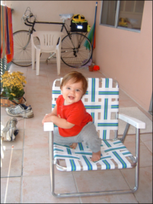
Does reducing size discard information?
199 by 255 = 50,745 pixels
350 by 466 = 163,100 pixels
Notes:
Did resizing this image discard information?
You still see the context with a bicycle and sneakers, but it seems intuitive that some information is lost.
The resized image has less than 1/3 the number of pixels of the original.
Some detail seems to have been lost – do you see the sneakers as clearly in the small image as in the original?
It seems that some information was lost in resizing and reducing the number of pixels.

Slide 5
More pixels → more information
Notes:
All things being equal, the amount of information in an image is a function of the number of pixels.
More pixels means more information and larger file sizes.
But, that is not the whole story.
Let’s see what happens when increase the size of an image.
Increasing the size of an image increases the number of pixels, but does it increase the amount of information?
Pause and think about that question before continuing.

Slide 6
Does increasing size increase information?
199 by 255 = 50,745 pixels
350 by 466 = 163,100 pixels
Notes:
Here we increased the image back to its original size of 163,100 pixels.
Your eye can see that increasing the size of the smaller image did not add information.
Instead it resulted in a larger, but blurry image.
(It will look sharper, but smaller if you step back from the screen).
If reducing the size of the image destroyed information, why didn’t increasing the size restore it?
Let’s zoom in and see what happens when we resize an image.

Slide 7
Resize, decrease size
Notes:
When decreasing the size of an image, multiple pixels are replaced by one.
In this example, four pixels, each with a different color, are replaced by one pixel with a single “average” color.
Information is lost because there are fewer pixels and also less color variety in the smaller image.
What happens when we increase image size?

Slide 8
Resize, increase size
Notes:
When we increase the size by 100% , one pixel becomes four.
But we have not added information because the four new pixels are the same color as the initial pixel.
It is as if one small pixel became one large pixel – it has the same color, but is bigger.
The overall image is larger, but the resolution has been cut in half -- no new information has been created.

Slide 9
An extreme example
1 pixel
250 by 250 = 62,500 pixels
250 by 250 = 62,500 pixels
Notes:
If you’re still not convinced that resizing an image to make it smaller destroys information and resizing it to make it larger does not add information, consider this extreme example.
I started with a 250 by 250 pixel image.
Then I resized it to 1 by 1 – a single pixel.
Its color is the average of the colors of all the pixels in the original image.
Then I resided the 1 by 1 version back to 250 by 250.
As you see, it is as large as the first image, 250 by 250, but each of those pixels now has the same average color.
The amount of information in an image is a combined function of the number of pixels and their color variety – the number of different colors they may take on.

Slide 10
600 by 600
360,000 pixels
Information requires variety.
Notes:
Information requires variety.
No matter how large an image is, it will not convey information if every pixel is the same color.

Slide 11
More pixels → more information
More color variety → more information
Notes:
Now we can add a second statement on the amount of information in an image.
Adding color variety adds information.
We allow for more unique colors in an image by increasing the number of bits for each pixel.
The more bits per pixel, the more possible colors.
The relationship between image size and information is perhaps more intuitive than the one on color variety.
Let me give you one more illustration of the importance of color variety.

Slide 12
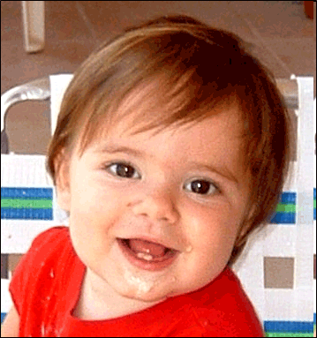
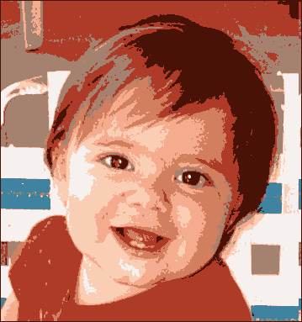
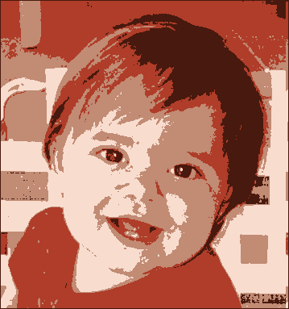
Less color variety → less information
256 colors
128 colors
64 colors
32 colors
16 colors
8 colors
4 colors
2 colors
Notes:
Each of these images is the same size, 170 by 182 = 30,940 pixels.
They have the same number of pixels, but the color variety varies.
The fewer the possible colors, the less information.
When we get down to a 32 color palette, Lucas’ right cheek begins to look faceted.
There are not enough unique colors to allow for a smooth transition from lit areas to shadows.
At 16 colors or fewer, the impact of assigning nearby pixels the same color is easily visible.
(That is called pixilation).
In the last image, every pixel has one of two colors – there is obviously less information.

Slide 13
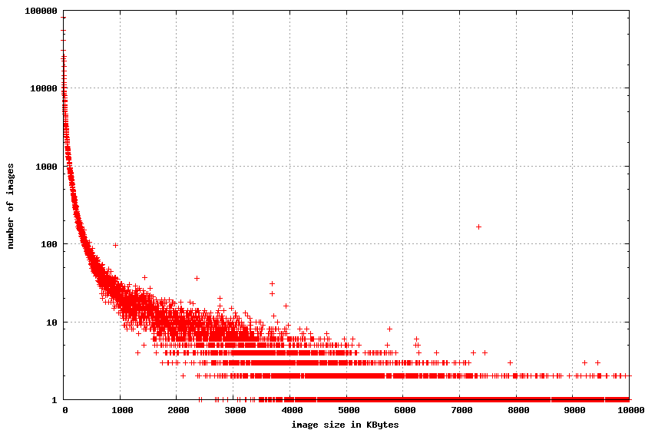
Google study – the big picture
65%
Notes:
Google analyzed a sample of a million Internet images and found that most were small.
(Note that the vertical axis of this plot is logarithmically compressed in order to fit it on the screen).
If images are small, you might not consider compression very important – who cares if they are a bit smaller?
Google also found that 65 percent of today’s Web traffic is images.
Saving even a few percent of that would be significant.

Slide 14
Lossy versus lossless compression
Emp. # | Name | Hourly rate | Hours worked | Gross pay
1 | Robinson, Jackie | 10 | 40 | $400
2 | Ladd, Alan | 12 | 40 | $480
3 | Douglas, Kirk | 54 | 40 | $2,160
4 | Dean, James | 34 | 40 | $1,360
5 | Gable, Clark | 12 | 40 | $480
6 | Davis, Bette | 34 | 40 | $1,360
7 | Monroe, Marylyn | 76 | 40 | $3,040
8 | Williams, Ted | 46 | 40 | $1,840
9 | Ruth, George | 49 | 40 | $1,960
10 | Merman, Ethyl | 21 | 40 | $840
Notes:
A final point is to distinguish between lossy and lossless compression.
We’ve used image compression as an example, but all types of data can be compressed -- images, audio, video, text and so forth.
When we compress an image information is lost, but it’s still usable.
For that reason, we can tolerate lossy compression for images.
But, we cannot tolerate lossy compression for numeric or text data.
You cannot tolerate even a small change in a payroll spreadsheet file when it is compressed.
You would not want to convert a nine into a one in your pay.
With lossless compression techniques, the file can be de-compressed to create an exact duplicate of the original.
No information is lost during compression.

Slide 15
Summary
More pixels → more information
More color variety → more information
Notes:
We saw that cropping an image or reducing its size discards information.
But increasing its size does not add information, because when we increase the size we reduce color variety.

Slide 16
Self-study questions
I took two pictures of Lucas on the balcony with a bicycle and sneakers. For one I had the camera set to low quality mode – 1 million pixels and the second it was set to high quality mode – 5 million pixels.
Which picture had more information?
If I cropped both to show just Lucas’ face, which would look sharper?
If I cropped both to show just Lucas’ face, which would have more information?
If I cropped a 200 by 200 pixel portion of each, which would show more of his face?
If I project an image on a large screen like the one in a classroom or auditorium, have I added information?
If I use my image processing program to zoom in on a portion of the image, have I added information?
In lossless compression, data is discarded – the compressed file has fewer bits than the original. How is that possible? What had to be changed to make it possible? (Hint: see this presentation: http://cis275topics.blogspot.com/2010/10/data-code-information.html

