Slide 1
The internet layer
Skills: none
Concepts: layered protocols, the internet layer, IP protocol, router, dumb (“end-to-end,” “neutral”) networks
This work is licensed under a Creative Commons Attribution-Noncommercial-Share Alike 3.0 License.
Notes:
We will quickly review the idea of layered protocols to put the internet layer in context.
The internet layer protocol is IP, which stands for “internet protocol.”
We will see how the IP layer forwards packets from router to router until they reach their destination.
Finally, we discuss the notion of a “dumb” network.

Slide 2
Where does this topic fit?
Internet concepts
Applications
Technology (communication)
Implications
Internet skills
Application development
Content creation
User skills
Notes:
The presentation deals with communication technology.

Slide 3
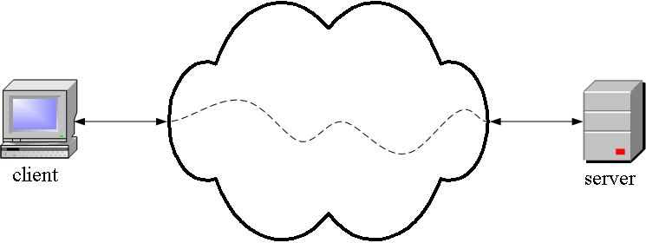
TCP/IP from the outside
Application
Program, for
example, a
Web client
Application
Program, for
Example, a
Web server
A TCP/IP network
Notes:
Application programs like Web clients and servers run in computers that are connected to the edges of the Internet.
Application programs on different hosts communicate using a collection of programs called “TCP/IP.”
People writing application programs don’t have to worry about how information is sent from client to server and back – that’s taken care of by lower level software.
This presentation focuses on the TCP/IP internet layer.

Slide 4
The internet layer
Layer | Function
Application | Do useful work like Web browsing, email, and file transfer
Transport | Transport data between application programs running on two hosts
Internet | Route packets between networks (inter network)
Data link | Send data within the local area network
Physical | Specify hardware characteristics and ways to differentiate between ones and zeros
Notes:
The internet layer software has only one function – quickly passing a packet toward its destination.
There are two transport layer protocols, TCP and UDP, but there is only one internet layer protocol.
It is called IP, which stands for internet protocol.

Slide 5
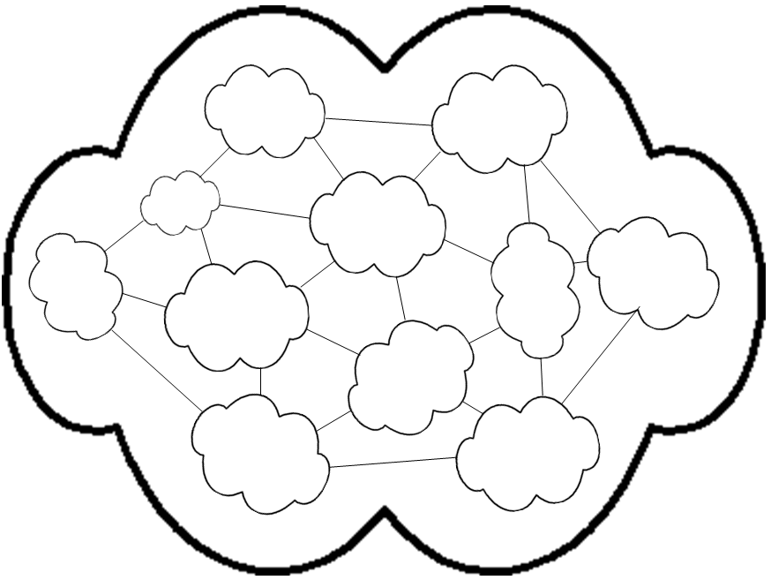
The Internet a network of networks
Notes:
Back in 1970s, the US Defense Department had several computer networks.
But hosts were only reachable on the one network to which they were connected.
A host on the ARPAnet could not communicate with a host on the ALOHA network.
The Internet grew out of the desire to connect them together, so that, for example, a client on one network could use a service provided by a server on another network.
DOD wanted to design a protocol to route packets between networks, creating inter-net connections.

Slide 6
A router at the edge
Notes:
Each network has at least one specially programmed computer called a router at its edge.
The router is programmed to send packets off into the Internet and to receive incoming packets when they arrive.
If a packet arrives and its destination is that router’s network, it is routed to the destination host within that network using data link layer.
If the packet is addressed to a host on another network, the router forwards it to another router as quickly as possible.
In the past, a router might be a general purpose computer running a packet routing program.
These days, most are special purpose computers, with packet routing programs in read only memory.
Fast “backbone” routers can process hundreds of terabits of a data every second.
The edge routers are not as fast as that, but they are extremely fast.

Slide 7
The router at the edge of our campus network
Campus
router
Firewall
CSU
router
Data
center
AT&T
Downtown LA
Responsibility of CSUDH
Links from campus buildings
1 gbps
Notes:
We have a router inside our campus LAN with links to every building.
That connects to a firewall, another special purpose computer that is programmed to look out for viruses and other threats.
The firewall connects to the router at the edge of the CSUDH network which connects to the Internet.
This presentation focuses on the Internet – beyond the dotted line.

Slide 8
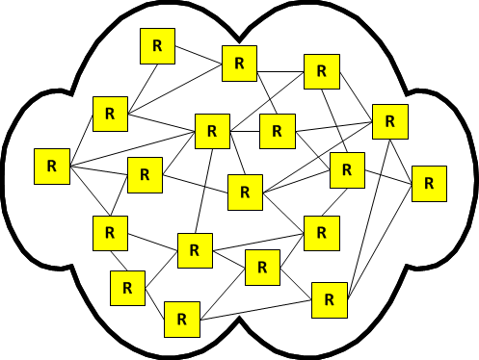
Communication between two hosts
Client
Server
Notes:
Lets trace the path between two hosts.
For example, one might be running a Web client and the other a Web server.
What happens when the client sends a page request to the server?

Slide 9
Send across LAN using data link
Client
Server
Notes:
First the client sends the request message across its local area network, to the router at the edge.
Data link software moves the data within the LAN.

Slide 10
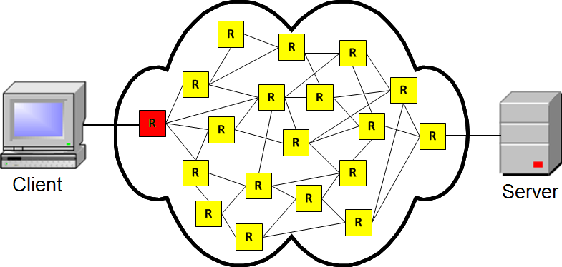
Downtown data center
Notes:
An IP packet containing the data is forwarded from the LAN router to a router on another network.
In the case of our campus, that would be in the downtown data center.
That router is connected to four other routers.
It checks the destination address in the packet header and its internally stored routing tables and decides which of the four routers to forward it to.
Once it makes the choice, it forwards the packet.
This takes a small fraction of a second.

Slide 11
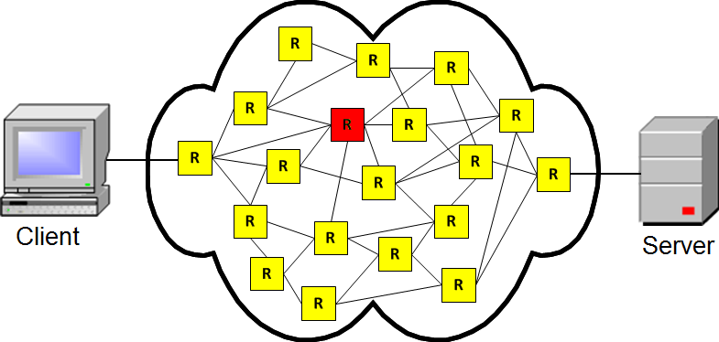
Forward to next network
Notes:
The packet arrives at the next router, which does the same thing – it selects one of the three routers it is connected to and sends the packet.

Slide 12
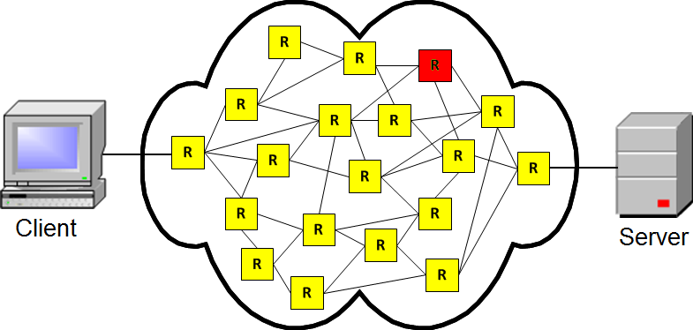
Forward to next network
Notes:
The next router chooses among two outgoing destinations, and forwards the packet again.

Slide 13
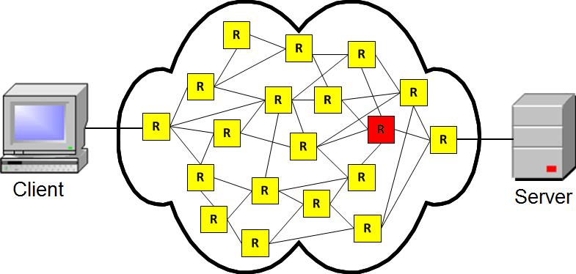
Forward to next network
Notes:
This router sends the packet on again.

Slide 14
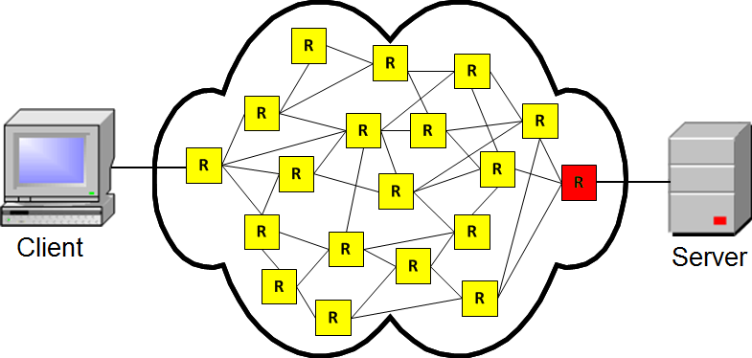
Reaches the destination network
Notes:
The packet has arrived at the destination network and is sent to the receiving LAN.

Slide 15
Delivered by the data link layer
Client
Server
Notes:
The data link layer delivers the data to the destination host.

Slide 16
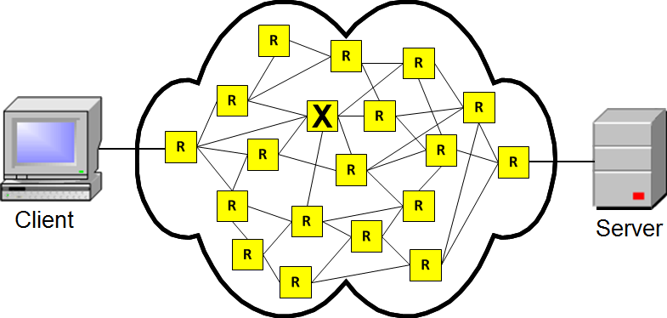
Router goes down
Notes:
What if a router breaks or becomes overloaded? What if a cable is cut?
The other routers will detect the problem and update their routing tables so as to stop sending packets to the one that is out of service.

Slide 17
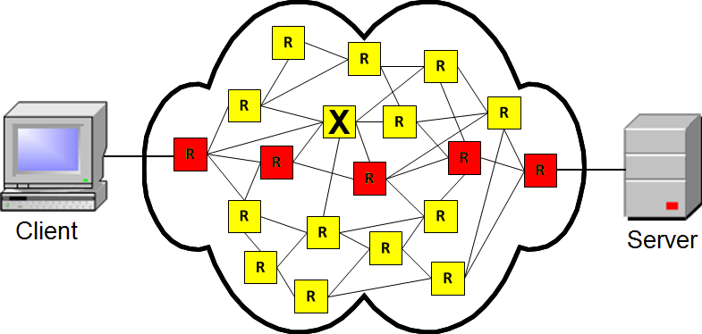
Net routes around problems
Notes:
The next time a packet is sent from our client to our server, it will take a different route.

Slide 18
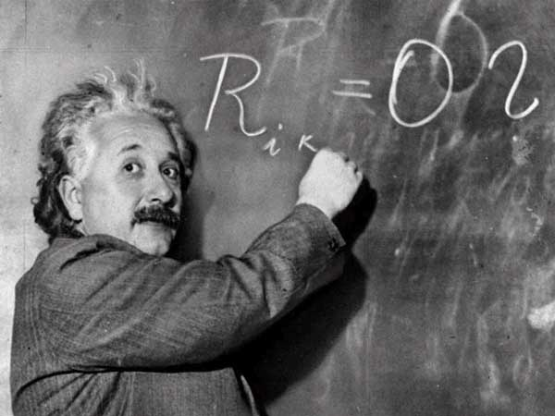
By design, the Internet is dumb
The Internet
The telephone network
The telephone network is smart
Notes:
The primary function of a router is to examine the destination address of an incoming packet and to forward it to the next network as quickly as possible.
To do more processing would take time, so the Internet was designed to be a dumb network that connects smart machines at its edges.
The clients and servers connected to the Internet are programmed to do all sorts of clever applications, but the job of the network is just to deliver packets rapidly.
Contrast that with the telephone network in which applications like setting up conference calls or an answering machine service run on computers inside the network.
The telephone network was designed to be a smart network connecting dumb devices – telephones – which have limited capability.

Slide 19
Self-study questions
Would the route from host A to B necessarily be the same as the route from B to A?
Might routes between two hosts change during the day?
Might the time to traverse a route vary during the day?
Has there been more innovation on the Internet or the telephone network in the last ten years?
We asked what happens when something goes wrong – what sorts of things might go wrong?

Slide 20
Resources
Test the speed of transmission to a nearby network using the service:
www.speedtest.net

