Slide 1
Teachable moment
Be careful what you post or write
Critique of copyright and patent law
Intellectual property politics

Slide 2
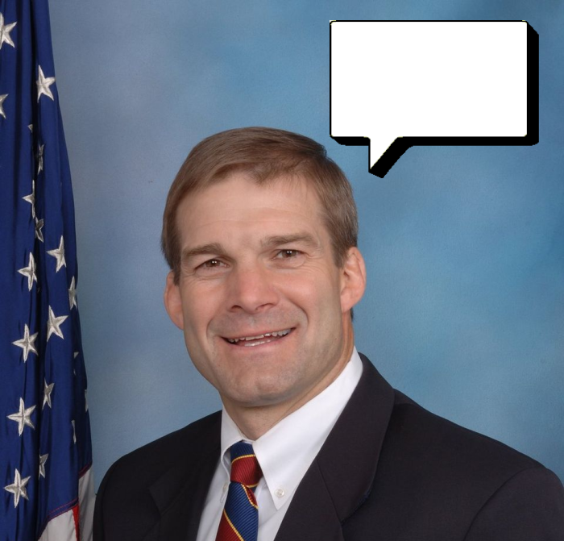
On the Internet, you own you own words
Whoops!
Notes:
The Well, an early online community, had a saying “you own your own words.” (http://bit.ly/SX1e9F)
What you say online may come back to haunt you, so think twice before posting something controversial.
Representative Jim Jordan of Ohio (http://jordan.house.gov/) learned that lesson on November 16, when the Republican Study Committee (RSC, http://rsc.jordan.house.gov/), which he chairs, published “The Three Myths of Copyright,” a well reasoned critique of the copyright and patent systems and their impact on the economy.

Slide 3
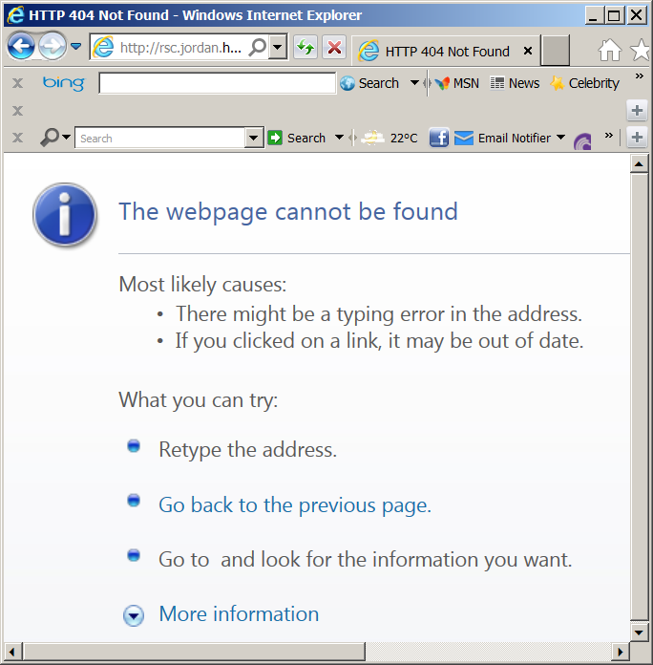
See it at: http://bit.ly/UzWgPE
Notes:
The well-reasoned critique was consistent with Jordan’s view of the government and free enterprise, but it disappeared from his Web site soon after it was published.
But, Lauren Weinstein had made a copy of the RSC document and published it on his excellent blog (http://bit.ly/UzWgPE). Note that Lauren marked it as “withdrawn,” since it was no longer on Jordan’s Web site.
Jordan has learned a lesson about Internet publication – you own your own words and they are difficult to erase.
And we citizens have gotten another look at the morality of politics and the rapidity with which principle and reason can be set aside.

