Slide 1
Layers
Skills: Adding independent layers to images
Concepts: Image layers
This work is licensed under a Creative Commons Attribution-Noncommercial-Share Alike 3.0 License.
Notes:
This presentation shows you how to add independent layers to a background image.
The key concept is that of layered images.

Slide 2
Where does this topic fit?
Internet concepts
Applications
Technology
Implications
Internet skills
Application development
Content creation (image)
User skills
Notes:
The presentation deals with image content creation.

Slide 3
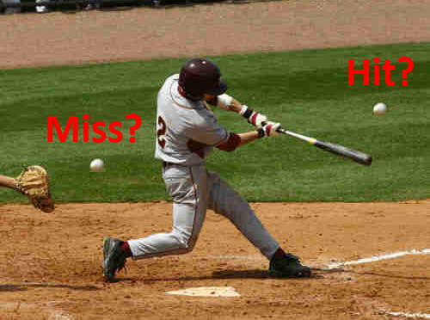
Hit or miss?
How did I make this image?
Notes:
I started with a picture of a baseball player swinging a bat and added two small images of baseballs and two text labels.
Each ball and label is on a different transparent layer “above” the background image.

Slide 4
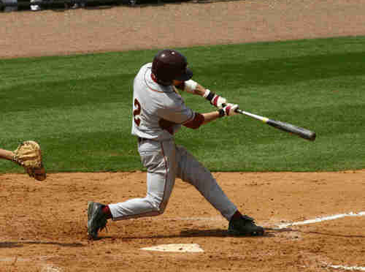
Two images
Notes:
I used two images – a background image showing the batter and catcher and a very small picture of a baseball.

Slide 5
The background layer
Notes:
I started with the background image.

Slide 6
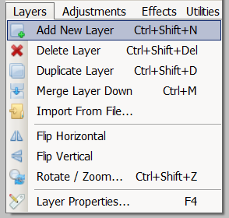
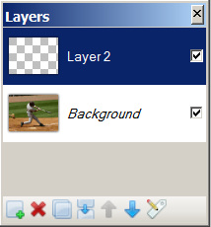
Add a new,
transparent layer
Notes:
Next I added a new transparent layer on top of the background image.
Note that the image looks the same as before, because the second layer is transparent.
It is as if you placed a piece of clear glass on top of a picture.
But the layer window on the right has changed – we see a background layer and layer 2.
Layer two is shown as a grey and white checkerboard, indicating that the entire layer is transparent.
Any portion of a layer that is shown using this checkerboard pattern will be transparent.
The checkboxes indicate that both layers are to be visible.
Level 2 is highlighted indicating that anything added to the image will be on layer 2.

Slide 7
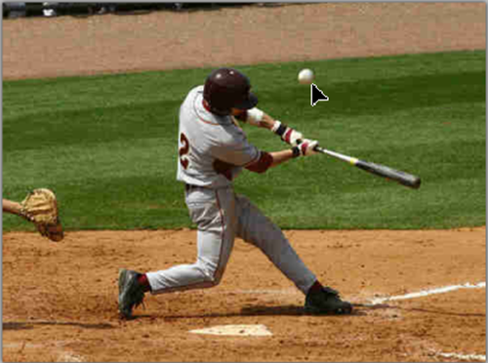
Place the ball on layer 2 and adjust its location
Which tool did I use to adjust the position of the ball?
Notes:
I copied the small baseball image onto layer 2 and moved it to the place I wanted it.
Since layer 2 is transparent, I could see where it was relative to the background image.

Slide 8
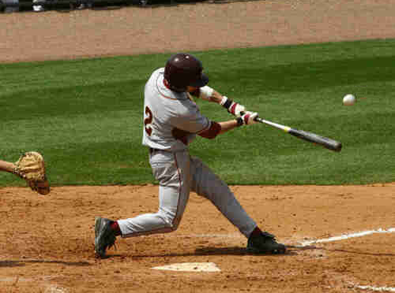
Layer 2 finished
What will I do next?
Notes:
I left it in this position and was ready to create another layer and add the second ball.

Slide 9
Layer 3 finished
What will I do next?
Notes:
I added a third layer and positioned the second ball on it.

Slide 10
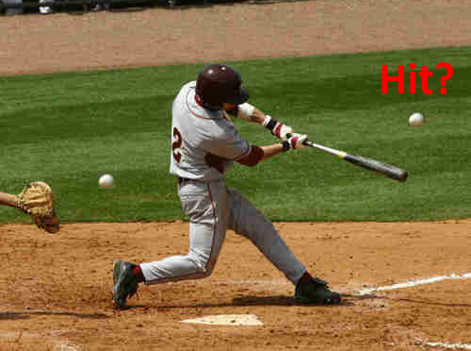
Layer 4 with a text label
What will I do next?
Notes:
I created a fourth layer and added a text label to it.
I moved it to a spot just above the ball.

Slide 11
Layer 5 with the second text label
Notes:
I added a fifth layer and placed the “Miss?” label above the second ball.

Slide 12
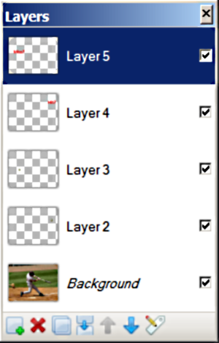
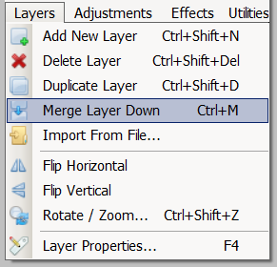
Five layers
Miss? text
Hit? text
Missed ball
Hit ball
Background image
Notes:
The final image is five layers deep.
When we are finished we can merge the layers down, creating a single, flat image.
Note that the layers are mostly transparent.
You can just see the red text on layers four and five.
If you look very carefully, you can just see the “missed” ball on layer 3.

Slide 13
Summary
Background image
Layer 2
Layer 3
Layer 4
Layer 5
Notes:
Here you see the five layers.

Slide 14
Self-study questions
Which Paint.net tool did we use to position the layers?
Which Paint.net tool did we use to create the text labels?
We created transparent layers, but layers can be anywhere from completely opaque to completely transparent. What would our image have looked like if Layer 4 were opaque? (Experiment using layer properties – Fn key 4).
What used normal mode layers, but several other modes are available. Pick one (using Fn Key 4) and experiment with it. What is its effect?

Slide 15
Resources
Tutorials:
http://www.getpaint.net/doc/latest/index.html
Download, forums, blog and email contact:
http://www.getpaint.net/doc/latest/WebLinks.html
Working with layers:
http://www.getpaint.net/doc/latest/WorkingWithLayers.html

