Slide 1
List servers (listservs)
Skills: subscribe to a list server, send messages to a list and unsubscribe from a list
Concepts: email list, subscription, client, server, client-server information flow, community of common interest, JCR Licklider’s work
This work is licensed under a Creative Commons Attribution-Noncommercial-Share Alike 3.0 License.
Notes:
This presentation introduces list servers, the idea of a subscription service, and client-server applications in general.
We see that a list server is used by a community of common interest, one of the many notions envisioned by Internet pioneer JCR Licklider.
We will also see the steps in subscribing to lists, sending messages, and unsubscribing.
Note that list servers are often called “listservs.”
Listserv was the name of the first list server program, and the system it was developed on limited file names to 8 characters.

Slide 2
Where does this topic fit?
Internet concepts
Applications
Technology
Implications
Internet skills
Application development
Content creation
User skills
Notes:
The presentation concerns an application, email lists, and shows how to subscribe to, post messages to, and unsubscribe from them.
We also introduce key concepts – client and server.

Slide 3
The first automated email list server program
Eric’s program provided an email management service to Internet users.
Notes:
Email list servers have been around since the earliest days of computer networks.
LISTSERV, the first automated email list server was developed in 1986.
List servers were in common use well before the Web was invented, and remain popular today.
The Web was not proposed until 1989 and did not begin to spread until the early 1990s.
You’ve probably subscribed to many email lists.
Even if you have, you may not have thought about the steps that are involved.
Let’s look at them.

Slide 4
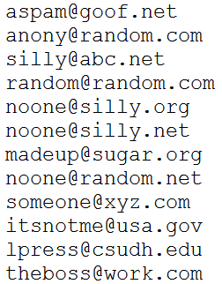
Subscribe
Server
Subscriber list
Notes:
To subscribe to a list, you send a an email message to the list server.
The server administrator will supply the server address and tell you what, if anything, the message should say.
If your request is properly formatted, the server will add your email address to the list it has stored.

Slide 5
Request and acknowledge
Server
Request to be added
Server
Acknowledge-
ment
The list server on our campus is currently configured to add people to the list without their confirmation. Why is that a bad policy?
Notes:
To combat spam (unsolicited junk email), you’ll receive an email asking you to confirm your subscription.
You’ll do that either by replying to the email or clicking on a Web link.
The server will then send you a welcome message acknowledging your confirmation.

Slide 6
Post
Server
Subscriber list
Message to distribute
…
Where is the subscriber list stored?
Notes:
List servers are very simple -- once you’re subscribed, you can send a message to every other subscriber by emailing it to the server.
The server maintains a list of the email addresses of the subscribers and forwards the incoming message to each of them.

Slide 7
Unsubscribe
Server
Subscriber list
Message to unsubscribe
Notes:
You can leave a list by sending a message to the server.
List servers can process other commands like a request for a copy of the subscriber list, but those commands are mostly used by list administrators.
Most users only need the commands we have seen here.

Slide 8
Client and server
Client
Server
Notes:
We have been referring to the computer that maintains the address list and broadcasts emails as a “server.”
The computer we use to send commands to the server is called a “client.”
In this case, the server is running a list management program -- list management is the service it offers to clients.
The client and server can communicate with each other because they are both connected to the Internet.
The Internet is usually represented by a cloud in diagrams, and it is often referred to as “the cloud.”
In this case, the client is running an email program and the server is running a list management program.

Slide 9
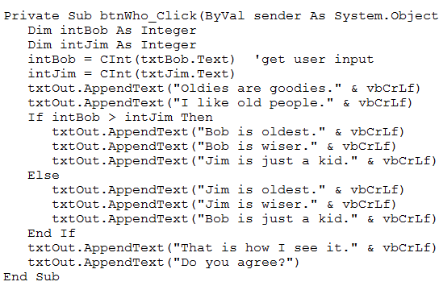
“Server” and “Server”
Server
Server
Is a server hardware or software?
Notes:
Note that the word “server” is used for two separate, but related things.
The term server is used for a computer that is connected and is programmed to provide some service.
The term “server” is used both for that program and for the computer it is running on.
That computer is the list server, it is connected to the Internet and is running a list server program.

Slide 10
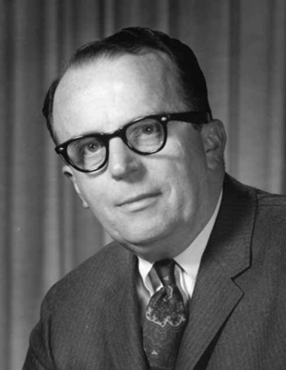
Communication and community
“In a few years, men will be able to communicate more effectively through a machine than face to face.”
“What will on-line interactive communities be like? ... They will be communities not of common location, but of common interest.”
Licklider and Taylor, 1968
Notes:
Email list management is a common Internet application.
We’ve described list servers, now let’s step back and talk about network applications.
The subscribers to a list form a community of common interest.
They may be collaborators on a project at work, students in a class, or people with a common hobby, etc.
This sort of communication was foreseen by JCR Licklider and Robert Taylor in the 1960s.
Licklider was instrumental in the invention and development of the personal computer, the portable computer and the Internet.
Microsoft, Apple, Google, Facebook, … owe him large intellectual debt.

Slide 11
Summary
Server
Subscriber list
…
Notes:
We learned what a list server is and talked about communities of common interest and the contribution of JCR Licklider.
We saw that the list server is a computer programmed to offer a service – maintenance of email lists – to the network and we call the computers utilizing those services “clients.”
The term server refers both to the computer offering a service and the program it is running.
We also saw how to subscribe to a list, send messages and unsubscribe.

Slide 12
Resources
Catalogs of list servers:
http://www.google.com/Top/Computers/Internet/E-mail/Mailing_Lists/Directories/
Influential 1968 article by Licklider and Taylor:
The Computer as a Communication Device
Description of listserv, the first email list server.
http://www.lsoft.com/news/listserv25story.asp
History of the World Wide Web:
http://info.cern.ch/

Slide 13
Self-study questions
Is an email list a stand alone application or a networked application?
Is an email list a collaborative application or a single-user application?
Is a list server a computer or a program?
Web surfing is a client-server application – explain what I mean by that.
Which lists do you subscribe to?
Do you post messages to the lists you subscribe to or are you a lurker?
How would you characterize the community of fellow subscribers – what is their common interest?
The assignment for this topic says you can send an email to the list by addressing it to <list name>@lists.csudh.edu. What is lists.csudh.edu?
Is a list server a one-to-many communication medium? (Explain)
What does Wikipedia say about the role of JCR Licklider in the development of the Internet, PC and laptop?

