Slide 1
I teach a class on the applications, implications and technology of the Internet.
When Donald Trump was nominated, I started a PowerPoint presentation on the political implications of the Internet and updated it weekly throughout the term.
The term has ended, but I’ve continued updating that presentation. The latest slides are shown below and the cumulative slide deck is here.
This work is licensed under a Creative Commons Attribution-Noncommercial-Share Alike 3.0 License.

Slide 2
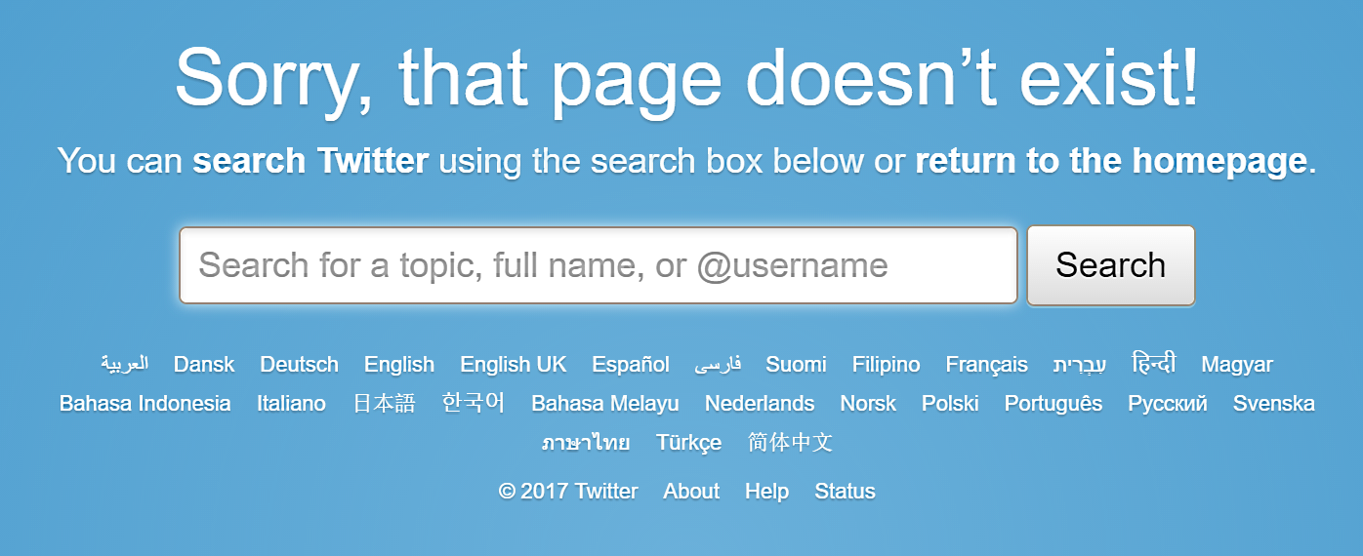
Balaji S. Srinivasan, a leading candidate to head the Food and Drug Administration (FDA), had 47.7K Twitter followers. Why did he delete his tweets?
https://twitter.com/balajis/status/810571335508209664
Perhaps it was because they
Were highly critical of the FDA
Revealed conflicts of interest
Were critical of Trump
Source
History is written by winners. Should political statements and data be preserved? Protected against modification?

Slide 3
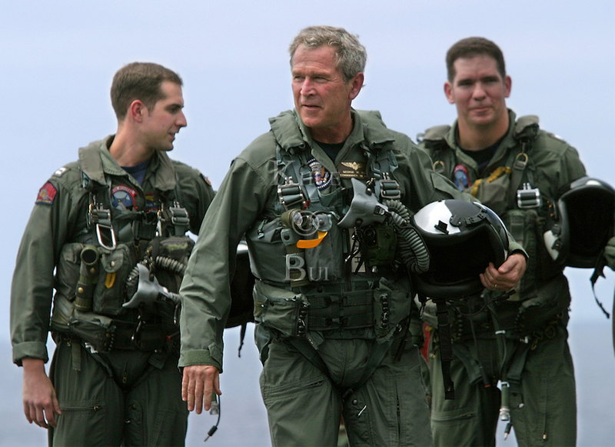
The Internet is fragile, with an unreliable political memory
83 percent of the PDFs on .gov and .mil sites were deleted between 2008 and 2012.
The headline of the press release for George Bush’s “mission accomplished” speech was first altered then deleted.
Source

Slide 4
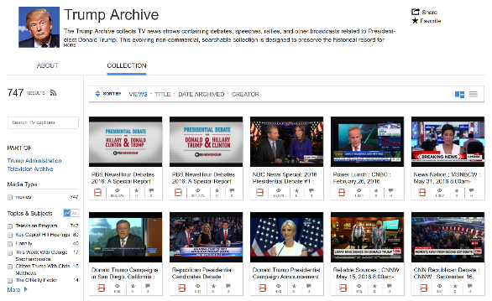
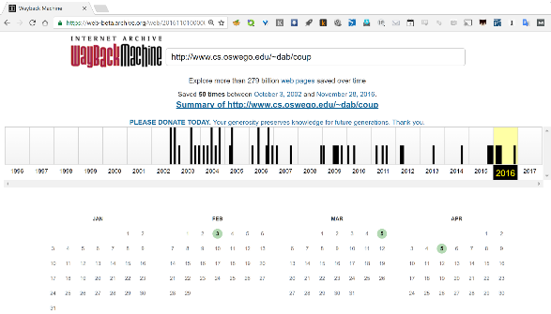
The Internet Archive protects the political record
Focused political archives: audio and video material
Web site backup: over 279 billion Web pages saved
Source

Slide 5
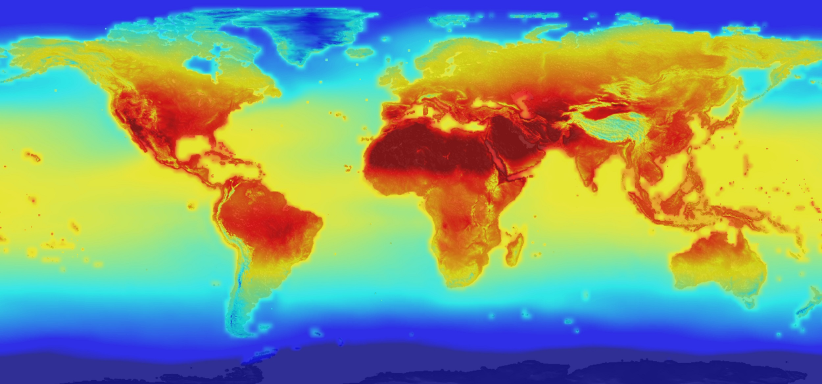
Climate science data and research archive
The Internet Archive collaborates with other, more specialized archive projects.
They plan to archive Interactive services in the future.
Source
Notes:
Trump cabinet appointments have added urgency to this project.

Slide 6
Note on my PowerPoint style
Few words
Images
Links to supporting material
Annotation
“Stop sign" questions
Source
Notes:
To prepare for teaching, I read the supporting material and then speak extemporaneously. I let the students know that they are responsible for reading the annotations (like this one) accompanying the slide, following and reading the linked material and attempting to answer the “stop sign” questions.
Follow the “Source” link for more on the way I use PowerPoint slides.

