Slide 1
I teach a class on the applications, implications and technology of the Internet.
When Donald Trump was nominated, I started a PowerPoint presentation on the political implications of the Internet and updated it weekly throughout the term.
The term has ended, but I’ve continued updating that presentation. The latest slides are shown below and the cumulative slide deck is here.
This work is licensed under a Creative Commons Attribution-Noncommercial-Share Alike 3.0 License.

Slide 2
Facebook to flag fake news in Germany
An extension of Facebook’s US trial
Version 1.0
In time for the next German election
Fact-checking by selected members of the Fact-Checking Network
Source
Notes:
The German Parliament’s computer network was hacked in May 2015. The German intelligence agency concluded that the attack was most likely the work of their Russian counterparts.
https://www.nytimes.com/2016/12/08/world/europe/germany-russia-hacking.html?_r=0

Slide 3
International Fact-Checking Network fact-checkers’ code of principles
Commitment to
Nonpartisanship and fairness
Transparency of sources
Transparency of funding and organization
Transparency of methodology
Open, honest corrections
43 Members to date
Source
Notes:
Some, but not all affiliated fact-checking organizatons

Slide 4
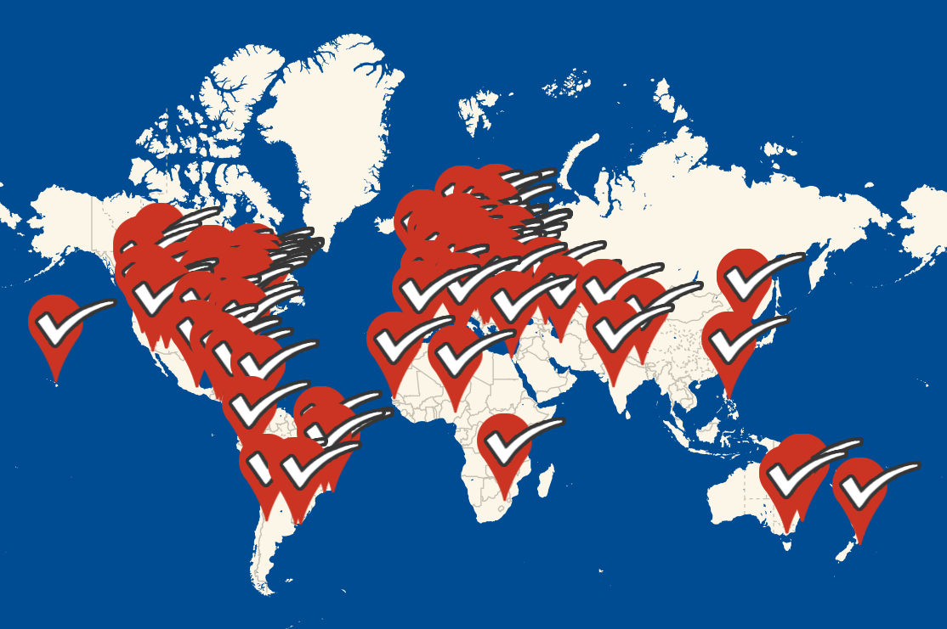
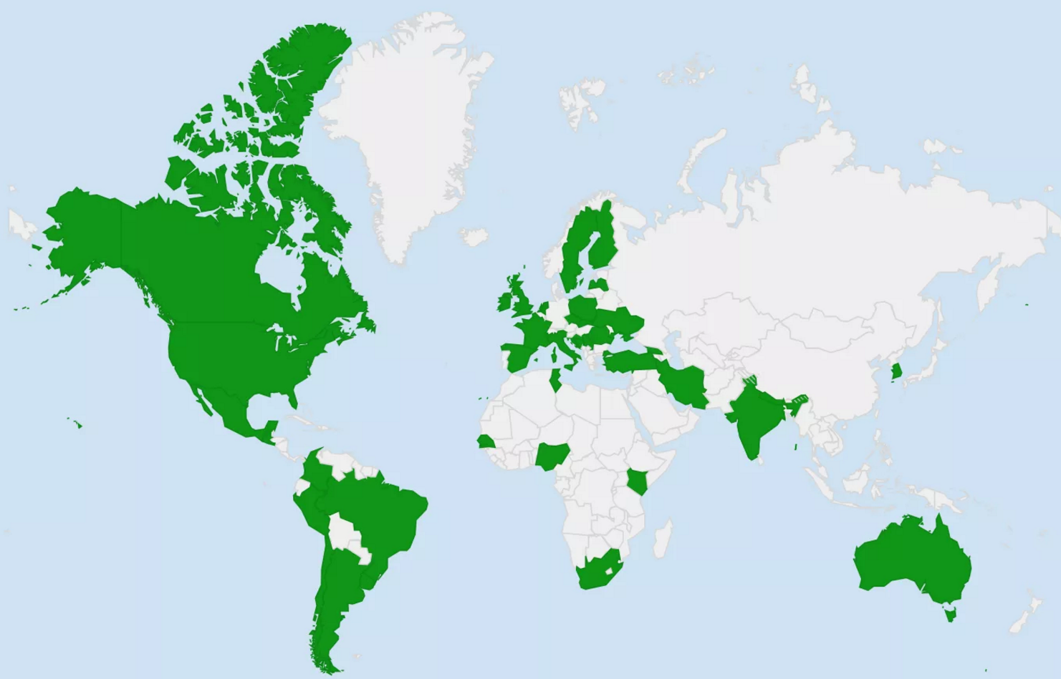
Duke University and the Fact-Checking Network both track fact-checkers
(See previous slide for links)
Could they pool their resources?
Could there be a standard application programming interface to facilitate fact-check sharing?

Slide 5
Note on my PowerPoint style
Few words
Images
Links to supporting material
Annotation
“Stop sign" questions
Source
Notes:
To prepare for teaching, I read the supporting material and then speak extemporaneously. I let the students know that they are responsible for reading the annotations (like this one) accompanying the slide, following and reading the linked material and attempting to answer the “stop sign” questions.
Follow the “Source” link for more on the way I use PowerPoint slides.

