Slide 1
I teach a class on the applications, implications and technology of the Internet.
When Donald Trump was nominated, I started a PowerPoint presentation on the political implications of the Internet and updated it weekly throughout the term.
The term has ended, but I’ve continued updating that presentation. The latest slides are shown below and the cumulative slide deck is here.
This work is licensed under a Creative Commons Attribution-Noncommercial-Share Alike 3.0 License.

Slide 2
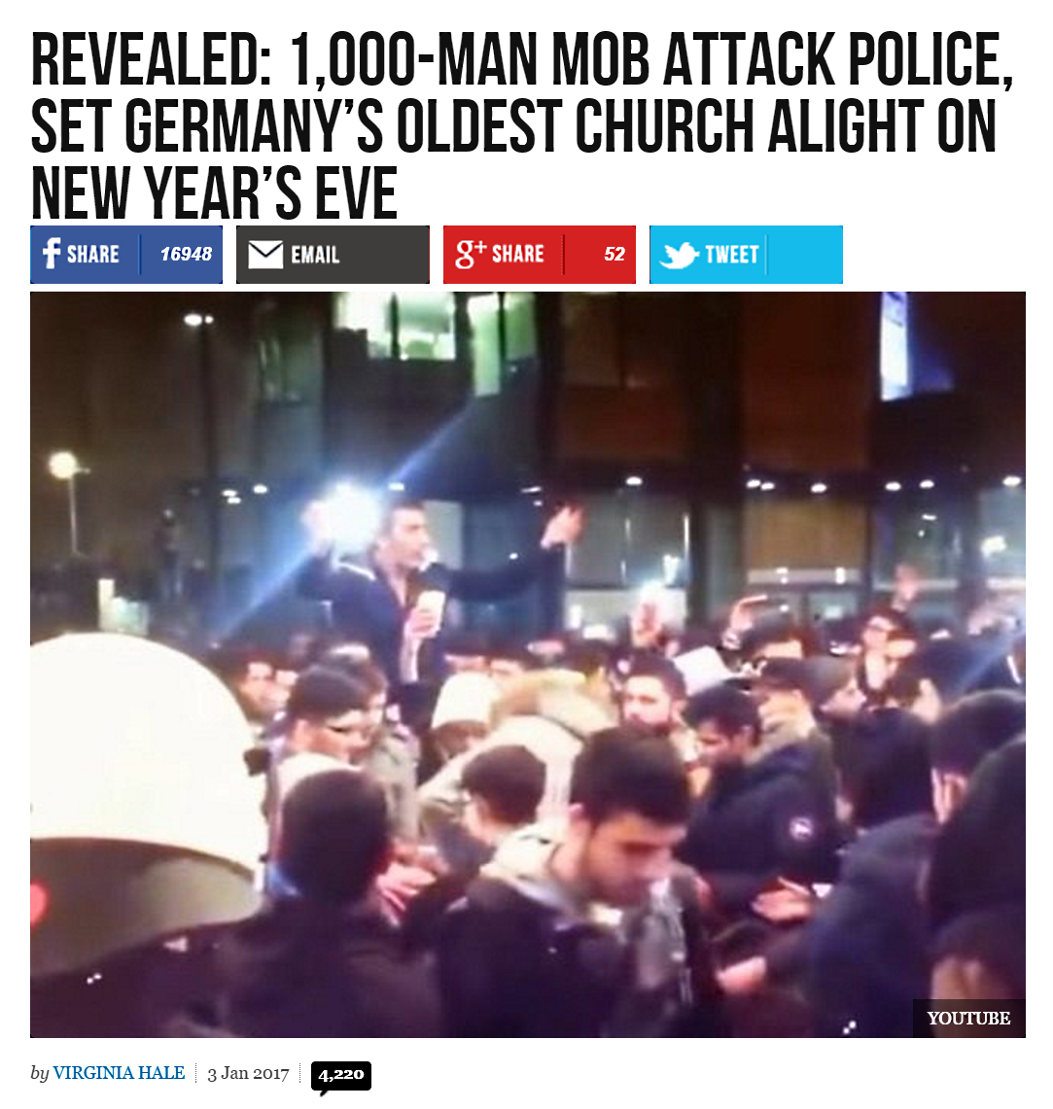
Fake story posted on Breitbart.com, January 2, 2016
Source

Slide 3
Engagement
source
There were 4,197 comments as of January 9, 2016.
The first comment, shown here, generated a threaded discussion with 838 entries.
Read some of the comments – how would you describe them?

Slide 4
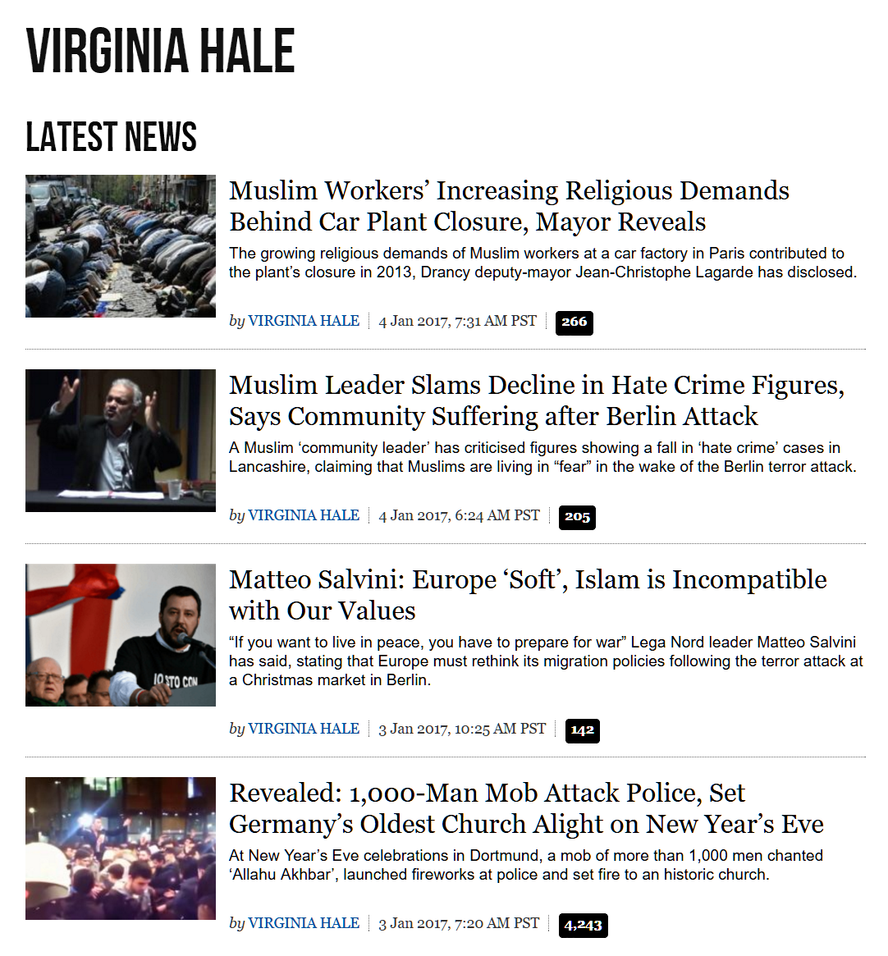
Fake story written by Virginia Hale
Hale has written hundreds of Breitbart stories.
Hale has written three others since the church fire hoax.
Source
Do you think “Virginia Hale” is a pseudonym? A real person? A group of free lance writers?
Notes:
“Virginia Hale” is a prolific writer, yet has no Wikipedia entry.
I wonder whether “Virginia Hale” is a pseudonym for a group of writers – perhaps free lancers.
I would love to meet Virginia.

Slide 5
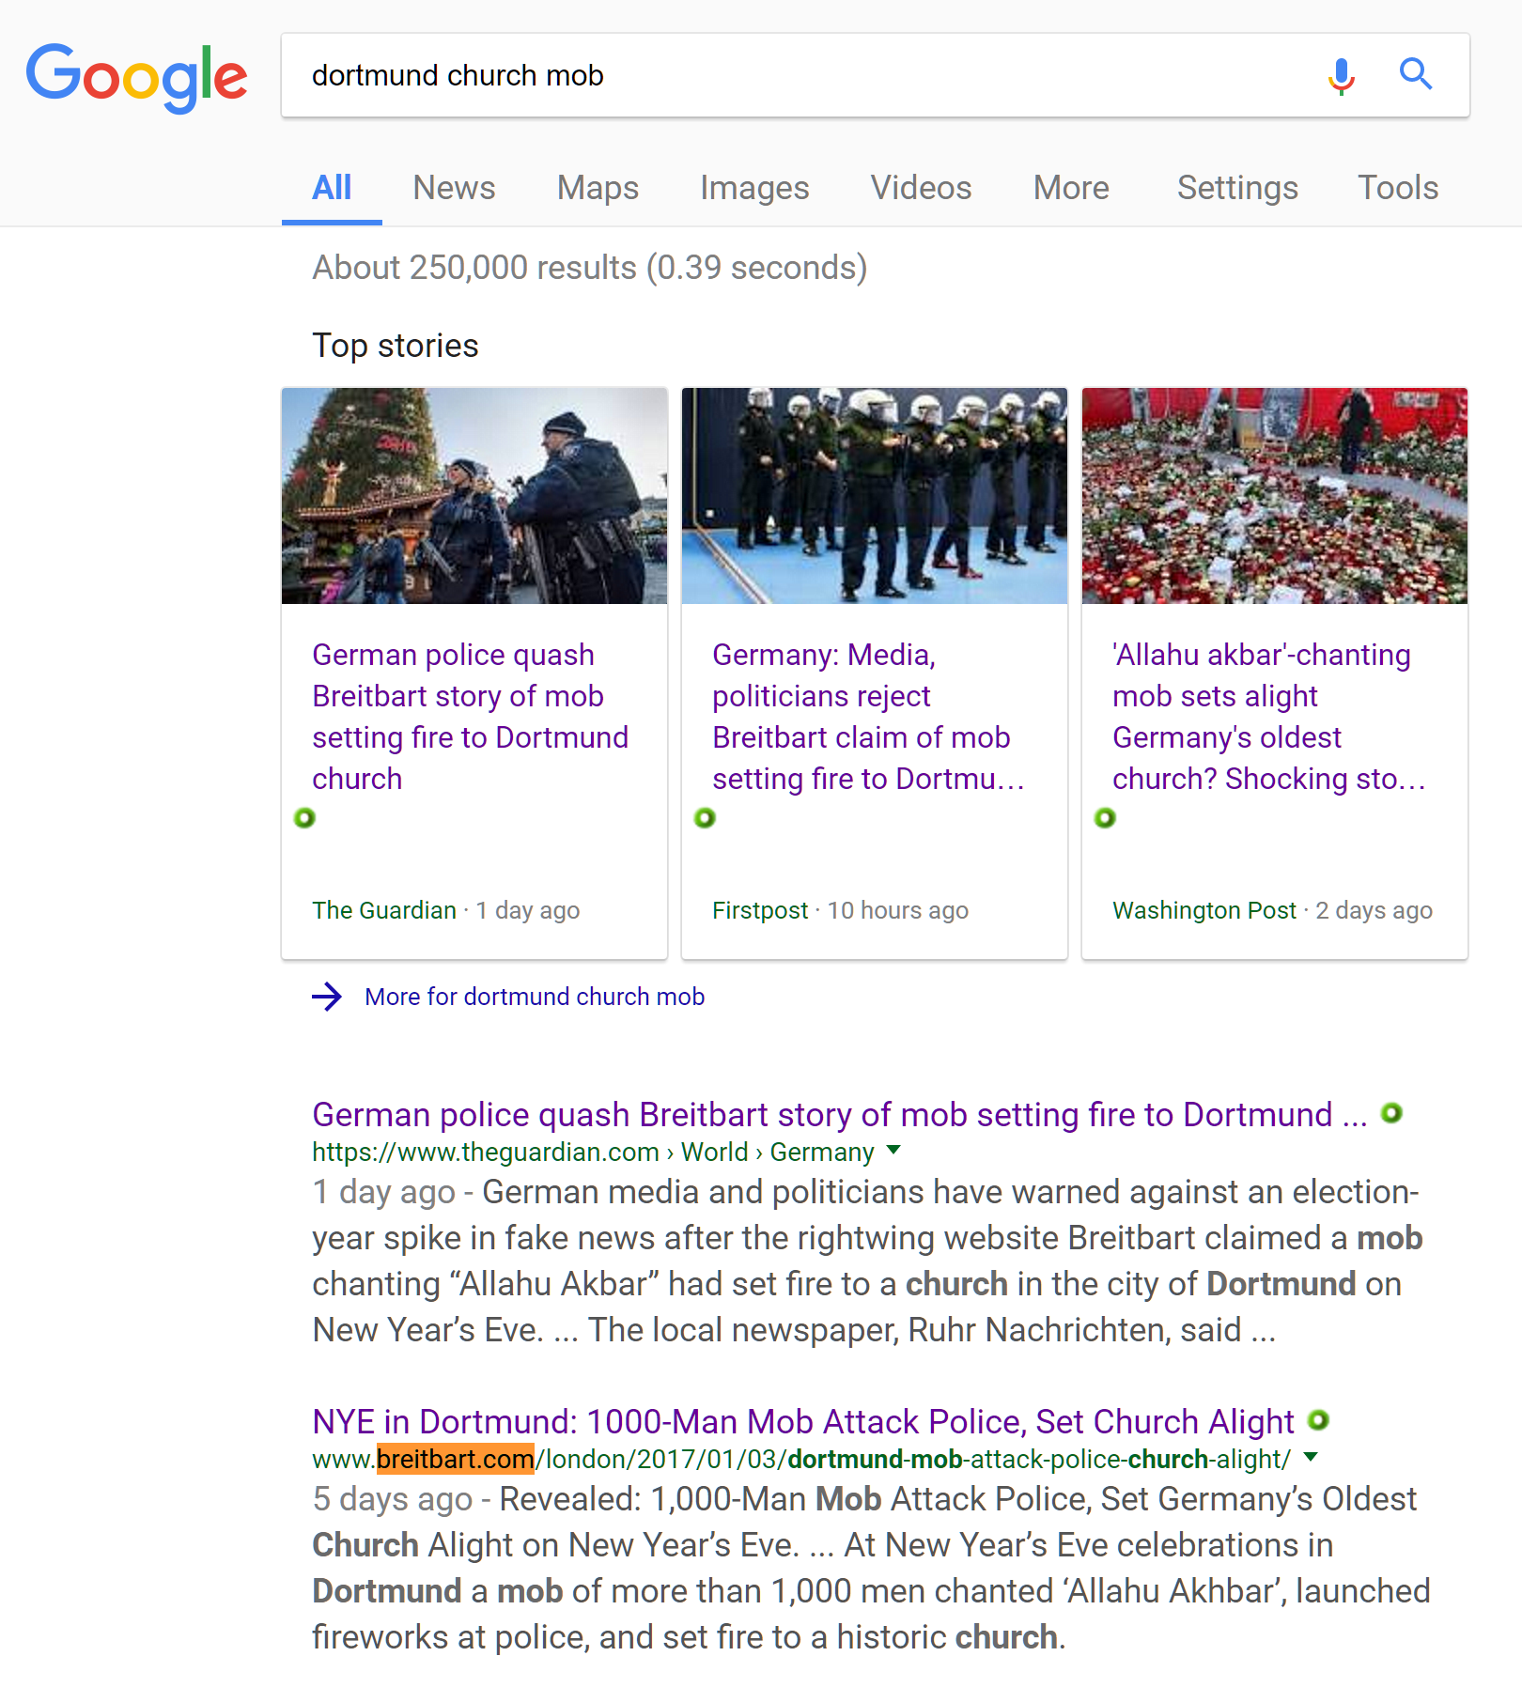
Google search for “Dortmund church mob” on January 8 2016
By January 8, the story had been debunked, but it still came up on the first page in a Google search.

Slide 6
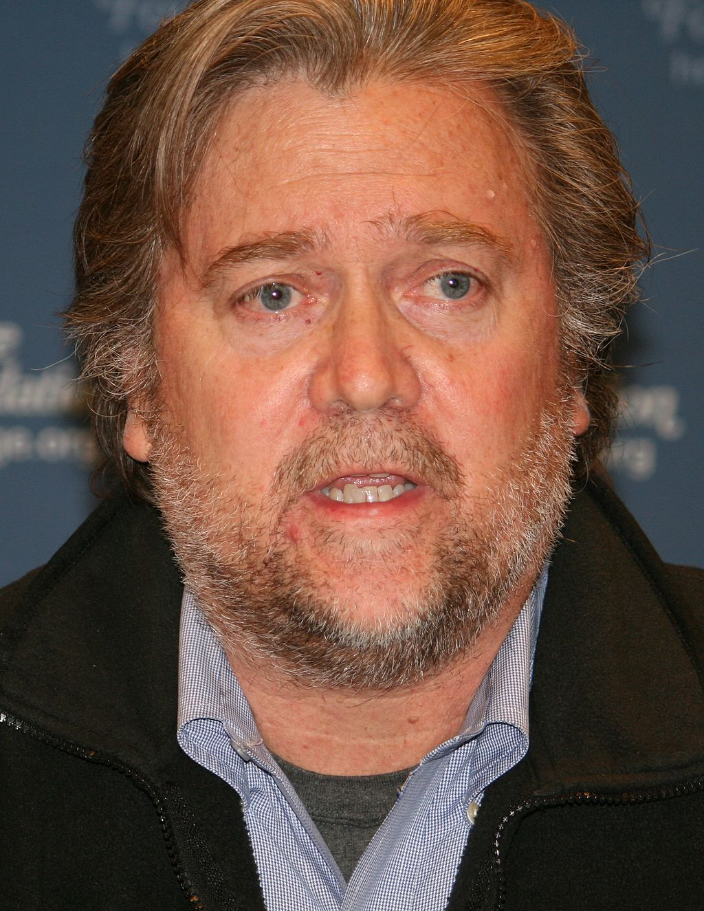
Breitbart Executive Chair, Steve Bannon
Founding member of the board of Breitbart News
Executive chair of Breitbart News LLC
Former CEO of Trump’s presidential campaign
White House Chief Strategist designate
Do you think being a media executive qualifies one to be Chief White House Strategist?
By Don Irvine
Notes:
Ex media executive Bannon is a master of social media (as Leni Re was a master of cinema) and Gerbels was a master of propaganda
Paul Joseph Goebbels was a German politician and Reich Minister of Propaganda of Nazi Germany from 1933 to 1945

Slide 7
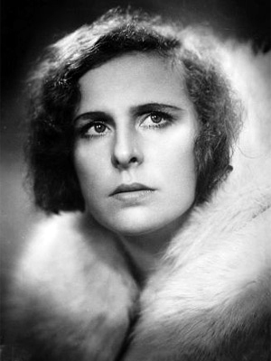
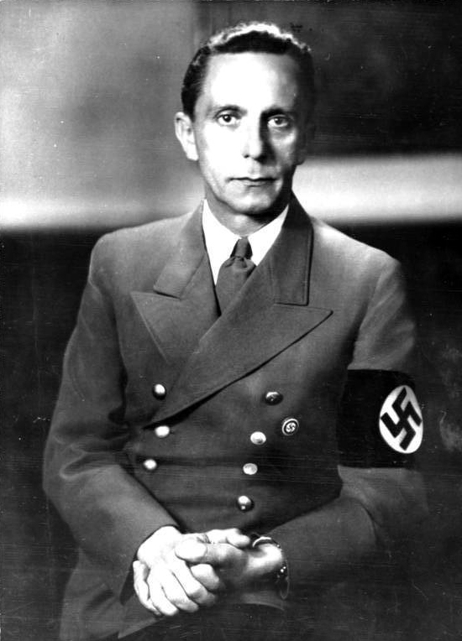
Different media, different nations, some parallels
Leni Riefenstahl, German film propagandist
Steve Bannon, social media propagandist, Chief White House Strategist
Paul Joseph Goebbels, Reich Minister of Propaganda
Notes:
The films of Leni Riefenstahl glorified Hitler and his position before the war.
Goebbels was responsible for propaganda during the war.
Steve Bannon was a successful social media propagandist and campaign CEO before Trump was elected and will also be a senior member of the administration.
The views expressed on Breitbart News are reminiscent of the beliefs of Nazi Germany.
While there are similarities, the US economy is much stronger than that of Germany was in the period before World War II. We also have a different and a hopefully independent Supreme Court and Congress.

Slide 8
Note on my PowerPoint style
Few words
Images
Links to supporting material
Annotation
“Stop sign" questions
Source
Notes:
To prepare for teaching, I read the supporting material and then speak extemporaneously. I let the students know that they are responsible for reading the annotations (like this one) accompanying the slide, following and reading the linked material and attempting to answer the “stop sign” questions.
Follow the “Source” link for more on the way I use PowerPoint slides.

