Slide 1
Open source
Skills: none
IT concepts: open source, copyright, license, the impact of open source software and content
This work is licensed under a Creative Commons Attribution-Noncommercial-Share Alike 3.0 License.
Notes:
Because Web protocols are standardized, there are many competing client and server programs – some open source and others proprietary.
We will use them as examples in defining open source.
We will also cover open source licenses and copyright.

Slide 2
Where does this topic fit?
Internet concepts
Applications
Technology
Implications
Internet skills
Application development
Content creation
Notes:
This is a technology presentation.

Slide 3
Popular Web client programs
Can you name the one that goes with each logo? The company that wrote the program?
Notes:
These are the logos of five popular Web clients.
Some are open source and some are primary – do you know which are which?

Slide 4
Popular Web client programs
Opera, Opera Software
Internet Explorer, Microsoft
Safari, Apple
Chrome, Google
Firefox, Mozilla Foundation
Web client and Web browser are synonyms.
Notes:
Here are the names of the programs and the names of the organizations that wrote them.

Slide 5
Popular Web client programs
How is it possible that any one of these Web clients works with any of the millions of Web servers on the Internet?
Notes:
Various Web client and Web server programs are compatible because they all are written to conform to the Web standard protocol (the Hypertext Transfer Protocol, HTTP).

Slide 6
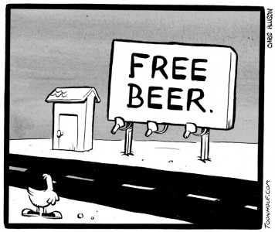
Open source software – free in two ways
Geeks say it is free as in “free speech” and free as in “free beer.”
Which Web clients are open source?
Notes:
Open source software is free in two senses: you can use it without paying and you are free to modify it.
As geeks say, it is “free as in free speech and as in free beer.”
There are different open source licenses, with different conditions.
For example, one might require that all programs that use the program must themselves be open source.
Other licenses may be unrestricted.

Slide 7
Web client programs
Proprietary, Opera Software
Proprietary, Microsoft
Proprietary, Apple
Open source
Open source

Slide 8
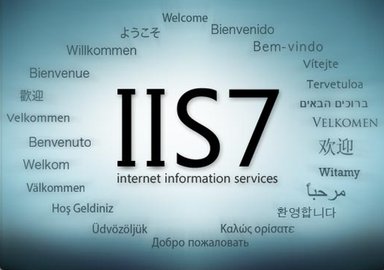
The most popular Web server programs
Proprietary
Open source
Which do you think is most popular?
Notes:
The two most popular Web server programs are Microsoft Internet Information Server and Apache.
IIS is proprietary -- written and maintained by Microsoft employees and included at no extra cost in most versions of Windows.
Apache is written and maintained by a volunteer community.
(Some of the Apache contributors are employed by companies that pay them to work on Apache).

Slide 9
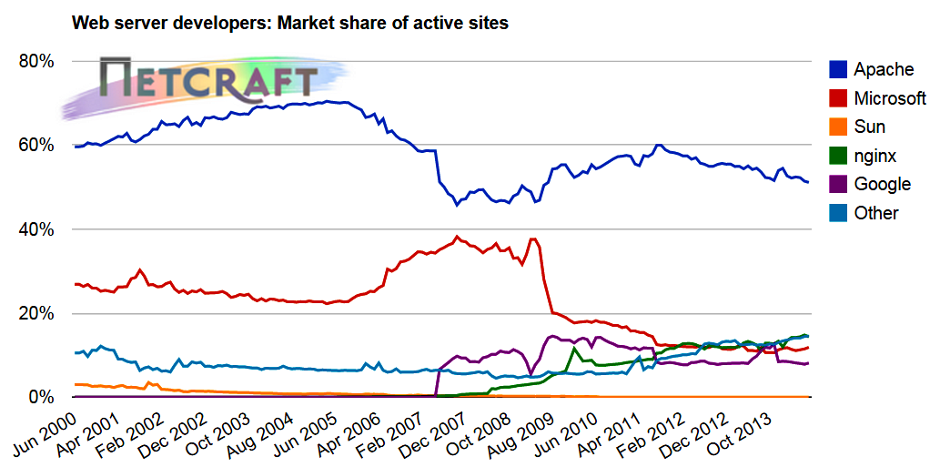
Note that there are many other, less popular Web server programs.
Source: Netcraft
Notes:
As shown here, Apache has a significantly larger share than Microsoft Internet Information Server.

Slide 10
Open source/copyright licenses
Open source software licenses
Choose a copyright license
This presentation
Notes:
The Open Source Initiative maintains nine different open source licenses.
Some allow totally unrestricted copying, others require users to contribute improvements back to the community, to refrain from commercial use, etc.
Similarly, Creative Commons allows one to create a copyright license for content.
This presentation is under a Creative Commons license allowing non-commercial copying and modification as long as the source is cited.

Slide 11
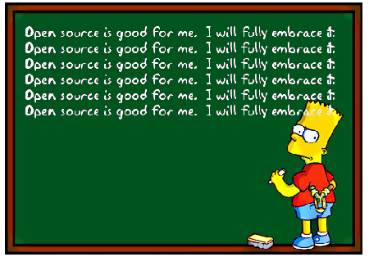
Is open source a good idea?
For society? For content and software creators?

Slide 12
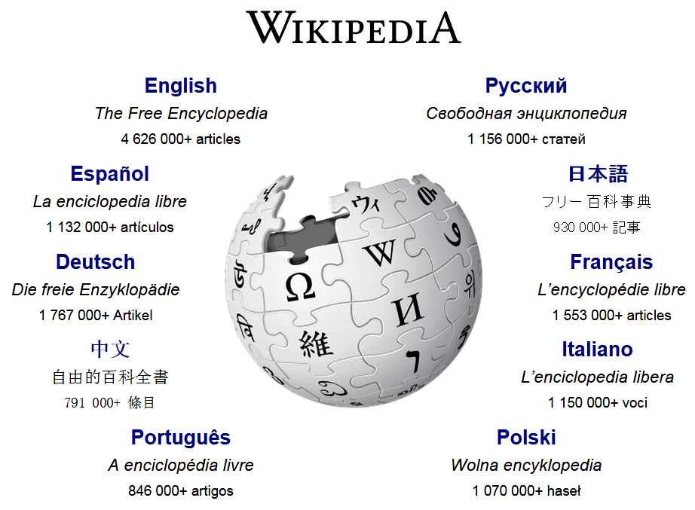
Why would anyone contribute to Wikipedia?

Slide 13
Before we end this presentation, have you used any open source software today?
Notes:
Yes, for example, if you downloaded this presentation from a Web site, it probably ran Apache server software.
Did you download it using the open source Chrome or Firefox Web clients?
The behind-the-scenes program that converted the server name in the URL to an IP address was almost certainly open source.
How about your Android phone? Android is open source.

Slide 14
Self-study questions
Why do suppose Apache is more popular than IIS?
The HTTP protocol is standardized, Explain how that leads to competition in Web client and server software.
We said open source software is open in two ways – can you explain them in your own words?
Why is Linux such a big deal if it only has 1.1% of the desktop operating system market?
Ethernet is the dominant protocol for wired communication between computers in local area networks, but IBM’s Token Ring protocol and products competed with Ethernet in the 1980s. Why did Ethernet prevail?
WiFi is the dominant protocol for wireless communication between computers in a LAN. To what do you attribute its success?
What motivates people to contribute to open source projects?

Slide 15
Summary
Open source
Proprietary
Notes:
We’ve looked at the popular Web client and server programs and seen their market shares.
We also noted that some are open source and others proprietary.

Slide 16
Resources
Web server market shares:
http://www.netcraft.com
Web client and other market shares:
http://www.netmarketshare.com/

