Slide 1
Using Paint.net
Skills: navigate the Paint.net user interface, and use the toolbox, tool settings and status lines, command menus, use the history, layer and color windows
Concepts: layer, pixel, image processing operation
This work is licensed under a Creative Commons Attribution-Noncommercial-Share Alike 3.0 License.
Notes:
This presentation is an overview of the operations and user interface of Paint.net.
I would advise you to review this presentation both before and after working with the program.
It will help you get started at first and consolidate your experience afterward.

Slide 2
Where does this topic fit?
Internet concepts
Applications
Technology
Implications
Internet skills
Application development
Content creation (image)
User skills
Notes:
The presentation deals with image content creation.

Slide 3
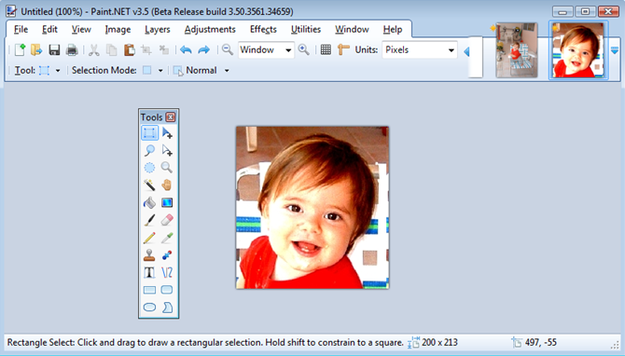
Paint.net screen layout
Open images
Command
menus
Tool settings
Tools
Current image
Status line
Notes:
This is an overview of the Paint.net screen layout.
The command menus, tool settings, status line, open image dock and current image are in fixed locations.
Editing windows like the Tools window shown here can be selectively hidden and, when visible, moved to any point on the screen the user finds convenient.
The next slide shows the other editing windows.

Slide 4
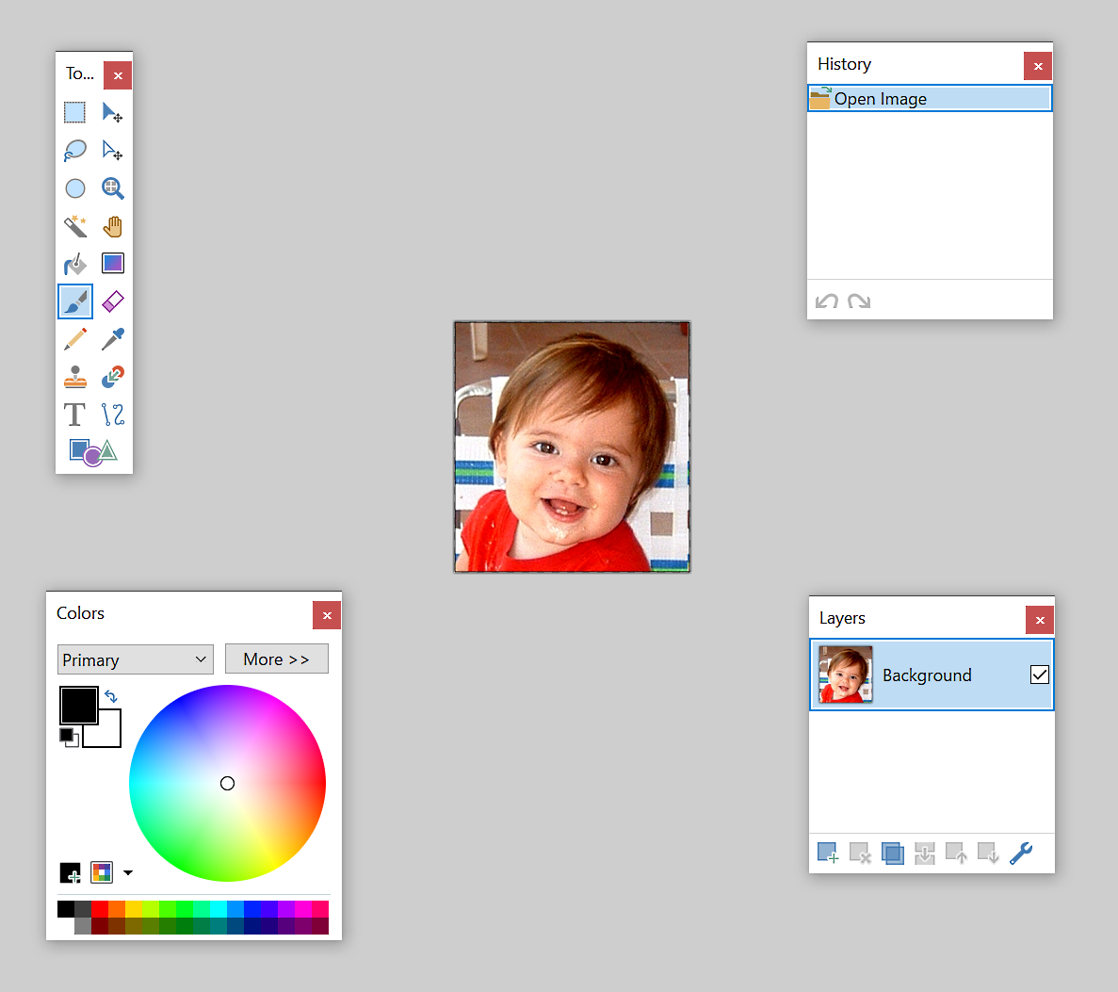
Four editing windows
You can move and temporarily hide the editing windows.
Notes:
In addition to the fixed areas mentioned in the previous slide, the Paint.net user interface has four windows that can be moved to any spot on the screen or temporarily hidden.
They are the Color, History, Tools and Layers windows.
We will review each of these as well as some of the commands on menu at the top of the screen.
Let’s begin with the Tool window.

Slide 5
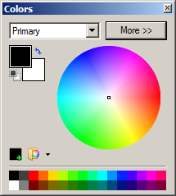
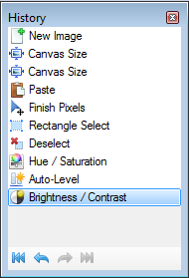
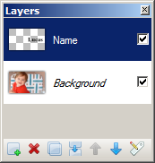
Four editing windows

Slide 6
The Tools window
Select a rectangular area
Move selected pixels
Add text to the image
Draw a rectangle
(If you do not see the tool window, give the Windows > Tools command).
Notes:
Paint.net has 22 tools.
Here we see the functions of four of the them.
You can see the functions of each by moving the mouse over it.
When you select a tool, two important things happen.
The settings choices for that tool appear at the top of the screen, just below the command menus.
Changing those settings will alter the way the tool works.
Selecting a tool also changes the tool-specific status line at the bottom of the screen
The status line will give you help and feedback as you use the tool.
Let’s look at the settings and status lines for one tool, the rectangular selection tool.

Slide 7
The Rectangular Selection tool settings
3
choices
2
choices
5
choices
Notes:
The tool settings are just under the program commands at the top of the screen.
There are 19 tools and each tool has its own settings.
The tool settings are different for each tool.
Here we see the three settings for the rectangular selection tool.
Clicking on the dropdown arrows reveals the tool setting options.
You can experiment with each to how it effects the rectangular selection tool.

Slide 8
Rectangular Selection tool status line
Tool description with a help hint:
Cursor location and size of selection area after you begin to use it:
Notes:
The status line, which is located at the bottom of the screen, also changes for each tool.
Let’s take the rectangular selection tool as an example.
When you first select a tool, the status line displays a description of the tool and a help hint.
When you use the tool, the status line switches, to show the changing width and height of the selection as you drag the cursor.
You should watch the status line as you work.
Becoming familiar with the various tools and operations will require experimentation and play.
As you do image processing assignments or tasks, be sure to explore the settings and status information for each tool you use.

Slide 9
The History window
(If you do not see the History window, give the Windows > History command).
Notes:
Feel free to experiment because anything you do can be undone.
The history window shows every operation you have performed on your image.
If you make a mistake, you can go back to any earlier point by clicking on the operation.
You can also undo the last operation by typing ctrl-z.
And you can redo an operation by typing Ctrl-y.
You can quickly compare an image before and after an operation by alternating between Ctrl-z and Ctrl-y.
Now that we have seen the Paint.net tools, let’s take a look at the command menus.

Slide 10
The command menu
Notes:
The Paint.net command menu is similar to that of other Windows programs.
For example, the typical File commands are the leftmost on the menu.
Let’s look at examples of the various sub-menus.

Slide 11
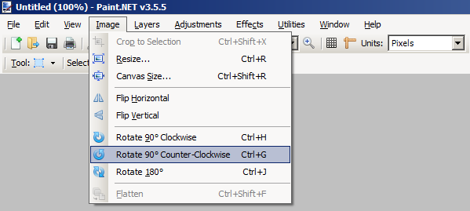
The Image menu
Notes:
Here we see the operations available under the Image menu.
As you see we can resize the image or the “canvas” it is on or rotate it.
In this example, I rotated the image 90 degrees counter-clockwise.

Slide 12
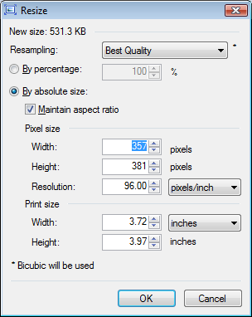
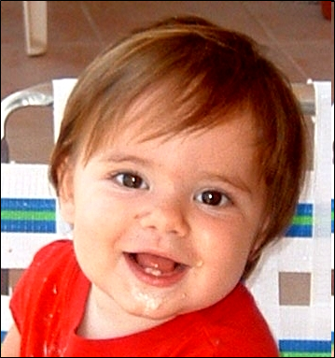
Aspect ratio
Notes:
Resizing is a common operation under the image menu.
You can resize images by a given percent or by setting the width or height to an exact value.
If you change the width or height without fixing the aspect ratio, the result will be distorted, as shown here.
You will usually want to keep the aspect ratio fixed.

Slide 13
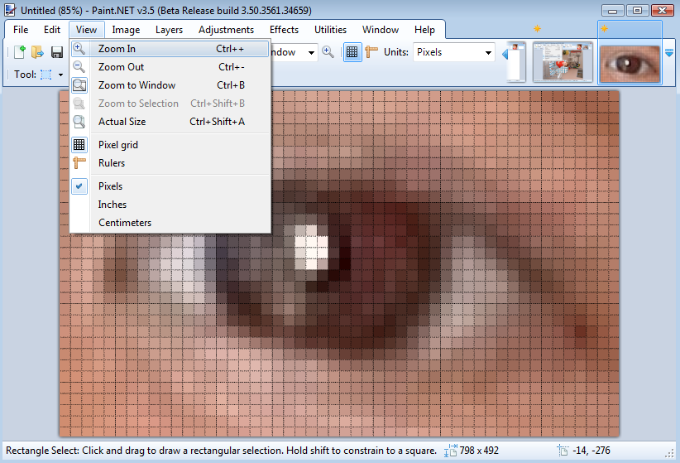
The View menu
Notes:
Using the view commands, you can zoom in and out and modify the way the image is displayed.
Changing zooming in or out does not alter the image, it just changes what you see when you are working on it.

Slide 14
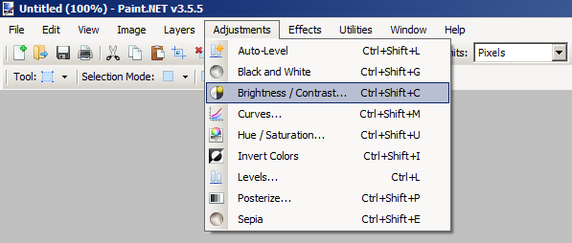
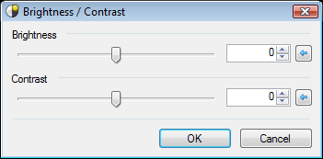
The Adjustments menu
Notes:
The adjustments commands allow you to alter the colors, contrast, and brightness of an image.
There is a corresponding dialog box to alter the degree of each operation.
Here we see the brightness/contrast dialog box with two sliders.

Slide 15
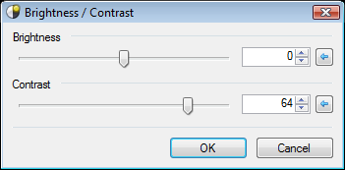
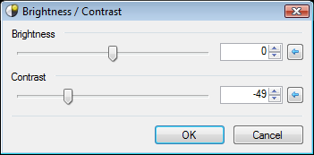
Immediate feedback
Notes:
As shown here, you get immediate feedback on the image adjustment when you move the sliders or other settings.
In the early days of image processing, one often had to wait overnight to see the results of changes like these.
Immediate feedback makes image processing quick and practical for many applications.
Next, let’s look at an example from the Effects menu.

Slide 16
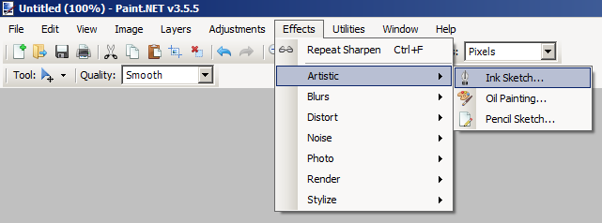
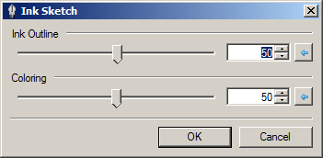
The Effects menu
Notes:
Paint.net includes a couple dozen special effect filters.
Like the adjustment operations, the effects have dialog boxes to control the strength of the effect.
Here we see the Ink Sketch effect applied to an image.
As with adjustments, the feedback is immediate.
Perhaps the most commonly used effect is sharpening an image (effects>photo>sharpen).
You should experiment with it and the others.

Slide 17
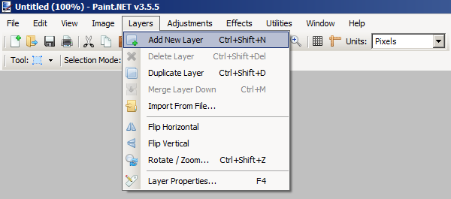
The Layers Window
(If you do not see the Layers window, give the Windows > Layer command).
Notes:
Image processing programs allow you to build an image by placing layers on top of each other.
In this example, the photo of Lucas is on the Background layer.
I created a second layer on top of that, and called it Name.
I then typed the word Lucas on that layer using the Text tool.
The checkerboard pattern on the Name layer indicates transparency.
The background layer is visible wherever the upper layer is transparent.
Only the word Lucas is opaque.
I was able to experiment with the position of the text by dragging the position of the top layer using the Move Selected Pixels tool.
The layer commands allow us to create new layers and change their properties, including the level of opacity.
When you are finished adjusting the layers, you can give the flatten command (image>flatten), to combine them into a one-layer image.

Slide 18
The Color window
(If you do not see the Colors window, give the Windows > Color command).
Notes:
Finally, let’s mention the Color window.
In this example, the current Primary color is black and the current secondary color is white.
New objects you draw will have the primary color, in this case black.
You can change the primary and secondary colors by selecting from the color wheel on the right or the palette at the bottom.
You can also pick the color of any pixel in your image using the Color Picker tool.
You can quickly switch the primary and secondary colors by clicking on the curved arrow next to them.
There are millions of unique colors, and we will see how to define them in another topic module.

Slide 19
Summary
Open images
Command
menus
Tool settings
Tools
Current image
Status line
Notes:
We have gone over examples illustrating the tools, tool settings and status lines, and the menu commands available in Paint.net.
We also looked at the history, layers and color windows.
We saw that it is easy to undo any change, making it quick and easy to play around with the program and learn by experimenting.
Paint.net is a typical image processing program, so time you spend learning to use it will apply to any other one.
That being said, there are many commands and options we did not cover in this presentation.
As with a full-featured word processor, you must experiment with them yourself to learn the full capability of the program.

Slide 20
Resources
Paint.net (don’t click on the ad):
http://www.dotpdn.com/downloads/pdn.html
Tutorials:
http://www.getpaint.net/doc/latest/
Download, forums, blog and email contact:
http://www.getpaint.net/doc/latest/WebLinks.html

Slide 21
Self-study questions
We saw four top-level command menus. Do you recall what they were?
If the Layer window is not on the screen, how can you make it visible?
What is the icon associated with the Color Picker tool in the toolbox?
Where is the Sharpen image command in the menu system?
What happens if you move the contrast slider up to 100? Down to 0?
What happens if you move the brightness slider up to 100? Down to 0?
What does the edit>fill selection command do? (Try an experiment rather than looking in the help documentation).
Repeat number 7 for other commands that you are curious about.

Slide 22
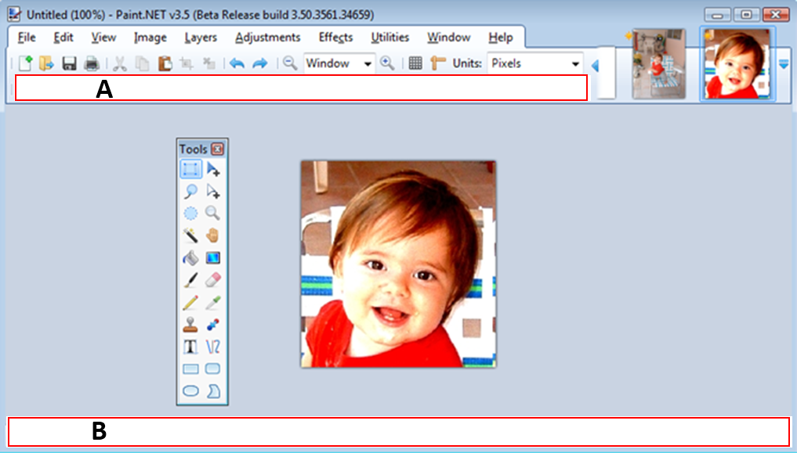
What are the areas marked A and B used for?

