Slide 1
Create a blog
Skills: create, modify and post to a blog
Concepts: wire-frame diagram, independence of content and appearance, gadget or widget, Blogger menu structure
This work is licensed under a Creative Commons Attribution-Noncommercial-Share Alike 3.0 License.
Notes:
We will see how to create and post to a blog using Blogger.
We will see examples of changing the behavior and appearance of the blog using the settings, layout, and template menus.
What we learn about Blogger will transfer easily to other blogging services.

Slide 2
Where does this topic fit?
Internet concepts
Applications
Technology
Implications
Internet skills
Application development
Content creation
User skills
Notes:
We are learning to develop blogs.

Slide 3
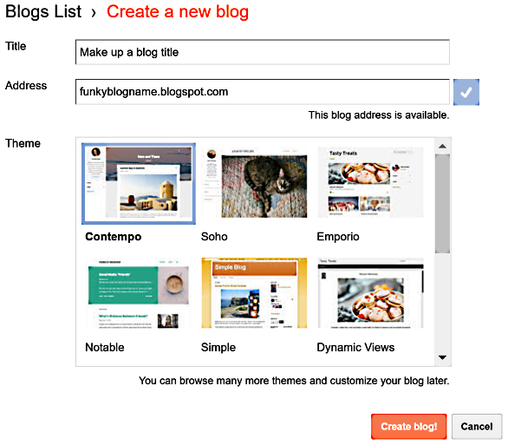
Create a blog
1
2
Go to blogger.com and log in using your personal Google account.
Click on Create a new blog and fill in three-question form.
3
Google blog creation help
Notes:
We will create blog using the Blogger.com service. There are alternatives to Blogger.com, but we will use it because it is simple and is owned by Google, so it will probably be around for a long time.
When you create a new blog, you will asked to provide specify three things:
The blog’s title (1), its URL (2) and its template style (3).

Slide 4
Modify the theme
Play around with theme settings for five minutes.
Notes:
Once your blog is created, you can further modify it’s appearance -- its “theme.”

Slide 5
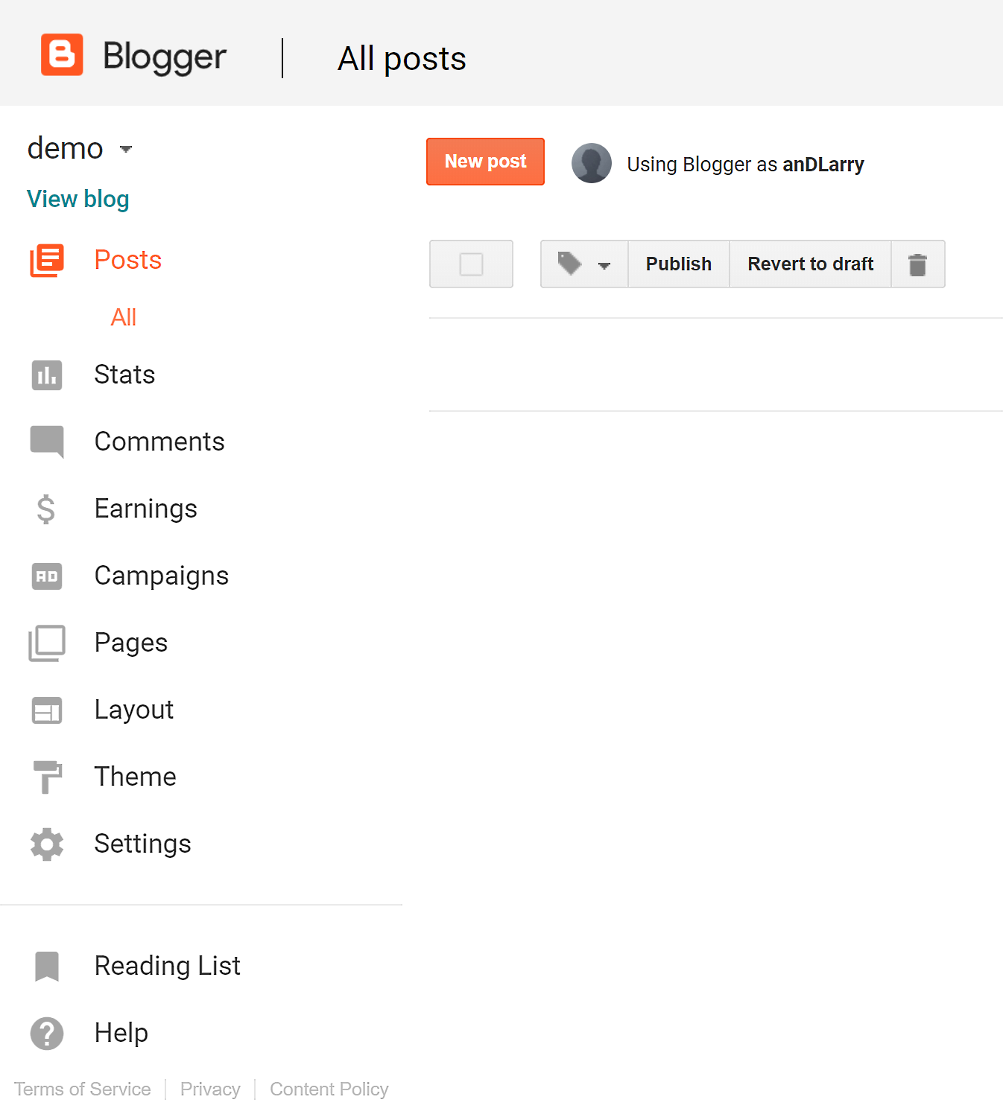
Initial dashboard with no posts
Explore the options on the left.
Notes:
This is the left side of the “dashboard” of a new blog before there have been any posts.
There will be a new entry for each post you write.
The options on the left have to do with traffic statistics, ad revenue, comment moderation, the theme and layout of the blog and various settings.
For example, you can click on Layout to choose a basic layout – two column, three column, etc.
Once you have picked a layout, you can customize it -- for example change the color scheme –or add or delete widgets - by clicking on Theme.
When you are ready to post something, click on New post.

Slide 6
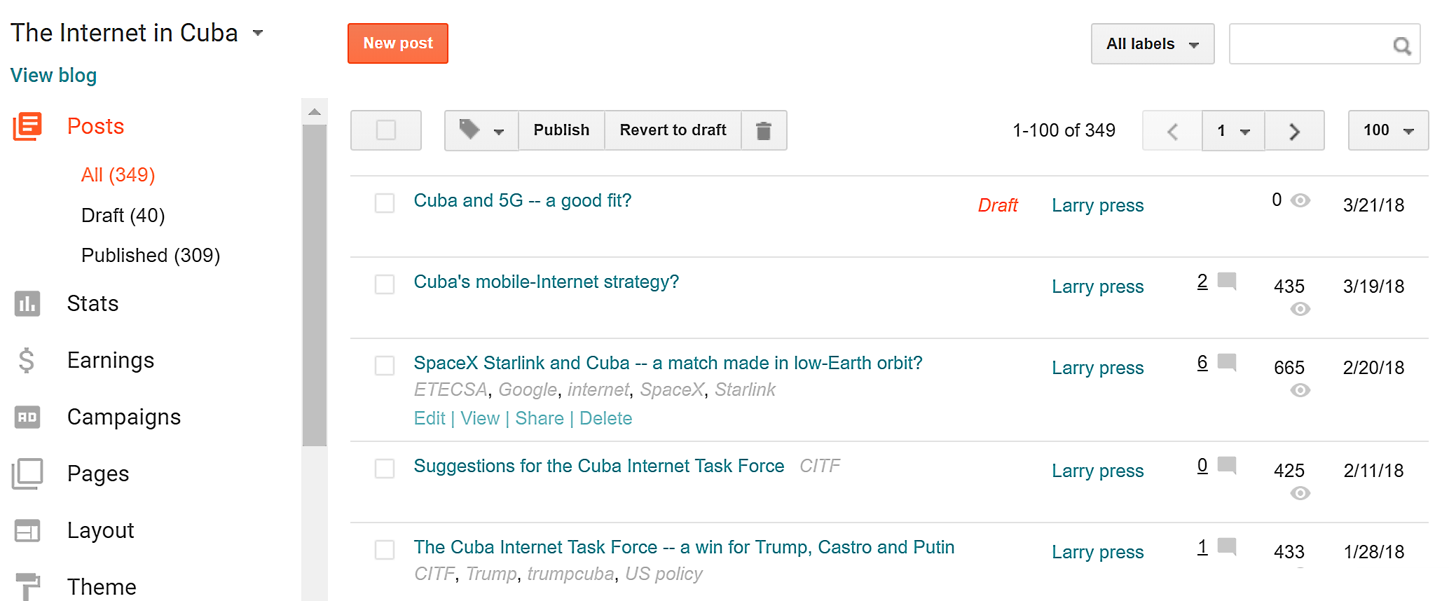
Dashboard with posts
Notes:
This is the dashboard from my blog on the Internet in Cuba. I’ve written several hundred posts over time – this list only shows the most recent five posts, one of which is still an unpublished draft.
When I rolled the cursor over the SpaceX post, four options appeared – I can edit it, view it (if it has been published), share it on Google Plus or delete it.
I’ve also assigned tags to the posts. For example, I assigned the tags CITF, Trump, Trumpcuba and US Policy to the post on the Cuban Internet task force.

Slide 7
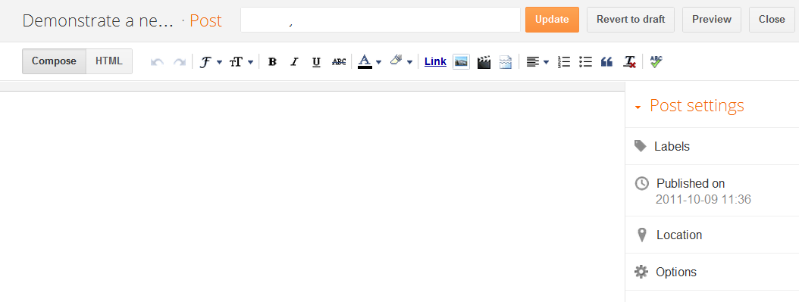
Simple word processor
Notes:
Clicking on new post brings up this simple word processor.
It has familiar commands across the top and a document area below that.
You are ready to type your post.

Slide 8
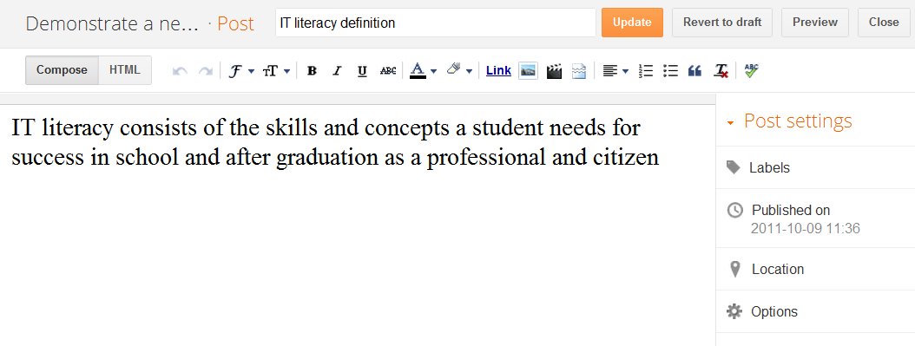
Compose and publish the post
Notes:
While composing your post, you can preview it or close the window and go back to your dashboard.
You can also save it and continue editing.
You can also add labels (often called tags).
The labels are key words, which can be used to search for and retrieve posts.
When it is complete, publish your post.
Note that you can still make changes after it has been published.

Slide 9
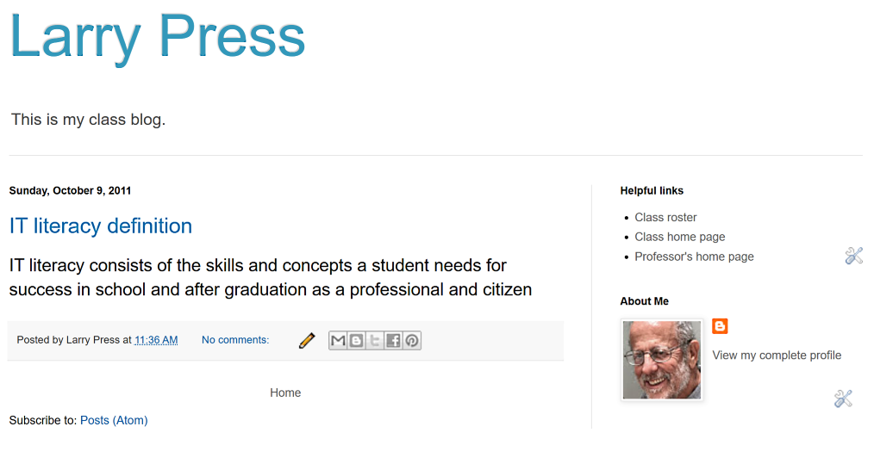
http://firstblogdemo.blogspot.com/
Notes:
Here we see the published post on the blog.
The blog URL is http://firstblogdemo.blogspot.com/
The title of the blog is “Larry Press” and the title of the first post is “IT literacy definition.”

Slide 10
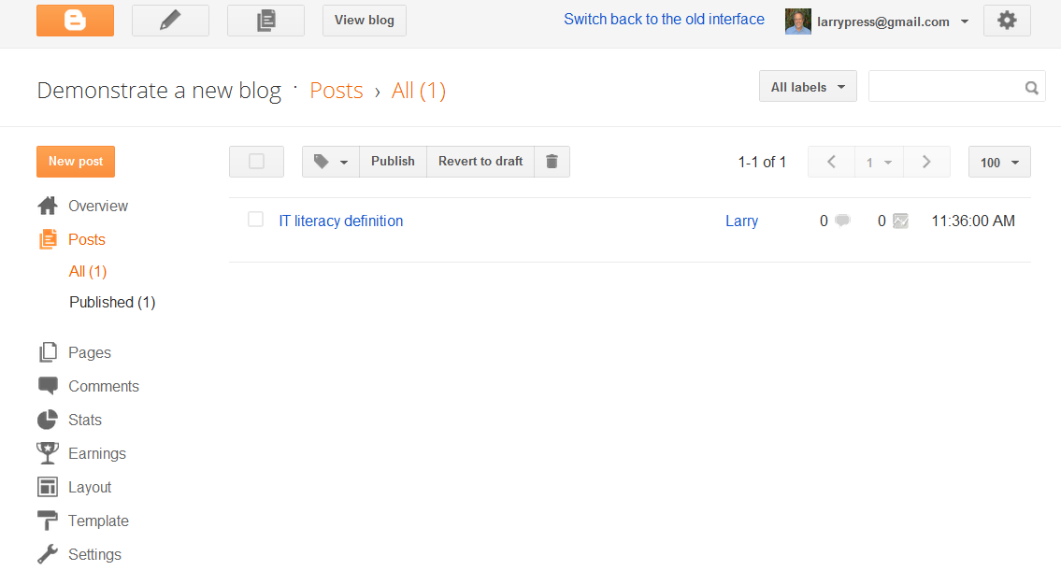
List of posts on this blog
Notes:
After the post is published, it appears in blog’s list of posts.
There is only one shown here, because I have only posted one entry on this blog.

Slide 11
Edit, view or delete a post
Notes:
If you want to edit, view or delete a post, simply hover the cursor near it to bring up this menu.
Several menus are listed on the left of the screen.
They are useful for finding information about your blog or for changing its behavior and appearance.
Let’s quickly look at a couple of them.
(You will have to spend time on your own exploring the options we do not look at on this quick “tour”).

Slide 12
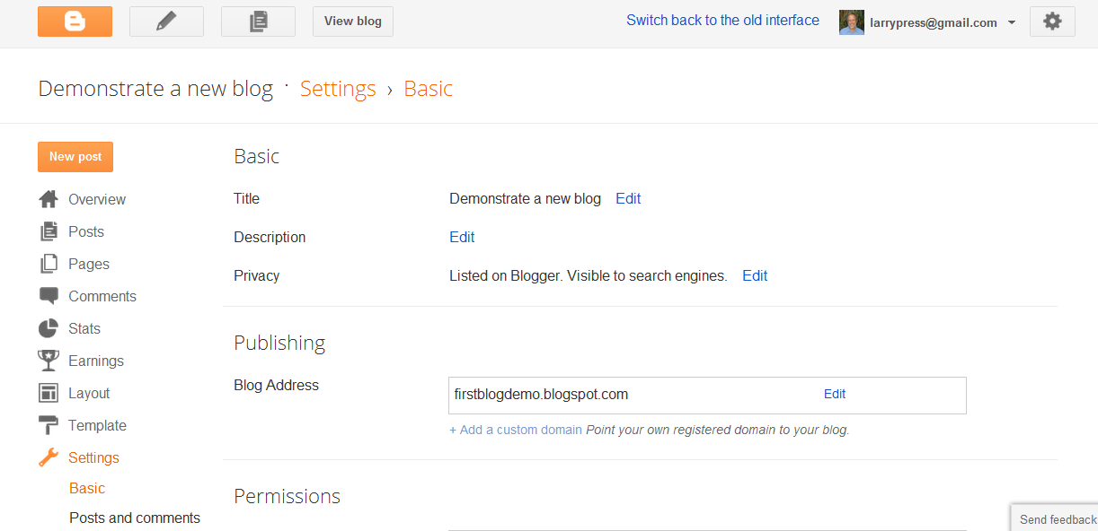
Blog settings
Notes:
Many options are available if you click on settings.
You can add a description to your blog, specify how comments are to be handled, change its URL, and so forth.
You should explore the other on your own.
Do not be afraid to play, to experiment, because you can undo any change you make.

Slide 13
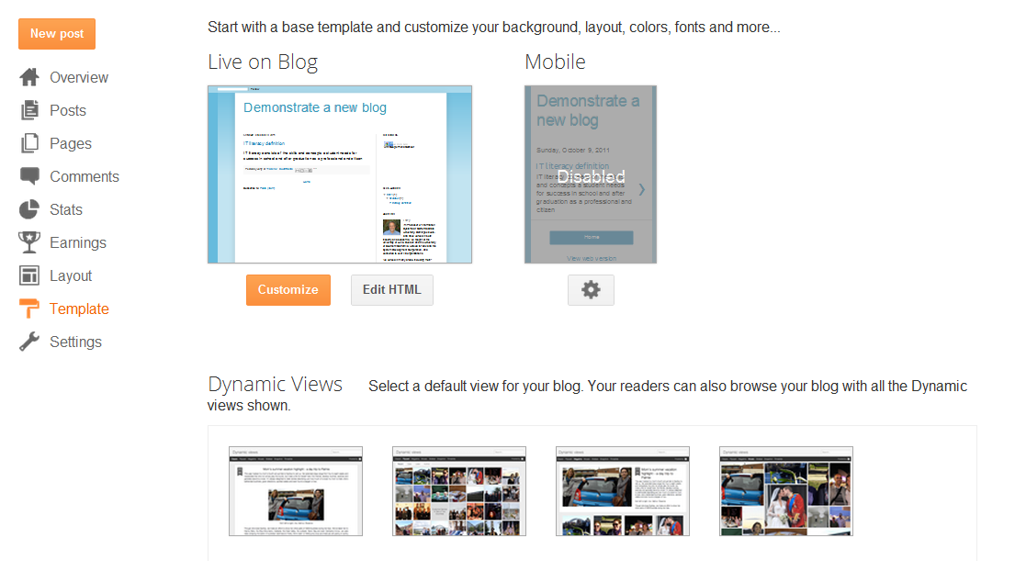
Blog template
Notes:
If you click template, you can select another template.
This will change the overall appearance of your blog, but not the content.
Note that there is not a mobile-friendly view for this template.
As with the other settings, you can undo anything you do.

Slide 14
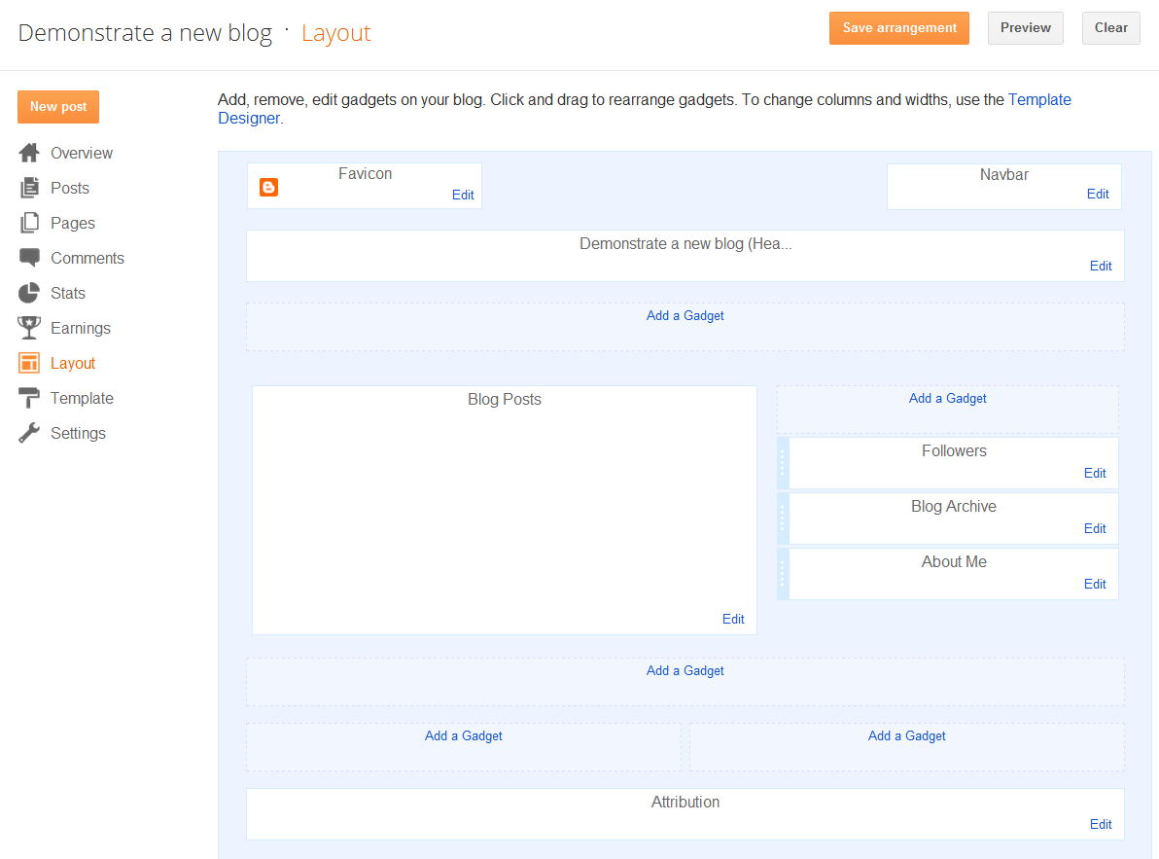
Layout
Notes:
You can also add, remove and edit user interface objects using the layout screen.
These removable, customizable objects are called gadgets in Blogger.
They are also commonly called widgets.

Slide 15
Summary
Notes:
We saw that it is easy to create and modify blogs using Blogger.
Creating a complex Web site like that would have taken many man months when a few years ago.

Slide 16
Self-study questions
What is the URL (Web address) of a blog once you have created it – where do readers go to see it?
If your readers complain of reading difficulty, how would you increase the font size in your Blogger posts?
How would you change your blog from a two column to a three column layout?
Does changing the appearance of a blog change its content?
What are dynamic views in Blogger blogs?

Slide 17
Resources
Blogger support
Get started with Blogger

