Slide 1
Two presentation research ideas
Skills: none
Concepts: presentation experiments, audio tempo, audio speed, independent variable, dependent variable
This work is licensed under a Creative Commons Attribution-Noncommercial-Share Alike 3.0 License.
Notes:
People generally agree that Steve Jobs does great presentations and the PowerPoint package that accompanies many text books is not so great.
We can learn by watching people like Jobs, and perhaps refine our understanding through research.
This presentation covers two questions we might answer by experimenting a little.

Slide 2
Where does this topic fit?
Internet concepts
Applications
Technology
Implications
Internet skills
Application development
Content creation
User skills
Notes:
The presentation will help us create better content.

Slide 3
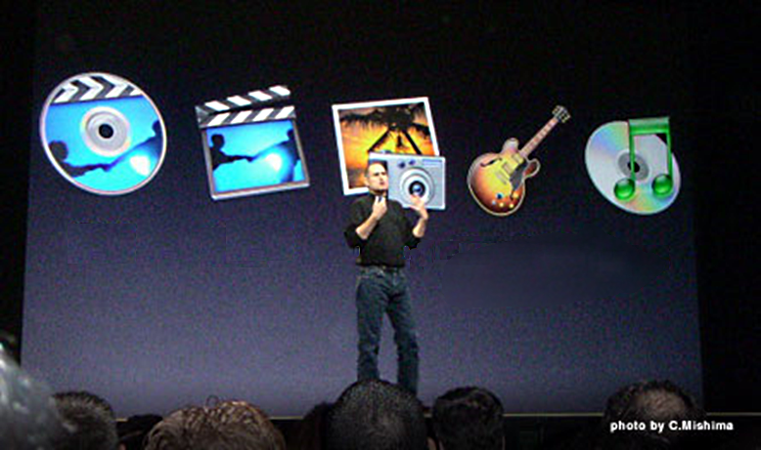
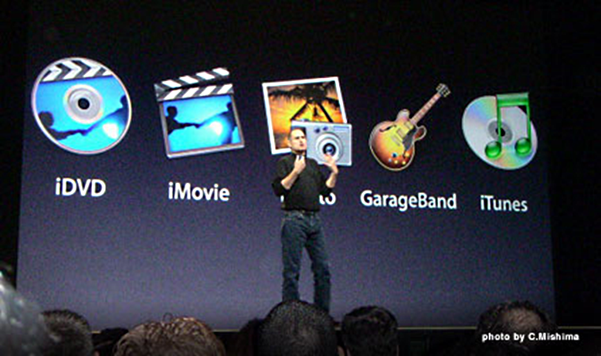
Should we label images?
Notes:
Steve Jobs is using images as bullet points in the top slide.
But would comprehension and retention be improved if the slides were labeled as in the second slide?
Reading the short labels would not seem to take much concentration away from what he is saying.
My hypothesis would be that something in between would work best.
Project the unlabeled slide and ask the audience if they could guess what the labels were – involve them actively.
Then reveal the labels and go on with the presentation of the material covered in the slide.
Regardless, we could conduct experiments in which the independent variable was the way bullet labels were revealed and the dependent variables were audience comprehension and retention.

Slide 4
Should we increase the tempo?
Notes:
Here is my second question – should we increase the tempo of a recorded presentation?
The top waveform shows 10 seconds of recorded audio.
The second waveform is the same, but the tempo has been increased by 15%.
(Note that increasing the speed instead of the tempo would have increased pitch).
Increasing the tempo left the pitch the same, and reduced the playback time to 8.5 seconds.
Cutting playback time has two beneficial effects – the file size would be smaller and it would save the listener’s time.
But, would the faster playback hurt comprehension and retention?
Again, it seems we could conduct experiments in which the independent variable was playback tempo and the dependent variables were audience comprehension and retention.

Slide 5
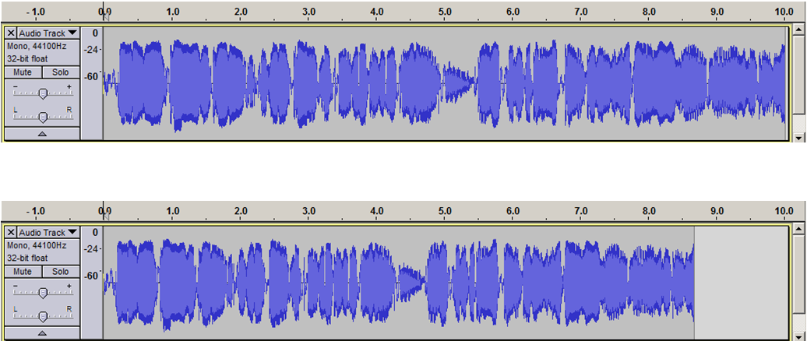
Summary
Notes:
We’ve presented two researchable questions – should images be labeled and by how much can we increase presentation tempo without cutting comprehension and retention.

Slide 6
Self-test questions
We mentioned three possible ways to treat bullet point labels – do you recall them?
We said we would do experiments to test two things after seeing a presentation – do you recall them?
Differentiate between tempo and speed in an audio recording.
Differentiate between independent and dependent variables.
Watch the fast-tempo version of the video of this module. Did you have to pause and go back or were you comfortable listening without stop? Watch the slow version. Is the slow version easier to understand? Do you think the fast version would be as good as the slow version?
Outline an experiment to test the effect of either changes in presentation tempo or bullet point labels. Who would be the test subjects? What would you present them with? How would you assess the outcome?

Slide 7
Resources
A presentation illustrating the delayed disclosure approach to labels (slide 14, My Solution):
http://som.csudh.edu/fac/lpress/presentations/channelislands.pptx
Topic modules on Audacity for changing recording tempo:
http://cis275topics.blogspot.com/search/label/audacity

