Slide 1
Internet profiles
Skills: none
Concepts: Internet profile, canonical or authoritative profile
This work is licensed under a Creative Commons Attribution-Noncommercial-Share Alike 3.0 License.
Notes:
Users have created profiles on the Web for years, but the profiles on major social networking sites are becoming increasingly important.
We will look quickly at one example – the Google Plus profile.

Slide 2
Where does this topic fit?
Internet concepts
Applications
Technology
Implications
Internet skills
Application development
Content creation
User skills
Notes:
This one is hard to classify – a profile is not a hardware or software technology, it is a data technology.

Slide 3
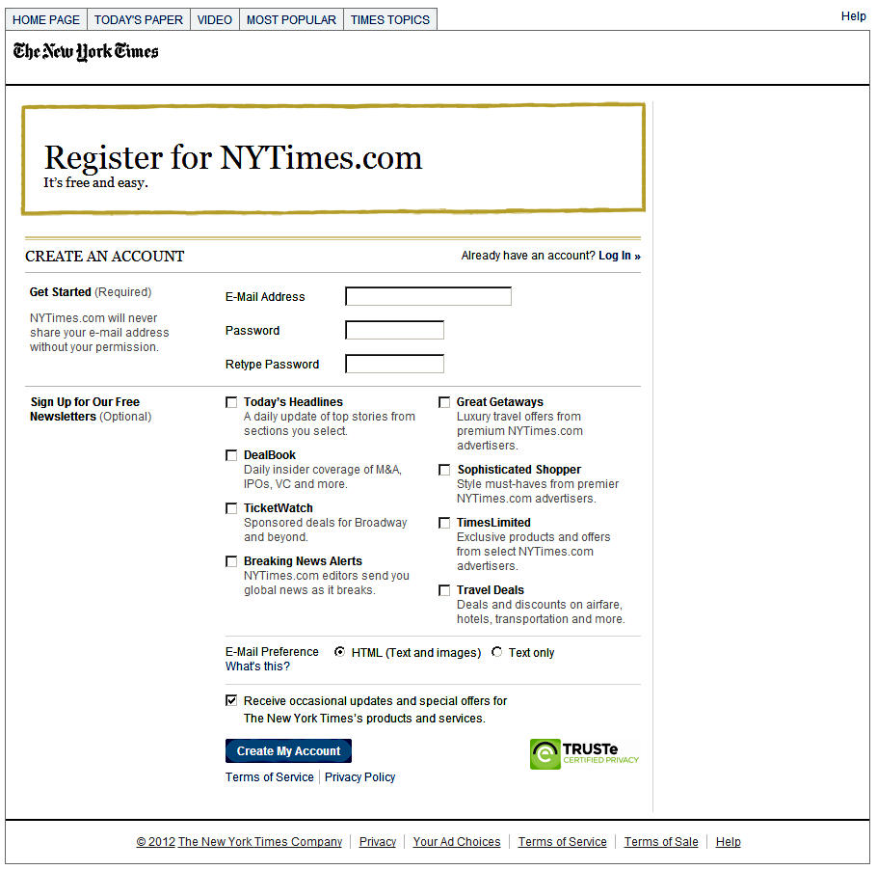
Profiles
with each account
Notes:
You volunteer information every time you register for an account on a service.
You give them an email address, which they will use and may sell to others.
Selecting newsletters also reveals information about your taste and interests.
The site operator keeps this information – they create a profile of your interests.

Slide 4
Social network profiles
Notes:
How may profiles have you created on the Internet?
Your profile information is all over – including many places you do not know about.
Social networking services would love to consolidate that information, to create your single, authoritative profile.
They would like you to refer people to their version of your profile to know about you and they would like you to use your credentials on their site when you log in to others.
Today, Facebook is in the lead.
Google may gain an advantage in that they are trying to give you control over your profile.
The profile wars are far from settled.
We may see new contenders and there will doubtless be several large players in the end.

Slide 5
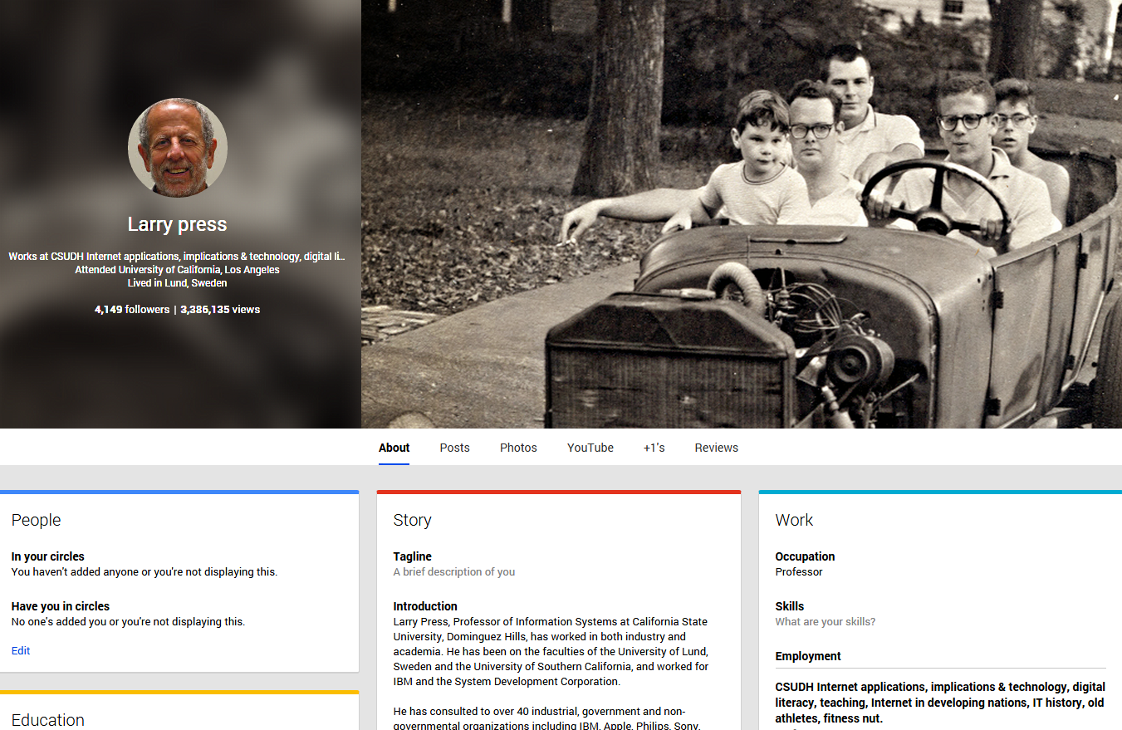
My Google Plus profile
Find my profile page online.
Notes:
This is my Google Plus profile.
I reached it by clicking on the Profile then About.
It has information about my career, education, places I’ve lived, contact information, interests, etc.
Google has unified their profile efforts, so, for example, my Google Plus profile appears on my blog, which is also hosted by a division of Google (blogger.com).

Slide 6
Explore my profile
Where did I go to college?
What is the topic of my most recent Google Plus post
Which nations have I lived in?
What is the title of the picture at the top of my profile?
What is the bragging right listed on my profile?
Find my profile page and answer these questions:

Slide 7
Summary
Notes:
People have been creating limited profiles at Web sites for years.
More recently, the major social networking sites have strived to house definitive, comprehensive profiles.
We looked at one example, Google Plus.

Slide 8
Self-study questions

Slide 9
Resources

