Slide 1
Prototypes
Skills: none
Concepts: research versus product prototypes
This work is licensed under a Creative Commons Attribution-Noncommercial-Share Alike 3.0 License.
Notes:
We will differentiate between research and product prototypes.
The transistor and Sketchpad graphics program illustrate the former.
They were far ahead of their time and there potential applications and importance were not widely recognized.
We will consider three examples of image processing products which might be in cell-phone in the relatively near future.

Slide 2
Where does this topic fit?
Internet concepts
Applications
Technology
Implications
Internet skills
Application development
Content creation
User skills

Slide 3
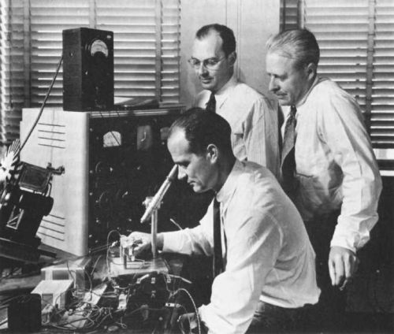
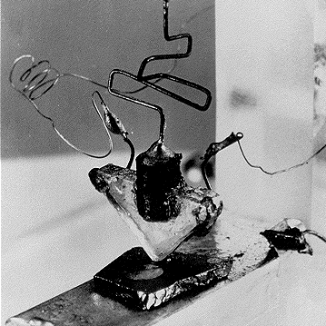
Research prototype, the first transistor
Notes:
New technologies usually begin with research prototypes developed at universities or research labs.
The prototype demonstrates a concept, then engineers improve it.
Here we see the inventors of the first transistor, John Bardeen, Walter Brattain and William Shockley, at Bell Labs.
They invented the transistor in 1948, but it was not introduced commercially until 1954.
An IT technology shift occurred when transistors replaced vacuum tubes in computers.
Discrete transistors improved steadily until they were displaced by a technology shift to integrated circuits.

Slide 4
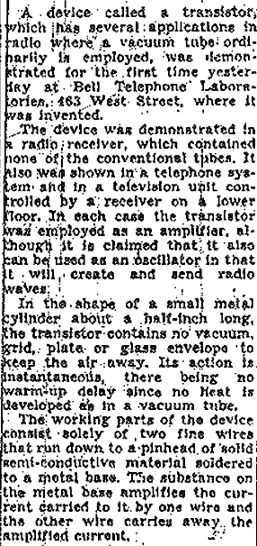
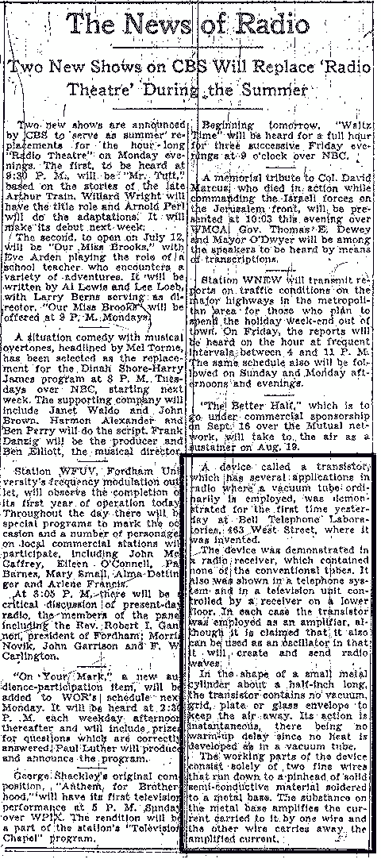
No big news -- the transistor (NY Times, page 46)
Notes:
Disruptive technology may not be recognized at the time it is introduced.
The transistor was arguably the most important invention of the 20th century, but its significance was not widely recognized at the time.
The first public demonstration of the transistor was at a press conference in New York City on June 26, 1948.
The New York Times nearly ignored the event, burying it in four short paragraphs in a column on page 46 five days later.
This is a common story.
We often fail to realize the importance or potential use of inventions.
Here are some other examples:
The telephone was invented to broadcast music.
Sound recording was invented for correspondence.
The New York times stated “commercial use in doubt” in its coverage of the first television demonstration in 1927.
Phillips expected their cassette tapes would be used in dictating machines.
WiFi was developed to link the cash registers in a store to a computer in the back room.
Bob Kahn, co-inventor of TCP/IP, initially estimated that the Internet would connect 256 networks.

Slide 5
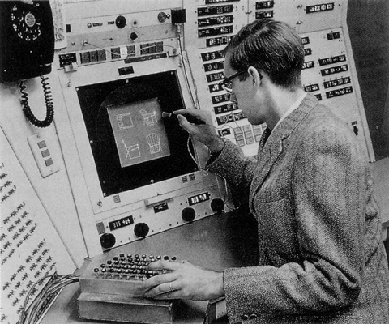
Research prototype, image processing
Notes:
Software technology also often begins with research prototypes.
Here we see Ivan Sutherland working on Sketchpad, the first significant image processing program, which he wrote for his doctoral dissertation at MIT in 1962.
Since technology improves rapidly, researchers like Sutherland develop prototypes on expensive equipment, assuming it will be affordable in the future.
Sketchpad foreshadowed much of what we do today on our personal computers, but required a multi-million dollar computer at the time.
Mainstream products are preceded by research and development of prototypes, which often takes many years.
Tomorrow’s products are in the lab today.

Slide 6
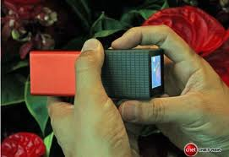
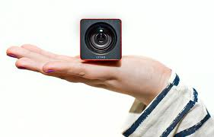
Product prototype, image processing
Cell phone camera tomorrow?
Notes:
Research prototypes are generally far ahead of their time, and their potential applications may not be recognized.
Expensive or somewhat crude products may also function as prototypes.
In this and the following two slides, we see three current products that are expensive today, but might be in typical cell-phone cameras in five years.
Here we see a camera that gathers all incoming light, enabling the user to select the focus region or plane after a photo is taken.
This camera is expensive today, but, if it catches on, it will be cheaper to manufacture in quantity in the future.

Slide 7
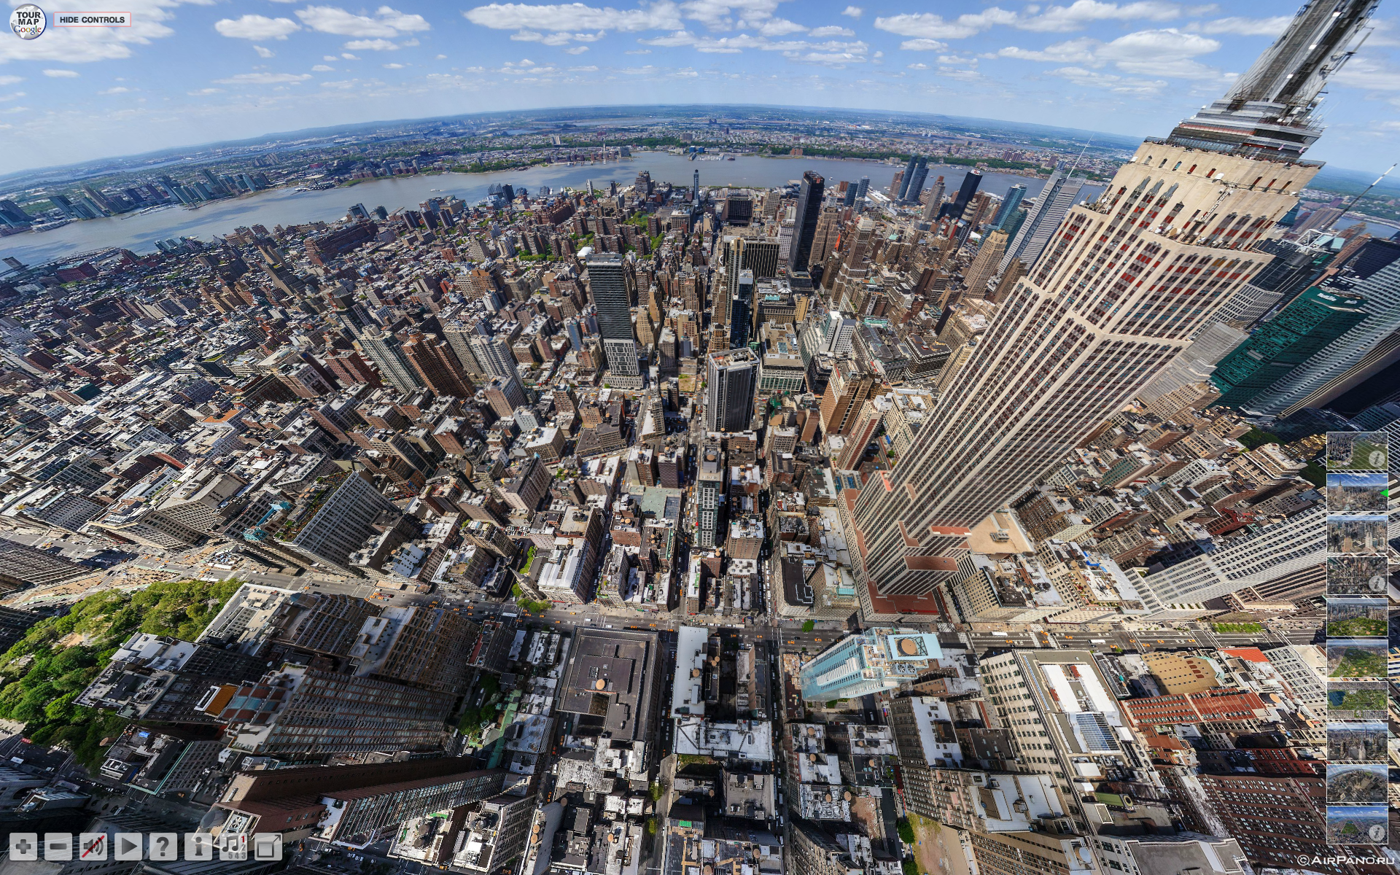
Product prototype, image processing
Cell phone camera tomorrow?
Notes:
This camera takes a 360 degree panoramic image.
Like the previous camera, it creates large data files because it is gathering more information than today’s cameras.

Slide 8
Product prototype, image processing
Cell phone camera tomorrow?
Notes:
This is a high resolution image, 297,500 x 87,500 pixels (26 gigapixels).
As with the two previous examples, the file sizes are large because it captures a lot of information, but the cost and speed of storage and processing will improve with time.

Slide 9
Summary
Notes:
We have seen two research prototype examples – the transistor and image processing software and we saw three examples of image processing product prototypes,

Slide 10
Self-study questions
Identify a product that you cannot afford today, but you think might be in mass use in five years.
Are information technology products more likely to improve radically in the next five years than mechanical products like auto engines?
Identify some medical research today that holds promise of widespread application in twenty years.

Slide 11
Resources

