Slide 1
Questions about communication link and speed
?

Slide 2
Welch
Hall
SAC
ERC
Why was Internet access slower from SAC than from ERC? Packets from both reach the Internet in two “hops.” Where must the bottleneck be?

Slide 3
Welch
Hall
1 gb/s
SAC
ERC
100 mb/s
1 gb/s
Notes:
The link from Welch Hall to the ERC building is faster than the link from SAC to the ERC building.

Slide 4
Why is it even slower from my home?
My house
15-20 mb/s
How does my link differ from those between the buildings on our campus and between the campus and the Internet?

Slide 5
S/R
S/R
Copper vs. fiber optic cable
Notes:
Factors like the length of a link, the cost and complexity of the sending and receiving equipment and its physical medium determine its data transmission speed.
The link from my house to the Internet uses copper cable, while the links between the buildings on our campus use optical fiber.
Fiber links are generally much faster than links over copper.
(Copper telephone wires are generally still slower).
The send/receive equipment in my house is also much cheaper than that used on campus.

Slide 6
Questions CPU, memory and network utilization
?

Slide 7
http://bit.ly/14xEeUs
Watch a little and vary image quality.
Notes:
I watched this interesting conversation – Sal Khan interviewing Elon Musk.
It is not technical or about the Internet, but gives insight into Musk’s goals and his motivation for investing in his companies Tesla and SpaceX.
I’d recommend your watching it, but, for now, I want to use it to raise a question about video streaming technology and computer memory and CPU utilization, so just watch a minute or two to get a feel for it.

Slide 8
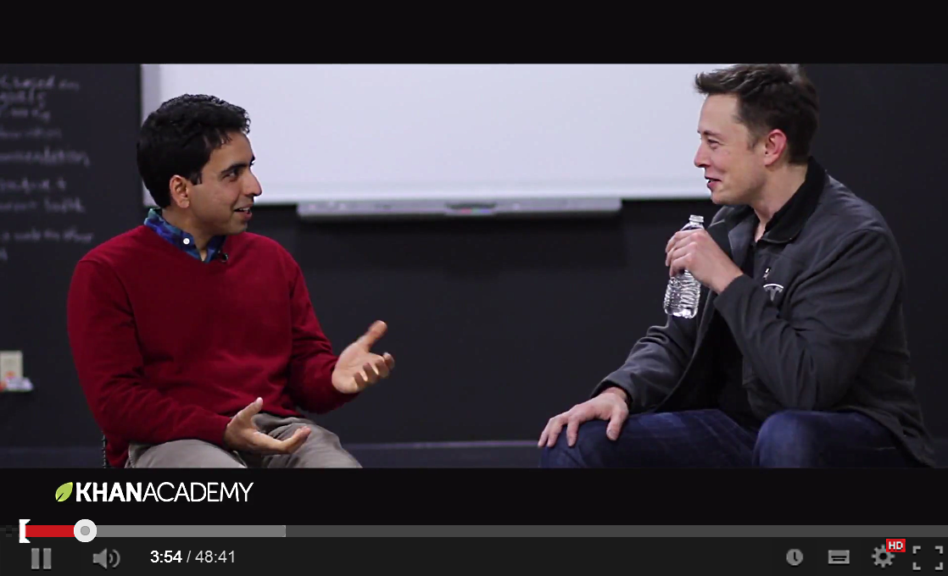
Which looks better?
Which requires a faster communication link? Why?
Which requires a faster CPU? Why?

Slide 9
What is this?
Notes:
The images are made up of dots of varying color.
Geeks call the dots “pixels,” which is short for “picture element.

Slide 10
Which image is made of more dots?
Which image has smaller dots?
Notes:
The top picture has 1,080 rows of pixels.
The bottom picture has only xx rows of pixels.
Both images are the same size on the screen, so the pixels in the top image must be smaller.

Slide 11
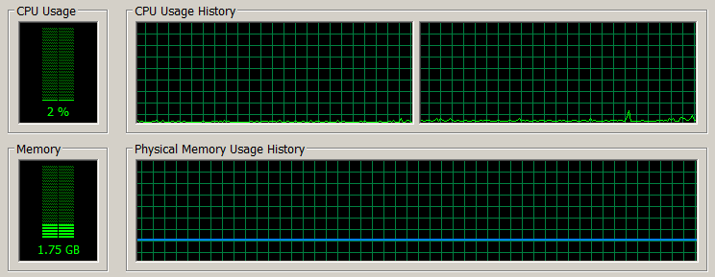
Baseline – only the operating system is running
Notes:
Here is a plot of memory and CPU utilization for about five minutes after I turned my laptop on.
No application programs are in memory – just the operating system and some basic utility programs.
As you see, it is only using about 2 per of the CPU capacity and 1.75 gigabytes of memory.
Next I loaded an image editing program into memory.

Slide 12
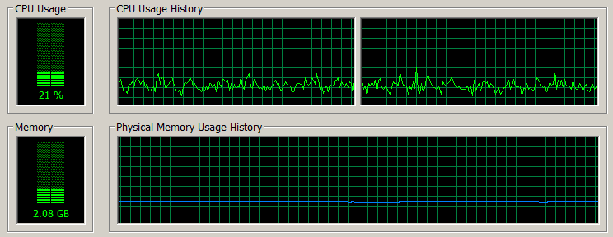
Viewing low resolution video
Why did memory utilization increase when the video was playing?
Why did CPU load increase when the video was playing?
Notes:
When I started streaming the video in the small window, the memory and CPU utilization went up noticeably.

Slide 13
Buffer bits in memory for smooth audio and video output
10011
10110
101001101010010101010010101101110101001010101010100101010101010100101010010101010100100101010101001010101
Storage
11101
Output
Memory
What else is in memory while the video is playing?
Notes:
When your computer is streaming video, packets of bits come into memory from the Internet and they are assembled into a video stream and sent out to the display.
Since the video data arrives in individual packets, the input rate varies, but to keep the audio and video playing smoothly, bits must be sent to the display at a constant rate.
To keep a steady output stream, the program lets the input get ahead of the output, buffering some bits in memory.
That is why it takes a little while before the video begins to play.
The CPU utilization goes up because it has to execute the program that reads those bits in, takes them out their packets to reassemble the video file and send it out to the display.
That is a lot of work.

Slide 14
Operating system
Video player program
101001101010010101010010101101110101001010101010100101010101010100101010010101010100100101010101001010101
Memory
Notes:
The operating system and the program to get and play the video must also be in memory.
If video performance is poor, you might be able to improve it by killing other programs – make sure that only the video player is running.

Slide 15
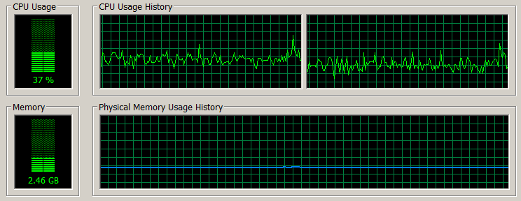
Viewing high resolution
Why did memory utilization increase when the resolution increased?
Why did CPU load increase when the resolution increased?
Notes:
It takes more bits per second to keep the high resolution image smooth so the buffer area in memory must be larger and the CPU has to input, format and output more bits per second.

Slide 16
Network utilization
Increased quality from 144p to 1080p
Why did network utilization increase when the resolution increased?
Why does network utilization vary rather than remain constant?
Notes:
This graph shows network utilization while streaming the video.
I started watching a low quality stream – the image was somewhat blurry, but network utilization was under five percent of its capacity.
When I switched to high quality, network utilization jumped to around twenty percent because more bits were coming in every second.
The utilization varies because the program fills the buffer, then waits for it to go down a bit, then refills it.

Slide 17
Questions about embedded computers
?

Slide 18
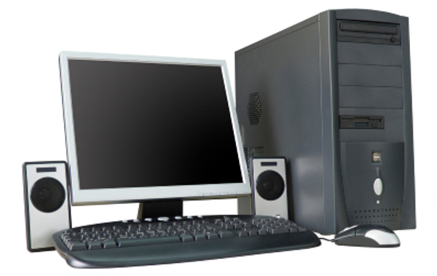
Some input/output devices people use
What about input/output devices computers use?
Notes:
Speakers, displays, keyboards, printers, microphones, scanners --- take information from people and present information to people.
But what about input/output devices computers use?

Slide 19
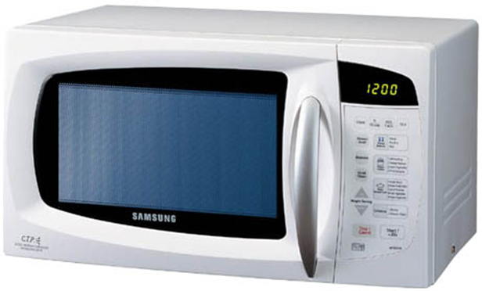
There a computer embedded in your microwave oven
What are its input/output devices for interaction with people?

Slide 20
Keypad
Display
Buzzer
What are its input/output devices for interaction with devices?
Notes:
Yes – there is a display, a keypad and a buzzer or bell that sounds when cooking finishes.

Slide 21
Switch to start cooking unit
Switch to turn light on/off
Switch to start rotation
Internal timer
Cooking power level adjustment
Temperature sensor
Does the oven have memory?
Is there a program in its memory? What does it do?
Notes:
The computer can send signals to turn things on and off, read the time and temperature (in some microwave ovens) and set the cooking power level.

Slide 22
Simplified microwave oven program
When the user hits start
Read the cooking time
Start the oven
Start the dish rotating
Turn the light on
When the cooking time has elapsed
Stop the oven
Stop the rotating dish
Turn the light off
Sound the buzzer
Stop
Do you ever change the program in your microwave oven? Maybe use it as a word processor or play games on it?

Slide 23
No
It comes from the factory with the cooking control program in memory.
Since you never change the program, it is in a special kind of memory called read-only memory
Since you never change the program, the oven does not need a storage device.

Slide 24
Questions about the Internet of smart things
?

Slide 25
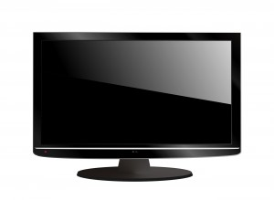
This is a “dumb” TV set and it is not connected to the Internet
Can I connect it to the Internet and make it “smart?”

Slide 26
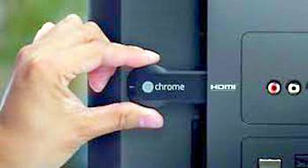
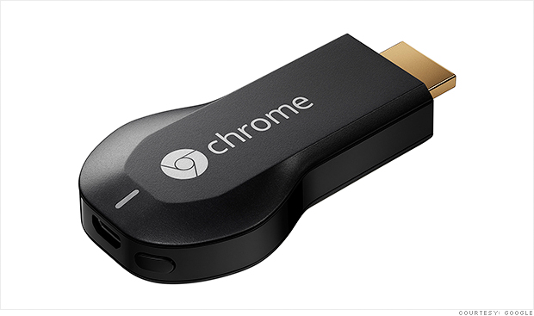
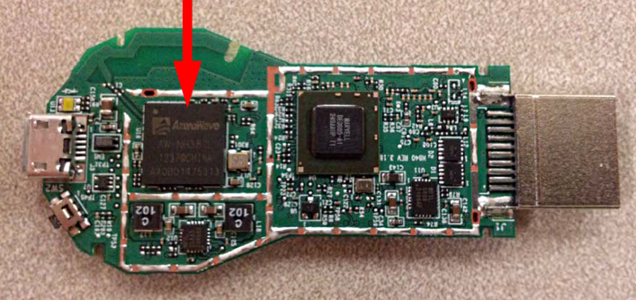
Connect your TV to the Internet of things
How does the Chromecast connect to the Internet and your tablet, phone or PC?
Notes:
Google’s Chromecast looks like a slightly oversized flash storage drive.
You plug it into a port on a TV set to connect the set to your home WiFi network and through it to the Internet.
That enables it to display images and video from a tablet, phone or PC in your home or from the Internet.
The arrow points to the CPU inside the Chromecast.

Slide 27
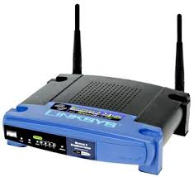
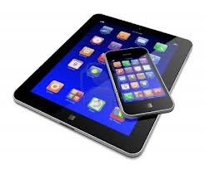
What would be the communication path for streaming video from your tablet, phone or PC to the TV set?
Notes:
As we saw, the Chromecast plugs into the TV set.
It uses the TV screen as an output device.
The Chromecast and your tablet, phone or PC connect wirelessly to your WiFi base station.
Your WiFi base station connects to the Internet.

Slide 28
What is the data path for a video being streamed from the Internet?

Slide 29
Why is local streaming more demanding on the local device?
Notes:
The commands to start the stream coming would be issued from your tablet, phone or PC, but once the Chromedast requested the video, you could use your device for other things.

Slide 30
Streaming from the Internet:
Streaming from the local phone, tablet or PC:
Notes:
When streaming from the Internet (top) the local device is only used while selecting the video to be streamed.
Once the stream starts, the Chromecast communicates directly with the video server on the Internet.
There is no further load on the local device.
But, when you stream from the local device to the Chromecast (below), it is constantly feeding bits to the Chromecast for display.
That takes a lot of CPU speed.
As you see here, it is too much – 100% -- for the CPU in my trusty old laptop.
My next laptop will be faster, so this will be less of a problem.

