Slide 1
The important role of questions in education
Skills: asking good questions, answering questions
Concepts: none
This work is licensed under a Creative Commons Attribution-Noncommercial-Share Alike 3.0 License.
Notes:
The presentation is a work in progress – trying to understand the role of questions in education – what sorts of questions do teachers ask, and why? What sorts of questions do students ask, and why? How can we get answers?
Note that the first skill listed here is “asking good questions” – that is more important and harder than answering questions.

Slide 2
Where does this topic fit?
Internet concepts
Applications
Technology
Implications
Internet skills
Application development
Content creation
User skills
Notes:
I put this under user skills because you should be learning to use the Internet to answer questions, but the tougher skill is asking good questions. This topic is germane to all classes.

Slide 3
Some questions about questions
(A geek might call them metaquestions.)
In school, why do teachers ask questions? Why do students ask questions?
On the job, who asks questions and why?
Outside of work or school, who asks questions and why?
Notes:
I want to talk about questions, but I am not sure what I am getting at.
I agree with Michael Wesch that questions are really important – not just in education, but on the job and in real life.
A student asking a question can be the first step in learning a new skill or concept.
It can help you form an opinion or make a decision.
Perhaps the most important, most fun questions are those that arise out of curiosity.
Teachers ask questions to get feedback, to see if the students understand something.
Teachers also ask questions grade students.
Teachers also ask questions to help students realize what they are confused about.
But, I think the most important questions teachers ask are those that get the students actively engaged in seeking the answer.
Active learning is way more effective and a lot more fun than passive learning.
Let’s look at some sample questions that are relevant to our class …

Slide 4
Consider a few example questions …

Slide 5
What is a Likert scale question?
Our class had an assignment in which the students completed a survey then answered a few questions about the survey. One of those questions was:
“Which survey question used a Likert scale?”
I was pretty sure no one knew what a Likert scale was.
Why did I ask that question?
How could students get the answer?
Notes:
I was pretty sure you did not know what a Likert scale question was, and I wanted to let you know that you have to figure out how to get answers to questions in real life.
I also wanted you to learn what a Likert scale question is because they are widely used in surveys and not as obvious as multiple choice or open ended questions.
My hope was that by actively finding the answer on your own, you would have a better chance of understanding and remembering it.
You can test this hypothesis on your 50th birthday – ask yourself what a Likert scale question is.

Slide 6
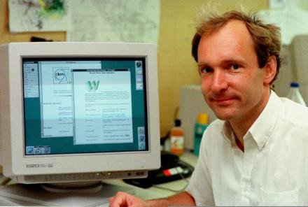
Who invented the World Wide Web?
How could you get the answer?
Is this a teacher or student question?
Why ask it?
Notes:
A teacher might ask this in order to test your knowledge of the history of the Internet or to let you know that this person made an important contribution and that the applications we use are invented by one or a small group of people.
A curious student could also ask the question in class.
Again, since most students would not know the answer, they would have to seek it actively.
You could find the answer using Google or another search engine or you could ask someone who knows – like your teacher.

Slide 7
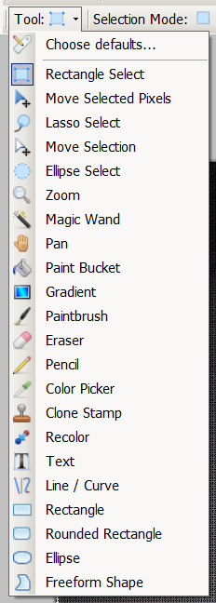
What is the difference between these image processing tools?
How could you get the answer?
How could you get the answer?
Is this a teacher or student question?
Why ask it?
Notes:
This is the “toolbox” of an image editing program called Paint.Net.
A student could ask answer this question by reading the tutorial and help material that comes with the program, by asking the teacher or another student or by doing an experiment – playing with both tools. Which would be most effective pedagogically?
A teacher might ask it on an exam or in class to get the students to focus on the various tools and the differences between them
A teacher might ask it in class to get the student to think about the program and the way it looks or to get the student to experiment

Slide 8
How many radios in an iPhone?
Are they input or output devices?
How could you get the answer?
Is this a teacher or student question?
Why might a teacher ask it?
Notes:
This question sheds light on your understanding of input and output devices and gets you thinking about the radios in your phone.
Alternatively, one could ask “there are x radios in an iPhone – what is each used for?”
It could be asked by a teacher or a curious student.
It might even surprise beginning students to realize there are radios in their phones.
You could ask someone for the answer, and, if that did not work, go to an online forum to find a person to help you.
If you were to search on Google, what terms would you search for?

Slide 9
How can I straighten this picture?
How could you get the answer?
Is this a teacher or student question?
Why ask it?
Notes:
A teacher could ask that or it may be something you need to do.
The teacher would ask in order to engage the class before giving a presentation or demonstration.
If you needed to find the answer on your own, you could either look for someone you know or do a search on the Web or in the program help and tutorials,
You would search for “straighten image” or something similar.

Slide 10
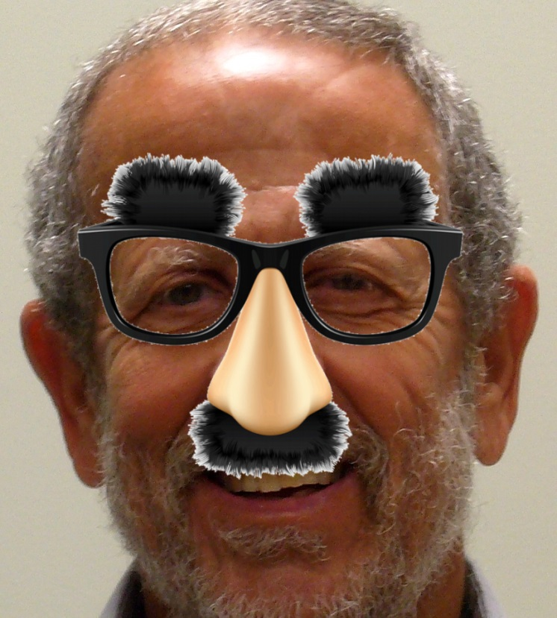
How did I do this?
How could you get the answer?
Is this a teacher or student question?
Why ask it?
Notes:
This question is less specific.
It would be asked by a teacher.
It would be difficult to find the answer using search, because it requires knowledge of image layers and you have no way of knowing that in advance.
It could be a test question, but in class it would be designed to engage the students in solving the riddle.
If it came up outside of class – you just saw the image and were curious, you could ask someone and, if that did not work, go to an online forum to find a person to help you.

Slide 11
Did Eric Snowden do the right thing?
How could you get the answer?
Is this a teacher or student question?
Why ask it?
Notes:
This question does not have a definite answer.
In asking it, a teacher would be trying to call attention to Snowden’s release of NSA documents and engage students in evaluating the pros and cons of Snowden’s act.
It also moves the class from a consideration of technology or skill to ethics and implications of the Internet.

Slide 12
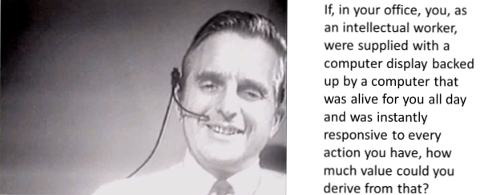
A research question
“Wisdom begins with wonder.” Socrates
Notes:
We have focused on questions asked by teachers and students, but let’s close with a question asked by a computer science researcher.
This is arguably the most important question that has ever been asked that is relevant to our class.
Doug Engelbart asked himself this question in the late 1950s and he spent the rest of his life working to discover the answer.
This is the best kind of question – it was motivated by curiosity and the desire to improve the world and it resulted in action.

Slide 13
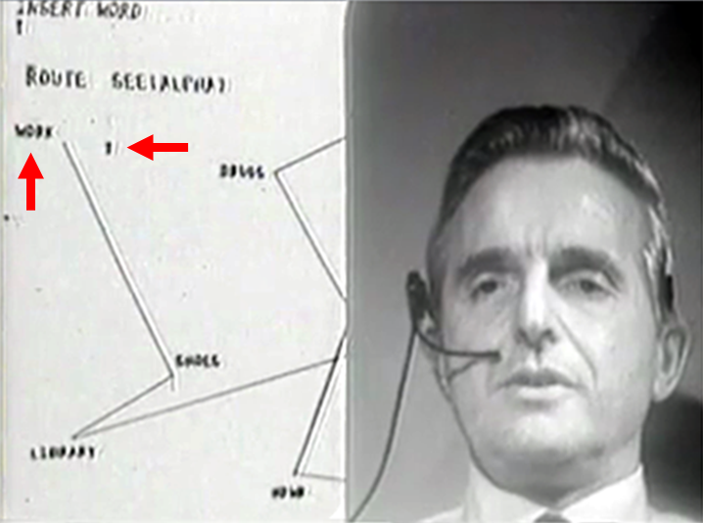
Some inventions that followed from that question
The mouse
Hyperlinks
Video conferencing
WYSIWYG word processor
Multi-window user interface
Shared documents
Shared databases
Documents with images & text
Keyword search
Instant messaging
Synchronous collaboration
Asynchronous collaboration
Chord keyboard
Notes:
In attempting to answer that question, Doug Engelbart and his colleagues invented much of the hardware and software we use today.
This photo shows Engelbart during a famous 1968 demonstration at a computer science conference.
The audience was stunned and the demonstration triggered many research and development projects.
It is simply referred to as “The Demo.”
Note that in this still from The Demo we see two staples of the Web, hyperlinks (the words), and a two dimension page that combines graphics and text.
The dot on the screen is the mouse-controlled cursor.

Slide 14
Is asking or answering questions harder?
Notes:
We have seen several reasons to ask questions and several ways to find answers.
Asking questions is generally harder.
As a student, you may not be aware that you do not fully understand a concept or technique – you often don’t know what you don’t know.
As a teacher, you may have a problem coming up with a question that will help the students learn.

Slide 15
Questions at work vs. questions at school
School failure: getting the wrong answer
Work failure: not knowing how to get the right answer
Play this excerpt, 1 min 4 sec
Getting the right answer requires that you know you are lost.
Self-diagnostic
Questions
Full presentation by Cathy Davidson, Duke University
Notes:
Cathy Davidson tells us why employers have trouble training college graduates.
On the job, knowing what you do not know and then asking the right question is important.
In school you have a chance to learn and practice that skill.
The purpose of self-diagnostic questions is to let you know you are lost.
If you like what professor Davidson says, listen to the entire talk.

Slide 16
School questions are diagnostic
Notes:
Think about this quote by one-time Secretary of Defense Donald Rumsfeld.
If a teacher talks about a concept in class, and asks “do you have any questions” or “do you all understand the topic.” students almost invariably say nothing.
Why don’t they speak up? They may be shy or they may be uncertain as to whether or not they did understand.
It would be better to ask a diagnostic question like” how long would it take to transfer a 30 MB file at 15 Mbps?”
The purpose of the question is not to test whether the student gets the correct answer, it is diagnostic.
The important, implicit question is “are you certain that your answer is correct?”
If the answer to that question is “no,” the student has discovered one of Rumsfeld’s unknown unknowns.
The primary purpose of the assignments and quizzes in our class is self-diagnosis – to help you realize what you don’t know.
Once you identify something you don’t know, you can figure out how to learn it.

Slide 17
Which are more important – student questions or teacher questions?
Notes:
Both have a role, but I’d go for student questions.
In class, only the students know when they are confused or curious; the teacher doesn’t.
There are no “teachers” on the job or most other places in the world – so we all have to become good at asking questions.

Slide 18
The effects of mentoring are largely guided by the questions of the student and that person’s willingness to learn from the answers.
Bob Cringley, The role of mentoring in Silicon Valley
Notes:
If we are lucky, we have life and professional mentors.
Professional mentors help us with job and organization skills.
My professional mentor formed my technical background while I assisted him on a large project.
If you had asked him if he was my mentor, he would have said “no, we worked together on a project.”
The value of a mentoring relationship is determined by the mentee, not the mentor.
As Cringely says – the burden is on the mentee to ask questions and to learn from the answers.

Slide 19
Summary
Notes:
We’ve discussed the importance of different kinds of questions in education, who asks them (teacher, student or researcher), why and how to get answers.
We considered several specific example questions, including a very large question Doug Engelbart asked himself at the start of his research.

Slide 20
Self-test questions
Give an example of a good question one of your teachers has asked. Why did he or she ask it and how did you work on the answer?
Give an example of a good question you would like to have answered in this class? In another class.
What would be a good question for your teacher to ask? Why?
What question would you ask a little kid to get him or her thinking about subtraction?
What are the ways you can get answers to questions?
Socrates said “understanding a question is half an answer” – what did he mean by that?
Socrates said “wisdom begins with wonder” – what did he mean by that>

Slide 21
Resources
Michael Wesch on the importance of good questions:
http://cis275topics.blogspot.com/2010/08/httpsom.html
Photo tribute to Doug Engelbart: http://anewdomain.net/2013/08/01/engelbart-photo-tribute/
Video of The Demo: http://sloan.stanford.edu/MouseSite/1968Demo.html
Column on mentors: http://bit.ly/1ccTX0b
Washington University tips for teachers asking questions:
http://teachingcenter.wustl.edu/strategies/Pages/asking-questions.aspx
Notes:
We looked at examples of questions teachers and student might ask.
Some were easy to answer and factual, others took research and thought.
Some had unambiguous answers, others were open to discussion.
We concluded with an important research question Doug Engelbart first asked then spent years developing an answer.

