Slide 1
Internet reading (and writing) Zen
Skills: mindful reading
Concepts: Internet reading is superficial, good writing requires mindful reading, the Internet and other modern media may be changing our brains
This work is licensed under a Creative Commons Attribution-Noncommercial-Share Alike 3.0 License.
Notes:
Research shows that we read carelessly on the Internet and we will see several examples of careless, unprofessional reading.
The Internet may be changing our brains, making it more difficult for us to concentrate and devote full attention to the task we’re working on.
But good writing requires careful, focused reading, so you should strive to slow down and become a mindful reader.

Slide 2
Where does this topic fit?
Internet concepts
  Applications
  Technology
  Implications
Internet skills
  Application development
  Content creation (text)
  User skills
Notes:
I placed this under content creation because good writing requires mindful reading.

Slide 3

How do people read on the Internet?
Quickly and superficially, starting in the upper left hand corner.
Is this a fair description of the way you read online?
How long do you typically spend reading a page before clicking away?
Notes:
How do people read on the Internet?
A one sentence answer is that they read quickly and superficially, starting in the upper left hand corner.
That is a quick answer, but there’s data to support it.
Before you go on, think about your own Internet reading habits.
Do you read quickly and superficially, starting in the upper left hand corner?
Most people do, and interface design researchers have data to back up that claim.
Let me show you a couple of anecdotal examples of careless reading by my students.

Slide 4
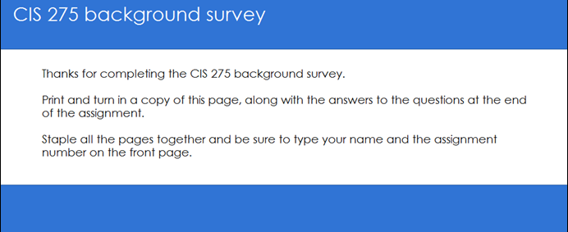
Two chances to read instructions
1.
“When you finish and submit the survey, you will see a thank-you screen with further instructions. Print that out to turn in along with the answers to the following questions: …”
2.
Notes:
I assigned a class to complete an online background survey then answer five questions about the experience.
An excerpt from the assignment, which was on the class Web site, is shown above.
When they completed the background survey, the “thank you” screen shown above was displayed.
For the second time, they were asked to answer the questions at the end of the assignment.
The instructions were displayed twice, but fewer than half the students followed them – they just completed the survey and assumed they had completed the assignment.

Slide 5
More careless reading
From: Mail Delivery System <MAILER-DAEMON@mx.csudh.edu>
Date: Tue, Oct 19, 2010 at 10:48 AM
Subject: Delivery Status Notification (Failure)
To: xxxxx
The following message to <lpress@csudh.edu> was undeliverable.
The reason for the problem:
5.1.0 - Unknown address error 552-'5.3.4 Message size exceeds fixed maximum message size'
Final-Recipient: rfc822;lpress@csudh.edu
Action: failed
Status: 5.0.0 (permanent failure)
Remote-MTA: dns; [155.135.55.129]
Diagnostic-Code: smtp; 5.1.0 - Unknown address error 552-'5.3.4 Message size exceeds fixed maximum message size'
Do you see the problem?
Notes:
Here is another example.
People often ignore error messages.
An error message may be full of irrelevant geek details, but you still have to read it carefully.
When a student tried to send me an email with a large attachment, he received the message shown above.
I ran into him two weeks later, and he told me he had tried to send the material he had promised, but the email did not work.
Was ignoring the bounced email a professionally acceptable response?

Slide 6
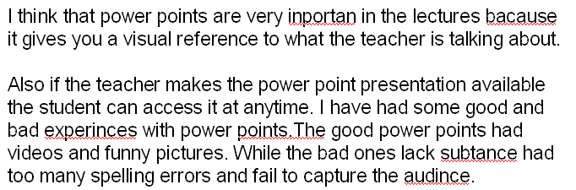
One more example
A student wrote the following comment on a blog post:
He hit the submit button without reading what he had written himself.
How many errors can you find?
Notes:
As a result of careless or no reading, this student misspelled six of the 78 words and made a number of grammar errors.
Would you be proud of this sort of work?
What would your boss say if you wrote something like this?

Slide 7
We all do it
Larry,
I guess you have seen that the new volume of Cuban in Transition (Vol. 21) is out and our articles look good there next to one another. I took the liberty of doing a post on my blog about our collaboration in DC and Miami last August with links to our papers and the video from DC.
I also took the opportunity to (re)read your new paper. As I said before, I think we can easily prepare a joint paper …
My lame reply:
Did ASCE ever publish the conference proceedings?
Notes:
Here is a final example of lame reading – by me.
A colleague sent me an email about writing a paper together.
In my lame reply, I asked if the papers had been published.
I had skimmed past his opening paragraph.

Slide 8

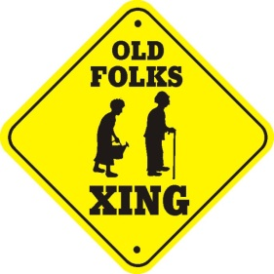
Good Internet writing is concise and to the point.
Every word or sentence is there for a reason.
It is often conversational.
It is often imperative.
So
Slow down and become a careful reader.
Take a deep breath.
Be mindful.
Notes:
Good Internet writing is concise and to the point.
That means you must read carefully because every word is important.
This is particularly true in conversational writing.
When you are talking to someone, you have to listen to what they say in order to respond coherently.
The same thing applies to written Internet conversation.
If someone asks or tells you to do something, you have to respond.
So fight your natural reaction, and slow down. Read carefully. Be mindful.

Slide 9
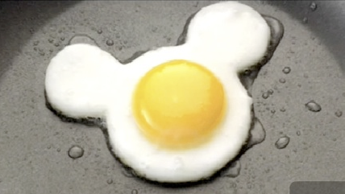

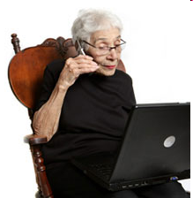
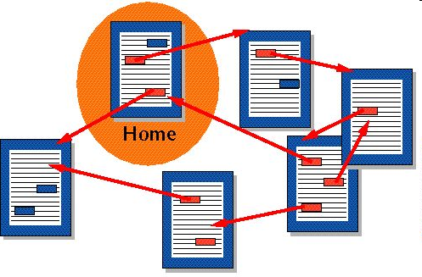

Is this is your brain on …
MTV
Multi-tasking
Hypertext
Video games
Notes:
You are probably not a mindful reader, and today’s information technology is part of the reason.
We play fast moving video games and watch fast cutting video.
We quickly jump from one link to another when browsing the Web and the Internet makes multitasking easy – an email or instant message is just a click away.
This tends to shorten our attention span and focus.
Researchers think it may be altering the structure of our brains.
One effect of this speeding up is that we tend to skim rather than read carefully.

Slide 10
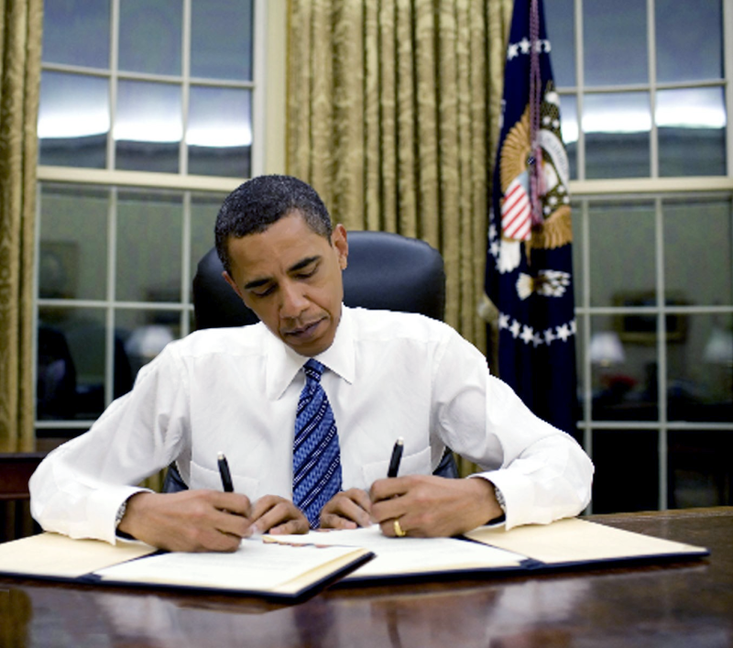
Multitasking is inefficient
Do you think multitasking saves you time?
Notes:
There research showing that people are less efficient when they switch from task to task rather than completing one task before going on to the next.
If, for example, you interrupt your work on an assignment to read your email or play a game for a while, you lose time re-orienting when you return to the original task.

Slide 11
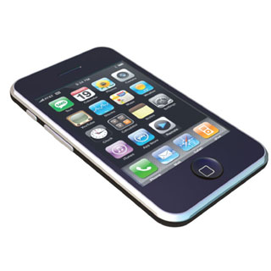
Mobile reading (and writing) is sloppy
Notes:
Mobile phone screens are small and you may not scroll down to read the entire message.
Typing is difficult and mobile users are often in the middle of doing something else.
I have not seen studies confirming it, but my guess is that reading from a small screen is even worse than on laptop and desktop computers.

Slide 12
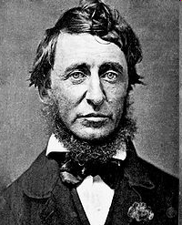
Zen and the art of Internet reading (and writing)
Books must be read as deliberately and reservedly as they were written, Thoreau, Walden, 1854
The best way to go fast is to go slow, Chinese proverb
Go slow now, go fast later, German proverb
Notes:
Here are a couple of quotes that summarize the main point of this presentation -- you can’t write well if you don’t read carefully.
When Henry Thoreau went to live in relative isolation at Walden Pond, he took only a few books.
He said he planned to read them as slowly and carefully as their authors had written them.
These proverbs from China and Germany are also telling us to slow down and be mindful.

Slide 13
Summary
Notes:
Research shows that people read carelessly on the Internet.
We saw several examples of careless reading by students.
Some argue that the Internet is reshaping our brains and research shows that multitasking is inefficient.

Slide 14
Self-study questions
When you read a magazine or newspaper article, do you read it all from start to finish?
Do you enjoy sitting for a long time and reading a book?
Do you interrupt what you are doing online to check email and messages.
How likely are you to follow a link in something you are reading and never return to the original?
Do you think information technology – cell phones, computers, the Internet, etc. are changing your attention span or level of patience?

Slide 15
Resources
Is Google making us stoopid?
http://computerliteracy3.blogspot.com/2008/08/does-internet-style-reading-change-our.html
New York Times series Your Brain on Computers:
http://topics.nytimes.com/top/features/timestopics/series/your_brain_on_computers/index.html
Interview of Matt Richtel, author of the above series.
http://www.npr.org/templates/story/story.php?storyId=129384107
Henry Thoreau at Walden pond:
http://en.wikipedia.org/wiki/Walden
Topic module with more on reading and user interface research:
http://cis275topics.blogspot.com/2010/09/internet-reading.html

