Slide 1
Supplementary material: Scientific collaboration and search vs taxonomy
I supplement my Internet literacy class with weekly discussion items, often based on some current event relevant to our class.
We stress the Internet as a collaboration tool and used this open biology database as an example.

Slide 2
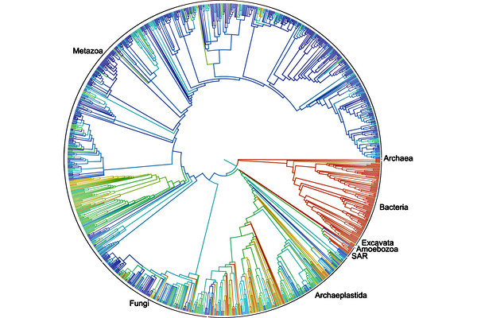
Scientific collaboration -- the open tree of life
The database
*
* 3.5 billion years ago … 2.3 million species
Notes:
http://www.csmonitor.com/Science/2015/0920/Scientists-create-the-first-digital-tree-of-life-for-2.3-million-species
Scientists from 11 organizations have digitized a “tree of life,” a genetic map of 2.3 million named species of animals, plants, fungi and microbes that all branched off over time from a common ancestor.
The database is far from complete, so this is just a start. It is open, like Wikipedia and all biologists are asked to add species they are familiar with.
Entries are accompanied by references to scientific papers.

Slide 3
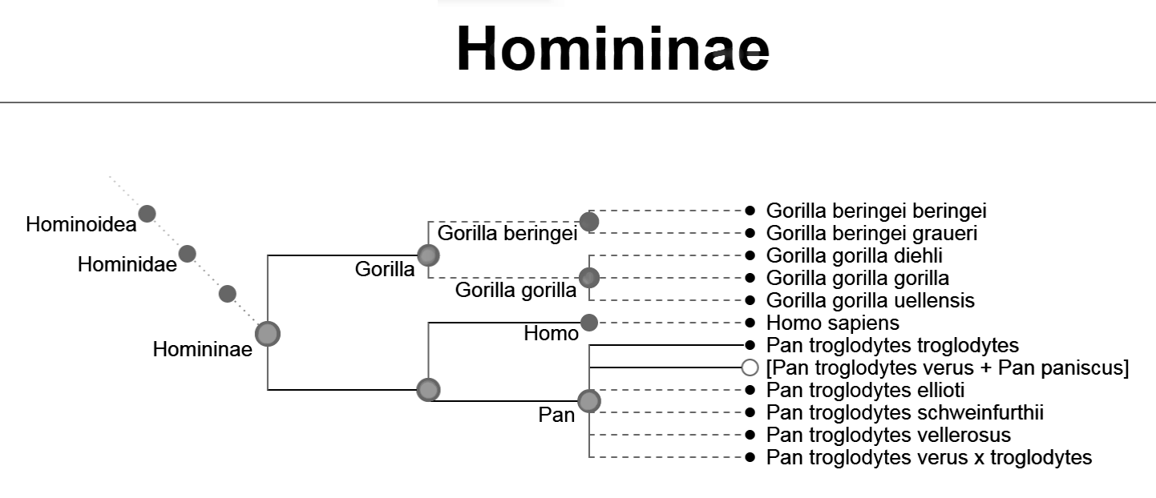
This data is organized into a tree – a taxonomy
Can you think of other examples of hierarchical taxonomies?
Can you start at the root of the tree and find Homo Sapiens?
The database
Notes:
You can locate information by drilling down within a taxonomy.
The files in your computer’s storage are organized hierarchically.
You can have files in folders, within sub-folders, …
The books on shelves in a public library are organized in a taxonomy called the Dewey Decimal System.

Slide 4
Search is an alternative to taxonomy
Notes:
The speed of computers has enabled us to leave information disorganized and search for it.

