Slide 1
The political implications of the Internet, with an emphasis on the last election
Slides at:
http://som.csudh.edu/fac/lpress/presentations/internetelectionselectedslides.pptx
This work is licensed under a Creative Commons Attribution-Noncommercial-Share Alike 3.0 License.

Slide 2
I teach a class on the applications, implications and technology of the Internet.
We spend a lot of time on current events relevant to our class, so when Donald Trump was nominated, I started a PowerPoint presentation on the political implications of the Internet and updated it weekly throughout the term.
Disclaimer – I was opposed to Trump during the campaign and continue to be opposed to him.
This work is licensed under a Creative Commons Attribution-Noncommercial-Share Alike 3.0 License.

Slide 3
Note on my PowerPoint style
Few words
Images
Links to supporting material
Annotation
“Stop sign" questions
Source
Notes:
To prepare for teaching, I read the supporting material and then speak extemporaneously. I let the students know that they are responsible for reading the annotations (like this one) accompanying the slide, following and reading the linked material and attempting to answer the “stop sign” questions.
Follow the “Source” link for more on the way I use PowerPoint slides.

Slide 4
Historical context
Lying
Fact checking
Fake news for money
Fake news for politics
Fake images
Trump dominated social media
More historical context - disillusion
Non-political consequences
Hacking USA
The Internet is ephemeral
Breitbart – “alt right” press
Money behind the scenes
Europe
(Imperfect) fixes
Future fake media

Slide 5
Historical context

Slide 6
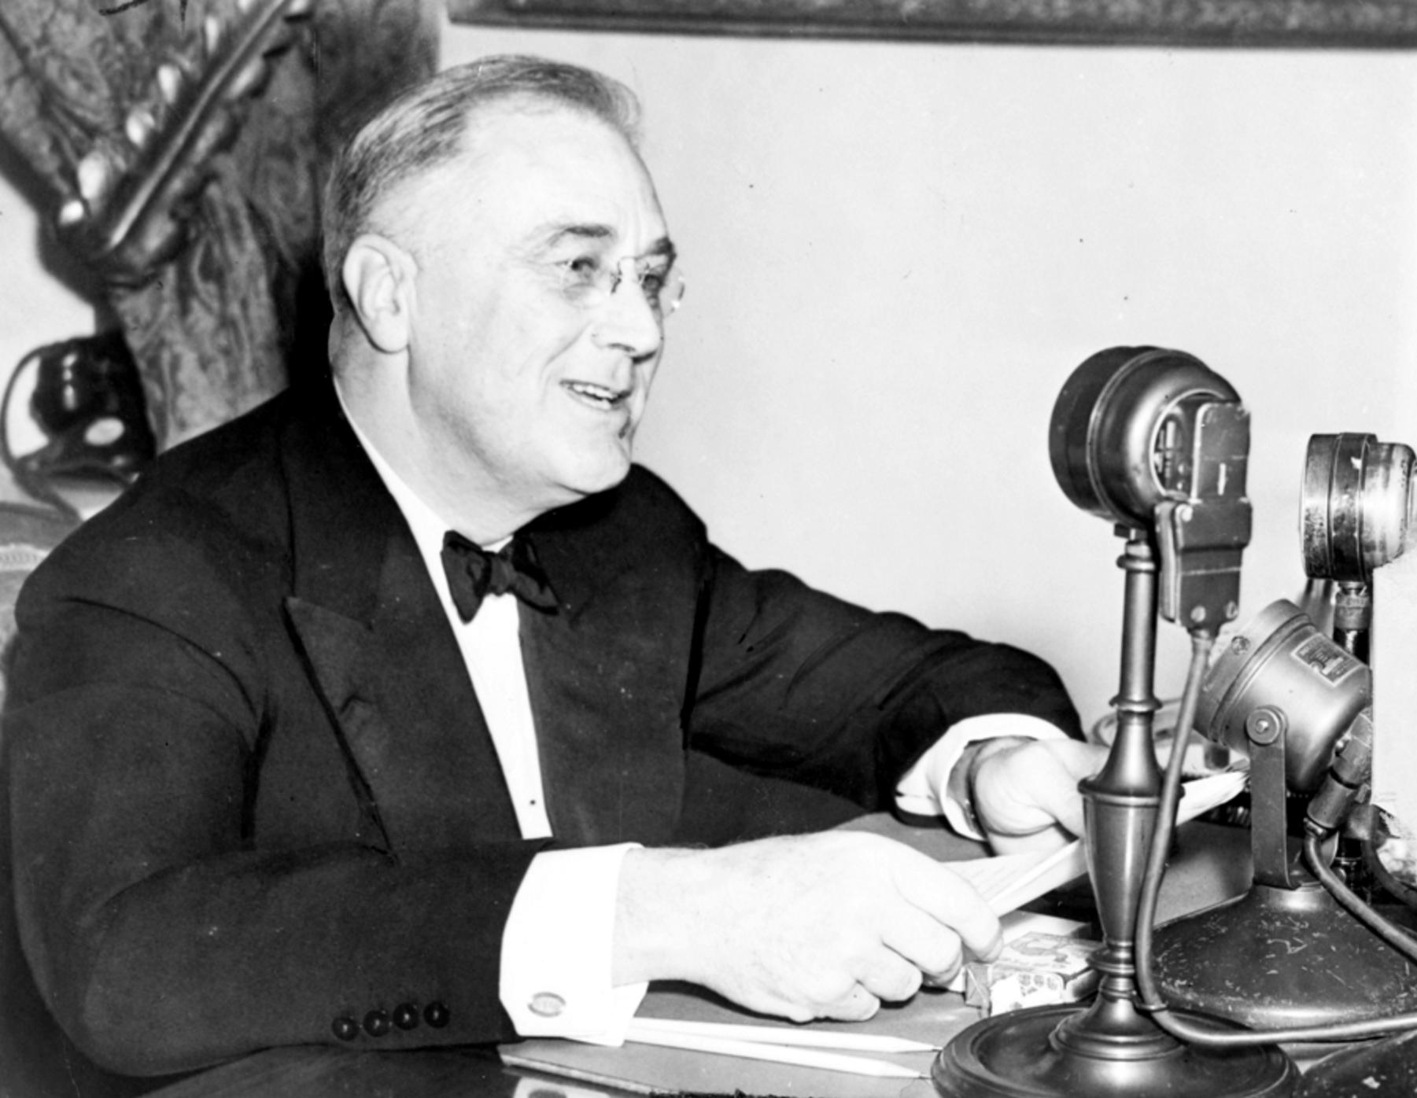
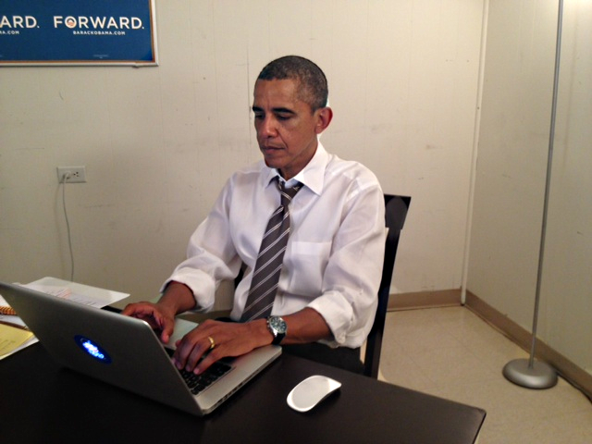
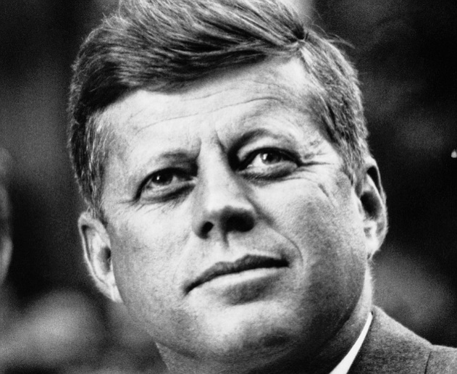
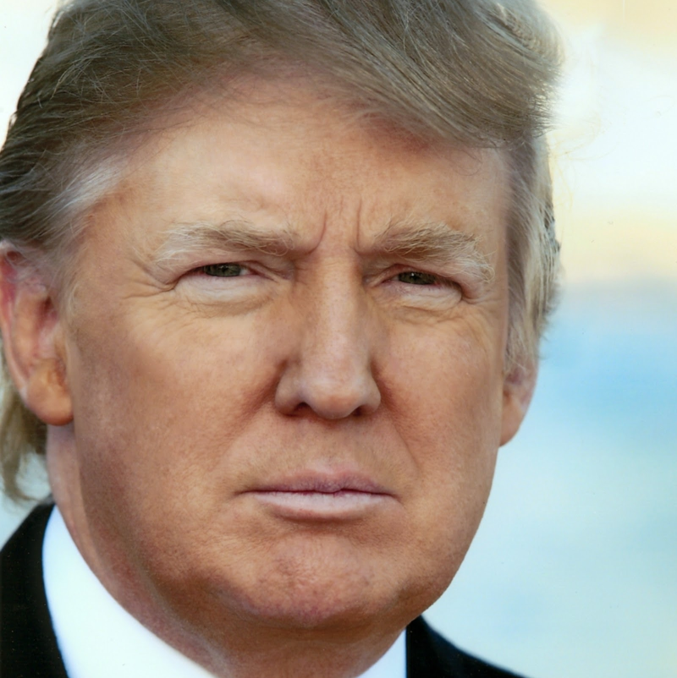
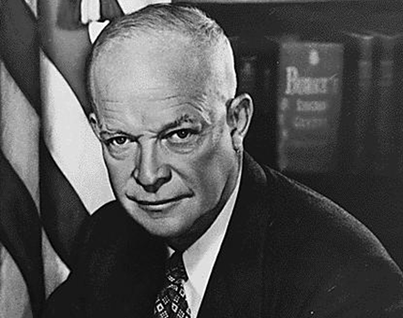
Who are these men?

Slide 7
Roosevelt
Obama
Kennedy
What do they have in common other than having been elected president?
Trump
Eisenhower
Notes:
They each exploited a new medium for campaigning and communicating with the people.

Slide 8
Roosevelt
Obama
Kennedy
Each encountered a new communication medium
Links and discussion
Trump
Eisenhower

Slide 9
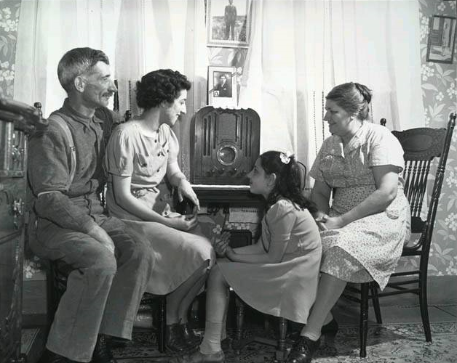
Radio
Roosevelt’s Fireside Chats

Slide 10
Television
Video
Video
Source
Notes:
At first new media mimic old media. For example, the Eisenhower commercial was a radio gingle with animation.

Slide 11
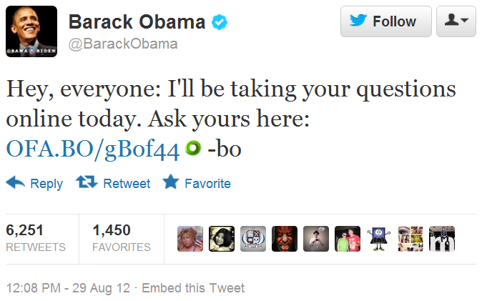
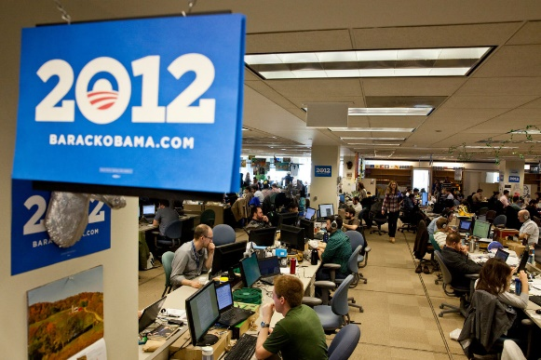
The Internet
Petition the administration, 2013
Fund raising
“Ground game”
Some public communication
Reddit: Ask me Anything
The “ground game”
Google Hangout on Air, 2012
Notes:
2012 and 2013
Long version of the hangout on air (2:08)
Ask me anything
Politicians using media, from Roosevelt's fireside chats to Obama's Ask me Anything
http://cis471.blogspot.com/2012/09/politicians-using-media-from-roosevelts.html
President Obama has used the Web in different ways.
Here he is shown answering questions during an unscripted “Ask me Anything” at Reddit.com.
His Google Hangout with constituents was billed as a “fireside chat” after Roosevelt.
Roosevelt was the first president to exploit a then new medium, radio, but his programs were broadcast – they were speeches to the nation.
Obama’s hangout is interactive and unscripted.
People post petitions on the “We the People” web site and the administration takes a stand if there are 100,000 or more signatures.
Each of these is also a campaign tool – the users are identified along with a signal as to their preferences.
This data is useful in fund raising and campaigning.

Slide 12
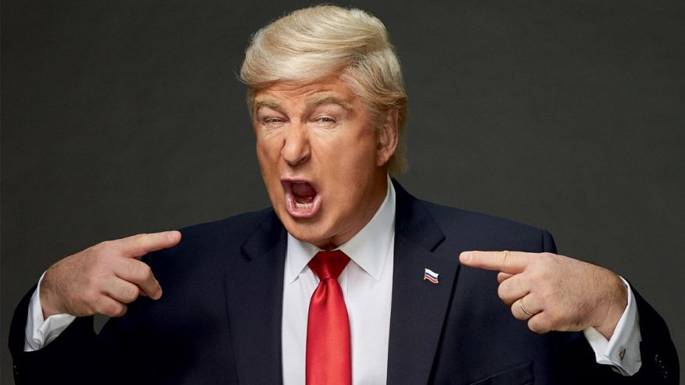
Alt Right media ↔ Twitter ↔ Mainstream media
Social media
3 million illegal voters
Obama bugged my phone
Source
Trump Saturday Night Live
Can you think of other examples? Is it a free-coverage strategy is it genuine stupidity?
Notes:
Trump’s use of social media was picked up by the mainstream media and he posted favorable content that appeared on mainstream media. He also constantly attacked unfavorable mainstream media online.
He dominated the news with his outrageous comments and the media made money talking about them.

Slide 13
Lying

Slide 14
TRUE – The statement is accurate and there’s nothing significant missing.
MOSTLY TRUE – The statement is accurate but needs clarification or additional information.
HALF TRUE – The statement is partially accurate but leaves out important details or takes things out of context.
MOSTLY FALSE – The statement contains an element of truth but ignores critical facts that would give a different impression.
FALSE – The statement is not accurate.
PANTS ON FIRE – The statement is not accurate and makes a ridiculous claim.
Politifact rating system explanation
Others
Factcheck.org
Snopes,com
Notes:
Politifact is a fact checking service run by a large Florida newspaper. They seem truly independent – you can read about their philosoohy, rating system and sources of funding on their Web page.
They have a six level scale for rating public statements by politicians.

Slide 15
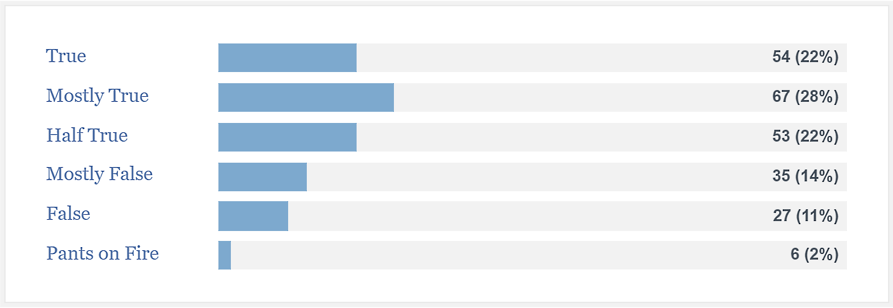
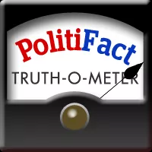
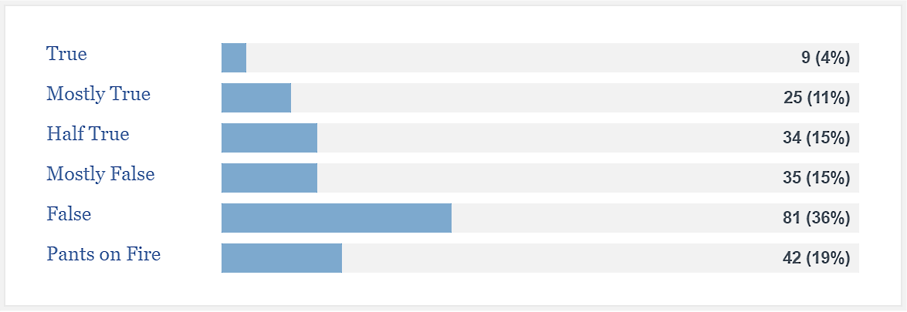
Hillary Clinton
Donald Trump
Notes:
As you see here, Clinton and Trump both make true and false statements, but Clinton is more accurate on the average.
These were their Politifact records on August 14, 2016.

Slide 16
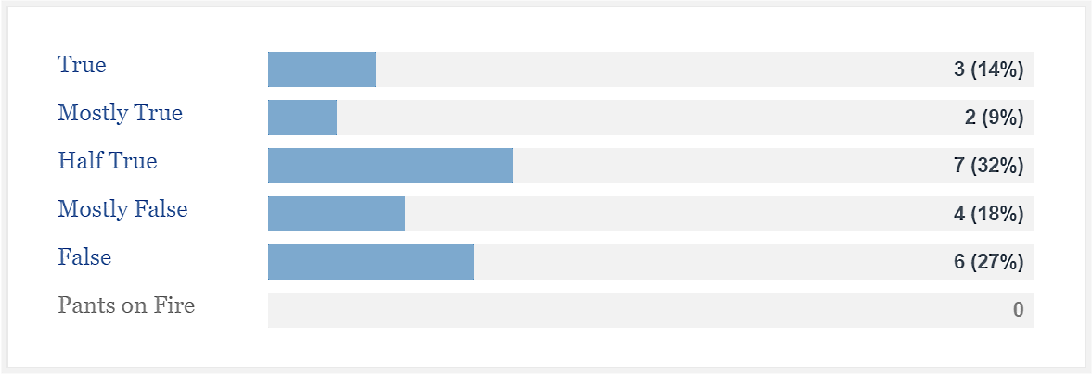
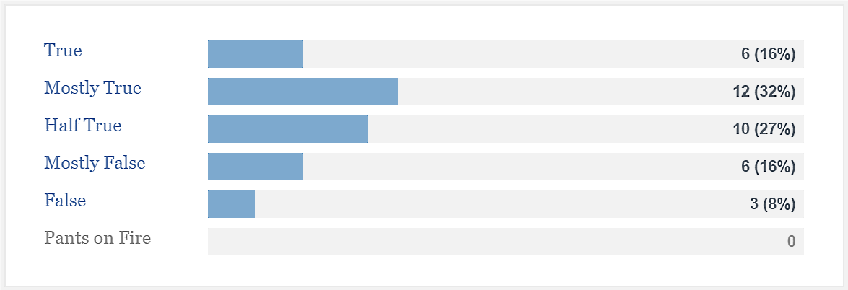
Mike Pence
Tim Kaine
Notes:
The vice-presidential candidates are more equal than the presidential candidates, but many fewer statements have been checked.
These were their Politifact records on August 14, 2016.

Slide 17
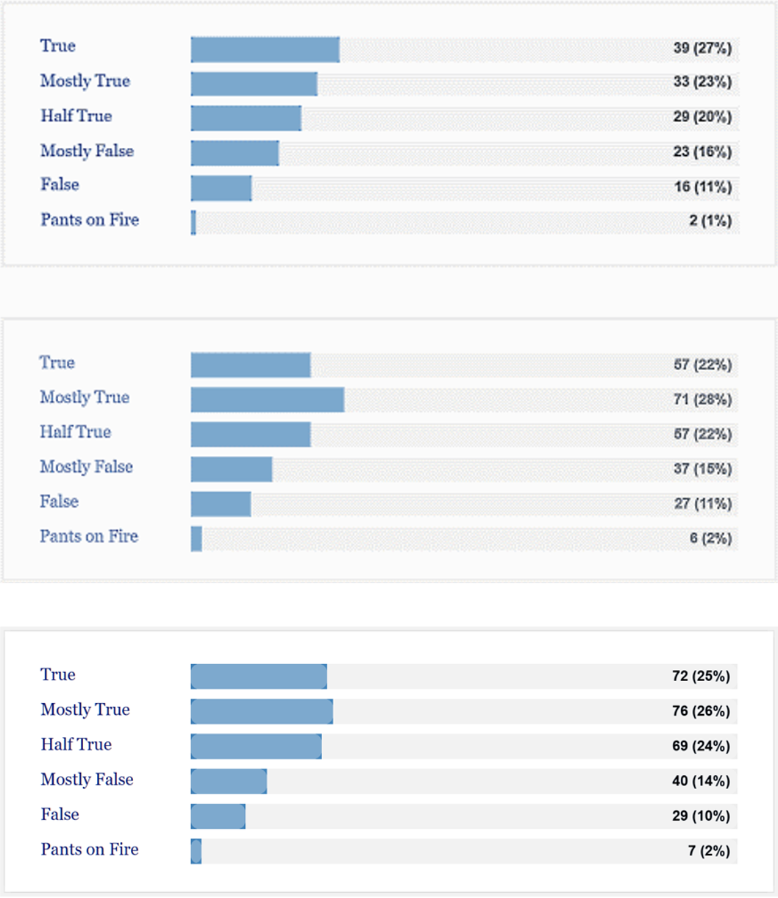
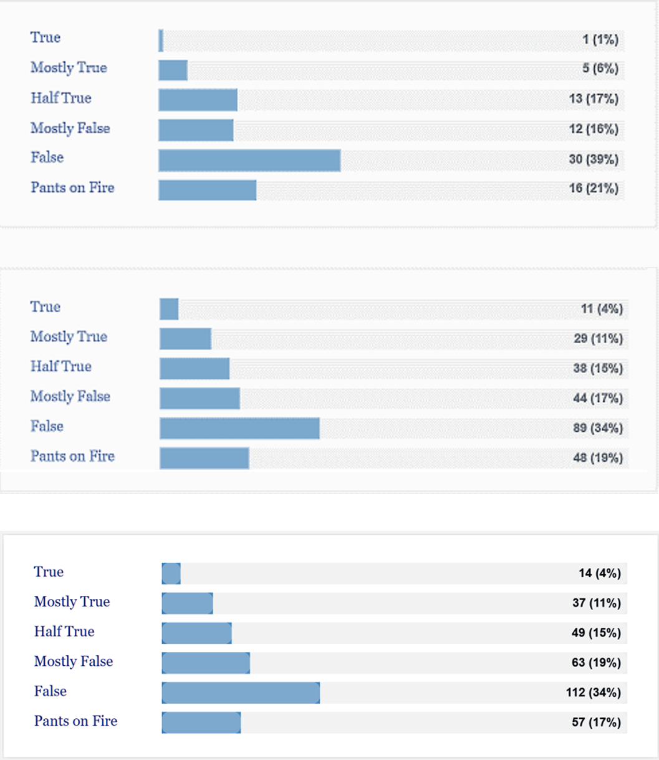
Clinton 1/4, 9/25, 11/9 2016
Trump 1/3, 9/25, 11/9 2016
Lying, crooked Hillary?
Source
Notes:
Politfact.org, a respected fact checking site found that Trump lied more frequently than Clinton and their rates of lying remained nearly constant throughout the campaign. The January results were found in the “Wayback Machine” Internet archive.

Slide 18
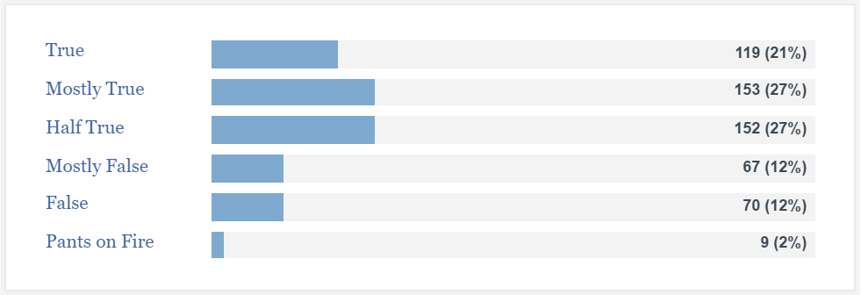
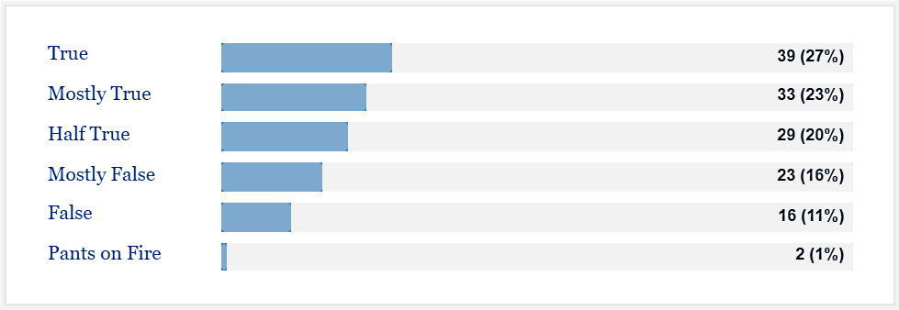
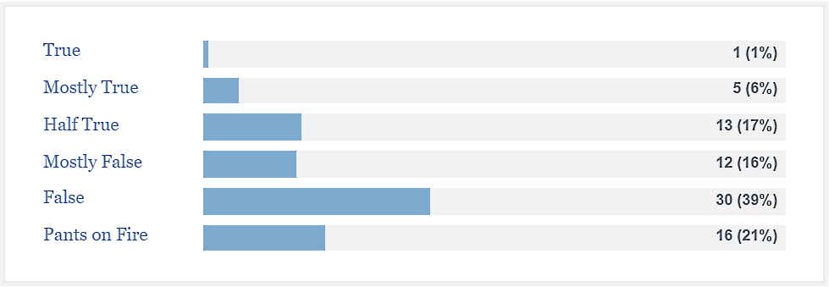
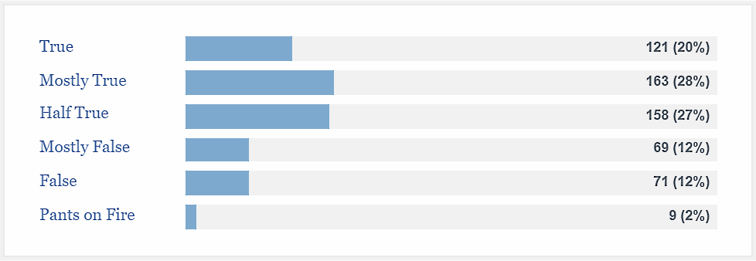
“Lying, crooked Hillary”?
Obama, 1/7 and 9/25 2016
Clinton, 1/4 and 9/25/2016
Trump, 1/3 and 9/25/2016
Clinton is a tiny bit more honest than President Obama (surprising?) and lies much less frequently than Donald Trump.
Notes:
Donald Trump often refers to Hillary Clinton as “Lying, crooked Hillary.”
In January and September 48% of President Obama’s statements were True or Mostly True. Hillary Clinton has also remained constant at 50%, but Donald Trump has is telling the truth more often, increasing his percent of True or Mostly True statements from 6 to 15%.
That is the good news for Trump – the bad news is that his rate of lying has increased from 50-53%.

Slide 19
Fact checking

Slide 20
Duke University fact checking database
Duke University fact-check database
Duke University fact-checking news
Interactive map of fact-checking organizations
Notes:
Lies can spread very quickly on the Internet, but it also enables fact checking. Duke University tracks fact-checking sites around the world.
Duke has an interactive database listing 115 active fact-checking organizations.

Slide 21
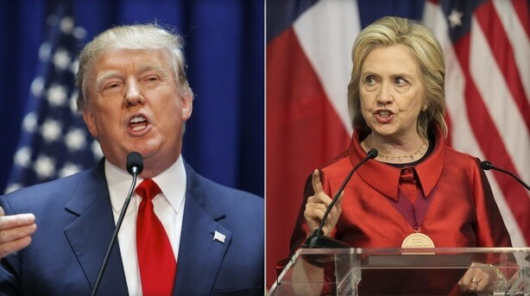
A new political medium
Twitter stream
NPR/PBS stream
Streaming video of a presidential debate with real-time fact-checking

Slide 22
Fake news – for politics

Slide 23
Hillary Clinton
Does truth matter?
The Age of Post-Truth Politics
Donald Trump
Notes:
Does truth matter today? William Davies argues that we are in the “age of post-truth politics,” where people rely heavily on “facts,” but those facts are often not true and one can usually find an “expert” to state any “fact.”
It would have been as easy for me to post this slide as the earlier slide showing that Hillary Clinton was relatively honest compared with Donald Trump.

Slide 24
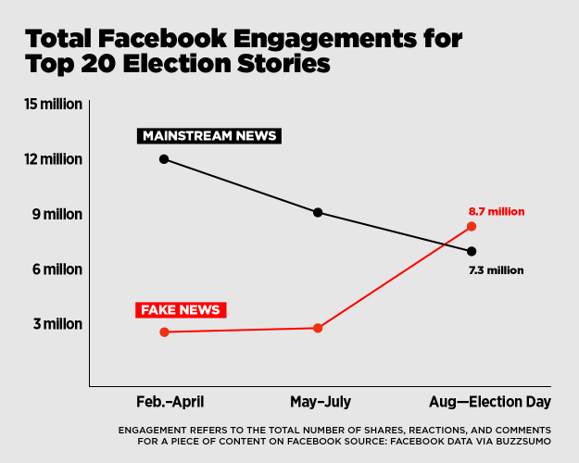
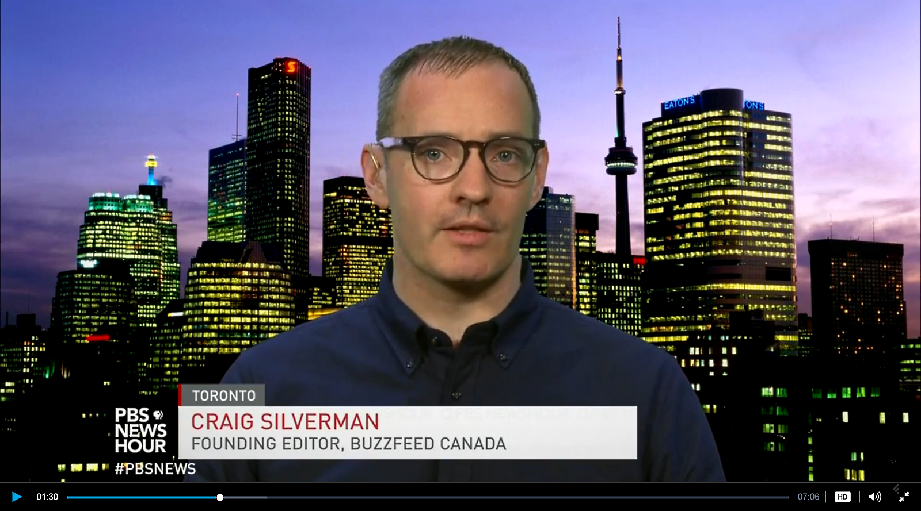
Buzzfeed: Fake/false stories outperformed mainstream news on Facebook during the last three months before the election.
Source
PBS News Hour segment video with transcript
Notes:
Buzzfeed analyzed the top 20 fake and real

Slide 25
Number of real posts
Number of fake/false posts
Top 20 true and fake/false Facebook engagement stories between August 1 and election day
Washington Post | 1
CNN | 1
FOX News | 1
Huffington Post | 2
NBC News | 1
New Yor Daily News | 1
New York Post | 1
New York times | 7
Vox | 1
Wall Street Journal | 1
Washington Post | 3
Abcnews.com.co | 1
Breitbart | 1
Burrard Street Journal | 1
Conservative State | 1
Denver Guardian | 1
Donald Trump News | 1
Ending the Fed | 5
Liberty News | 1
The Political Insider | 1
Twitchy | 1
USA Newsflash | 1
World News Daily Report | 2
World Politic US | 2
Yes I'm Right | 1
Seven of the fake/false posts have been deleted, one is flagged as misleading by Web of Trust and two are from Macedonian sites
(11/19/2016)
One of the pro-Clinton posts was fake/false’ one of the pro-Trump posts was real.
Raw data spreadsheet
Notes:
Four of the five “Ending The Fed” posts have been deleted, but one remains online.

Slide 26
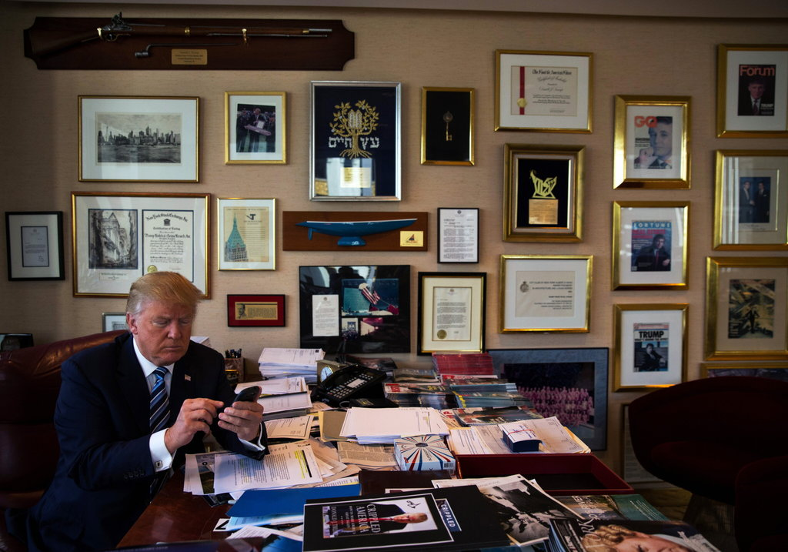
Ten examples of Trump spreading fake news
Obamacare death panels, his landslide Electoral College victory, 3 million illegal voters, etc.
The 10 examples
His excuses:
“I don’t know what they made up; all I can do is play what’s there.”
“All I know is what’s on the internet.”
"Am I gonna check every statistic?"
Tweets with index finger, not thumbs
What do his excuses say about him?

Slide 27
Fake news – for money

Slide 28
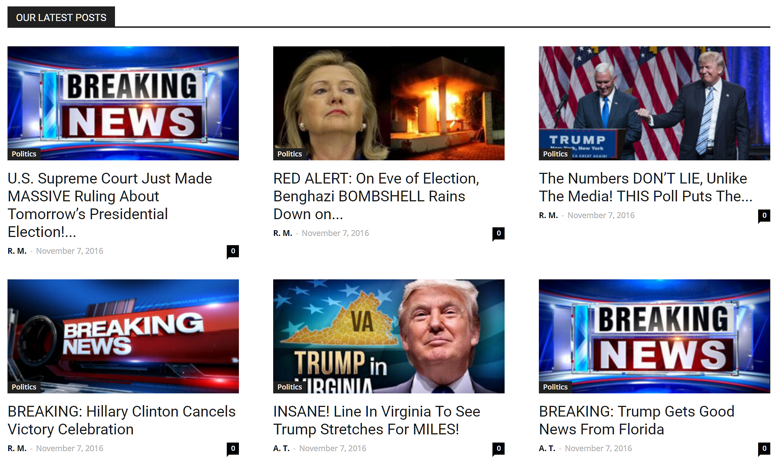
Worldpoliticus.com front page 4 PM, November 7, 2016
BuzzFeed News identified over 100 active US politics websites being run from Veles, Macedonia.
Why are nearly all of these sites aggressively pro-Trump?
Notes:
Like the US media, they get more ad revenue from Trump stories than from Clinton stories.
These sites, and others like them, are not ideological – they feature Trump because Trump supporters are more engaged than Clinton supporters so Trump fakes generate more ad revenue.

Slide 29
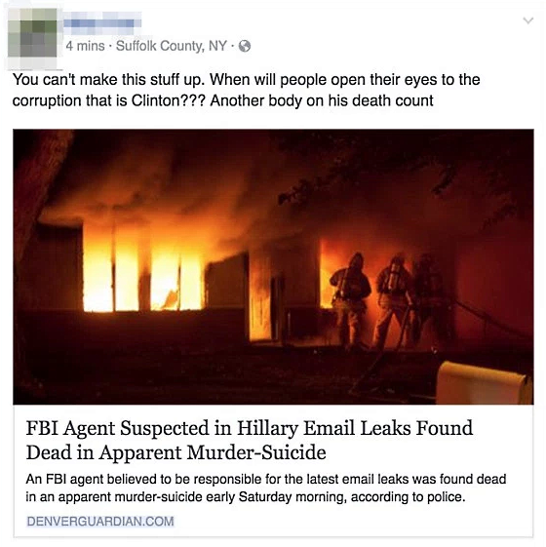
NPR outs the CEO of fake news purveyor, Jestin Coler.
Source
The search to identify Coler began with this tweet, which was shared on Facebook more than 500,000 times.
Coler’s Linkedin page
Notes:
Fake news blog posts:
http://cis471.blogspot.com/search/label/fake%20news

Slide 30
Here are a few things Coller said in the NPR interview:
He is CEO of Disinfomedia, which has a number of fake news sites.
At any given time he has round 20 - 25 contributors all over the country.
He is a registered Democrat.
He does fake news to show how easily it spreads, not for money.
His income is comparable to other operations reporting $10,000 to $30,000 a month.
There are hundreds of ad networks, so losing Google Ad Sense is not a problem.
Fake news for liberals never takes off – after a few debunking comments it fizzles out.
He abandoned dot-com-dot-co domains because copyright/trademark violation.
Now he is working on fake-local domain names like Denverguardian.com.
He has no regrets and doesn't think fake news swayed the election.
He tries to hide his identity because he has received a number of death threats.
Listen to or read the interview here.
Notes:
Fake news blog posts:
http://cis471.blogspot.com/search/label/fake%20news

Slide 31
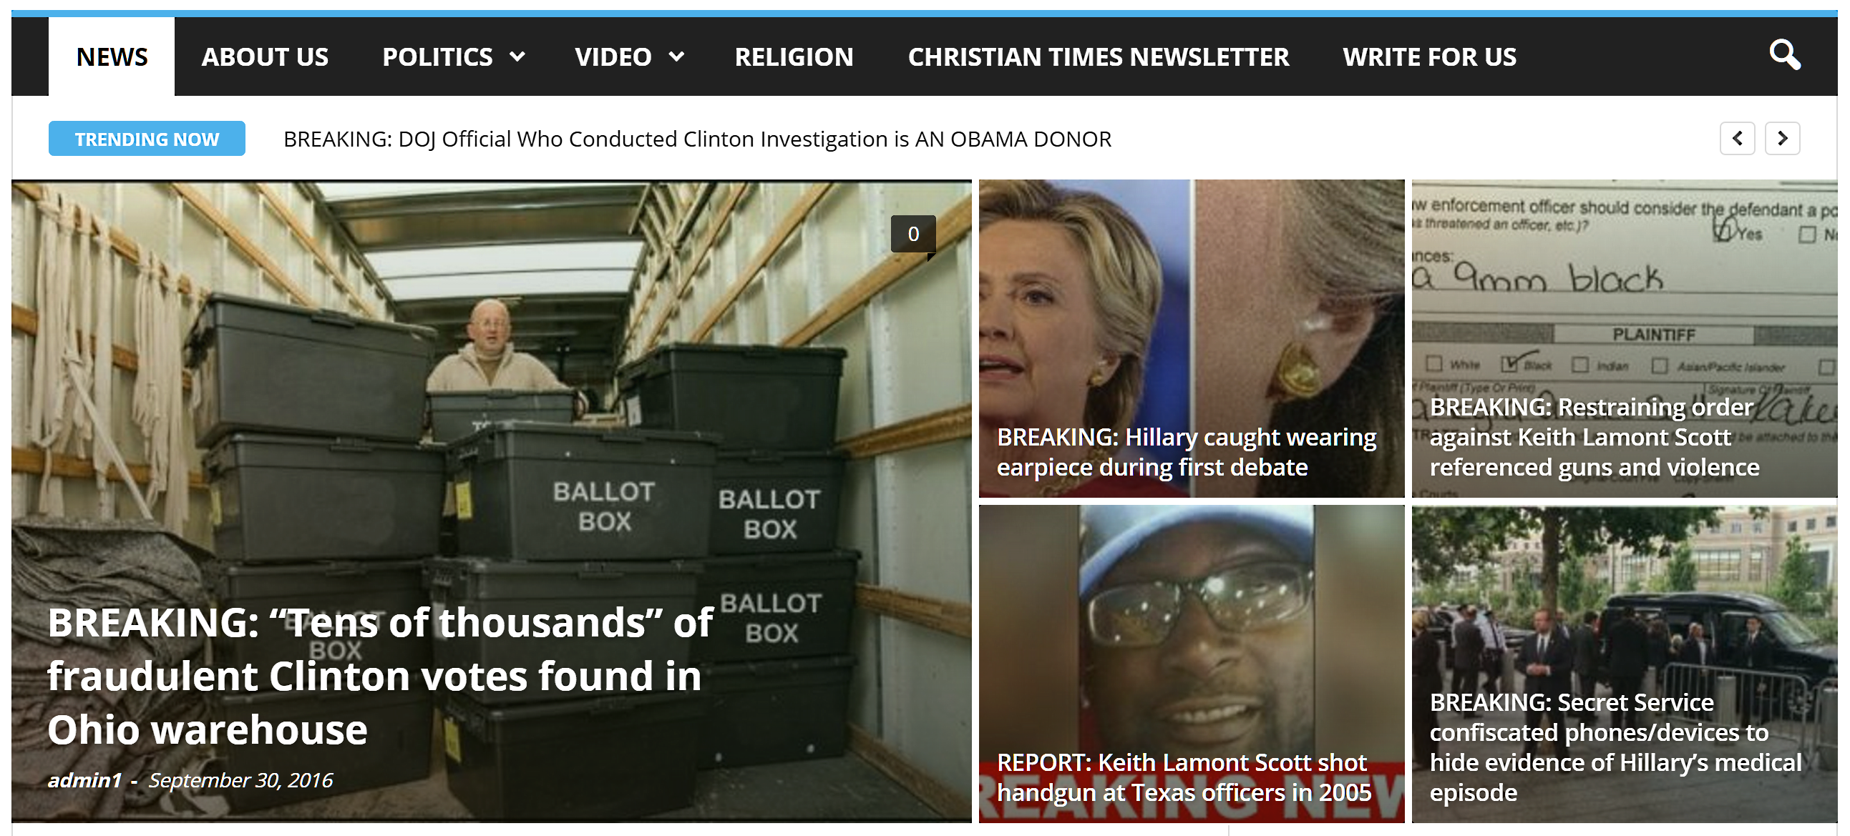
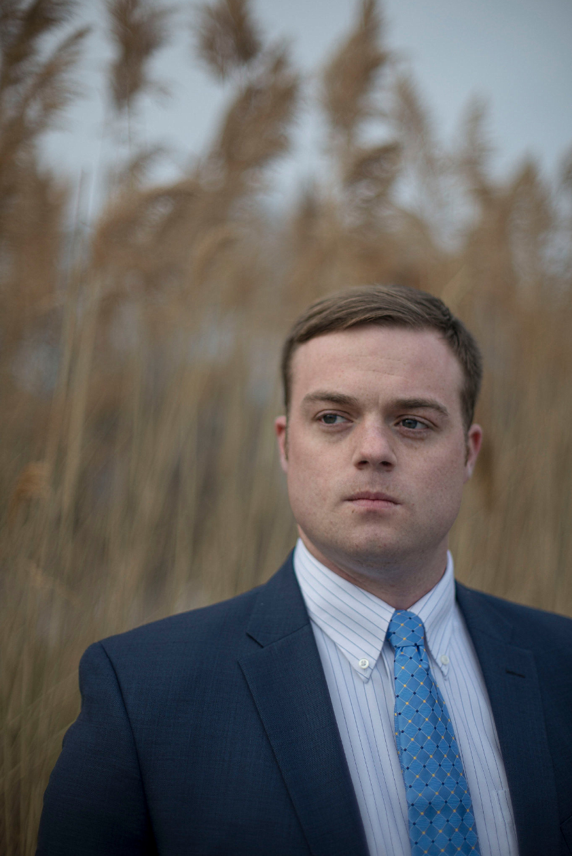
The rise and disappearance of the ChristianTimes
CTN no longer exists
Site archived on 10/3/2016
Earned $22,000 for about 20 hours work
“Fraudulent votes” post viewed 6 million times
Used 6 Facebook accounts to hype stories
Collected 24,000 email addresses
Harris fired from his job
Cameron Harris,
creator of
ChristianTimes
NY Times reporting on ChristianTimes
Notes:
The photograph showing ballot boxes with fraudulent Clinton votes was found to be a fake and the Christian Times subsequently disappeared, but the photo and post was preserved by the Internet Archive. The fraudulent post was viewed 6 million times and the creator of the site collected 24,000 email addresses.

Slide 32
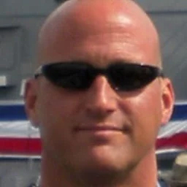
Local “entrepreneurs”
These creeps are faking news in Long Beach and, they say, making $10-40,000 a month. Six months ago they were unemployed restaurant workers. (source)
Their Web site
Tip from

Slide 33
Fake images

Slide 34
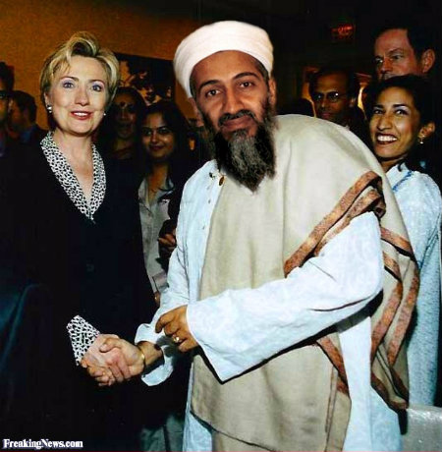
What does this photograph show?

Slide 35
What does this photograph show?
Freakingnews.com
False: Snopes.com

Slide 36
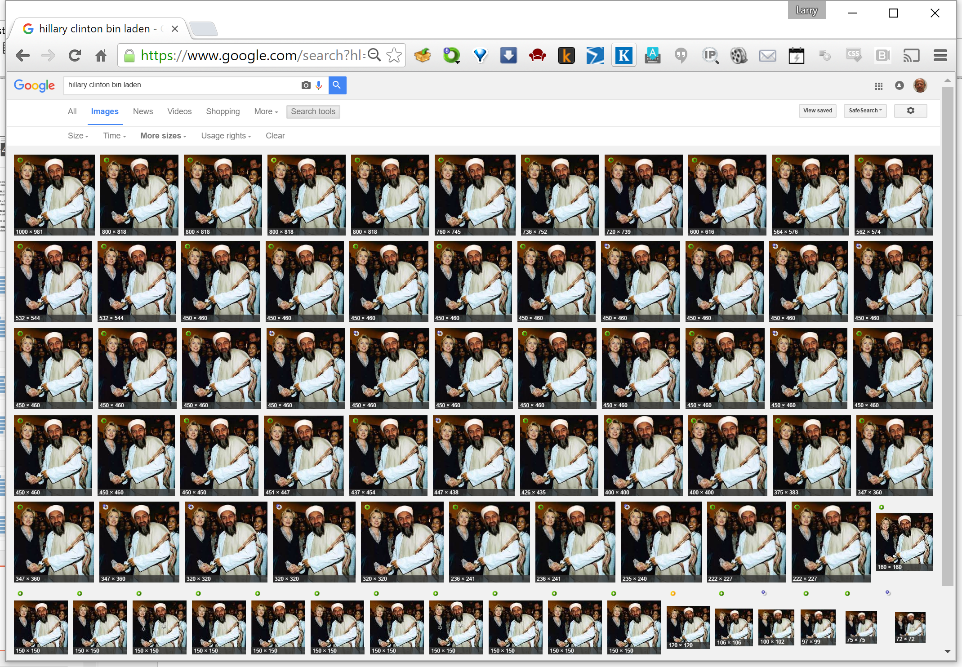
Rapid dissemination on social media
Does truth matter?
Google image search

Slide 37
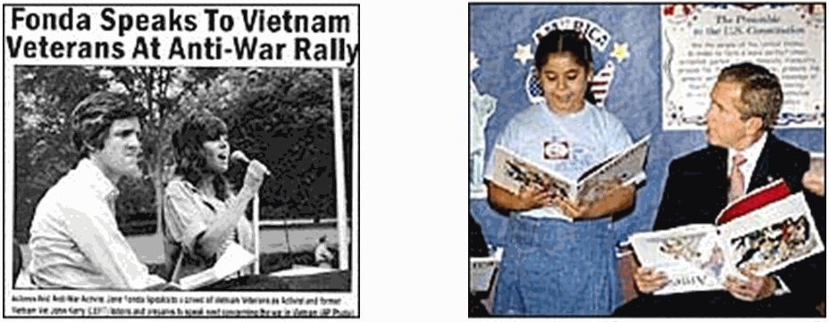
Kerry vs Bush, 2004
Do you think political candidates touch up their pictures in ads?
Notes:
Fake images, spread on social media, were used prior to the last election.
These fake photographs were widely circulated during the 2004 election between George Bush and John Kerry.
One shows Jane Fonda and presidential candidate John Kerry at an anti-war rally together.
It was a fake, made by combining separate photos of each of them.
The other shows President Bush, who appears to be holding his book upside down, but that too is a fake.

Slide 38
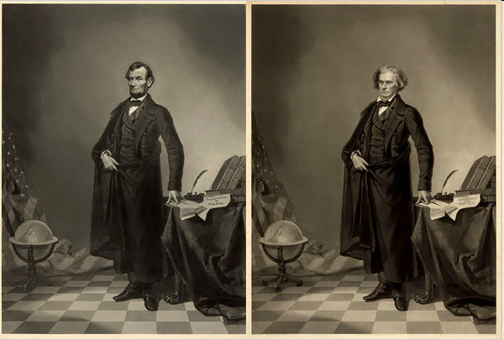
Abraham Lincoln’s head on John Calhoun’s body
Notes:
Here we see “Honest Abe” Lincolns head on John Calhoun’s body.
People made fake photographs before computers were invented, but everyone can do it today.

Slide 39
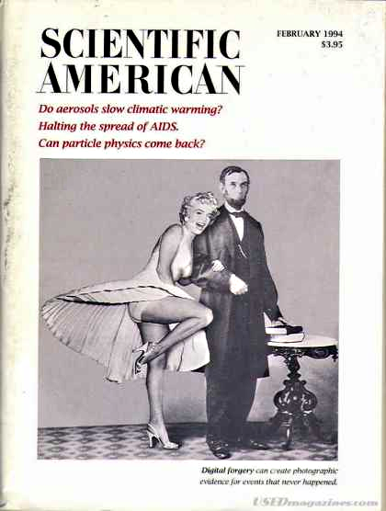
Abraham and Marilyn

Slide 40
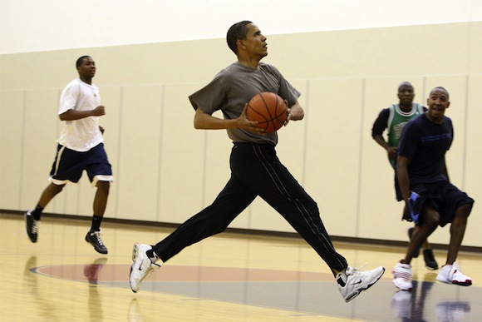
Selected photos
Notes:
When photographers follow you constantly, they will get some flattering photos.

Slide 41
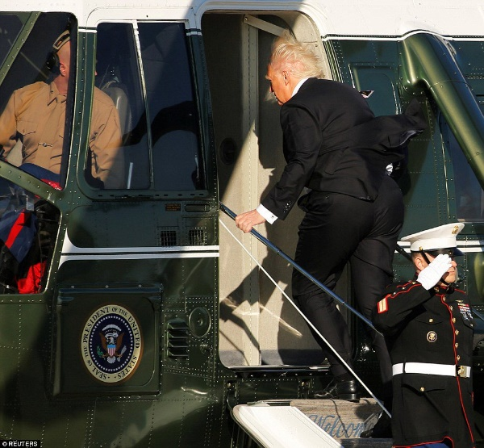
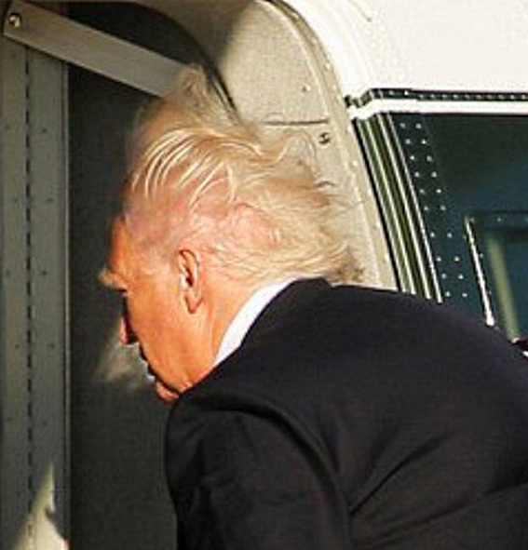
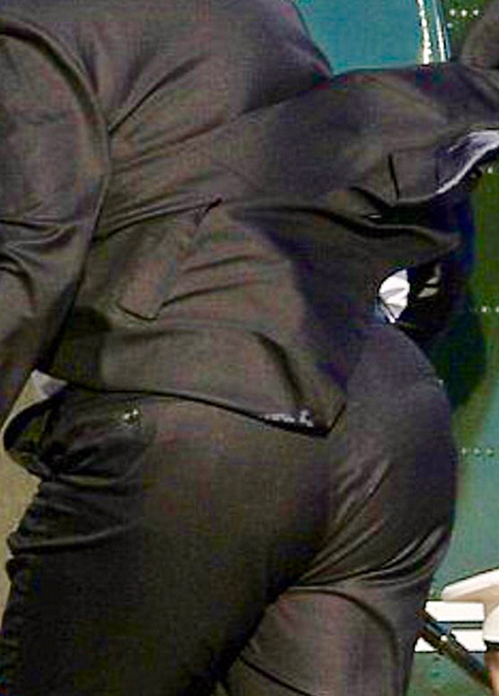
Selected photos
Notes:
When photographers follow you constantly, they will get some unflattering photos. This photo of Trump boarding a helicopter was widely circulated and repurposed.

Slide 42
Trump dominated social media

Slide 43
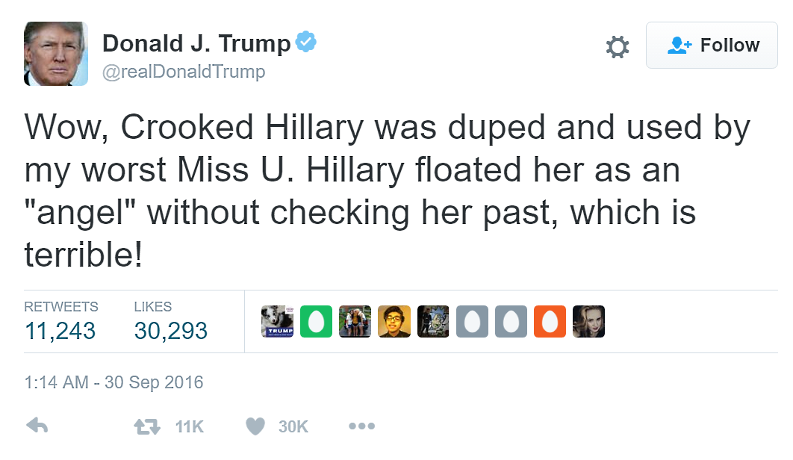
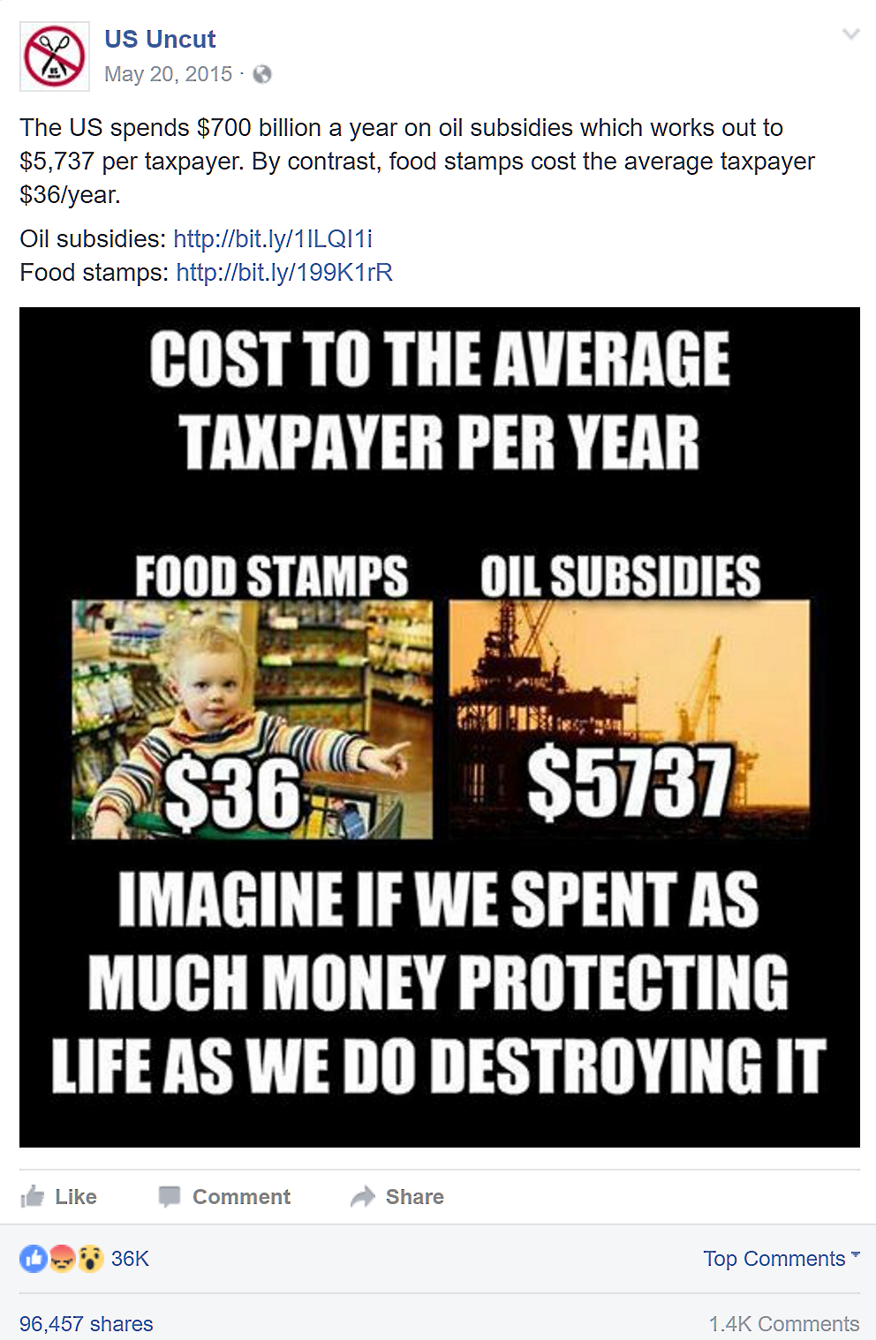
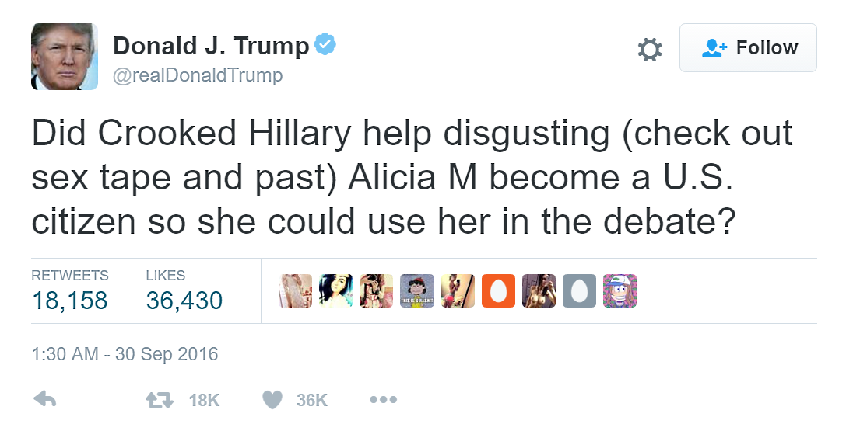
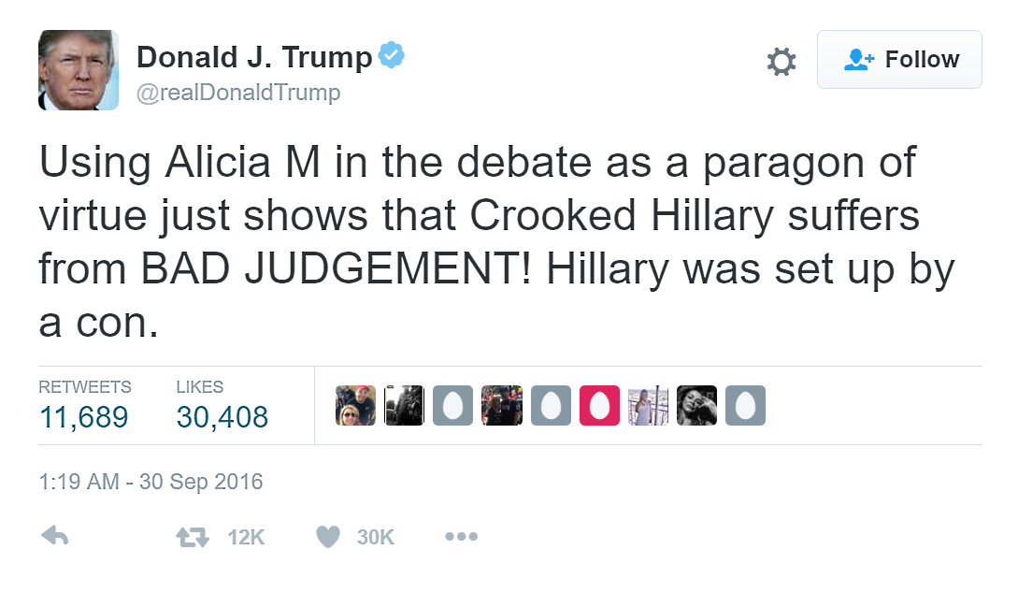
Sanders & Trump used social media better than Clinton
Source
Source
Source
Source
Notes:
In these examples, Trump used a burst of tweets, resulting in over 40,000 retweets, many of which were doubtless re-tweeted.
Sanders posted an image with a slogan and two asserted facts. The facts included links to sources -- I wonder how many readers followed the links. I wonder how many of those read and fact-checked them.
Let’s look more closely at Facebook, the social network platform most used in the US.

Slide 44
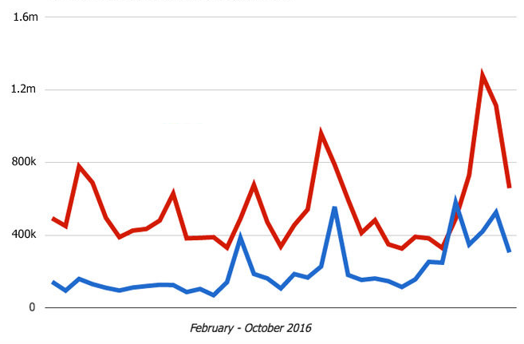
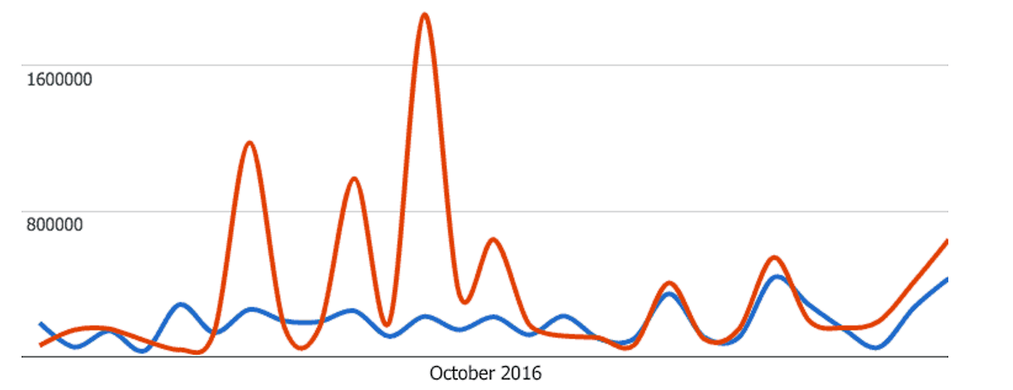
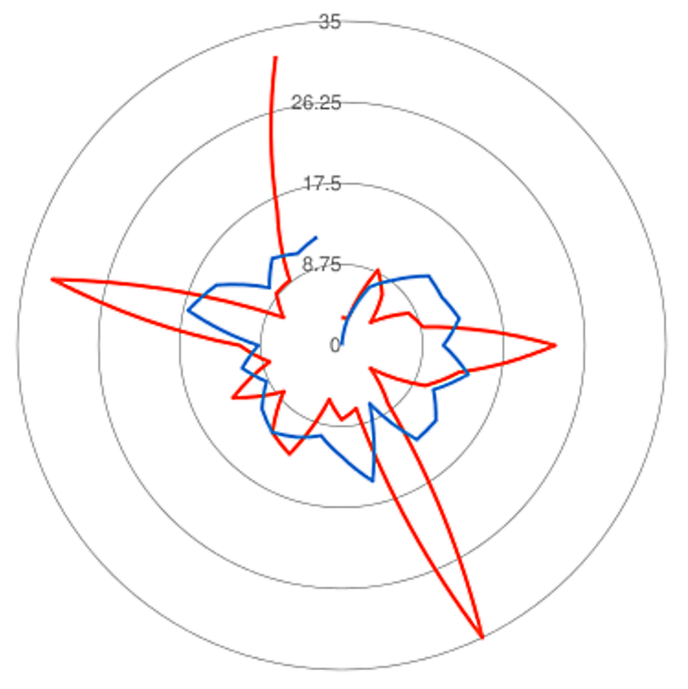
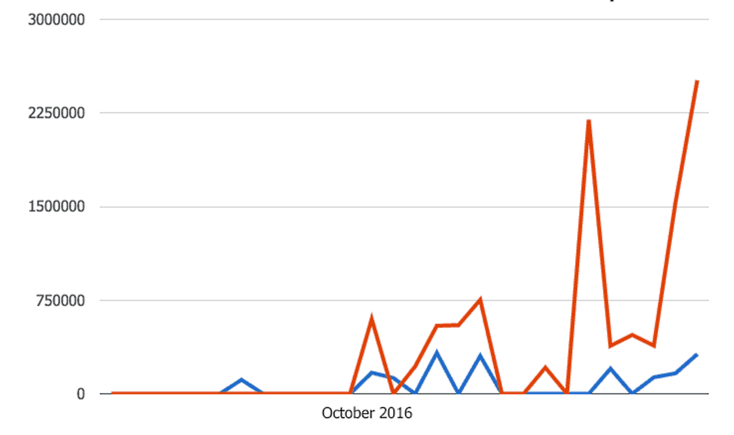
Trump dominated Clinton on Facebook
A: Total weekly engagement
B: Video engagement
Source: Ezyinsights
C: Live video engagement
D: Number of posts, October
Notes:
Graph A shows weekly engagement (likes, reactions, comments and shares) with posts by Clinton and Trump.
B and C show recorded and live video engagement. Note that live video became available in October and Trump moved quickly to use it.
D shows that they posted about the same number of times during October, but Trump’s posts jumped on four specific days.

Slide 45
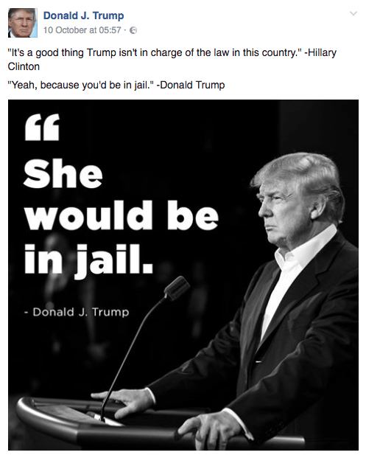
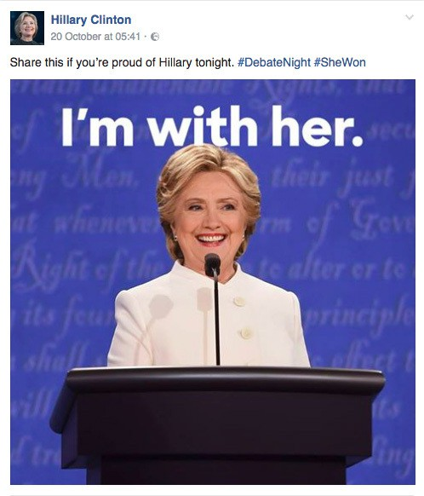
Candidate’s most popular Facebook posts during October
Source: Ezyinsights
Notes:
Slogans and emotional images, not fact-checking, analysis, debate and policy papers, dominated the campaign.
Part of the explanation for that is that we read quickly and superficially on (and off) line.
This sort of post – an image with a slogan – was important in the 2016 election, but by 2020, video clips and live video will dominate.
It will be interesting to see what forms that takes and who best learns to use the medium.

Slide 46
Filter bubble

Slide 47
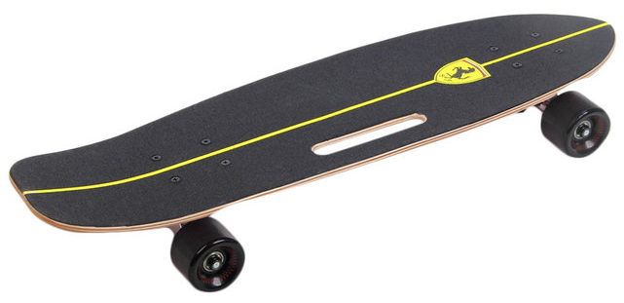
I never see ads for or stories about skateboards.
Why?
Notes:
Advertising services know that I am not interested in skateboarding.

Slide 48
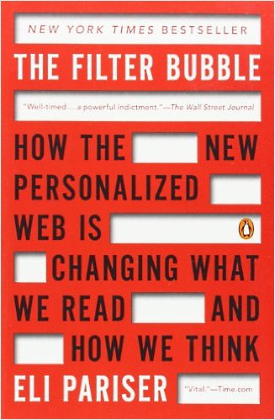
We see ads and other content that reinforce our beliefs.
The Filter Bubble
Notes:
We are increasingly shown news, ads and other content that will appeal to us, creating what Eli Parser has called a “filter bubble.” The goal of Facebook and others is to keep you on their Web sites so you will see more ads. To do that, they tend to show you material with which you agree.
My guess is that one could post a made-up slide showing “Crooked Hillary” to be a liar on a pro-Trump Web site and many people would take it for a “fact.” that supported their opinion.

Slide 49
Pew survey: adult use of social media for news
Source

Slide 50
Facebook dominates social media news
65% of Facebook users are white, non-Hispanic and 57% are women.
66% of Facebook users get news there.
47% of users got news from Facebook in 2013.
44% of adults get news on Facebook.
64% of adults get news on only one site, 26% from two sites and 10% from 3 or more.
Source
How many news sources do you use regularly?
Notes:
Correlation does not imply causality, but political polls underestimated Trumps appeal to women and white, non-Hispanics favored Trump.

Slide 51
Cambridge Analytica micro-targeted ads
Demographics: age, education, sex, …
Psychographics: interests, opinions, values, …
Five personality traits: openness to experience, conscientiousness, extraversion, agreeableness, and neuroticism
Send the strong terrorism ad to a 64 year old, gun-owning medium-neurotic.
Claiming credit for Cruz Iowa gain, Source
How do they gather the information?
https://motherboard.vice.com/en_us/article/how-our-likes-helped-trump-win
Notes:
Cambridge Analytica targets ads using demographics, psychographics and personality traits. They say personality traits differentiate them from other Internet ad services.

Slide 52
“We have profiled the personality of every adult in the United States of America—220 million people.”
Source
“We are thrilled that our revolutionary approach to data-driven communications played such an integral part in President-elect Donald Trump’s extraordinary win.”
Source
Nix speech (11 min)
Do we want technique and data to determine our political leaders? Would Cambridge Analytica work for a Democrat?
Notes:
Cambridge Analytica CEO Alexamder Nix took credit for Ted Cruz’s surge in Iowa and explained their technology and data in this video.
The day after the election, he said they were “thrilled that their revolutionary approach to data-driven communication has played such an integral part in President-elect Trump's extraordinary win.”
While he claimed to have had a large role in the election, many disputed that claim: https://www.nytimes.com/2017/03/06/us/politics/cambridge-analytica.html?_r=1
I reached out to Cambridge Analytica, asking whether they would had or would accept a Democratic candidate, but did not receive a reply.

Slide 53
Do you live in a filter bubble?
Where do you get political news?
Do you ever look at “alt-right” sources? Fox News? Rush Limbaugh?

Slide 54
My filter bubble
NY Times
The Guardian
Washington Post
Atlantic Monthly
The Economist
New Yorker
Red: print
Black: online
About Crooked Media
I subscribe as a political contribution.
Notes:
I list subscriptions on the left.
I also listen to Crooked Media podcasts.

Slide 55
More historical context – disillusion

Slide 56
Citizen journalism
We were naively optimistic about the power of the Internet.
Discussion
Notes:
In the early Internet days – before the invention of the World Wide Web – we were optimistic that the Internet would enable democracy and improve health, education and the world economy.
We were naïve, not realizing that, like any tool, it could be used for good or evil.

Slide 57
The “Arab Spring”

Slide 58
Pre Internet citizen journalism, March 1991
Video
Do you recognize this event?
Notes:
Rodney King was stopped by police and beaten.
The beating was video taped by a man standing on the balcony of his nearby apartment.
The video was widely televised and several of the police officers were tried.
The acquittal of four officers triggered rioting in which 53 people were killed and over two thousand people were injured.

Slide 59
Internet citizen journalism, August 1991
Protests in Moscow
Kremvax
They try to close all mass media, they stopped CNN an hour ago, and Soviet TV transmits opera and old movies. But, thank Heaven, they don't consider RELCOM mass media or they simply forgot about it. Now we transmit information enough to put us in prison for the rest of our life.
Polina Antonova
Discussion
Video clip, 3m 13s, (highlight at 1m 40 s :-)
Notes:
Perhaps the first example of networked citizen journalism was during the August 1991 coup attempt in which eight high level Soviet officials tried to take control of the country from Soviet president Mikhail Gorbachev.
The coup attempt was met by civil resistance and contributed to the dissolution of the Soviet Union.
There were two days of confrontation between demonstrators and troops, during which all Russian media except Usenet news were shut down by the authorities.
Russia’s Usenet network was run by Relcom, a small unix consulting company in Moscow.
Relcom’s “Kremvax,” the central computer in the network, exchanged Usenet posts with computers in 70 Russian cities and with one in Helsinki several times each day.
Relcom staff actively reported news as well as transmitting it.
The quote on this slide is from Polina Antonova, a Relcom staff member who was also reporting news.
I had coincidentally organized a conference in Moscow the week before the coup attempt, and had met and gotten to know the Relcom staff at that time.
As such, I was able to serve as a conduit to-and-from them during the coup attempt.

Slide 60
Cuba and other dictatorships saw the Internet as a potential threat
But Cuba and other governments have used
the Internet for
Censorship
Surveillance
Terrorism
Propaganda
Hacking infrastructure
Seeking regime change
Source
Notes:
Dictatorships like that in Cuba, debated the pros and cons of the Internet.
These quotes are from talks at the Fifth Plenum of the Central Committee of the Cuban Communist Party, a year after Cuba's first connection to the Internet. Lage saw the promise of the Net, Castro the threat. Castro was unwilling to risk political instability in order to achieve the benefits of the Internet, and he prevailed, opting for a small Internet effort with tight control over content and access. (He cited Khrushchev's "glasnost" (openness and transparency) policy as a cause of the demise of the Soviet Union and noted the role the Relcom network had played during the Soviet coup attempt of 1991).
Also compare Castro’s attitude to that of the technicians who connected Cuba to the Internet: http://laredcubana.blogspot.com/2011/02/cubas-first-internet-connection.html
Castro was frightened by the fall of the Soviet Union and the role early network played in stopping the subsequent coup attempt:
http://cis471.blogspot.com/2011/01/before-twitter-revolutions-there-was.html

Slide 61
Chinese Government Censors History
Source

Slide 62
Ten years in prison
Source
Shi Tao
Wang Xiaoning
Watching individuals and demonstration plans
Notes:
Shi Tao and Wang Xiaoning were identified by Yahoo and sentenced to ten year prison terms for divulging state secrets in China. In addition to watching individuals, the authorities learn of plans for demonstations and other gatherngs and collective action.

Slide 63
Terrorist use the Internet to plan and recruit
Source
Video

Slide 64
Propaganda
Cuba’s Operation Truth
Chinese "Trolls"
Notes:
Cuban and Chinese government employees are paid to post favorable content and challenge unfavorable content – a practice often referred to as “trolling.”

Slide 65
Hacking infrastructure
Stuxnet: the US and Israel teamed up to destroy Iranian uranium-enrichment centrifuges.
Stuxnet
Notes:
The US and Israel teamed up to destroy Iranian uranium-enrichment centrifuges:
https://www.washingtonpost.com/world/national-security/stuxnet-was-work-of-us-and-israeli-experts-officials-say/2012/06/01/gJQAlnEy6U_story.html

Slide 66
Regime change: The equipment Alan Gross brought into Cuba
Source
More on Alan Gross
Notes:
Alan Gross, a subcontractor to the United States Information Agency, spent five years in prison in Cuba after he was arrested for bringing low-capacity satellite Internet equipment into the country.

Slide 67
Who can you trust?
Cuban trolls
Chinese trolls
Russian trolls
More on Russian trolls
Yet more on Russian trolls
Bot trolls
Should the US government pay trolls?
In 1961, Newton Minnow gave a talk to the National Association for Broadcasters in which he said television had become a “vast wasteland.” Will we lose all trust in the Internet?
Newton Minnow

Slide 68
Non-political consequences

Slide 69
Internet lies have real world consequences
Death threats
Profiles in cowardice
Violent acts
Source
Source
Source
Do Trump’s statements legitimize and encourage violence?
Notes:
Lucy Richards, 57, faces four counts of transmitting threats in interstate commerce. Ms. Richards sent four messages in January that said things such as: “You gonna die. Death is coming to you real soon,” according to an indictment made public on Wednesday.
Ms. Richards’s belief “that the school shooting was a hoax and never happened allegedly motivated her to make the charged threats,” the United States attorney’s office in Miami said in a statement.
Each charge carries a maximum five-year sentence upon conviction.
According to the indictment, the threats were sent to a parent identified only as “L.P.” The initials are an apparent reference to Lenny Pozner, whose son, Noah, was the youngest of 20 children murdered at Sandy Hook Elementary School four years ago.
-----
Excerpt from Scott Pelley’s interview of House Speaker Paul Ryan:
(http://www.cbsnews.com/news/60-minutes-paul-ryan-on-partnership-with-donald-trump/)
Scott Pelley: Trump tweeted, in the last week or so, that he had actually won the popular vote, if you deduct the millions who voted illegally. Do you believe that?
Paul Ryan: I don’t know. I’m not really focused on these things.
Scott Pelley: Wait a minute. Wait a minute. You have an opinion on whether millions of Americans voted illegally.
Paul Ryan: I have no way of backing that up. I have no knowledge of such things.
Scott Pelley: You don’t believe that—
Paul Ryan: But I don’t-- it doesn’t matter to me. He won the election.
But how, we asked, does he negotiate with a man whose word, or tweets, cannot always be believed?
Paul Ryan: Look, like I said, he’s going to-- the way I see the tweets you’re talking about, he’s basically giving voice to a lot of people who have felt that they were voiceless. He’s communicating with people in this country who’ve felt like they have not been listened to. He’s going to be an unconventional president. I really think we have a great opportunity in front of us to fix problems, produce results, and improve people’s lives. That’s why we’re here in the first place. And so that’s what’s going to matter at the end of the day. Did we improve people’s lives? Did we solve the problems that the American people need solved? Are we addressing the concerns of people who are tired of being tired? And who cares what he tweeted, you know, on some Thursday night, if we fix this country’s big problems? That’s just the way I look at this.
Fake news blog posts:
http://cis471.blogspot.com/search/label/fake%20news
Someone should send Speaker Ryan a copy of John F. Kennedy’s book Profiles in Courage.

Slide 70
Fake news
Playing with fire
Source
Real news
Source
Real news
Source
Notes:
As we saw with “Pizzagate” (above), fake stories can have serious real-world consequences.
Fake news leading to nuclear war would be ultimate (literally) instance of fake news leading to real-world consequenses/

Slide 71
“Get out of my country”
Adam W. Purinton, 51, shot two Indian men and a white man who came to their rescue.
Source
Source
Has the hate-crime rate gone up since the campaign began?

Slide 72
Hacking USA

Slide 73
In 1972, the police caught five men breaking into the Democratic National Committee headquarters. They had cameras and film for copying documents. This eventually led to the resignation of President Nixon.
It’s a lot easier in the Internet era.
Election 2016 hacks:
Clinton email
Democratic National Committee
Clinton staff email
Wall Street Journal accuses Russia
US Government accuses Russia
How they did it
Source

Slide 74
Russian hacking: USA
“The U.S. Intelligence Community (USIC) is confident that the Russian Government directed the recent compromises of e-mails from US persons and institutions, including from US political organizations.”
Joint Statement from the Department Of Homeland Security and Office of the Director of National Intelligence on Election Security
"I don't know if we know it was Russia who broke into the DNC," Trump said at the debate. "[Clinton is] saying Russia, Russia, Russia. Maybe it was. It could also be China, it could be someone sitting on their bed that weighs 400 pounds."
Source
Notes:
The US intelligence community is confident that Russia directed hacking of the Democratic National Headquarters.
Donald Trump dismisses their conclusion.

Slide 75
Russian hacking: USA
“FBI director James Comey has signed on to a previously reported CIA assessment that Russian President Vladimir Putin directly intervened in the US presidential election in aid of Donald Trump, according to an internal CIA memo obtained by the Associated Press and Washington Post. The report has also been endorsed by the Office of the Director of National Intelligence, giving it the unanimous support of US intelligence agencies.”
FBI and CIA now agree that Russia hacked to help Trump win
Notes:
The CIA concluded that Putin had directly interfered with the election in a manner favoring Trump.
FBI director James Comey, who sent a letter that damaged Hillary Clinton shortly before the election, agrees with the CIA assessment.

Slide 76
“Sen. John McCain said Russian election-related hacks threaten to "destroy democracy" and faulted the American response as "totally paralyzed."
Russian hacking: USA
McCain: Russian election-related hacks threaten to 'destroy democracy'
Four influential Democratic and GOP senators on Sunday amplified their call for a special investigation into foreign cyberwarfare, defying Majority Leader Mitch McConnell, who has already ruled out a select panel to probe Russian interference in the U.S. election.
Sens. Chuck Schumer (D-N.Y.), John McCain (R-Ariz.), Lindsey Graham (R-S.C.) and Jack Reed (D-R.I.) urged McConnell in a new letter to create a Senate select committee on cyber, a panel that Schumer said would focus not only on Russian meddling but also potential threats from other countries, including China and Iran.
McCain, Schumer double down on Russia probe
Notes:
Several Senators have called for select panel to investigate political hacking by Russia, China and Iran. The Republican leadership and Trump has ignored their pleas so far.

Slide 77
Russian hacking: Cyberforgery
“A Russian cyberforgery ring has created more than half a million fake internet users and 250,000 fake websites to trick advertisers into collectively paying as much as $5 million a day for video ads that are never watched.”
Russian Cyberforgers Steal Millions a Day With Fake Sites
I steal from the rich and give to the poor.
Robin Hood
I rob banks because that’s were the money is.
Willie Sutton

Slide 78
Not Russian hacking: Fake news
“Mr. Latsabidze and others here say they serve only their bank balances, not Russia or anything else.”
Inside a Fake News Sausage Factory: ‘This Is All About Income’
Notes:
This fake news operation is in Georgia, but is not being run for Russia.

Slide 79
The Internet is ephemeral

Slide 80
The Internet is fragile, with an unreliable political memory
83 percent of the PDFs on .gov and .mil sites were deleted between 2008 and 2012.
The headline of the press release for George Bush’s “mission accomplished” speech was first altered then deleted.
Source

Slide 81
Sample tweets by General Michael Flynn, Trump’s pick for national security advisor
Source
@genflynn
Source
Source
Would you accept and retweet these posts or be skeptical?

Slide 82
General Flynn deleted this embarrassing tweet.
Source
But, it had been saved by the Internet Archive.
CNN background story

Slide 83
The Internet Archive protects the political record
Focused political archives: audio and video material
Web site backup: over 279 billion Web pages saved
Source

Slide 84
Climate science data and research archive
The Internet Archive collaborates with other, more specialized archive projects.
They plan to archive Interactive services in the future.
Source
Notes:
Trump cabinet appointments have added urgency to this project.

Slide 85
Internet Archive preserves fake news site
christiantimesnewspaper.com no longer exists
Internet Archive saved a copy on October 3, 2016
Christian Times, 10/3
Debunk
Christian Times, 10/3
Debunk
Background on the Internet Archive

Slide 86
The deleted tweets
Badlands National Forest tweets deleted
Source

Slide 87
The Internet routes around censorship.
Source
Alternative account established by employees of the National Park Service.
Notes:
Civil Service employees of the government will resist Trump – doing what they think is right and establishing independent channels of communication.

Slide 88
Breitbart – “alt right” press

Slide 89
Fake story posted on Breitbart.com, January 2, 2016
Source

Slide 90
Engagement
source
There were 4,197 comments as of January 9, 2016.
The first comment, shown here, generated a threaded discussion with 838 entries.
Read some of the comments – how would you describe them?

Slide 91
Fake story written by Virginia Hale
Hale has written hundreds of Breitbart stories.
Hale has written three others since the church fire hoax.
Source
Do you think “Virginia Hale” is a pseudonym? A real person? A group of free lance writers?
Notes:
“Virginia Hale” is a prolific writer, yet has no Wikipedia entry.
I wonder whether “Virginia Hale” is a pseudonym for a group of writers – perhaps free lancers.
I would love to meet Virginia.

Slide 92
Google search for “Dortmund church mob” on January 8 2016
By January 8, the story had been debunked, but it still came up on the first page in a Google search.

Slide 93
Breitbart Executive Chair, Steve Bannon
Founding member of the board of Breitbart News
Executive chair of Breitbart News LLC
Former CEO of Trump’s presidential campaign
White House Chief Strategist designate
Do you think being a media executive qualifies one to be Chief White House Strategist?
By Don Irvine
Notes:
Ex media executive Bannon is a master of social media (as Leni Re was a master of cinema) and Gerbels was a master of propaganda
Paul Joseph Goebbels was a German politician and Reich Minister of Propaganda of Nazi Germany from 1933 to 1945

Slide 94
Money behind the scenes

Slide 95
Who is running the show?
Robert Mercer-- $10 million to Breitbart News and $10 million to Cambridge Analytica
Rebekah Mercer -- quietly shaping Trump’s operation along with her father
Background and connections
Rebekah and Robert Mercer
Bannon and Conway were advisors to the Mercers.
Bannon ran Breitbart News.
Bannon and Conway are high-ranking Trump staff members.
Is Trump an easily maneuverable pawn?
Steve Bannon and Kellyanne Conway
Notes:
Podcast on Mercer:
http://www.newyorker.com/magazine/2017/03/27/the-reclusive-hedge-fund-tycoon-behind-the-trump-presidency?mbid=nl_TNY%20Template%20-%20With%20Photo%20(147)&CNDID=38756252&spMailingID=10643193&spUserID=MTMzMTg0NTA3NzYwS0&spJobID=1121383986&spReportId=MTEyMTM4Mzk4NgS2

Slide 96
Who is running the show?
Do you know who these men are?

Slide 97
Who is running the show?
Who is running the show?
The Koch brothers
Wealthy supporters of libertarian, “tea party” policies
Support of congressional gerrymandering
Notes:
Survey of the Koch brothers political activity:
http://www.newyorker.com/magazine/2010/08/30/covert-operations
A recent move by the Koch brothers was to offer financial support to Republican congressmen and women who voted against the recent health care law because it did not fully abolish Obama care:
http://www.politico.com/story/2017/03/koch-brothers-obamacare-house-republicans-236389
A more important, long term effort was their support of congressional gerrymandering:
http://www.huffingtonpost.com/entry/our-country-must-be-saved-from-gerrymandering_us_58cec0d2e4b07112b6472eed

Slide 98
Gerrymandering
All about gerrymandering
Gerrymandering 1788 – 2017

Slide 99
Gerrymandering works
Source
State legislative seats by party

Slide 100
Jon Ossoff: congressional candidate in a gerrymandered district
Source
Trump tweets and Politifact checks
Source
Notes:
Democrat Jon Ossoff is running for a vacated in a gerrymandered district.
Both sides of the campaign have received large political contributions from in and out of state.
Politicians like Donald Trump have publically supported the Republican candidates running against Ossoff.
(Ossoff did not get 50% of the votes, so there will be a runoff against the top Republican).

Slide 101
Georgia State Senator Fran Millar admits to gerrymandering for political advantage in the campaign against Ossoff.
Source

Slide 102
≈
The Koch brothers live in Texas and interfere with elections in other states. Putin lives in Russia and interferes with elections in other nations. Are they legally and morally similar?

Slide 103
Modern gerrymandering
Internet data + mapping software
Maptitude
Should elections be influenced by technical skill and data on voters?
Notes:
The Internet has increased the power of gerrymandering – providing voting and demographic data to be analyzed by mapping software like Mapitude.

Slide 104
The Democrat’s new gerrymandering organization, the NDRC, is not the answer. Can we separate politics from money?
Is Larry Lessig’s proposed Citizen Equality Act the answer?
Source
Notes:
The Democrats have formed their own gerrymandering organization, the National Democratic Redistricting Committee, headed by Eric Holder and supported by President Obama, but do we want elections to be influenced by gerrymandering?
Larry Lessig ran for president in 2016 on a single issue – citizen equality. His proposed Citizen Equality Act would promote equal right to vote, equal representation and citizen-funded elections. Would that save democracy?

Slide 105
Europe

Slide 106
Russian hacking: Germany
“The German election is at risk from ‘outside manipulation’, said Wolfgang Bosbach, a senior MP in Chancellor Angela Merkel's conservative CDU party.”
“Russia was blamed for a cyberattack on the German parliament last year.”
Russian hackers 'threaten Germany 2017 election', MPs warn
“After hackers infiltrated the German Parliament’s computer network in May 2015, it took nearly a year before the country’s intelligence agency concluded that the attack was most likely the work of their Russian counterparts.”
After a Cyberattack, Germany Fears Election Disruption
Notes:
Russian political hacking in Germany dates back at least to 2015 and observing the US election, raises questions about German elections in 2017.

Slide 107
Russian fake news: Italy
“The constellation of Five Star Movement sites recently lit up with a video that appeared on Russia Today, purporting to show thousands of people protesting against the referendum. In fact, the people had gathered in support of Mr. Renzi and his reform.”
“He recently posted on the Five Star Movement blog that NATO was secretly preparing a “final assault” on Russia.”
Spread of Fake News Provokes Anxiety in Italy
Notes:
Russian fake news supported the Five Star party in Italian elections.

Slide 108
Russian fake news: France
Two days before France’s recent presidential election, hackers leaked nine gigabytes of emails from candidate Emmanuel Macron’s campaign onto the web.
“Look, we’re watching the Russians, we’re seeing them penetrate some of your infrastructure.”
NSA Director Mike Rogers
Source
Notes:
Russian fake news supported the Five Star party in Italian elections.

Slide 109
Don’t Pin the Macron Email Hack on Russia Just Yet
Source
“It isn’t difficult to compile a list of countries whose interests would be served by stoking tensions between Russia and the West.”
Source
Notes:
The French hack was obvious and released too late to influence the election. May it have been a “false flag” attack by a third nation or even an organization like ISIS to create tension between the Russia and NATO nations?

Slide 110
European social media influence
Germany’s Angela Merkel Declares War On Fake News
Source
Brexit campaign would have failed before advent of social media, say remain voters in new poll
Source
Spread of Fake News Provokes Anxiety in Italy
Source
Italy’s most popular political party is leading Europe in fake news and Kremlin propaganda
Source
Notes:
The slogan on the Brexit campaign bus turned out to be a lie: http://www.newstatesman.com/politics/uk/2016/06/how-brexit-campaign-lied-us-and-got-away-it
Fake news blog posts:
http://cis471.blogspot.com/search/label/fake%20news

Slide 111
Brexit, Trump campaign links
Both used the same technology
Mercer backed both with hidden contributions

Slide 112
What do these folks have in common?

Slide 113
(Imperfect) fixes

Slide 114
Fact checking organizations, Duke University and The Poynter Institute
Global fact-checking organizations, Poynter Institute
Interactive map of fact-checking organizations
Duke University fact-check database
International fact-checking network
Duke University fact-checking news
Notes:
Fake news blog posts:
http://cis471.blogspot.com/search/label/fake%20news

Slide 115
Facebook will work with the Poynter Institute to identify fake news.
Source
Could they develop a fact-check API to partially automate the collaboration?
Notes:
Poynter had been critical of Facebook in the past:
http://www.poynter.org/2016/the-real-problem-or-problems-with-facebooks-trending-topics/411498/
Fake news blog posts:
http://cis471.blogspot.com/search/label/fake%20news

Slide 116
The Panama Papers
Q: How do you analyze 2.6 terabytes 11.5 with million documents?
A: Organize an Internet-based collaboration by 400 journalists from some 100 news outlets from nearly 80 countries.
The Panama Papers
Excellent 15 minute podcast with transcript

Slide 117
Panama Papers on Secretary of State nominee Rex Tillerson
Has ties to Russia and 67 offshore companies
Holds an estimated $228 million in Exxon stock, creating conflicts of interest on climate change and sanctions against Russia
Source
Notes:
“How Running ExxonMobil Did (And Didn't) Prepare Rex Tillerson For Secretary Of State,” is an excellent, balanced interview of New Yorker writer Ted Coll by Terry Gross. The audio and a transcription are at: http://www.npr.org/2016/12/20/506286977/how-running-exxonmobil-did-and-didnt-prepare-rex-tillerson-for-secretary-of-stat

Slide 118
Personally I think the idea that fake news on Facebook, which is a very small amount of the content, influenced the election in any way — I think is a pretty crazy idea. Voters make decisions based on their lived experience.
Source
Notes:
Initially, CEO Mark Zuckerberg dismissed the suggestion that Facebook may have influenced the 2016 election.

Slide 119
Flag posts that are disputed by fact-checkers affiliated with the Poynter Institute
Notes:
Poynter Institute: http://www.poynter.org/

Slide 120
Let users report fake news
Source
Notes:
Subsequently, under pressure from Facebook employees and the press and public, Facebook began testing features to identify and mitigate the effect of fake news.

Slide 121
Warn users if they are about to share a flagged post

Slide 122
Facebook to change “trending topics”
Publisher headline below each topic name
Multiple publishers need to write about a listed topic
No more personalized lists – everybody in the same country will see the same list
Source
The goal is to fight fake news and reduce filter bubbles.

Slide 123
Future fake media

Slide 124
The near future of fake audio
Video
More Adobe sneak peaks
Notes:
The words are changed and the voice sound natural and like the speaker.

Slide 125
The near future of fake video
Putin at 1:47
Trump at 3:13
Obama at: 4:17
Source and details

Slide 126
Image processing from research prototype to ubiquitous product
…
Research prototype
Expensive, limited market
Mass market product
Ubiquitous
product
Can you identify any of these computers?
Is the speed of technology evolution increasing?
Technology progress
Notes:
If those demos look unrealistic, think about how quickly technology improves.
This is a recap of improvements in image processing.
Sketchpad foreshadowed much of today’s image processing and user interfaces.
This is typical of technological development – researchers build prototype systems using very expensive equipment.
With time, technology improves and the prototypes are refined and become products.
They are often expensive and for specialized markets at first, but with time and further technological improvement and product evolution, they eventually become part of the mainstream.
Sketchpad is the grandfather of the image processing hardware and software built into today’s tablets and phones.
The Xerox Alto was developed at the Xerox Palo Alto Research Center at a cost of around $100,000 each. Xerox tried to sell products based on it’s design, but they were too expensive and failed in the market place.
The 1984 Apple Macintosh was the first successful image processing computer.
Today, we all have powerful image processing computers in our pockets and brief cases.

Slide 127
But -- the class met on Tuesday and Thursday. The following slides were presented based on feedback from students during and after the first day.

Slide 128
Filter bubble update from a student
Filter bubble – you can avoid it by having diverse friends.
Trump is not a joke affecting people in this room

Slide 129
CIS 275, Internet literacy
The applications, implications and technology of the Internet.
The concepts and skills one needs for success in school and after graduation as a professional and citizen
Course overview
A couple students asked about the class in which I originally covered this topic. Here is a link to a course description and the course “tag lines.”

Slide 130
Worldpoliticus.com front page 4 PM, November 7, 2016
BuzzFeed News identified over 100 active US politics websites being run from Veles, Macedonia.
Why are nearly all of these sites aggressively pro-Trump?
Notes:
Like the US media, they get more ad revenue from Trump stories than from Clinton stories.
These sites, and others like them, are not ideological – they feature Trump because Trump supporters are more engaged than Clinton supporters so Trump fakes generate more ad revenue.

Slide 131
My filter bubble
NY Times
The Guardian
Washington Post
Atlantic Monthly
The Economist
New Yorker
Red: print
Black: online
About Crooked Media
I subscribe as a political contribution.
Did you check it out? Consider becoming politically active.
Notes:
I list subscriptions on the left.
I also listen to Crooked Media podcasts.

Slide 132
An assignment idea – fact check a conflicted story
The totally phony Susan Rice story, explained
The former national security advisor’s surveillance activity is neither illegal or unethical.
Source
Rush Limbaugh Reveals The Truth Behind Obama’s Surveillance
Source

Slide 133
1. Why do you sit spread out rather than more together and near the front?
2. If you didn’t talk to your neighbor when I asked you to, was it because:
You are shy.
You do not want to seem dumb.
You were not paying attention and did not know what I had asked.
You are too cool.
You really don’t care about this stuff.
You talked, but about something else.
Other ___.
3. Can you think of ways to foster interaction in a large room?
lpress@csudh.edu

