Slide 1
The Internet in Cuba – bad news; good news
Larry Press
lpress@csudh.edu
Blog on the Cuban Internet: http://laredcubana.blogspot.com/
These slides have mnemonic images and few words, but they include comments and links to supporting material. The presentation may be downloaded at:
http://som.csudh.edu/fac/lpress/presentations/statedepartmentpanel.pptx
This work is licensed under a Creative Commons Attribution-Noncommercial-Share Alike 3.0 License.

Slide 2
The Cuban Internet in context, 2016
UNDP Human Development Index
LA&C
Freedom House Internet Freedom rank
65 countries
ITU ICT Development Index (IDI)
175 countries.
Chile
Argentina
Barbados
Uruguay
Bahamas
Panama
Antiqua and Barbuda
Trinidad and Tobago
Costa Rica
Cuba
Cuba
Uzbekistan
Ethiopia
Iran
Syria
China
Cuban Rank
IDI: 135
Access: 167
Use: 150
Skills: 57
Source
Source
Source
Discussion from 2014 reports
Notes:
The United Nations Development Programme HDI is a function of income, health and education.
The Freedom House index is a function of obstacles to Internet access, limits on content and violations of user rights.
The International Telecommunication Union IDI is a function of user access, use and skills and those are each a function of several indicators the ITU tracks.
Cuba was ranked second to Chile in Latin America and the Caribbean in 2011. They have fallen somewhat, but are still highly ranked by regional standards.
Cuba’s relatively high rank on education has resulted in relatively high ICT skills.

Slide 3
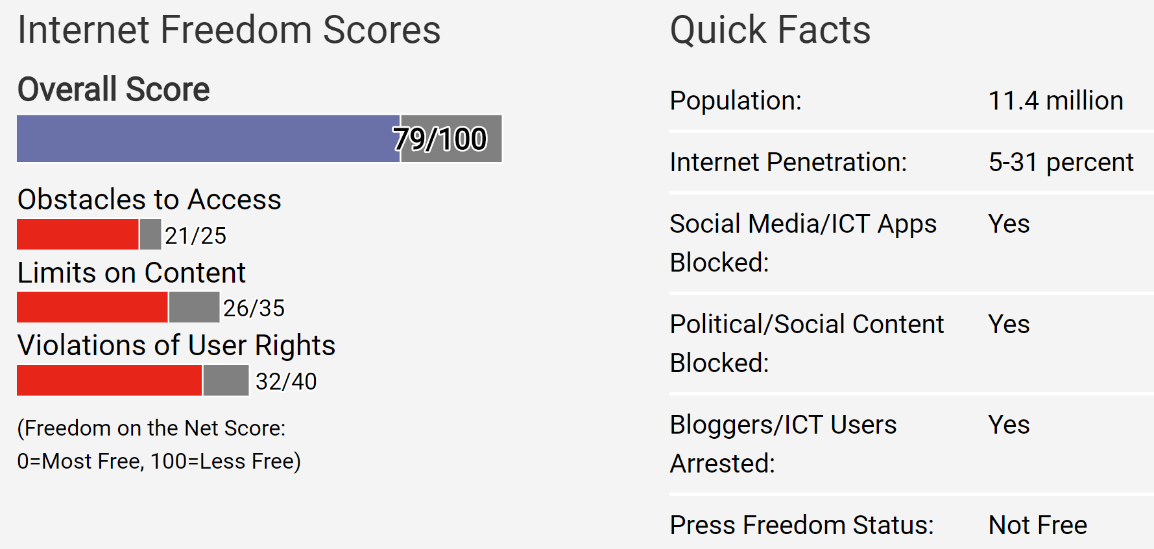
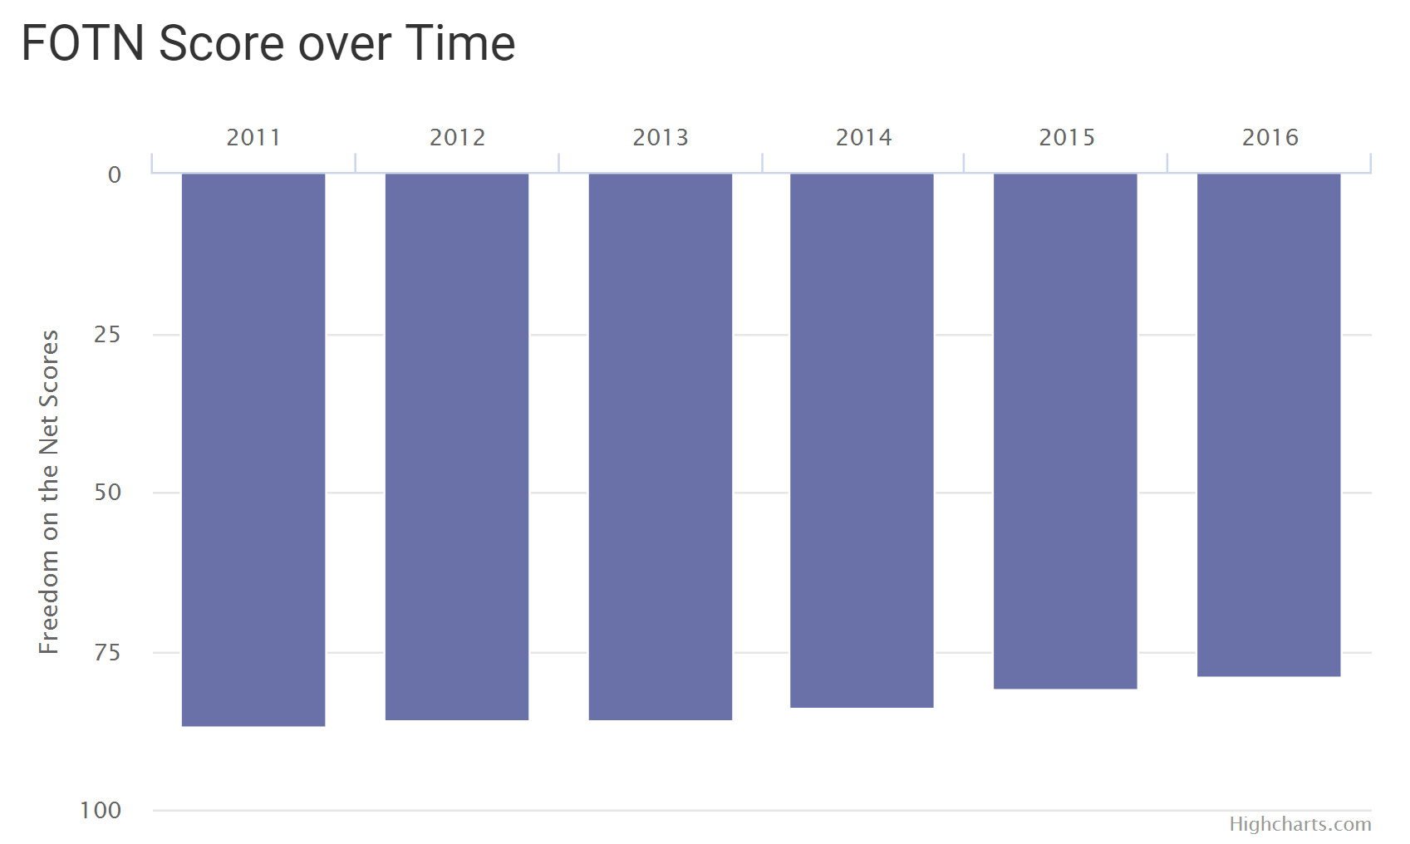
Freedom House country report for Cuba
Source
Notes:
These figures are taken from the Freedom House country report on Cuba.
Cuba’s overall score has improved a little over time, but the have poor rankings on each of the three sub-indices.

Slide 4
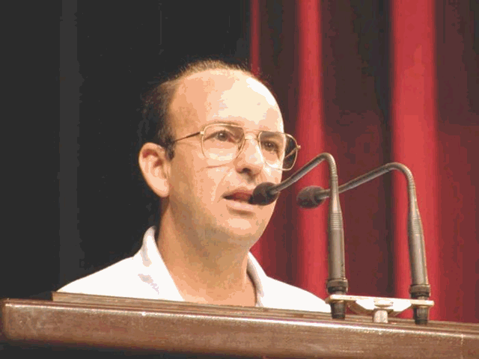
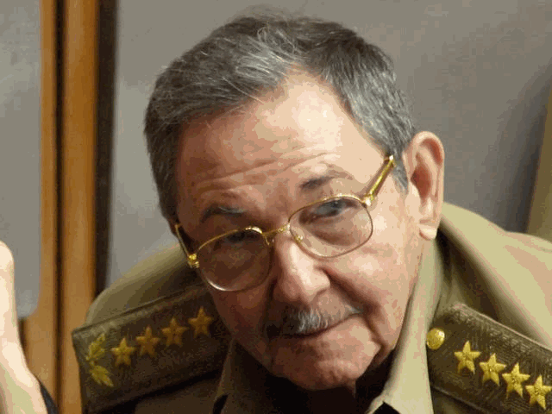
The dictator's dilemma and the special period
One telex can cost twelve dollars [whereas] the same message costs 75 cents in the form of a fax and 3 cents via the Internet ... in spite of our blockaded circumstances, we are in a relatively good position [to face the challenges of such scientific and technological changes], due to the educational and scientific work developed by the revolution. Carlos Lage, Executive Secretary of the Council of MinistersMarch, 1966
Glasnost which undermined the USSR and other socialist countries consisted in handing over the mass media, one by one, to the enemies of socialism.
Raúl Castro, October, 1997
Source
Notes:
The Internet began during the special period after the fall of the Soviet Union. The leaders were frightened by the Soviet collapse and they could not afford Internet infrastructure.
The hard-liners prevailed and Cuba decided to constrain the Internet. China assessed the situation differently at that time. Their strategy was to invest heavily in the Internet, while using it as a repressive tool by censoring content, surveillance and propaganda. They also introduced completion among backbone networks and retail Internet service providers.
See: see: http://itidjournal.org/itid/article/view/134/4

Slide 5
What is the problem?
1996: fear of political and cultural impact and $$$
Today: power, greed, bureaucracy and $$$
So the Cubans are trying to maintain control. They're not interested in democracy they're not interested in respecting the rights of people but they realize they have to have a better economic relationship with the US. …. Raúl Castro is like “I am going to open up, but I am going to open up as little as I can and hold on for as long as I can”... The Cubans are trying desperately to hold on to control, and they are finding it harder and harder to do.
Source
Dan Restrepo was Special Assistant to President Obama and Senior Director for Western Hemisphere Affairs, The White House
Source
Notes:
Political and cultural fear and money are still problems, but there are also strong vested interests today, as evidenced by the ETECSA monopoly.

Slide 6
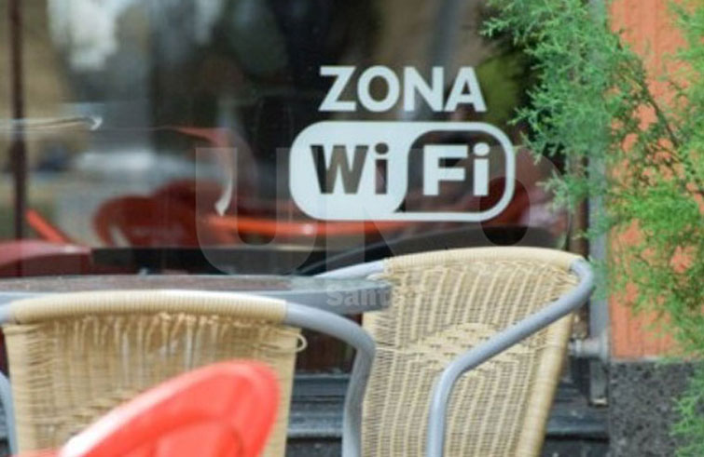
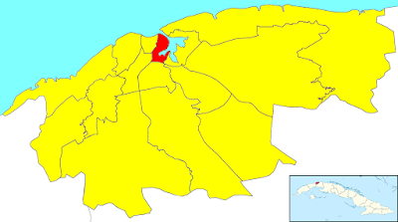
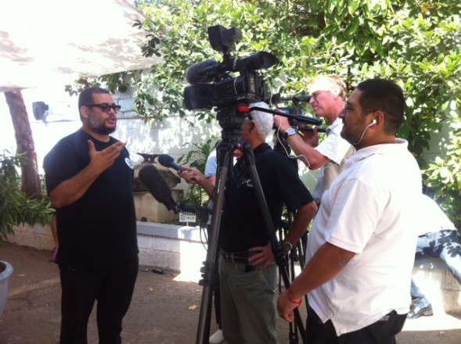
Hyped, obsolete drops in the bucket
353 WiFi hotspots
ETECSA home – 358 paid subscribers
3G mobile trial
Kcho + Google hotspot
Source
Source
Source
Source
An opportunity to leapfrog technology
Notes:
These highly publicized initiatives are a distraction – people in ETECSA must know that. They are based on old technology and Cuba should be investing in future technology, not that of the past.
The WiFi zones are expensive, slow and difficult to use.
The Home trial had only 358 subscribers as of 3/14 2017. It is based on telephone equipment and wires and would cost a fortune to roll out across the nation.
The 3G trial is very small and limited to users with compatible phones. The technology is a generation behind current 4G mobile.and 5G deployments will begin relatively soon.
The public hotpspot offered by the well-connected artist Kcho in conjunction with Google has garnered enormous publicity, but the technology is the same as other public-access hotspots and Google’s equipment contribution is miniscule.
Cuba should be looking to leapfrog today’s technology, while running these trials using yesterday’s technlopgy.

Slide 7
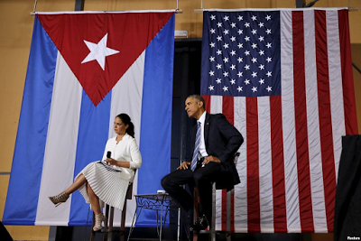
Disappointment after President Obama's trip to Cuba
Stripe assistance to entrepreneurs
CISCO network training at UCI
Google wireless
Even tractors will be made in Alabama
Source
Notes:
He talked about Airbnb and three other Internet “initiatives” in his entrepreneurial talk in Cuba. Airbnb is doing well, but nothing seems to have come from the others.

Slide 8
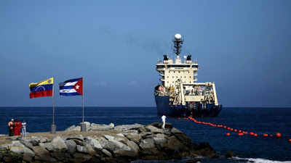
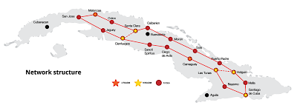
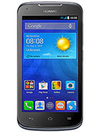
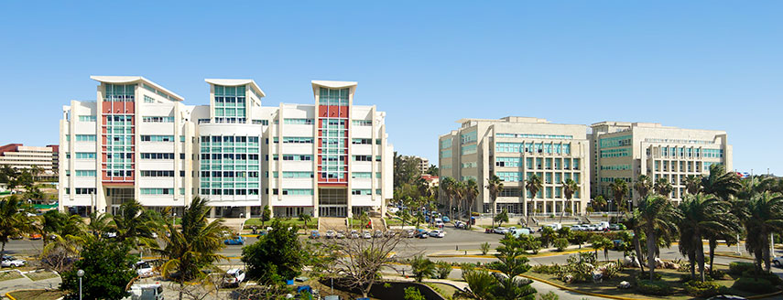
China (Huawei) won the first infrastructure round
Undersea cable
Basckbone network
Public access
Home Internet
User devices
Huawei office location
Source
Notes:
Chinese companies have been involved with the undersea cable, backbone network, WiFi hotspots and the home DSL trial. They also sell consumer equipment like cell phones, home routers and set-top boxes.
There is also some manufacturing (assembly) in Cuba as well (see http://laredcubana.blogspot.com/search?q=haier).
Huawei is particularly strong and has a long-established relationship with Cuba.

Slide 9
Other suppliers
Cisco in the beginning
Selective enforcement of restrictions by Trump?
Notes:
Cisco equipment was used at the very start, but today Huawei is the dominant Cuban supplier.
ZTE has also been active in Cuba (http://laredcubana.blogspot.com/search?q=zte), bu they paid $1.2 billion fine for embargo violation.
https://www.nytimes.com/2017/03/07/technology/zte-china-fine.html
https://www.nytimes.com/2016/03/19/technology/zte-document-raises-questions-about-huawei-and-sanctions.html
Huawei is being investigated and Trump could brag that he was being tough on both China and Cuba by finding Huawei guilty, but he would be harming the Cuban people.
https://www.nytimes.com/2017/04/26/business/huawei-investigation-sanctions-subpoena.html?_r=0
https://www.nytimes.com/2016/06/03/technology/huawei-technologies-subpoena-iran-north-korea.html

Slide 10
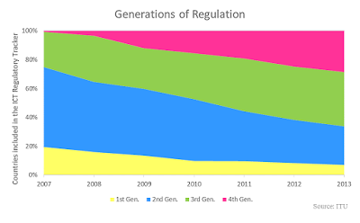
Infrastructure ownership and regulation
G1: Regulated public monopolies – command and control approach
G2: Basic reform – partial liberalization and privatization across the layers
G3: Enabling investment, innovation and access – dual focus on stimulating competition in service and content delivery, and consumer protection
G4: Integrated regulation – led by economic and social policy goals
Source
An opportunity to leapfrog policy
Notes:
The ETECSA monopoly is one of few remaining in the world. They could, if they wished to do so, leapfrog infrastructure ownership and regulation policy.
It is hard to imagine them making good decisions and leapfrogging technology without doing the same for policy and infrastructure ownership.
My wish would be that they move to level 4, formulating policy based on economic and social policy goals rather than relying heavily on foreign investement.

Slide 11
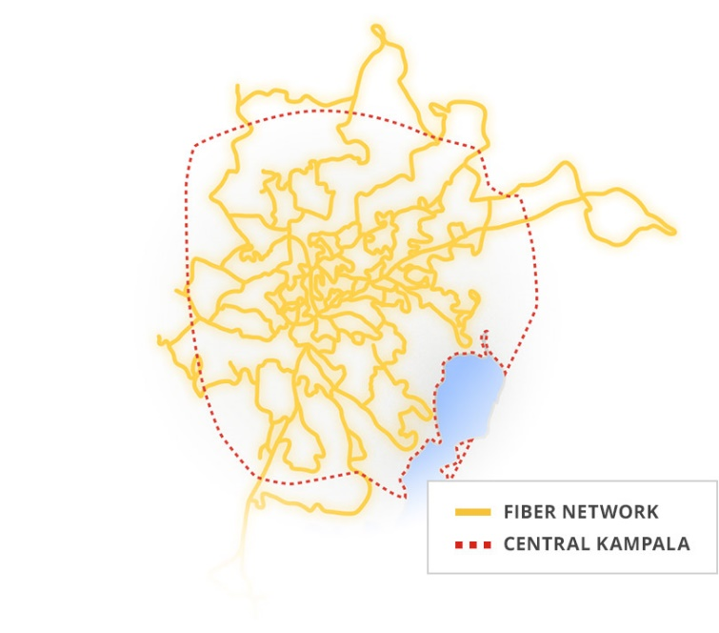
Roles for both national and local government
Cities like Havana, Stockholm, Accra or Kampala
Small towns and villages
Backbone network
Source
Source
Source
Cuba should look at alternatives from around the world
Notes:
Since they are coming late to the Internet game and have few legacy resources, Cuba should consider a balance between the roles of foreign investors and local and national government. They have an opportunity to learn from the successes and failures of other nations.

Slide 12
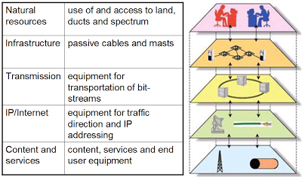
Government as wholesaler
Wholesale
Retail competition
Source
Notes:
Governments that open (local and national) infrastructure to all at the same prices and terms have been successful.

Slide 13
Who is running the show?
Owner | Class | Percent
Telefónica Antillana SA | A | 51.006
Rafin SA | B | 27.003
Universal Trade & Management Corporation SA | B | 11.086
Banco Financiero Internacional SA | B | 6.157
Negocios en Telecomunicaciones SA | B | 3.825
Banco Internacional de Comercio SA | B | 0.923
 |  | 100
Source
Notes:
I do not understand the relationship of ETECSA to their stockholders and the Ministry of Communication and have many questions about the role and responsibility of an “autonomous society” concerning profits and losses and assets and liabilities in a communist nation.

Slide 14
Entrepreneurial startup scene
Source
Goofy list of self-employment occupations
Notes:
There is a startup scene and one of the occupations eligible for self-employment is computer programmer.
Note that the number of licensed programmers is growing at an increasing rate (and that they now outnumber clowns and button coverers compbined ☺.
The attempt to enumerate occupations that are eligible for self-employment offers sad testimony to the level of Cuban bureaucracy.

Slide 15
Entrepreneurial startup scene
Off-shore programming Startups Positive change
Notes:
Merchise organizes events.
NinjaCuba and CubaOutSource match freelancers with clients.
Revolico, Cubisima, Bachecubana and Porlalivre are competing classified-ad sites.
Netflix and Google are potential developers of Spanish language content for consumption in Cuba and the rest of the Spanish-speaking world
TICS 2017 was a workshop on private-public sector collaboration on ICT – quite a departure from the government’s early attitude toward non-state developers.

Slide 16
Miguel Díaz-Canel
Next president?
Internet for all
for the benefit of all
must be used legally
What he’s said and done
News coverage of talk
"The State will work to make this resource available, accessible and affordable for everyone."
Full transcript
Notes:
Many expect Díaz-Canel to replace Raúl Castro next year. He has not spoken out a lot, but was trained as an engineer and has made some positive statements about the Internet.
In addition to the 2015 talk linked to in this slide, he talked about the Internet in a 2013 presentation at an education conference:
http://www.cubadebate.cu/noticias/2013/05/06/diaz-canel-para-que-el-pueblo-pueda-discernir-lo-cierto-de-lo-falso/#.WRHfA-UrI2x
And
Defended the right to free speech on a (largely pro-government) blog:
https://cubasincensura.wordpress.com/2013/10/05/la-prensa-cubana-silencia-la-critica-al-silencio-de-miguel-diaz-canel/
It sounds like he may favor the Chinese model of ubiquitous access along with censorship, propaganda and surveillance.
(Cuba is too small to have its own search, ecommerce, etc. sites as China does).

Slide 17
The Internet in Cuba – bad news; good news
Larry Press
lpress@csudh.edu
Blog on the Cuban Internet: http://laredcubana.blogspot.com/
These slides have mnemonic images and few words, but they include comments and links to supporting material. The presentation may be downloaded at:
http://som.csudh.edu/fac/lpress/presentations/statedepartmentpanel.pptx
This work is licensed under a Creative Commons Attribution-Noncommercial-Share Alike 3.0 License.

