Slide 1
Online survey design
Skills: survey design -- planning and writing questions Concepts: types of survey question, user interface widget (radio button, text box and check box), Likert scale, and output options
This work is licensed under a Creative Commons Attribution-Noncommercial-Share Alike 3.0 License.
Notes:
This presentation covers survey design skills -- planning and constructing a survey.
It begins with descriptions of several types of open-ended and limited-response questions, including Likert scale questions and standard user interface widgets -- radio buttons, checkboxes and text boxes.
This is followed by a look at planning a survey, considering your goals, the motivation of respondents to participate, and the analysis you expect to conduct.

Slide 2
Where does this topic fit?
Internet concepts
Applications
Technology
Implications
Internet skills
Application development
Content creation
User skills
Notes:
We’re concerned here with an application – online surveys – and survey development skills.
We won’t focus on the mechanics of any one service – these skills and concepts are applicable to any of them.

Slide 3
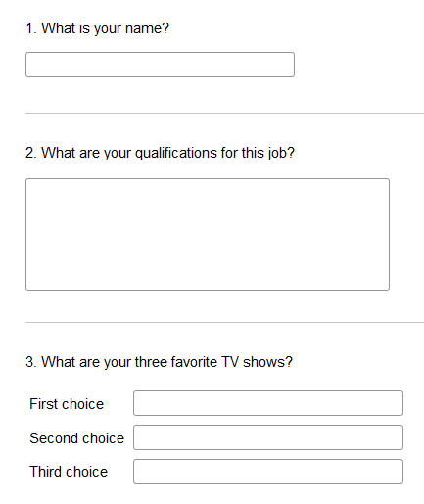
Open-ended questions
Single line of text
Free text
Imposed ranking
Notes:
Online survey services offer a selection of question formats.
Some are open-ended and others require a choice among fixed responses.
The ones shown here allow open-ended responses, and the respondents can interpret the question and reply as they see fit.
We get rich feedback from open-ended questions – often getting unanticipated replies.
Most systems are capable of doing some checking on the type of the answer, for example restricting it to a being number or a legal email address.

Slide 4
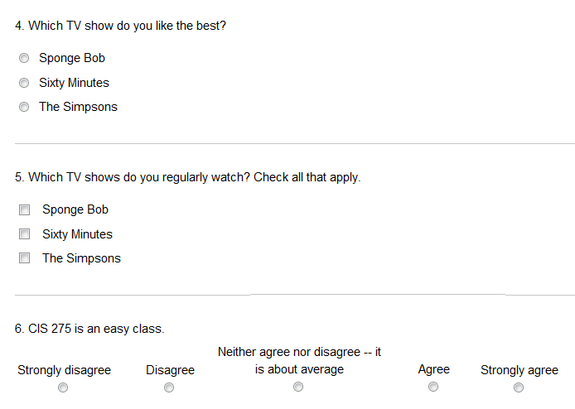
Limited-response questions
Multiple choice,
choose 1
Multiple choice,
all that apply
Five-level
Likert scale
Notes:
Limited-response questions are not as flexible as open-ended questions, but they allow for statistical analysis and reporting.
Since open-ended and fixed-response questions each have advantages, it is often a good idea to use both on the same topic.

Slide 5
Likert scale questions are flexible
A statement the respondent can agree or disagree with
strongly disagree
disagree
neither agree nor disagree
agree
strongly agree
Variation: How important is X? Responses: not at all important to extremely important.
Variation: respondent assigns one or more stars to something like a movie or TV show.
Notes:
Likert scale questions are a common limited-response format.
They’re flexible and also lend themselves to statistical analysis and presentation.
A Likert scale is symmetrical.
One typically makes a statement then allows five replies ranging from strong disagreement to strong agreement with a neutral response in the middle.

Slide 6
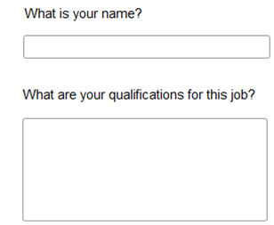
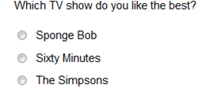
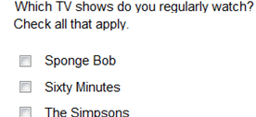
User interface elements – widgets
Text boxes
Radio buttons
Check boxes
Notes:
You may have noticed the user interface elements or “widgets” used in our examples – text boxes, radio buttons and checkboxes.
I bet you have seen them before.
Programmers use these standard widgets in building user interfaces.
Look for these and other user interface widgets in the programs you use.

Slide 7
Plan before you begin
What is the purpose of the survey?
What do you hope to learn?
What results do you expect?
Who is the audience – who will complete the survey?
How will you reach them?
How can you encourage them to respond?
Who will be interested in the results?
Are you personally curious about the results?
The best way to go fast is to go slow.
Notes:
Let’s turn from survey options to survey design.
Your tendency will be to start writing questions right away, but you should resist that urge, and consider the consider the survey from both your perspective and that of the potential respondents.
What motivates you and what motivates them?
Give yourself time to think about questions like these before you begin composing the survey.
Time spent planning a survey or anything else you design nearly always pays dividends.

Slide 8
Design tips
Your questions must be carefully worded to make sure they are not ambiguous.
Your questions must be carefully worded to make sure they are not biased.
Set your survey aside for at least a day, then reread it.
Test the survey with others before posting it.
Use open-ended and limited-response questions.
Notes:
Once you’ve decided which issues you’re interested in, draft questions that address each of them.
Consider both open-ended and limited-response questions for each issue you are interested in learning about.
One can often use both, for example, asking a multiple choice question and providing a text box for explanation of the answer.
Give yourself plenty of time to write the questions, set them aside for a while then revise them.
Test the survey on others and revise it before distributing it widely.

Slide 9
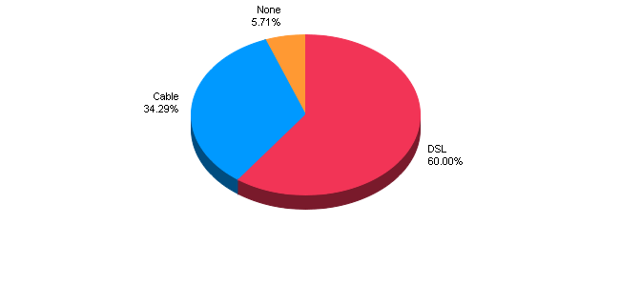
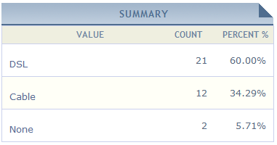
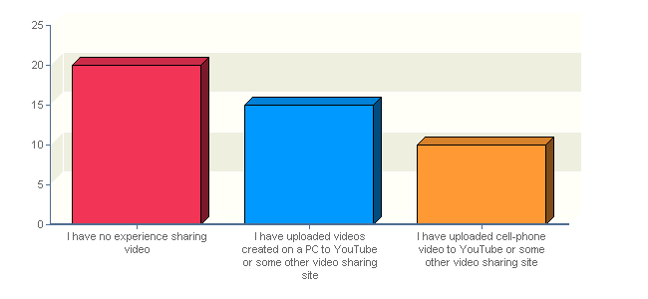
Analysis and presentation
Notes:
Survey services offer a variety of reports using charts, plots, spreadsheets, and statistical analysis.
In planning your survey, think in advance about the way you will analyze and present the results.

Slide 10
Summary
The best way to go fast is to go slow
Chinese proverb
Go slow now, go fast later
German proverb
Notes:
We’ve introduced several types of open-ended and limited-response questions, including Likert scale questions.
We also saw some standard user interface widgets -- radio buttons, checkboxes and text boxes.
But, the most important point is that you should take plenty of time planning and testing your survey before you deploy it.
That will save you time in the long run, (This advice applies to all application development, not just surveys).

Slide 11
Self-study questions
We divided survey questions into two general groups, what were they?
We saw three types of widget – what were they?
Find examples of each of the three types of widget in Microsoft Word.
Can you identify other user interface widgets that are used in Word?
We discussed the importance of planning before constructing a survey, and suggested eight questions to consider – what were they?
We listed five design tips – what were they?
What point was I trying to make when I quoted the Chinese and German proverbs?

Slide 12
Resources
A Few Good Online Survey Tools:
http://www.idealware.org/articles/fgt_online_surveys.php

