Slide 1
How does an online survey service work?
Skills: none
Concepts: client, server, service, upload, download, client-server application, Internet, hardware, software
This work is licensed under a Creative Commons Attribution-Noncommercial-Share Alike 3.0 License.
Notes:
Use this list of skills and concepts as a self-check on your understanding. Can you explain each of the concepts to someone else in your own words? Do you have the skill? If not, get help.

Slide 2
Where does this topic fit?
Internet concepts
Applications
Technology
Implications
Internet skills
Application development
Content creation
User skills
Notes:
I was able to develop our class survey application in a short time using Survey Gizmos service.

Slide 3
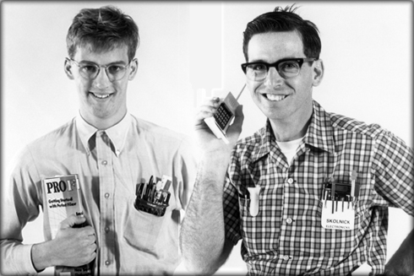
Do you recall this slide? What point was it making?
Skill -- application development
Batch processing and time sharing
Personal computer
Internet
Four computing eras -- application development keeps getting easier, but we do more complex things.
Notes:
As technology improves, our tools improve and the kinds of applications we can create become more powerful.
During the early days of computing, we shared large, expensive computers by connecting terminals to them or submitting jobs in batches and waiting – usually several hours – to get the results.
In those days, programs were written by specialized engineers.
With the advent of personal computers, managers, teachers and others were able to develop applications using tools like spreadsheets or personal database managers.
Today, the general public can easily develop simple applications using tools like blogging, survey, database development services.
Modern technology makes new, complex applications possible and, while it is easier to develop simple applications, professional programmers are still needed to develop complex applications.
New programs were written by professional programmers in those days and I
This enables us to develop simple applications easily and frees us to develop previously impossibly complex applications.

Slide 4
Three client programs are needed
Create the survey
Complete the survey
Analyze the results
Notes:
We’ve all taken online surveys.
In our class, we begin the term with a student background survey.
I create the survey using an Internet service run by a company called Survey Gizmo and each student completes it.
This presentation shows the process works -- how the survey is created, completed and analyzed.
I use Survey Gizmo in this example, but there are many competing survey services on the Internet and they all work in the same general way.
The first step is creating the survey.

Slide 5
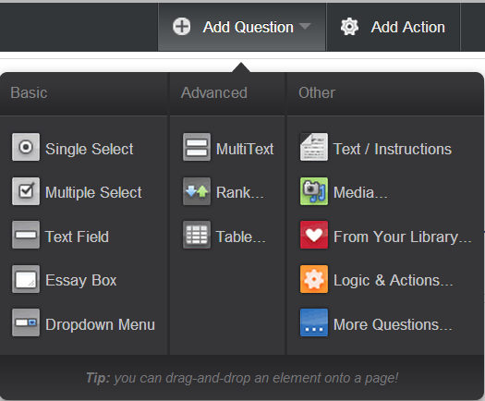
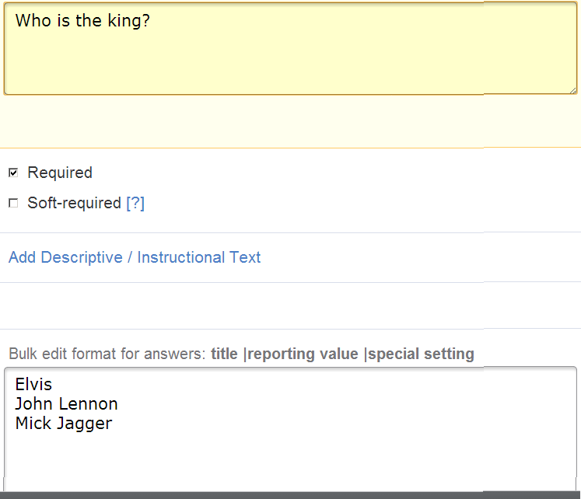
Step 1: I created the survey
Notes:
I added the survey questions one at a time using the survey creation program.
First I selected the question type from a drop down menu. (left)
Then I entered the question and alternative answers . (right)
There is a different form for entering each type of question.

Slide 6
I saved the survey questions on the server
Survey file
Server
Is the server connected to the Internet? Where is it?
Notes:
When I finished the drafting the survey, I saved it on the Survey Gizmo server.
A geek might say the survey data was “uploaded” to the server

Slide 7
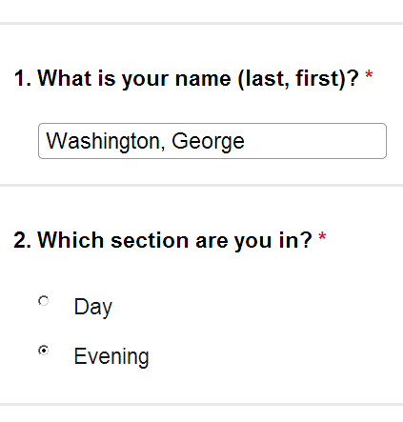
Step 2: You completed the survey
Notes:
The questions were transferred (downloaded) from the server to your client computer and you completed the survey using a survey completion program.

Slide 8
You saved your results on the server
Your response file
Server
Notes:
When you finished the survey, your answers were saved on the Survey Gizmo server.

Slide 9
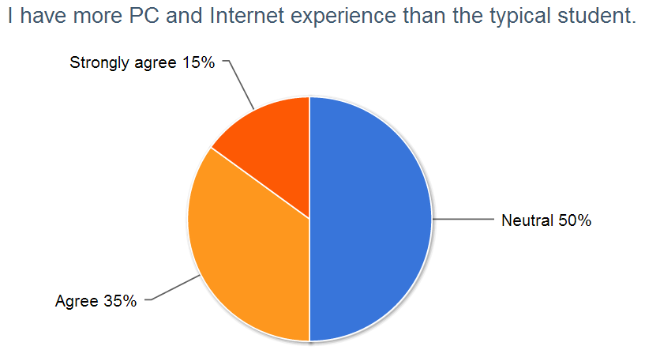
Step 3: I retrieved and displayed the results
Notes:
The results were transferred from the server to my client computer, which displayed them.

Slide 10
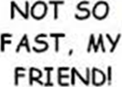
Simple – right?
Where is that server?
How does information get to and from the server?
Is the server a computer? A person?
Where was I while I was composing the survey?
Where were you while you completed it?
Were we using computers?
Notes:
Think about these questions – try to answer at least some of them before you go on

Slide 11
A client-server application
Client (me)
Server
Client (you)
What does the cloud-shape in the center represent?
Notes:
While I was creating the survey and reviewing the results, my computer was the client of the server.
While I was creating the survey, I was running a survey creation program on my client computer.
While you were completing the survey, you were running survey completion software on your client computer.
My client computer is a Dell laptop and I was sitting in my home office when I created the survey.
Where were you and what computer were you using while you completed the survey? At school in a computer lab or classroom? At home? At work?
The server is owned by Survey Gizmo, the company that provides the survey service.
Survey Gizmo’s office is in Boulder, Colorado.
Perhaps the server is there, perhaps not. All we know for sure is that it is connected to the Internet.
Our client computers are also connected to the Internet and information travels across the Internet.

Slide 12
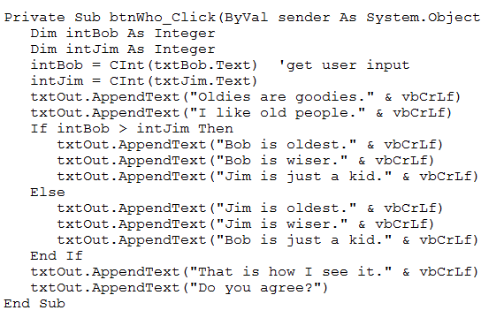
“Server” and “Server”
Server program
Server computer
Is a server hardware or software?
Notes:
Note that the word “server” is used for two separate, but related things.
The term server is used for a computer that is connected and is programmed to provide some service.
The term “server” is used both for that program and for the computer it is running on.
In this case, the server is a computer that is connected to the Internet and is running a survey server program.

Slide 13
“Client” and “Client”
Client program
Client computer
Is a client hardware or software?
Notes:
The word “client” is also used to designate a computer that is connected to the Internet and is programmed to use (geeks say “consume”) some service.
The term “client” is used both for that program and for the computer it is running on.
In this case, I used survey creation program on my client computer and you used a survey completion program on your client computer.

Slide 14
A final question
?
Client program
Client computer
We used three client programs:
one I used to create the survey
one you used to complete the survey
one I used to analyze the survey results.
How and when did the client programs get into our client computers?
Notes:
We have seen three client programs – one that I used to create the survey, one you used to complete it and a third that I used to analyze the survey results.
Those programs were running on our client computers.
But, how did those programs get to our client computers?
Did they come pre-installed from the factory? Did we purchase them?
None of the above – it turns out they were downloaded from the Survey Gizmo server.
For example, when you clicked on the link to the survey on the Survey Gizmo Web site, it automatically downloaded both the survey completion program and the survey questions (data used by that program).

Slide 15
Summary
Notes:
We saw how a survey service works – creating, completing and analyzing a survey.
We saw how data flowed between client and server computers.
The survey authoring, completing and analysis programs were downloaded from a server to our client computers.
I uploaded the survey questions and the students uploaded their answers.
Then I requested a summary report and it was downloaded from the server to my client computer.

Slide 16
Self-study questions
I said that the Survey Gizmo server might be in Boulder Colorado, the location of the company headquarters. Might it be somewhere else? Could it be anywhere in the world? Explain your answer.
I was at home when I created the survey. Could I have done it from my office at school? Could I have done it from an outdoor location like a park? Could I have done it from anywhere in the world? Explain your answer.
We used Survey Gizmo as an example. Pick a competing online survey service on the Internet. Which one did you pick? How does its price compare to that of Survey Gizmo? Does it have any features that Survey Gizmo is missing?

Slide 17
Resources
Survey Gizmo Web site: http://surveygizmo.com
Free Survey Gizmo account: http://surveygizmo.com/plans-pricing/#

